Slide 1
多元统计分析
——多重检验
报告人：黄实磊 李昊峰
吴成诚 杨帆

Slide 2
1 Introduction
2 Family-Wise Error Rate (FWER) Control
3 False Discovery Rate (FDR) Control
4 False Discovery Proportion Estimation
5 Examples

Slide 3
1 Introduction
1.1 Single Hypothesis
1.2 Joint hypotheses and multiple hypothesis
1.3 Concerns in multiple hypotheses
1.4 Formal description of multiple hypotheses
1.5 Distribution of p-value

Slide 4
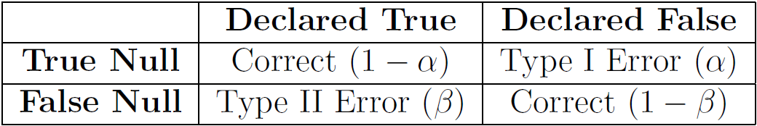
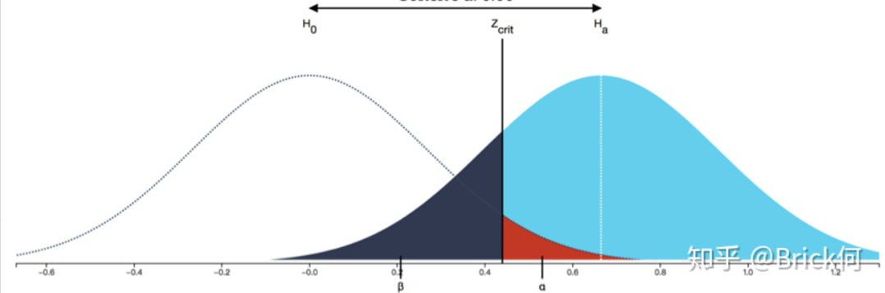

1.1 Single Hypothesis
$H_{0} :θ=θ_{0}$
$H_{1} :θ=θ_{1} , or θ<θ_{0} , or θ>θ_{0} , or θ≠θ_{0} …$
$β$ $α$
图片来源：知乎.第一类错误和第二类错误的关系是什么，https://www.zhihu.com/question/20993864

Slide 5
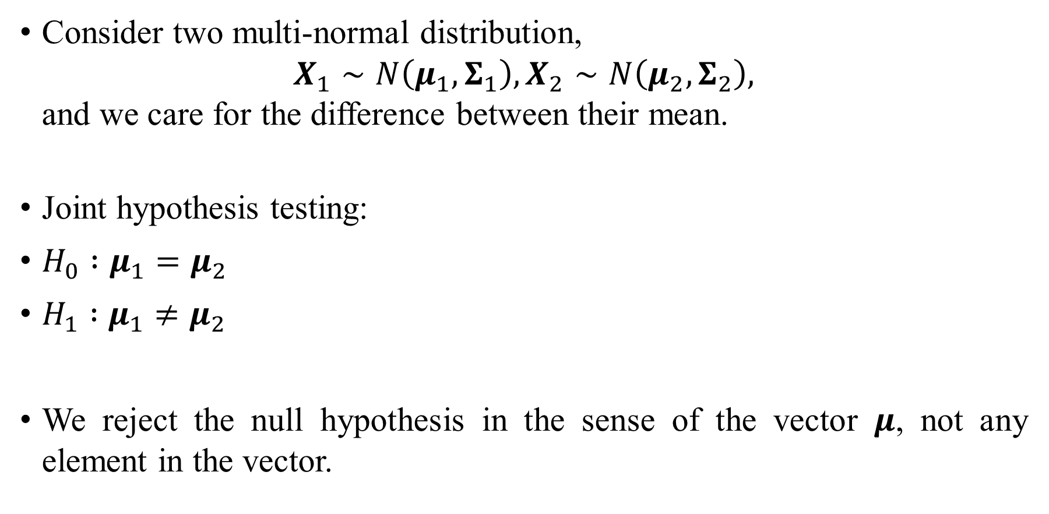
1.2 Joint hypotheses and multiple hypothesis
Consider two multi-normal distribution,
$X_{1}∼N\left(μ_{1},Σ_{1}\right), X_{2}∼N\left(μ_{2},Σ_{2}\right),$
and we care for the difference between their mean.
Joint hypothesis testing:
$H_{0} :μ_{1}=μ_{2}$
$H_{1} :μ_{1}≠μ_{2}$
We reject the null hypothesis in the sense of the vector $μ$, not any element in the vector.

Slide 6
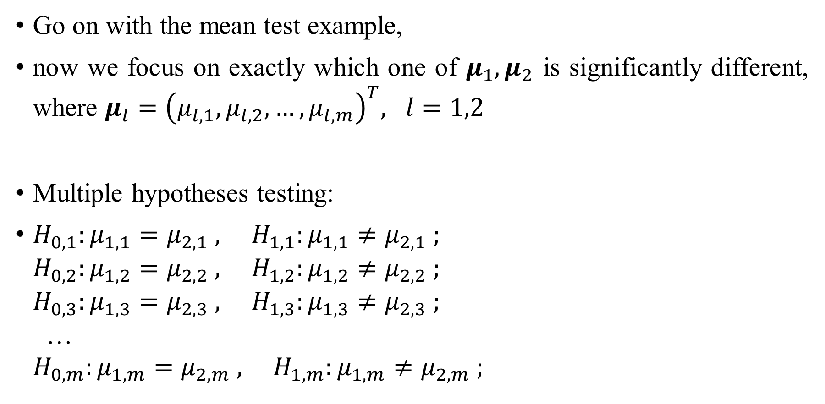
1.2 Joint hypotheses and multiple hypothesis
Go on with the mean test example,
now we focus on exactly which one of $μ_{1},μ_{2}$ is significantly different, where $μ_{l}={\left(μ_{l,1},μ_{l,2},…,μ_{l,m}\right)}^{T}, l=1,2$
Multiple hypotheses testing:
$H_{0,1}:μ_{1,1}=μ_{2,1} , H_{1,1}:μ_{1,1}≠μ_{2,1} ;$
$H_{0,2}:μ_{1,2}=μ_{2,2} , H_{1,2}:μ_{1,2}≠μ_{2,2} ;$
$H_{0,3}:μ_{1,3}=μ_{2,3} , H_{1,3}:μ_{1,3}≠μ_{2,3} ;$
…
$H_{0,m}:μ_{1,m}=μ_{2,m} , H_{1,m}:μ_{1,m}≠μ_{2,m} ;$

Slide 7
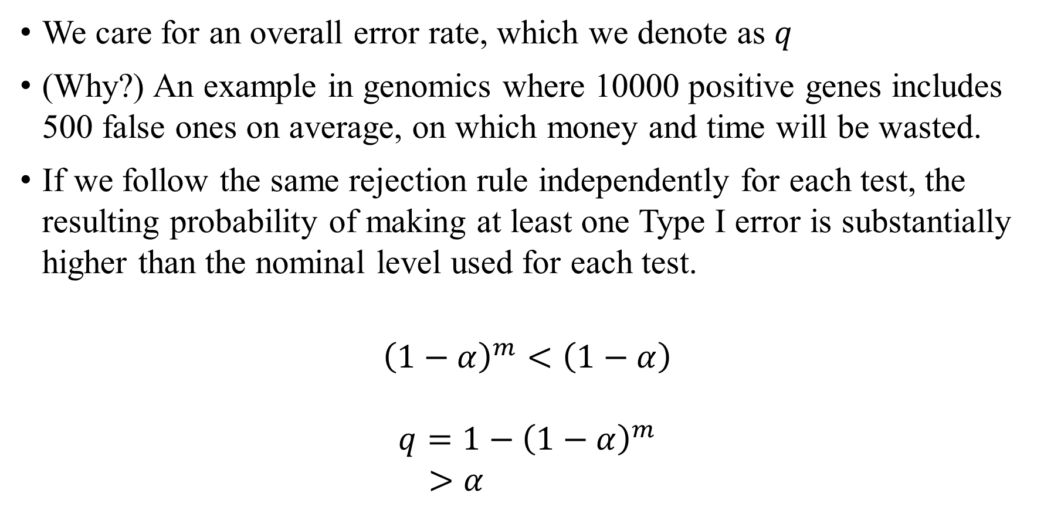
1.3 Concerns in multiple hypotheses
We care for an overall error rate, which we denote as $q$
(Why?) An example in genomics where 10000 positive genes includes 500 false ones on average, on which money and time will be wasted.
If we follow the same rejection rule independently for each test, the resulting probability of making at least one Type I error is substantially higher than the nominal level used for each test.
$${\left(1−α\right)}^{m}<\left(1−α\right)$$
$$q=1−{\left(1−α\right)}^{m} \\ >α$$

Slide 8
1.3 Concerns in multiple hypotheses
To address this issue, multiple testing procedures seek to make the individual tests more conservative.
The cost of these procedures is often a reduction in the power of the individual tests.

Slide 9
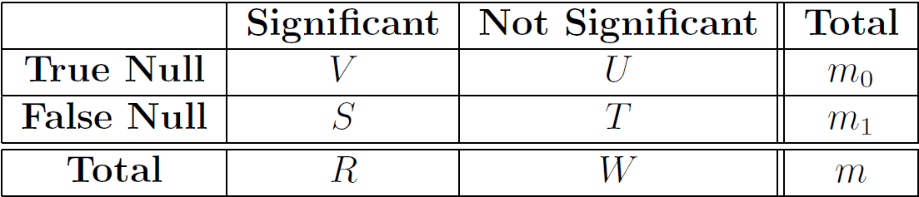
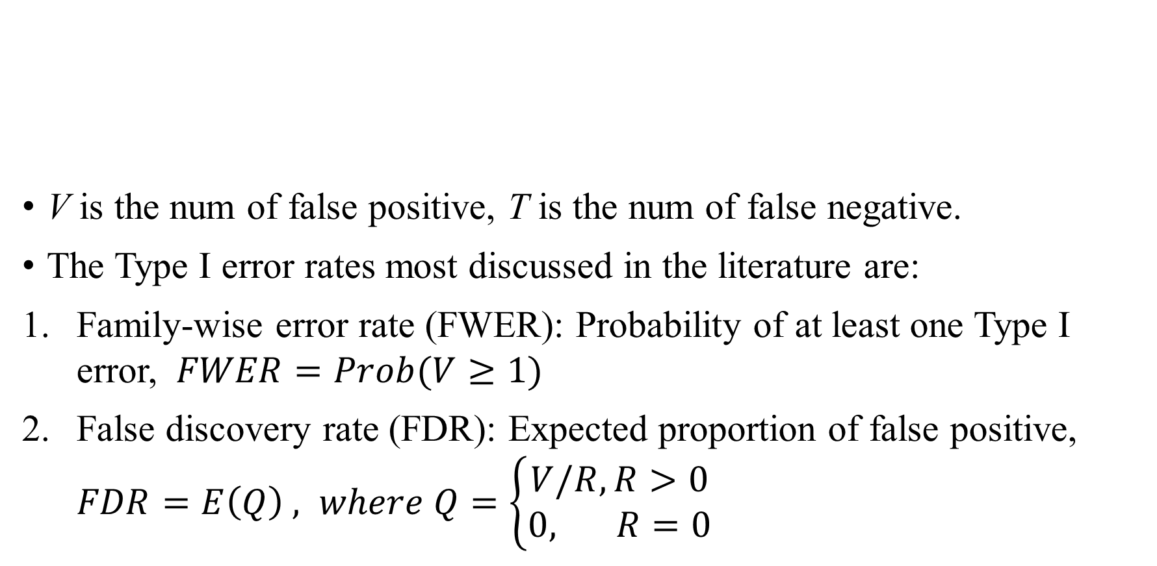
1.3 Concerns in multiple hypotheses
V is the num of false positive, T is the num of false negative.
The Type I error rates most discussed in the literature are:
Family-wise error rate (FWER): Probability of at least one Type I error, $FWER=Prob(V≥1)$
False discovery rate (FDR): Expected proportion of false positive,
$FDR=E\left(Q\right) , where Q=\left\{\begin{aligned}V/R, R>0 \\ 0, s s R=0\end{aligned}\right.$

Slide 10
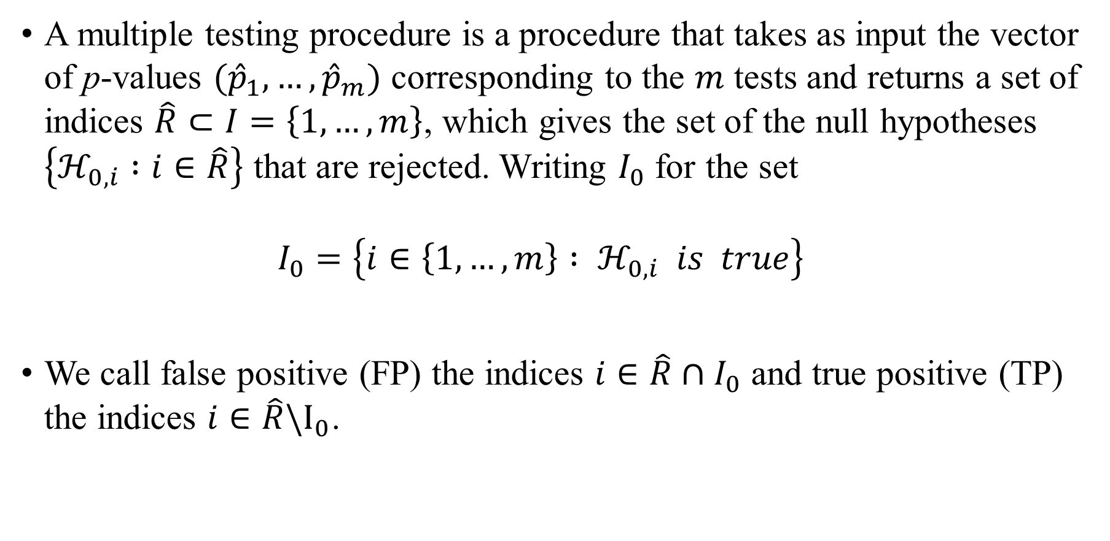
1.4 Formal description of multiple hypotheses
A multiple testing procedure is a procedure that takes as input the vector of p-values $({\hat{p}}_{1}, …,{\hat{p}}_{m})$ corresponding to the $m$ tests and returns a set of indices $\hat{R}⊂I=\left\{1,…,m\right\}$, which gives the set of the null hypotheses $\left\{ℋ_{0,i} :i∈\hat{R}\right\}$ that are rejected. Writing $I_{0}$ for the set
$I_{0}=\left\{i∈\left\{1,…,m\right\} : ℋ_{0,i} is true\right\}$
We call false positive (FP) the indices $i∈\hat{R}∩I_{0}$ and true positive (TP) the indices $i∈\hat{R}\backslash I_{0}$.

Slide 11
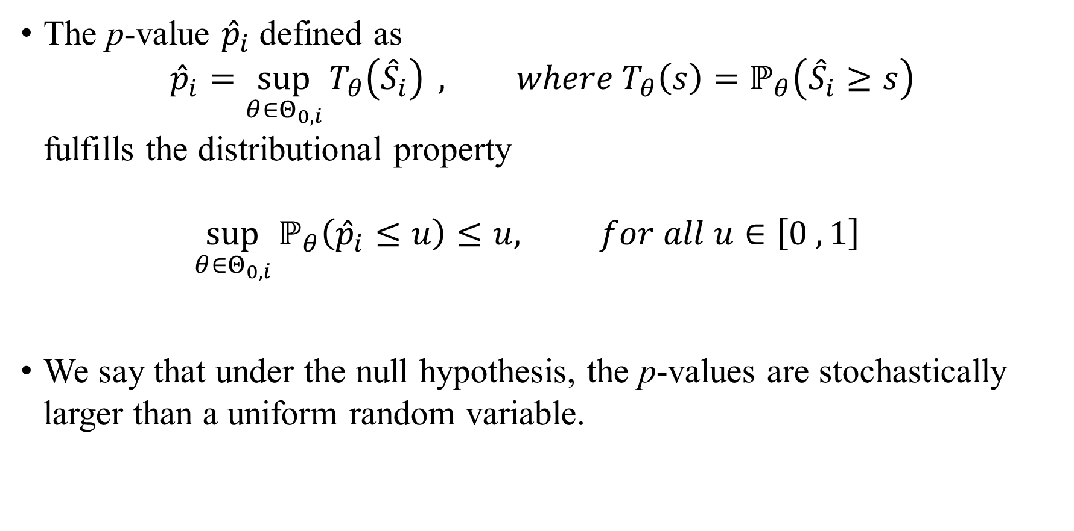
1.5 Distribution of p-value
The p-value ${\hat{p}}_{i}$ defined as
${\hat{p}}_{i}=\sup_{θ∈Θ_{0,i}}{T_{θ}\left({\hat{S}}_{i}\right)} , where T_{θ}\left(s\right)=ℙ_{θ}\left({\hat{S}}_{i}≥s\right)$
fulfills the distributional property
$\sup_{θ∈Θ_{0,i}}{ℙ_{θ}\left({\hat{p}}_{i}≤u\right)≤u, for all u∈\left[0 , 1\right] }$
We say that under the null hypothesis, the p-values are stochastically larger than a uniform random variable.

Slide 12
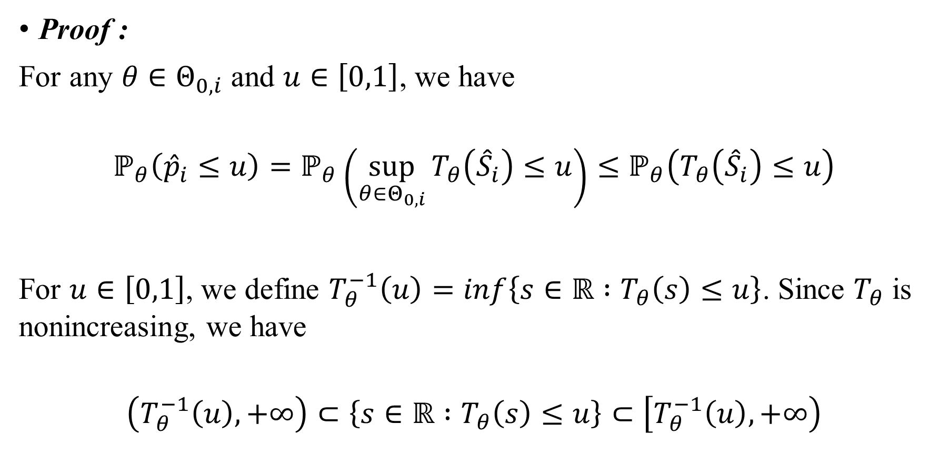
1.5 Distribution of p-value
Proof :
For any $θ∈Θ_{0,i}$ and $u∈\left[0,1\right]$, we have
$$ℙ_{θ}\left({\hat{p}}_{i}≤u\right)=ℙ_{θ}\left(\sup_{θ∈Θ_{0,i}}{T_{θ}\left({\hat{S}}_{i}\right)≤u}\right)≤ℙ_{θ}\left(T_{θ}\left({\hat{S}}_{i}\right)≤u\right)$$
For $u∈\left[0,1\right]$, we define $T_{θ}^{−1}\left(u\right)=inf\left\{s∈ℝ :T_{θ}\left(s\right)≤u\right\}$. Since $T_{θ}$ is nonincreasing, we have
$$\left(T_{θ}^{−1}\left(u\right),+∞\right)⊂\left\{s∈ℝ :T_{θ}\left(s\right)≤u\right\}⊂\left[T_{θ}^{−1}\left(u\right),+∞\right)$$

Slide 13
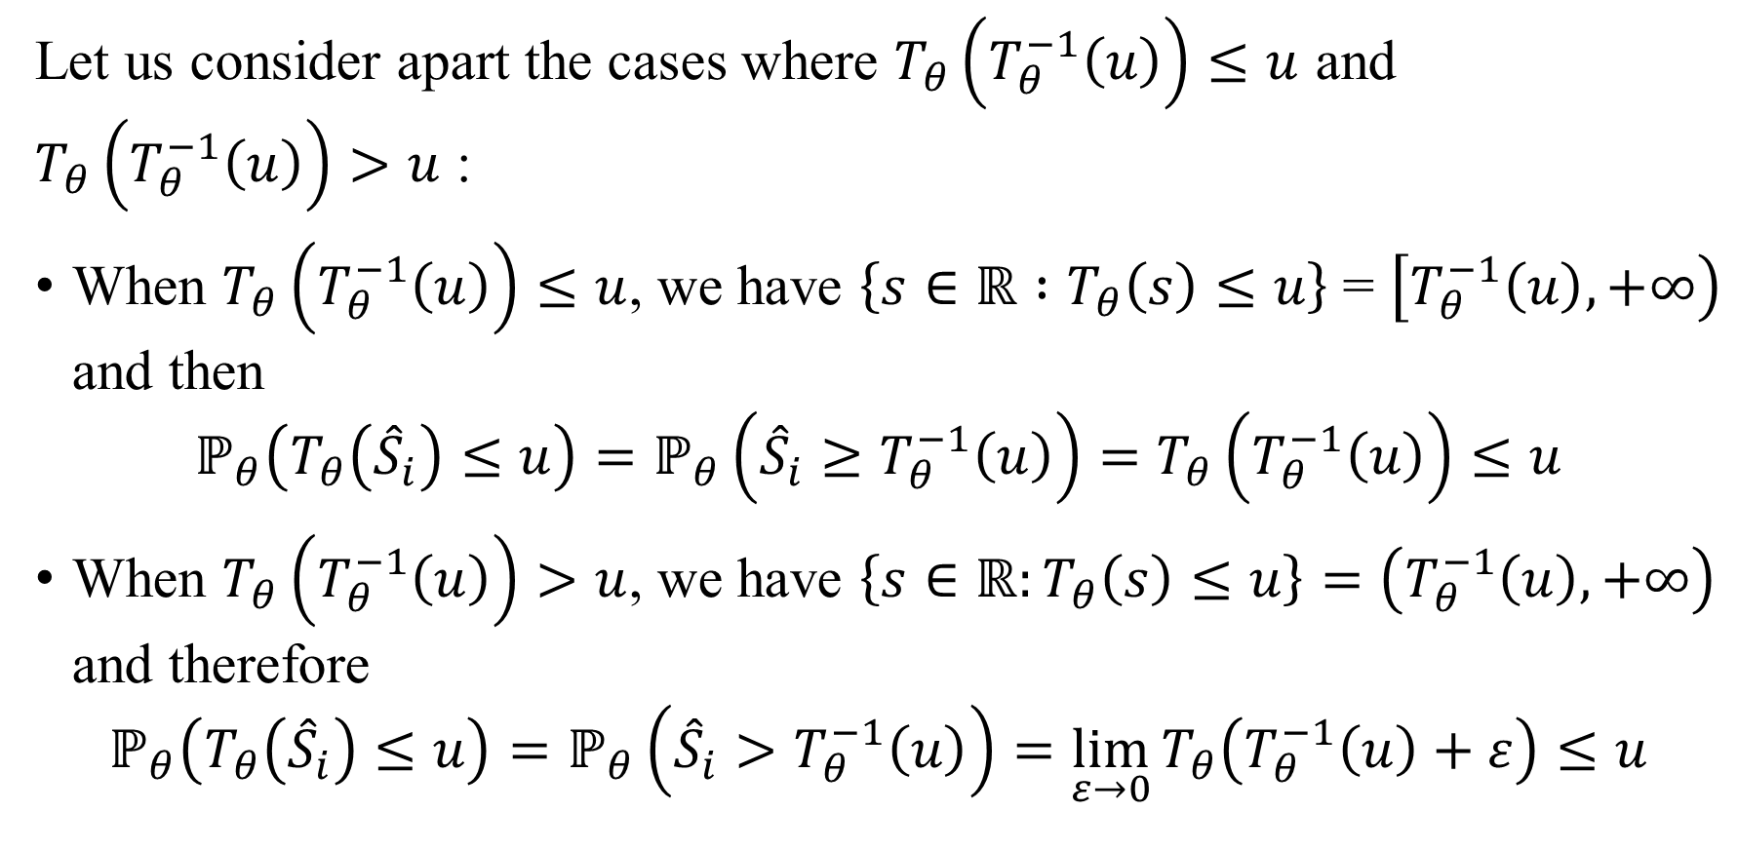
1.5 Distribution of p-value
Let us consider apart the cases where $T_{θ}\left(T_{θ}^{−1}\left(u\right)\right)≤u$ and $T_{θ}\left(T_{θ}^{−1}\left(u\right)\right)>u$ :
When $T_{θ}\left(T_{θ}^{−1}\left(u\right)\right)≤u$, we have $\left\{s∈ℝ :T_{θ}\left(s\right)≤u\right\}$ = $\left[T_{θ}^{−1}\left(u\right),+∞\right)$ and then
$$ℙ_{θ}\left(T_{θ}\left({\hat{S}}_{i}\right)≤u\right)=ℙ_{θ}\left({\hat{S}}_{i}≥T_{θ}^{−1}\left(u\right)\right)=T_{θ}\left(T_{θ}^{−1}\left(u\right)\right)≤u$$
When $T_{θ}\left(T_{θ}^{−1}\left(u\right)\right)>u$, we have $\left\{s∈ℝ:T_{θ}\left(s\right)≤u\right\}=\left(T_{θ}^{−1}\left(u\right),+∞\right)$ and therefore
$$ℙ_{θ}\left(T_{θ}\left({\hat{S}}_{i}\right)≤u\right)=ℙ_{θ}\left({\hat{S}}_{i}>T_{θ}^{−1}\left(u\right)\right)=\lim_{ε→0}{T_{θ}\left(T_{θ}^{−1}\left(u\right)+ε\right)}≤u$$

Slide 14
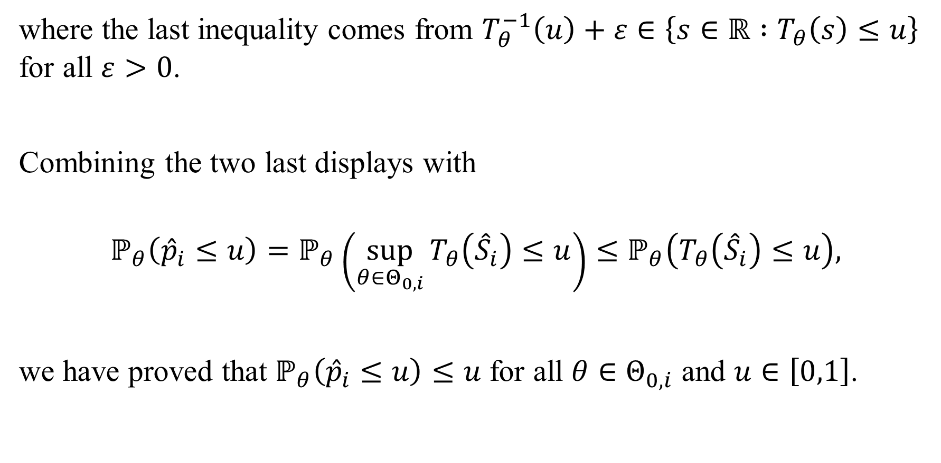
1.5 Distribution of p-value
where the last inequality comes from $T_{θ}^{−1}\left(u\right)+ε∈\left\{s∈ℝ :T_{θ}\left(s\right)≤u\right\}$ for all $ε>0$.
Combining the two last displays with
$$ℙ_{θ}\left({\hat{p}}_{i}≤u\right)=ℙ_{θ}\left(\sup_{θ∈Θ_{0,i}}{T_{θ}\left({\hat{S}}_{i}\right)≤u}\right)≤ℙ_{θ}\left(T_{θ}\left({\hat{S}}_{i}\right)≤u\right),$$
we have proved that $ℙ_{θ}\left({\hat{p}}_{i}≤u\right)≤u$ for all $θ∈Θ_{0,i}$ and $u∈\left[0,1\right]$.

Slide 15
2 Family-Wise Error Rate (FWER) Control
2.1 Definition of FWER
2.2 Methods for FWER control
Bonferroni procedure,
Holm procedure,
Hochberg procedure,
Hommel procedure;
2.3 Summarization and use of FWER

Slide 16
2.1 Definition of FWER
Family-wise error rate (FWER) is define as
The probability of erroneously rejecting even one of the true null hypotheses.
It is the earliest multiple hypothesis adjustment methods, and these are still commonly used today.

Slide 17

2.2 Methods for FWER control
Bonferroni procedure
If, for $i=1,…,m$, hypothesis $H_{i}$ is rejected when
$p_{i}<\frac{α}{m}$
then the FWER for simultaneous testing of $H_{1},…,H_{m}$ satisfies $FWER<α$.

Slide 18
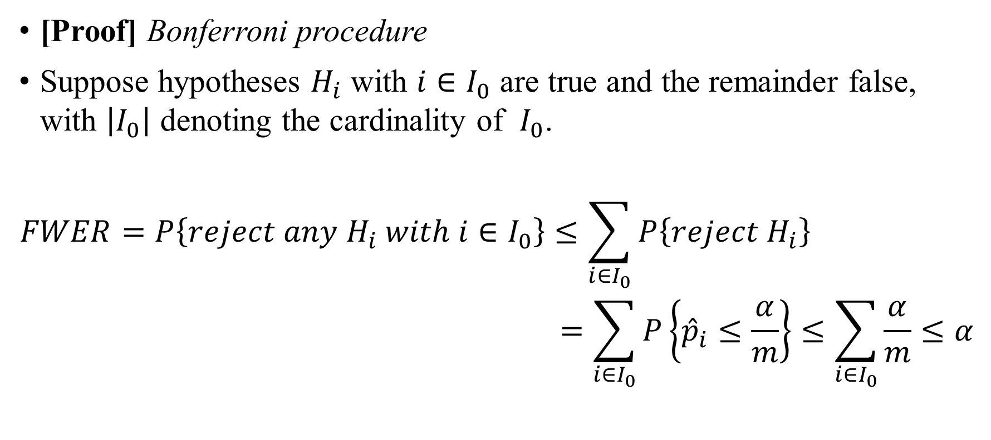
2.2 Methods for FWER control
[Proof] Bonferroni procedure
Suppose hypotheses $H_{i}$ with $i∈I_{0}$ are true and the remainder false, with $\left|I_{0}\right|$ denoting the cardinality of $I_{0}$.
$$FWER=P\left\{reject any H_{i} with i∈I_{0}\right\}≤\sum_{i∈I_{0}}{P\left\{reject H_{i}\right\}}$$
$$=\sum_{i∈I_{0}}{P\left\{{\hat{p}}_{i}≤\frac{α}{m}\right\}≤\sum_{i∈I_{0}}{\frac{α}{m}≤α}}$$

Slide 19

2.2 Methods for FWER control
Bonferroni procedure’s trade-off
While such Bonferroni based procedures satisfactorily control the FWER, their ability to detect cases in which $H_{i}$ is false will typically be very low since $H_{i}$ is tested at level $α/m$ which - particularly if $m$ is large - is orders smaller than the conventional $α$ levels.

Slide 20
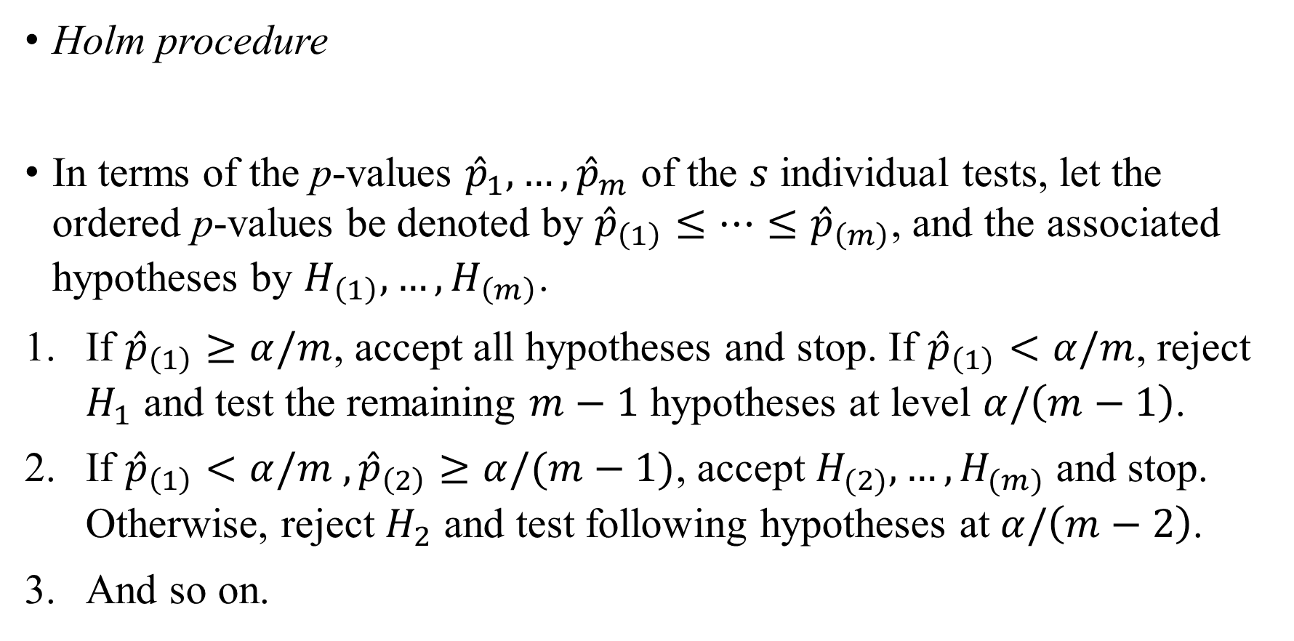
2.2 Methods for FWER control
Holm procedure
In terms of the p-values ${\hat{p}}_{1},…,{\hat{p}}_{m}$ of the $s$ individual tests, let the ordered p-values be denoted by ${\hat{p}}_{\left(1\right)}≤…≤{\hat{p}}_{\left(m\right)}$, and the associated hypotheses by $H_{\left(1\right)},…,H_{\left(m\right)}$.
If ${\hat{p}}_{\left(1\right)}≥α/m$, accept all hypotheses and stop. If ${\hat{p}}_{\left(1\right)}<α/m$, reject $H_{1}$ and test the remaining $m−1$ hypotheses at level $α/\left(m−1\right)$.
If ${\hat{p}}_{\left(1\right)}<α/m ,{\hat{p}}_{\left(2\right)}≥α/(m−1)$, accept $H_{(2)},…,H_{(m)}$ and stop. Otherwise, reject $H_{2}$ and test following hypotheses at $α/\left(m−2\right)$.
And so on.

Slide 21
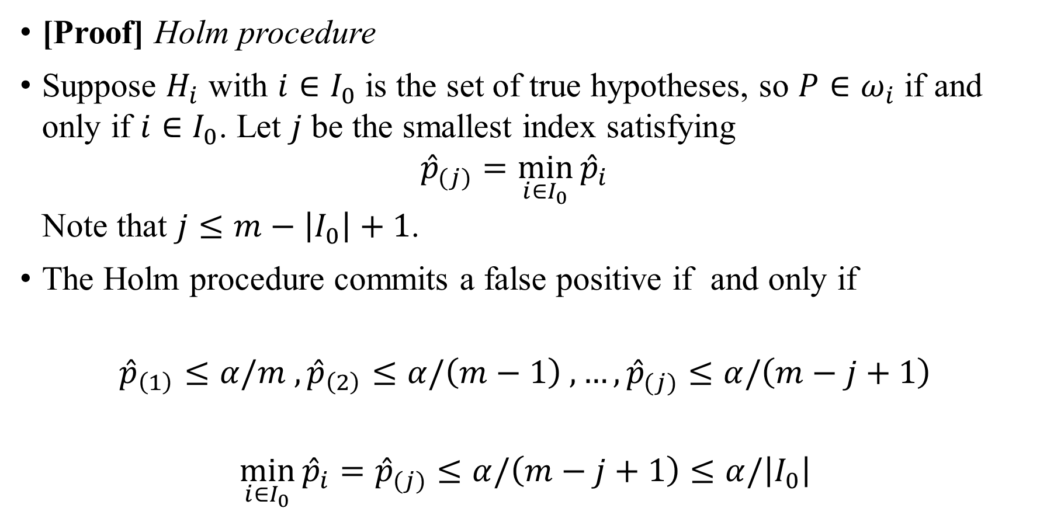
2.2 Methods for FWER control
[Proof] Holm procedure
Suppose $H_{i}$ with $i∈I_{0}$ is the set of true hypotheses, so $P∈ω_{i}$ if and only if $i∈I_{0}$. Let $j$ be the smallest index satisfying
${\hat{p}}_{(j)}=\min_{i∈I_{0}}{{\hat{p}}_{i}}$
Note that $j≤m−\left|I_{0}\right|+1$.
The Holm procedure commits a false positive if and only if
$${\hat{p}}_{\left(1\right)}≤α/m , {\hat{p}}_{\left(2\right)}≤α/\left(m−1\right) , …,{\hat{p}}_{(j)}≤α/\left(m−j+1\right)$$
$$\min_{i∈I_{0}}{{\hat{p}}_{i}}={\hat{p}}_{(j)}≤α/\left(m−j+1\right)≤α/\left|I_{0}\right|$$

Slide 22

2.2 Methods for FWER control
Therefore, by the Bonferroni inequality, the probability of a false positive is bounded above by
$P\left\{\min_{i∈I_{0}}{{\hat{p}}_{i}≤a/\left|I_{0}\right|}\right\}≤\sum_{i∈I_{0}}{P\left\{{\hat{p}}_{i}≤a/\left|I_{0}\right|\right\}}≤α$

Slide 23
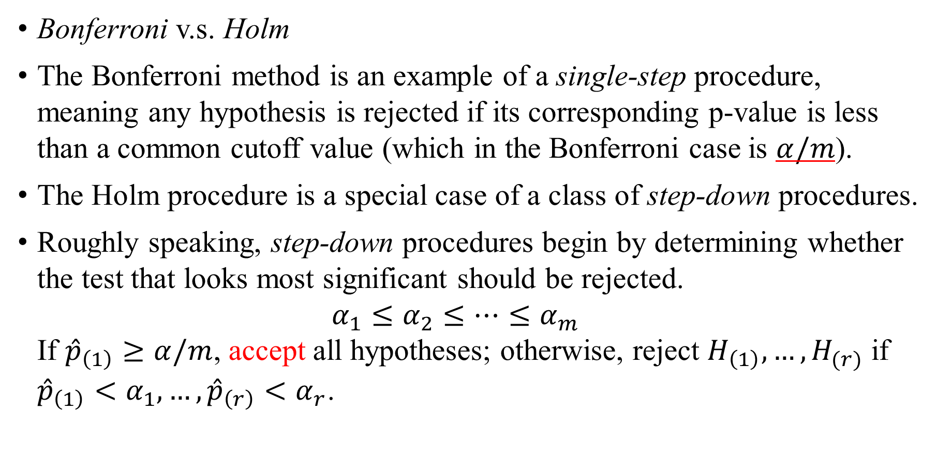
2.2 Methods for FWER control
Bonferroni v.s. Holm
The Bonferroni method is an example of a single-step procedure, meaning any hypothesis is rejected if its corresponding p-value is less than a common cutoff value (which in the Bonferroni case is $α/m$).
The Holm procedure is a special case of a class of step-down procedures.
Roughly speaking, step-down procedures begin by determining whether the test that looks most significant should be rejected.
$α_{1}≤α_{2}≤…≤α_{m}$
If ${\hat{p}}_{\left(1\right)}≥α/m$, accept all hypotheses; otherwise, reject $H_{\left(1\right)}, …,H_{(r)}$ if ${\hat{p}}_{\left(1\right)}<α_{1},…,{\hat{p}}_{\left(r\right)}<α_{r}$.

Slide 24

2.2 Methods for FWER control
On the other hand, step-up procedures begin by looking at the least significant p-value.
Reject all the hypotheses if ${\hat{p}}_{\left(m\right)}<α_{m}$. Otherwise, for $r=m,…,1$, reject hypotheses $H_{（1）},…,H_{\left(r\right)}$ if
${\hat{p}}_{\left(m\right)}≥α_{m},…,{\hat{p}}_{\left(r+1\right)}≥α_{r+1} but {\hat{p}}_{\left(r\right)}<α_{r}$

Slide 25
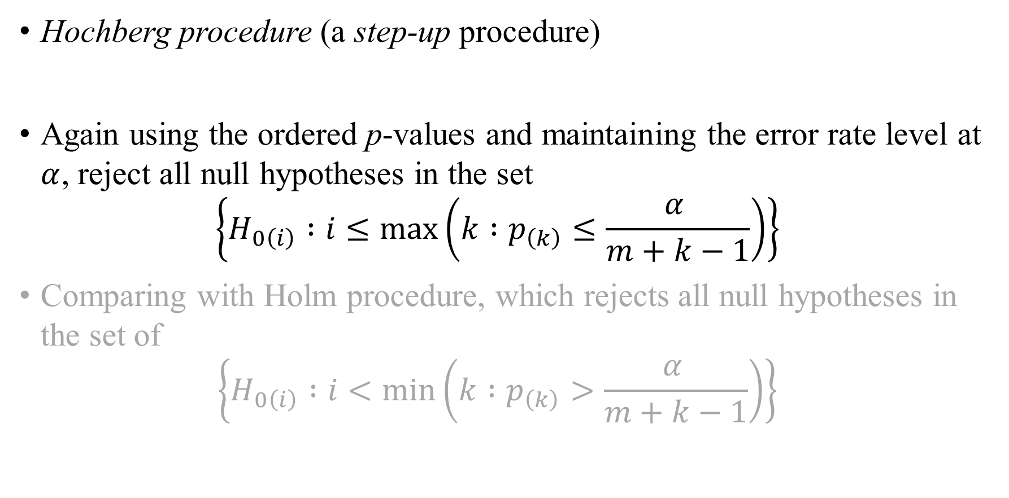
2.2 Methods for FWER control
Hochberg procedure (a step-up procedure)
Again using the ordered p-values and maintaining the error rate level at $α$, reject all null hypotheses in the set
$\left\{H_{0\left(i\right)} :i≤\max\left(k :p_{\left(k\right)}≤\frac{α }{m+k−1}\right)\right\}$
Comparing with Holm procedure, which rejects all null hypotheses in the set of
$\left\{H_{0\left(i\right)} :i<\min\left(k :p_{\left(k\right)}>\frac{α }{m+k−1}\right)\right\}$
Notes:
A step-up procedure

Slide 26
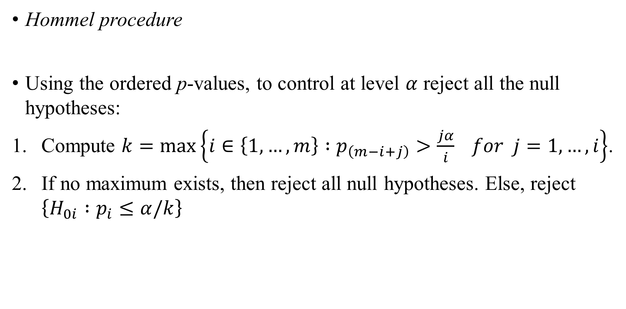
2.2 Methods for FWER control
Hommel procedure
Using the ordered p-values, to control at level $α$ reject all the null hypotheses:
Compute $k=\max\left\{i∈\left\{1,…,m\right\} :p_{\left(m−i+j\right)}>\frac{jα}{i} for j=1,…,i\right\}$.
If no maximum exists, then reject all null hypotheses. Else, reject $\left\{H_{0i} :p_{i}≤α/k\right\}$

Slide 27
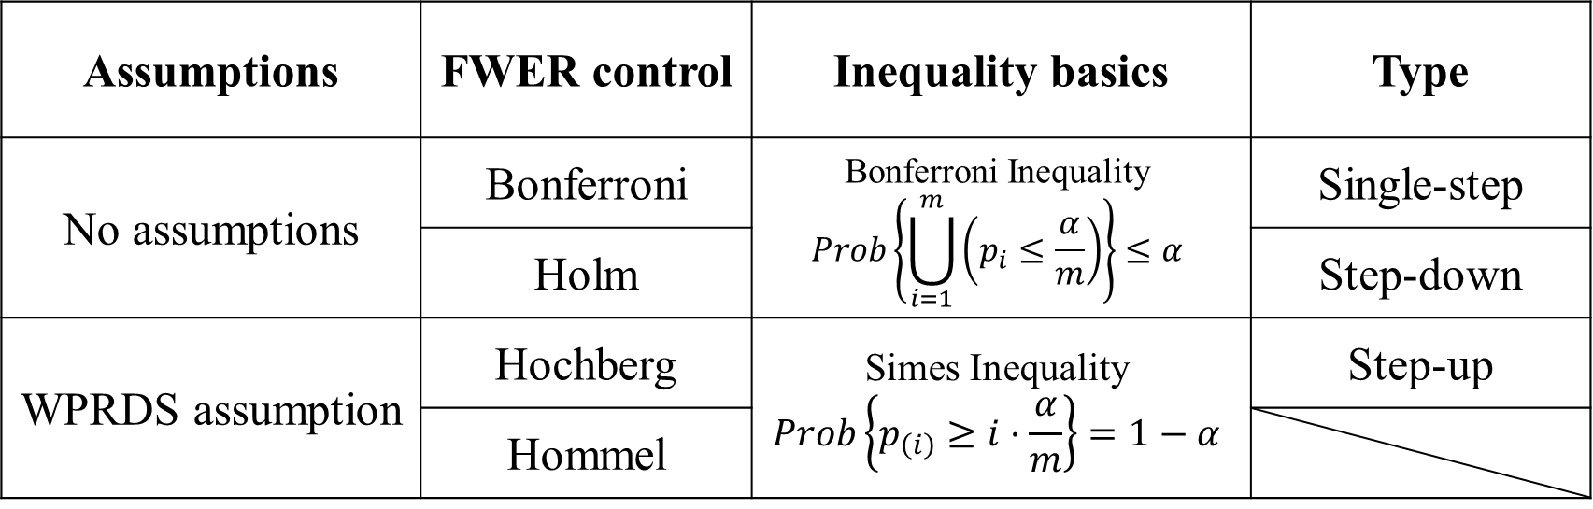
2.3 Summarization and use of FWER
Necessary assumption and for FWER control procedures
Assumptions | FWER control | Inequality basics | Type
No assumptions | Bonferroni | Bonferroni Inequality $$Prob\left\{\bigcup_{i=1}^{m}{\left(p_{i}≤\frac{α}{m}\right)}\right\}≤α$$ | Single-step
 | Holm |  | Step-down
WPRDS assumption | Hochberg | Simes Inequality $$Prob\left\{p_{\left(i\right)}≥i⋅\frac{α}{m}\right\}=1−α$$ | Step-up
 | Hommel

Slide 28
3 False Discovery Rate (FDR) Control
3.1 Introduction to FDR
3.2 FDR control under WPRDS
3.3 General control of FDR
3.4 Adaptive FDR
3.5 Use of FDR

Slide 29
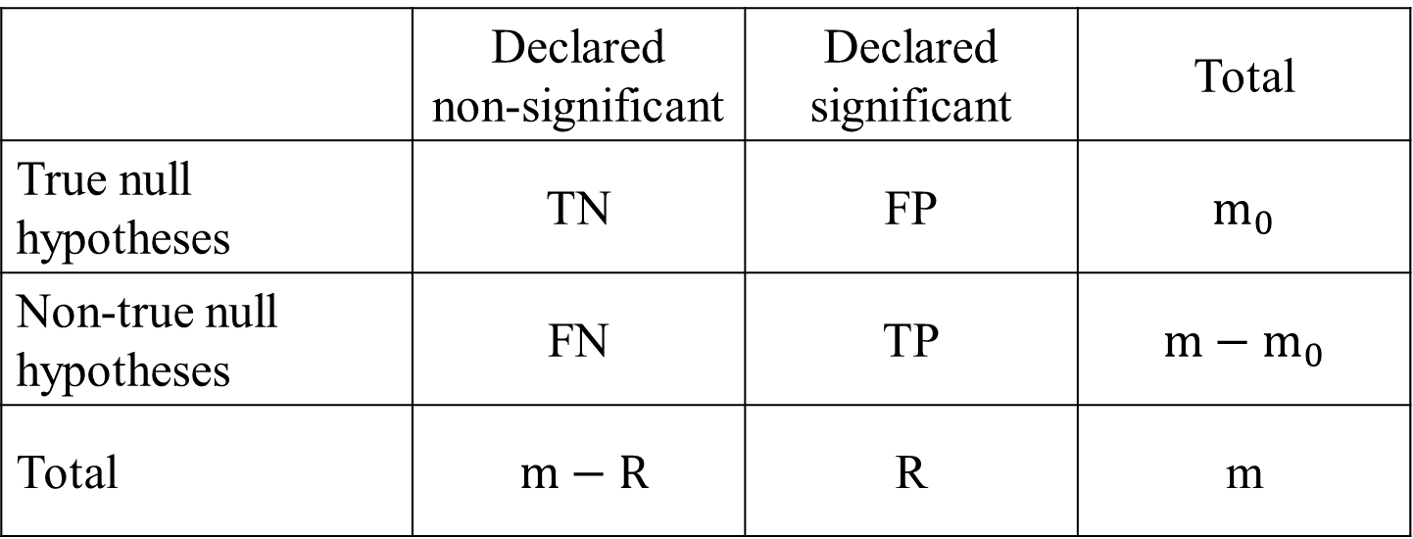

3.1 Introduction to FDR
Consider the problem of testing simultaneously m (null) hypotheses, of which $m_{0}$ are true. R is the number of hypotheses rejected. The following table summarizes the situation in a traditional form.
 | Declared non-significant | Declared significant | Total
True null hypotheses | TN | FP | $$m_{0}$$
Non-true null hypotheses | FN | TP | $$m−m_{0}$$
Total | $m−R$ | R | m

Slide 30
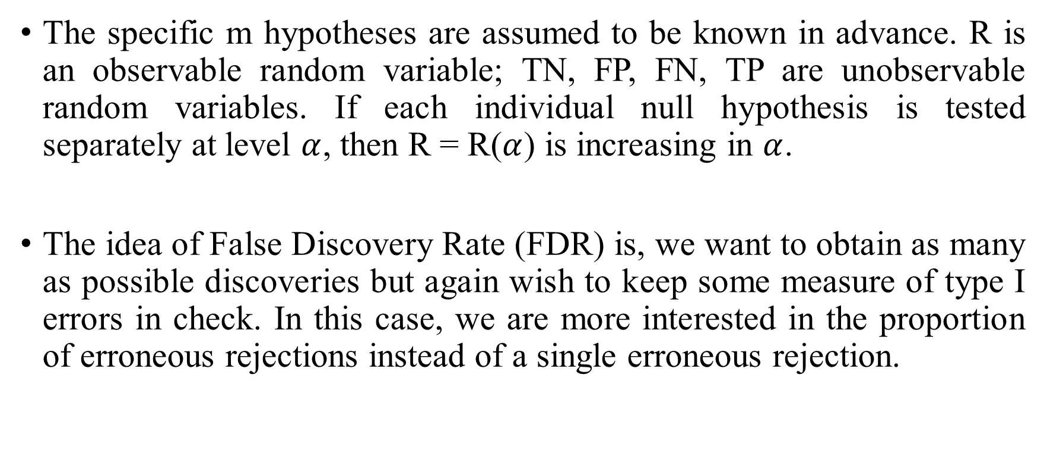
The specific m hypotheses are assumed to be known in advance. R is an observable random variable; TN, FP, FN, TP are unobservable random variables. If each individual null hypothesis is tested separately at level $α$, then R = R($α$) is increasing in $α$.
The idea of False Discovery Rate (FDR) is, we want to obtain as many as possible discoveries but again wish to keep some measure of type I errors in check. In this case, we are more interested in the proportion of erroneous rejections instead of a single erroneous rejection.

Slide 31
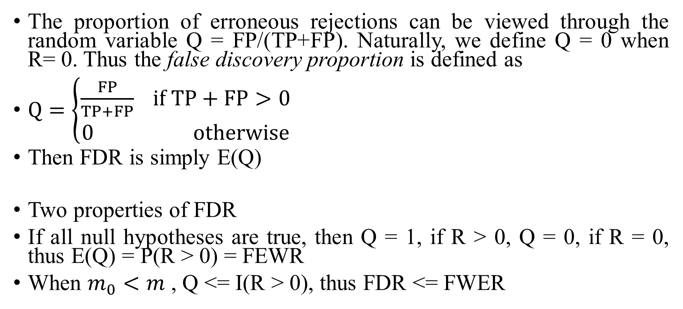
The proportion of erroneous rejections can be viewed through the random variable Q = FP/(TP+FP). Naturally, we define Q = 0 when R= 0. Thus the false discovery proportion is defined as
$Q=\left\{\begin{aligned}\frac{FP}{TP+FP} if TP+FP>0 \\ 0 otherwise\end{aligned}\right.$
Then FDR is simply E(Q)
Two properties of FDR
If all null hypotheses are true, then Q = 1, if R > 0, Q = 0, if R = 0, thus E(Q) = P(R > 0) = FEWR
When $m_{0}<m$ , Q <= I(R > 0), thus FDR <= FWER

Slide 32
Example
Consider a situation in which the overall decision problem is whether to recommend a new treatment over a standard treatment.
Discoveries here are rejections of null hypotheses claiming that treatment is no better than standard on specified end points, the set of discoveries will be used to reach an overall decision regarding the new treatment
We wish therefore to make as many discoveries as possible, which will enhance a decision in favor of the new treatment, subject to control of the FDR.
Control of the probability of any error is unnecessarily stringent, as a small proportion of errors will not change the overall validity of the conclusion

Slide 33
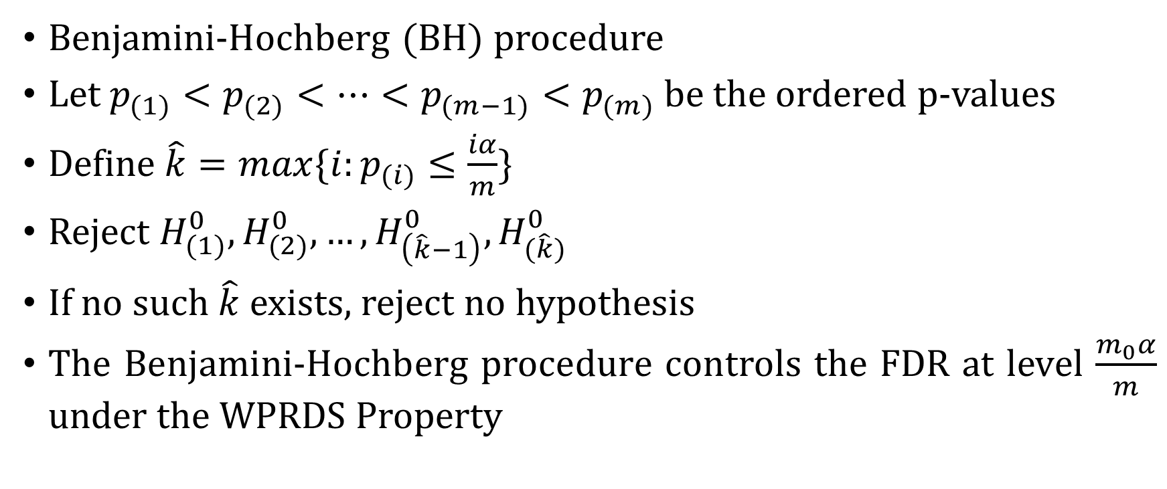
3.2 FDR control under the WPRDS Property
Benjamini-Hochberg (BH) procedure
Let $p_{(1)}<p_{(2)}<…<p_{(m−1)}<p_{(m)}$ be the ordered p-values
Define $\hat{k}=max⁡\{i:p_{(i)}≤\frac{iα}{m}\}$
Reject $H_{(1)}^{0},H_{(2)}^{0},…,H_{\left(\hat{k}−1\right)}^{0},H_{(\hat{k})}^{0}$
If no such $\hat{k}$ exists, reject no hypothesis
The Benjamini-Hochberg procedure controls the FDR at level $\frac{m_{0}α}{m}$ under the WPRDS Property

Slide 34
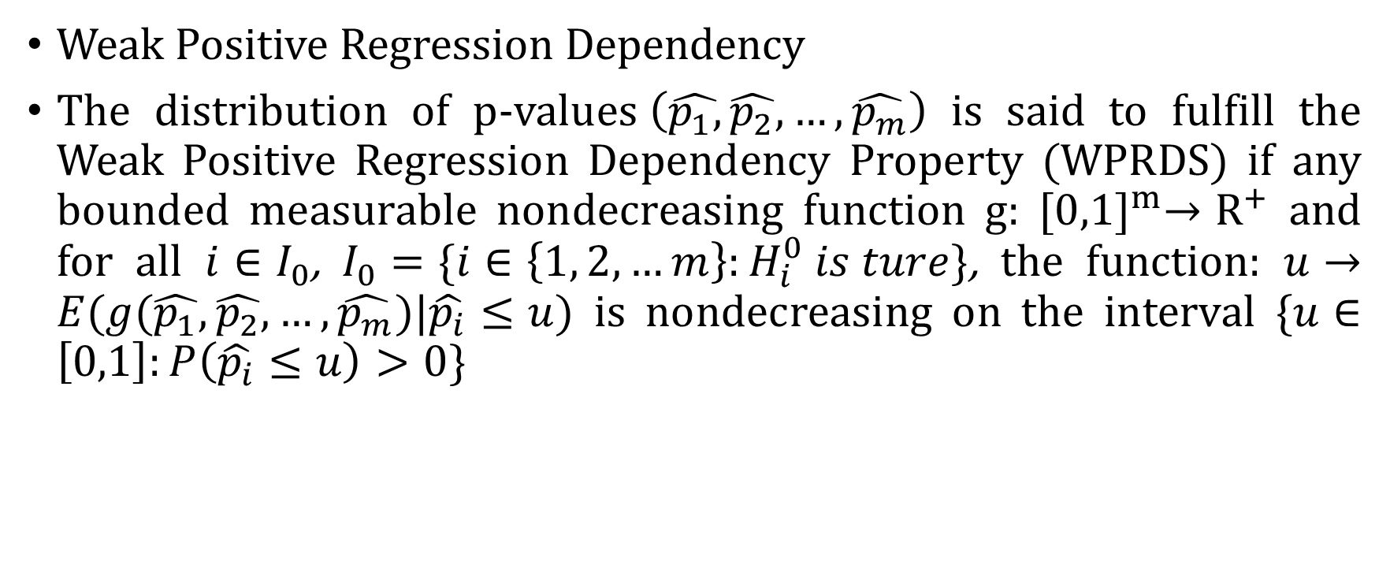
3.2 FDR control under the WPRDS Property
Weak Positive Regression Dependency
The distribution of p-values$\left(\hat{p_{1},}\hat{p_{2}},…,\hat{p_{m}}\right)$ is said to fulfill the Weak Positive Regression Dependency Property (WPRDS) if any bounded measurable nondecreasing function g: ${[0,1]}^{m}→R^{+}$ and for all $i∈I_{0}$, $I_{0}=\{i∈\left\{1, 2,…m\right\}:H_{i}^{0} is ture\}$, the function: $u→E(g(\hat{p_{1}},\hat{p_{2}},…,\hat{p_{m}})|\hat{p_{i}}≤u)$ is nondecreasing on the interval {$u∈\left[0,1\right]:P\left(\hat{p_{i}}≤u\right)>0$}

Slide 35

3.2 FDR control under the WPRDS Property
Theorem. When the distribution of the p-values fulfills the WPRDS property, the Benjamini-Hochberg procedure controls the FDR at level $\frac{m_{0}α}{m}$.

Slide 36
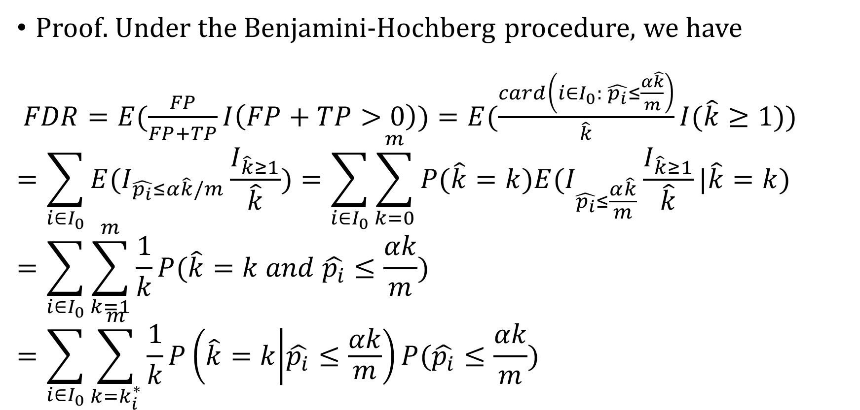
3.2 FDR control under the WPRDS Property
Proof. Under the Benjamini-Hochberg procedure, we have
$FDR=E(\frac{FP}{FP+TP}I\left(FP+TP>0\right))=E(\frac{card\left(i∈I_{0}: \hat{p_{i}}≤\frac{α\hat{k}}{m}\right)}{\hat{k}}I(\hat{k}≥1))$
$$=\sum_{i∈I_{0}}{E(I_{\hat{p_{i}}≤α\hat{k}/m}\frac{I_{\hat{k}≥1}}{\hat{k}})}=\sum_{i∈I_{0}}{\sum_{k=0}^{m}{P(\hat{k}=k)E(I_{\hat{p_{i}}≤\frac{α\hat{k}}{m}}\frac{I_{\hat{k}≥1}}{\hat{k}}|\hat{k}=k)}}$$
$$=\sum_{i∈I_{0}}{\sum_{k=1}^{m}{\frac{1}{k}P(\hat{k}=k and \hat{p_{i}}≤\frac{αk}{m})}}=\sum_{i∈I_{0}}{\sum_{k=k_{i}^{∗}}^{m}{\frac{1}{k}P\left(\hat{k}=k | \hat{p_{i}}≤\frac{αk}{m}\right)P(\hat{p_{i}}≤\frac{αk}{m})}}$$

Slide 37
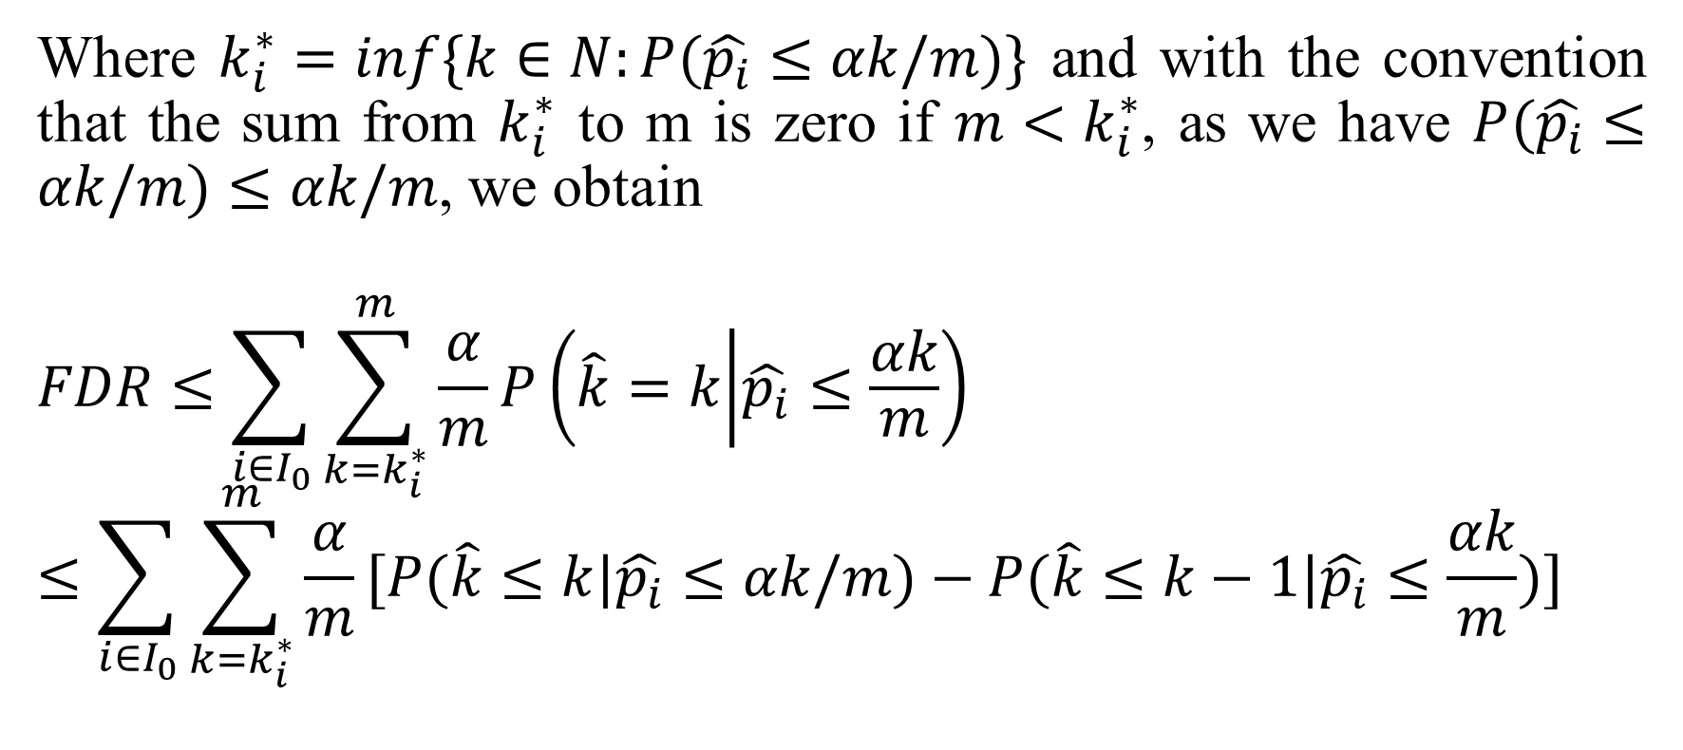
Where $k_{i}^{∗}=inf⁡\{k∈N:P(\hat{p_{i}}≤αk/m)\}$ and with the convention that the sum from $k_{i}^{∗}$ to m is zero if $m<k_{i}^{∗}$, as we have $P(\hat{p_{i}}≤αk/m)≤αk/m$, we obtain
$$FDR≤\sum_{i∈I_{0}}{\sum_{k=k_{i}^{∗}}^{m}{\frac{α}{m}}P\left(\hat{k}=k | \hat{p_{i}}≤\frac{αk}{m}\right)}≤\sum_{i∈I_{0}}{\sum_{k=k_{i}^{∗}}^{m}{\frac{α}{m}}[P(\hat{k}≤k|\hat{p_{i}}≤αk/m)}−P(\hat{k}≤k−1|\hat{p_{i}}≤\frac{αk}{m})]$$

Slide 38
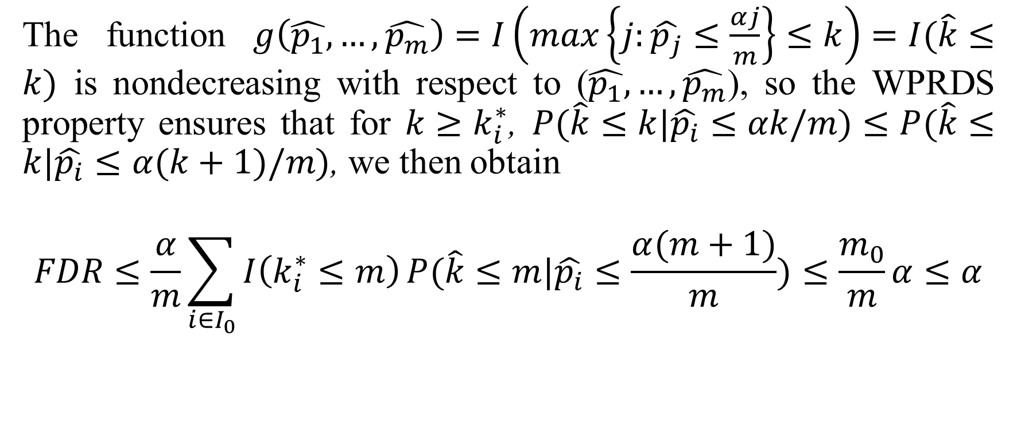
The function $g\left(\hat{p_{1}},…,\hat{p_{m}}\right)=I\left(\max\left\{j:\hat{p_{j}}≤\frac{αj}{m}\right\}≤k\right)=I(\hat{k}≤k)$ is nondecreasing with respect to ($\hat{p_{1}},…,\hat{p_{m}}$), so the WPRDS property ensures that for $k≥k_{i}^{∗}$, $P(\hat{k}≤k|\hat{p_{i}}≤αk/m)≤P(\hat{k}≤k|\hat{p_{i}}≤α(k+1)/m)$, we then obtain
$$FDR≤\frac{α}{m}\sum_{i∈I_{0}}{I\left(k_{i}^{∗}≤m\right)}P(\hat{k}≤m|\hat{p_{i}}≤\frac{α(m+1)}{m})≤\frac{m_{0}}{m}α≤α$$

Slide 39

3.2 FDR control under the WPRDS Property
Theorem. Independent p-values fulfills the WPRDS
Assume that the${{(\hat{p}}_{i}) }_{i∈I_{0}}$, are independent random variables and that ${{(\hat{p}}_{i}) }_{i∈{I\backslash I}_{0}}$are independent from the${{(\hat{p}}_{i}) }_{i∈I_{0}}$. Then, the distribution of $(\hat{p_{1}},\hat{p_{2}},…,\hat{p_{m}})$ fulfills the WPRDS property.

Slide 40
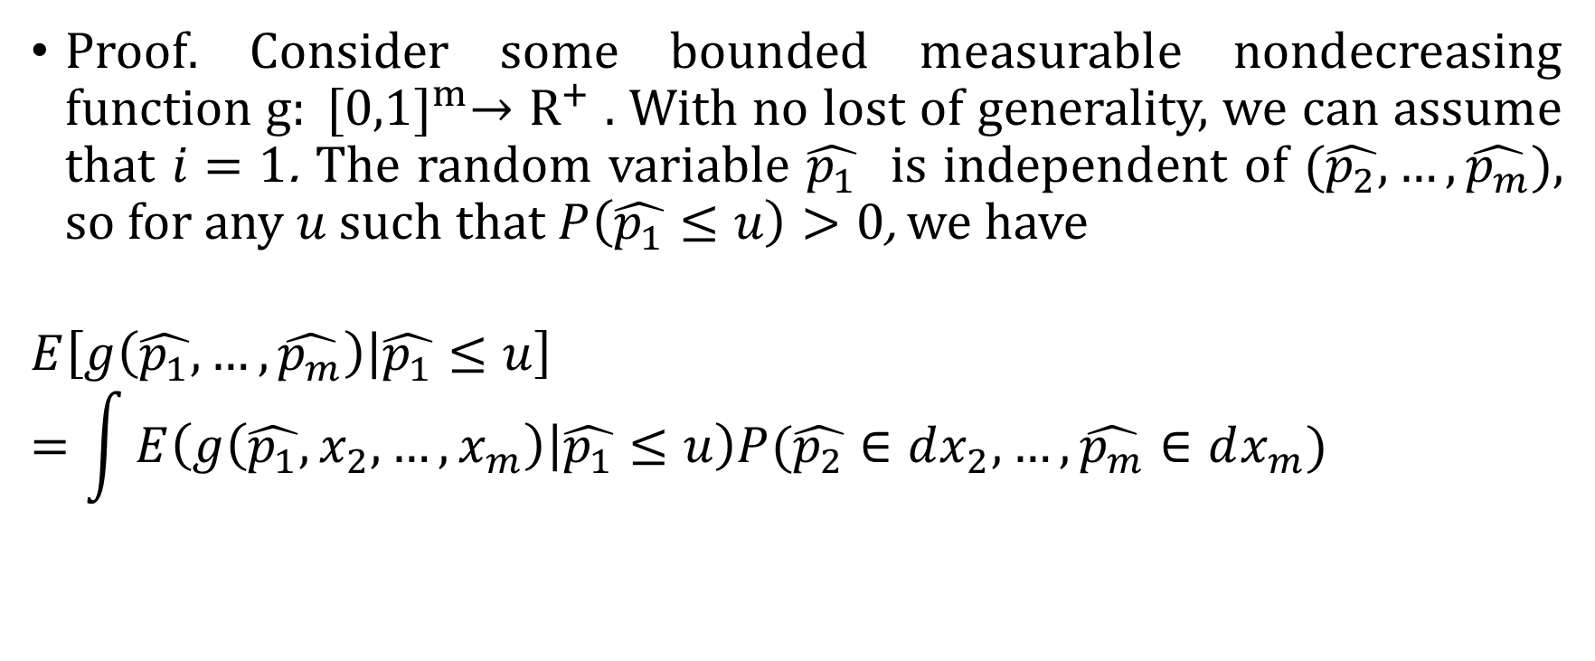
3.2 FDR control under the WPRDS Property
Proof. Consider some bounded measurable nondecreasing function $g: {[0,1]}^{m}→R^{+}$ . With no lost of generality, we can assume that $i=1$. The random variable $\hat{p_{1}}$ is independent of $(\hat{p_{2}},…,\hat{p_{m}})$, so for any $u$ such that $P\left(\hat{p_{1}}≤u\right)>0$, we have
$$E\left[g\left(\hat{p_{1}},…,\hat{p_{m}}\right) | \hat{p_{1}}≤u\right]=\int{E\left(g\left(\hat{p_{1}},x_{2},…,x_{m}\right) | \hat{p_{1}}≤u\right)P(\hat{p_{2}}∈dx_{2},…,\hat{p_{m}}∈dx_{m})}$$

Slide 41
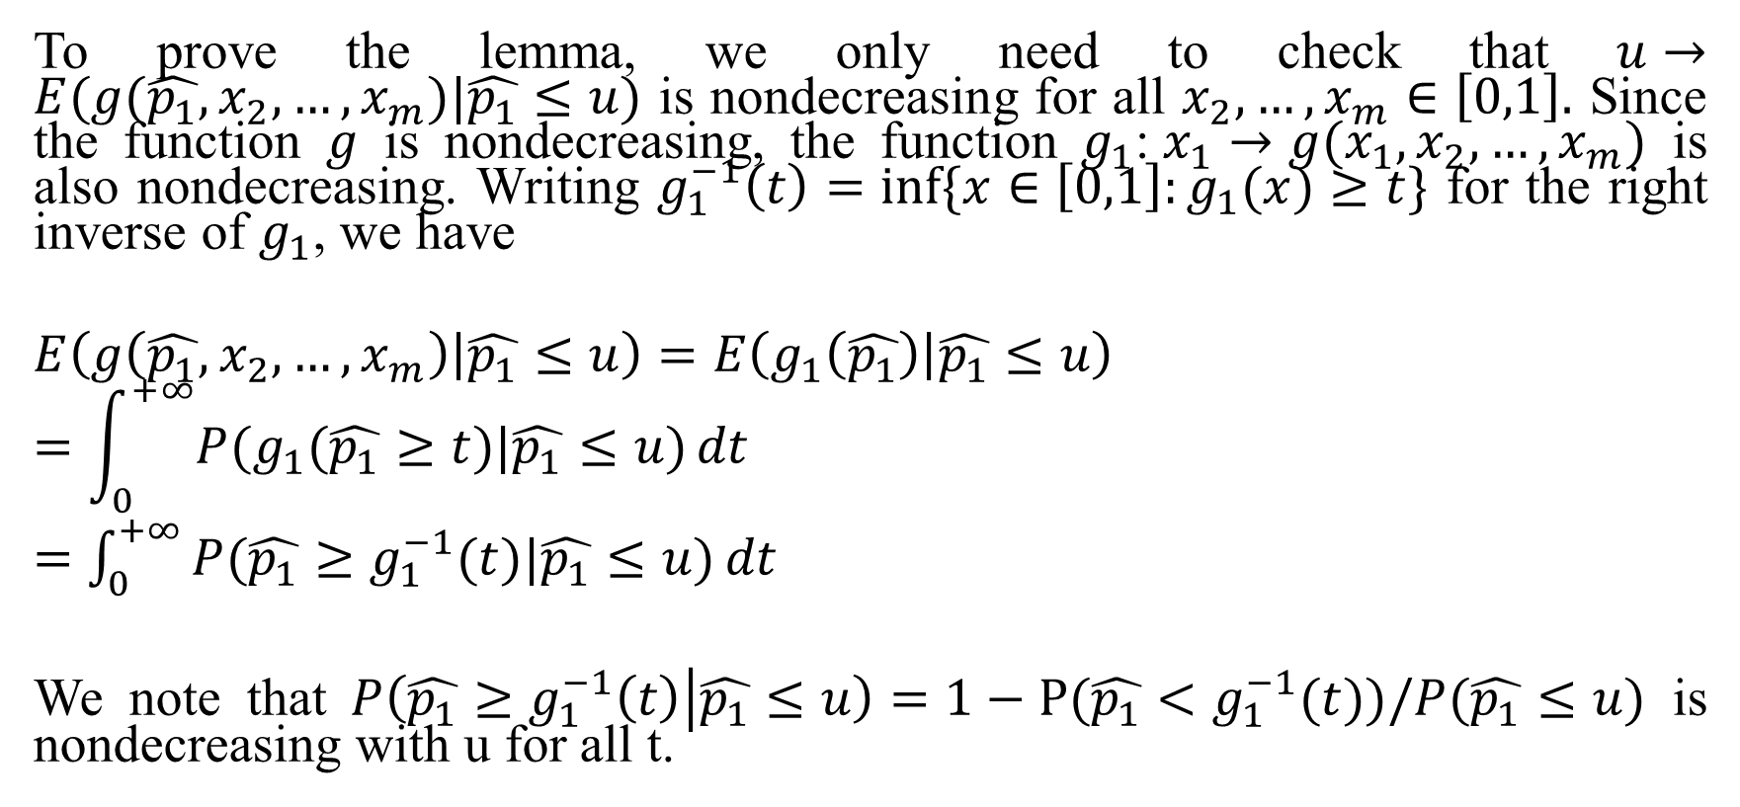
To prove the lemma, we only need to check that $u→E(g(\hat{p_{1}},x_{2},…,x_{m})|\hat{p_{1}}≤u)$ is nondecreasing for all $x_{2},…,x_{m}∈\left[0,1\right].$ Since the function $g$ is nondecreasing, the function $g_{1}$:$x_{1}→g(x_{1},x_{2},…,x_{m})$ is also nondecreasing. Writing $g_{1}^{−1}\left(t\right)=inf⁡\{x∈\left[0,1\right]:g_{1}(x)≥t\}$ for the right inverse of $g_{1}$, we have
$$E\left(g\left(\hat{p_{1}},x_{2},…,x_{m}\right) | \hat{p_{1}}≤u\right)=E\left(g_{1}\left(\hat{p_{1}}\right) | \hat{p_{1}}≤u\right)$$
$$=\int_{0}^{+∞}{P(g_{1}(\hat{p_{1}}≥t)|\hat{p_{1}}≤u)}dt$$
$=$ $\int_{0}^{+∞}{P(\hat{p_{1}}≥g_{1}^{−1}(t)|\hat{p_{1}}≤u)}dt$
We note that $P\left(\hat{p_{1}}≥g_{1}^{−1}\left(t\right) | \hat{p_{1}}≤u\right)=1−P(\hat{p_{1}}<g_{1}^{−1}(t))/P(\hat{p_{1}}≤u)$ is nondecreasing with u for all t.

Slide 42
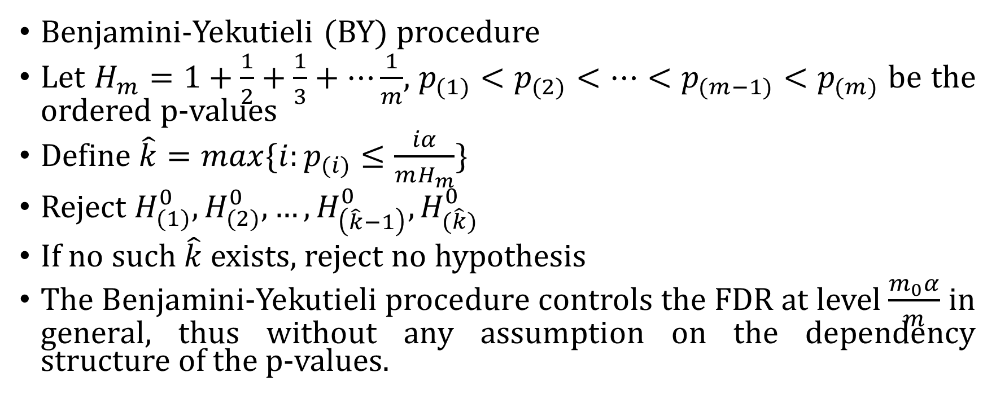
3.3 General Control of FDR
Benjamini-Yekutieli (BY) procedure
Let $H_{m}=1+\frac{1}{2}+\frac{1}{3}+…\frac{1}{m}$, $p_{(1)}<p_{(2)}<…<p_{(m−1)}<p_{(m)}$ be the ordered p-values
Define $\hat{k}=max⁡\{i:p_{(i)}≤\frac{iα}{mH_{m}}\}$
Reject $H_{(1)}^{0},H_{(2)}^{0},…,H_{\left(\hat{k}−1\right)}^{0},H_{(\hat{k})}^{0}$
If no such $\hat{k}$ exists, reject no hypothesis
The Benjamini-Yekutieli procedure controls the FDR at level $\frac{m_{0}α}{m}$ in general, thus without any assumption on the dependency structure of the p-values.

Slide 43
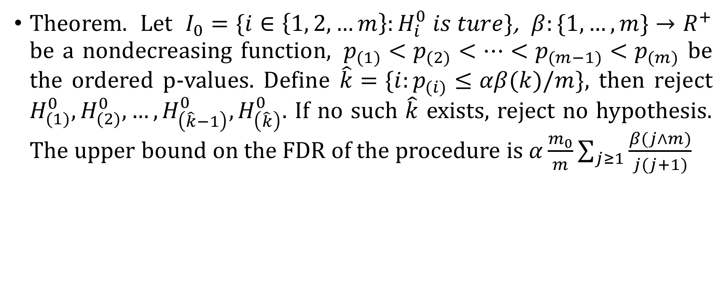
3.3 General Control of FDR
Theorem. Let $I_{0}=\{i∈\left\{1, 2,…m\right\}:H_{i}^{0} is ture\}$, $β:\{1,…,m\}→R^{+}$ be a nondecreasing function, $p_{(1)}<p_{(2)}<…<p_{(m−1)}<p_{(m)}$ be the ordered p-values. Define $\hat{k}=\{i:p_{(i)}≤αβ(k)/m\}$, then reject $H_{(1)}^{0},H_{(2)}^{0},…,H_{\left(\hat{k}−1\right)}^{0},H_{\left(\hat{k}\right)}^{0}$. If no such $\hat{k}$ exists, reject no hypothesis. The upper bound on the FDR of the procedure is $α\frac{m_{0}}{m}\sum_{j≥1}{\frac{β(j∧m)}{j(j+1)}}$

Slide 44
3.3 General Control of FDR
Proof. With Fubini theorem, we can obtain
$$FDR=\sum_{i∈I_{0}}{E(I(\hat{p_{i}}≤αβ(\hat{k})/m)\frac{I(\hat{k}≥1)}{\hat{k}})}$$
$$=\sum_{i∈I_{0}}{E(I(\hat{p_{i}}≤αβ(\hat{k})/m)\sum_{j≥1}{\frac{I\left(j≥\hat{k}\right)}{j\left(j+1\right)}}I(\hat{k}≥1))}=\sum_{i∈I_{0}}{\sum_{j≥1}{\frac{1}{j\left(j+1\right)}E(I\left(\hat{p_{i}}≤\frac{αβ\left(\hat{k}\right)}{m}\right)I\left(j≥\hat{k}\right)I(\hat{k}≥1))}}$$
$$≤\sum_{i∈I_{0}}{\sum_{j≥1}{\frac{1}{j\left(j+1\right)}}}P\left(\hat{p_{i}}≤\frac{αβ\left(j∧m\right)}{m}\right)≤\sum_{i∈I_{0}}{\sum_{j≥1}{\frac{1}{j\left(j+1\right)}\frac{αβ\left(j∧m\right)}{m}}}$$
$$≤α\frac{m_{0}}{m}\sum_{j≥1}{\frac{β(j∧m)}{j(j+1)}}$$

Slide 45

If we choose $β$ such that $\sum_{j≥1}{\frac{β(j∧m)}{j(j+1)}}≤1$,then the FDR is less than $\frac{m_{0}}{m}α$. Specifically, we can set $β\left(k\right)=k/H_{m}$, that is the Benjamini-Yekutieli procedure. Another example of $β$ is $β\left(k\right)=\frac{k(k+1)}{2m}$

Slide 46
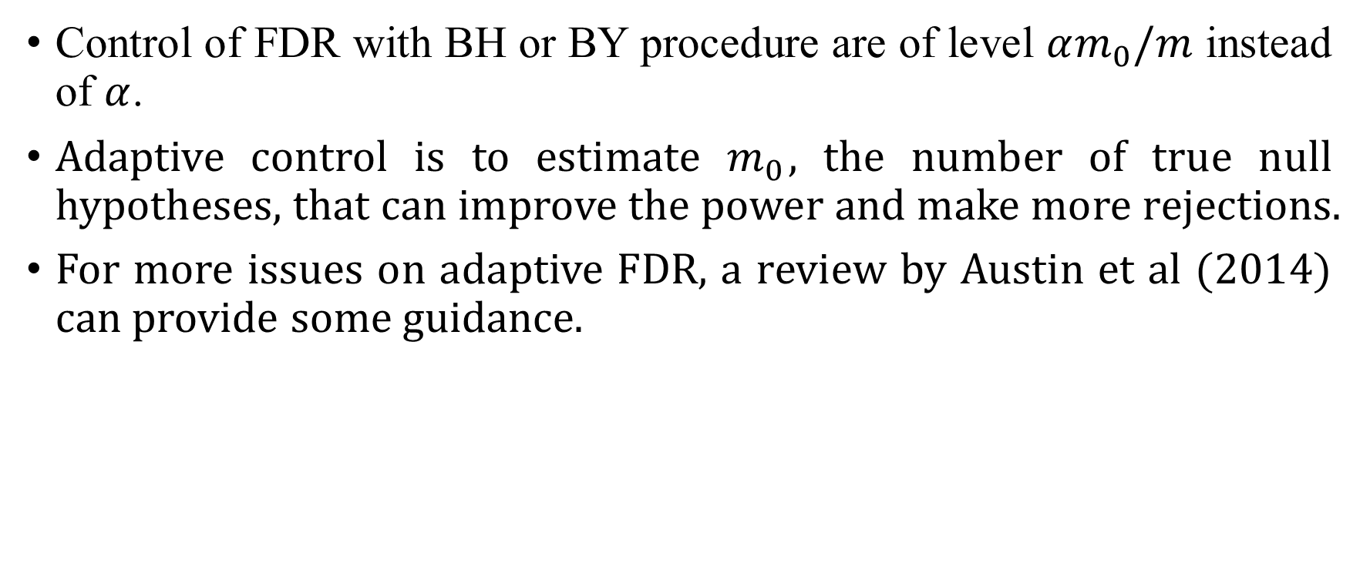
3.4 Adaptive FDR
Control of FDR with BH or BY procedure are of level $αm_{0}/m$ instead of $α$.
Adaptive control is to estimate $m_{0}$, the number of true null hypotheses, that can improve the power and make more rejections.
For more issues on adaptive FDR, a review by Austin et al (2014) can provide some guidance.

Slide 47
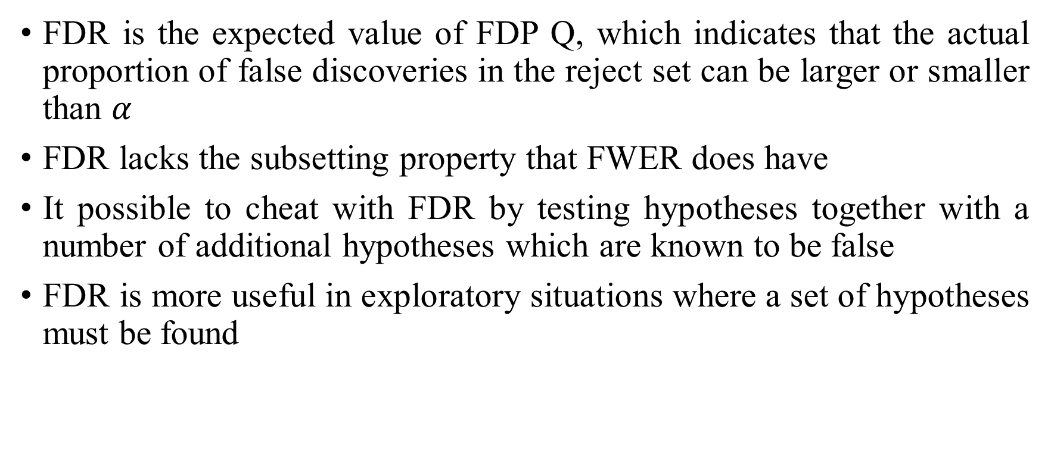
3.4 Use of FDR
FDR is the expected value of FDP Q, which indicates that the actual proportion of false discoveries in the reject set can be larger or smaller than $α$
FDR lacks the subsetting property that FWER does have
It possible to cheat with FDR by testing hypotheses together with a number of additional hypotheses which are known to be false
FDR is more useful in exploratory situations where a set of hypotheses must be found

Slide 48
4 False Discovery Proportion
4.1 FDP v.s. FDR
4.2 Storey’s approach
4.3 Efron’s approach
4.4 FDP confidence

Slide 49
4.1 FDP v.s. FDR
The routine of the multiple testing procedure is reversed.
FDR: Start with the choice of error rate to be controlled;
the procedure that controls it;
a single rejected set that fulfills the creteria.
FDP: Start with the set of hypothesis “would like” to reject;
an estimate or confidence interval for the error rate(FDP).

Slide 50
4.1 FDP v.s. FDR
Repeat the same experiment $n$ times:
FDR: obtain sets $R_{1},⋯,R_{n}$ with FDP $Q_{1},⋯,Q_{n}$;
if $n$ large, the average of $Q_{i}$ is bounded by $α;$
a property of procedure leading to a rejected set $R_{i}$.
FDP: A fixed set $R$ with $Q_{1},⋯,Q_{n}$ and CI $\left[L_{1},U_{1}\right],⋯,[L_{n},U_{n}]$;
directly informative about $R$ itself.

Slide 51
4.1 FDP v.s. FDR
If reliable estimates of FDP is available for every set $R$ of potential interest, then can review the sets and their estimate, and select the most promising one.
$R$ do not necessarily consist of the hypothesis with top $p values$;
Allow a mixture of statistical and biological considerations.

Slide 52
4.2 Storey’s Approach
Rejected hypothesis of the form:$R=\{H_{i}:p_{i}<t\}$
$FDP=\frac{m_{0}t}{\#R}$, need estimate $m_{0}$
$\hat{m_{0}}=\frac{\#\{p_{i}>λ\}+1}{1−λ}$
$E(\hat{m_{0}})≥m_{0}$: a conservative estimate of $m_{0}$
$FDP=\hat{Q}=\frac{\hat{m_{0}}t}{\#R}=\frac{t(\#\left\{p_{i}>λ\right\}+1)}{\left(1−λ\right)\#\{p_{i}≤t\}}$

Slide 53
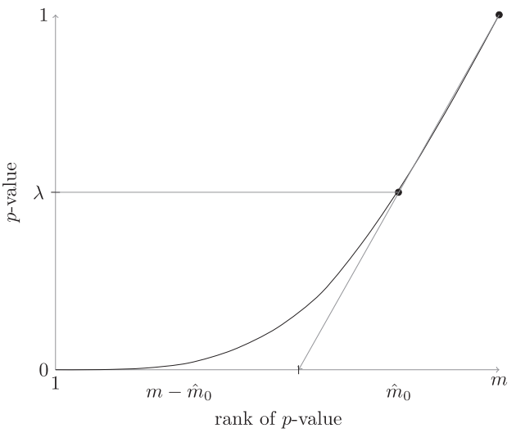
4.2 Storey’s Approach

Slide 54
4.2 Storey’s Approach
Under assumption of independence among $p$-values
The number of hypothesis with $p values$ below $t$ can have high variance especially if $p values$ are positively correlated.

Slide 55
4.3 Efron’s Approach
Storey: only make statements about a set containing top $k$ $p$-values
such statements do not translate to individual hypothesis
Efron: $local$ FDR. Provide estimates for FDP of individual hypothesis.
Assume test statistics $S_{1},⋯,S_{m}$ from mixture distribution:
$$f\left(t\right)=π_{0}f_{0}\left(t\right)+\left(1−π_{0}\right)f_{1}\left(t\right)$$

Slide 56
Local FDR
Assume test statistics $S_{1},⋯,S_{m}$ from mixture distribution:
$$f\left(t\right)=π_{0}f_{0}\left(t\right)+\left(1−π_{0}\right)f_{1}\left(t\right)$$
Local FDR:
$$fdr=P\left(H_{i} is true | S_{i}=t\right)=\frac{π_{0}f_{0}\left(t\right)}{f\left(t\right)}$$
It is convenient to use $z$ value

Slide 57
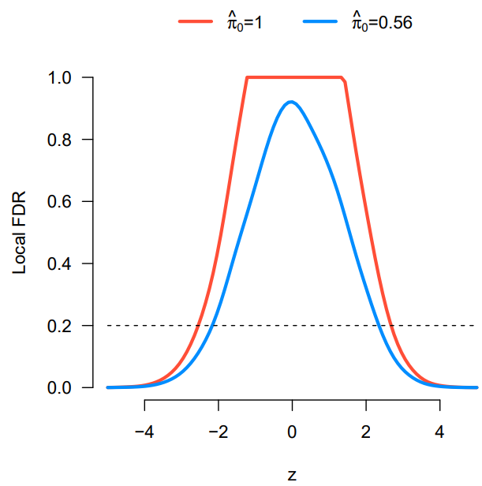
Local FDR

Slide 58
4.3 FDP Confidence
Give a $1−α$ confidence interval for any selected set $R$
The confidence intervals are one-sided:
$$P\left(Q\left(R\right)≤\overline{Q}\left(R\right)\right)≥1−α$$

Slide 59
4.3 FDP Confidence
Consider not only the elementary hypothesis, but all intersection hypothesis of the form $H_{I}=∩_{i∈I}H_{i}$
$H_{1},⋯,H_{n}$: the collection of hypothesis
$T$: true hypothesis
$H_{I}=∩_{i∈I}H_{i}$: intersection hypothesis
$C$: closure of the index set $\{1,⋯,n\}$

Slide 60
4.3 FDP Confidence
Local test: $α$-level tests for every $H_{I}, I∈C$
Dente: $U⊆C$ being the collection of subsets for which reject $H_{U}$
Closed testing procedure: Reject every $I∈C$ for which $J∈U$ for every $J⊇I$
Strongly controls the familywise error for all hypothesis $H_{I},I∈C$ at level $α$

Slide 61
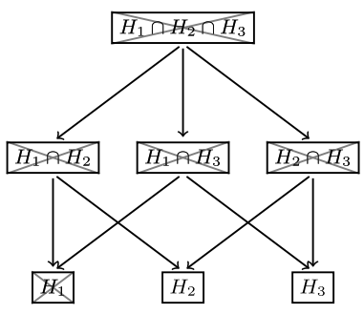
4.3 FDP Confidence

Slide 62
4.3 FDP Confidence
$τ\left(R\right)=\#\left(T∩R\right)$
$C_{R}=\{I∈C:I⊆R\}$
$t_{α}\left(R\right)=max⁡\{\#I:I∈C_{R},I∉χ\}$

Slide 63
4.3 FDP Confidence
The set $\left\{0,⋯,t_{α}\left(R\right)\right\}$ is a $(1−α)$-confidence set of $τ_{R}$
event E: all rejections are correct
Given that E has happened, $τ_{R}$ cannot be greater than $t_{α}\left(R\right)$, since otherwise a true intersection hypothesis would be rejected
Consequently, $τ\left(R\right)∈\{0,⋯,t_{α}\left(R\right)\}$ with probability at least $P\left(E\right)=1−α$
$\overline{Q}\left(R\right)=\frac{t_{α}\left(R\right)}{\#R}$

Slide 64
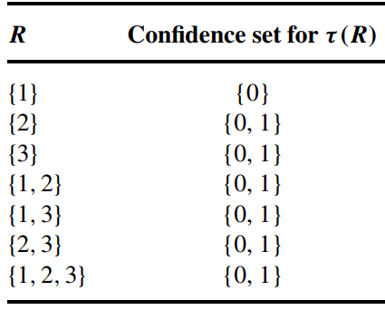
4.3 FDP Confidence

Slide 65
4.3 FDP Confidence
$\overline{Q}\left(R\right)=\frac{t_{α}\left(R\right)}{\#R}$
Point estimate: $\hat{Q}\left(R\right)=\overline{Q}\left(R\right)$at level $α=0.5$

Slide 66
Main References
Giraud C. Introduction to high-dimensional statistics[J]. Monographs on Statistics and Applied Probability, 2015, 139: 139.
Goeman J J, Solari A. Multiple hypothesis testing in genomics[J]. Statistics in medicine, 2014, 33(11): 1946-1978.
Austin S R, Dialsingh I, Altman N. Multiple hypothesis testing: a review[J]. J Indian Soc Agric Stat, 2014, 68(2): 303-14.
Roquain E. Type I error rate control for testing many hypotheses: a survey with proofs[J]. Journal de la Société Française de Statistique, 2011, 152(2): 3-38.
Benjamini Y, Hochberg Y. Controlling the false discovery rate: a practical and powerful approach to multiple testing[J]. Journal of the Royal statistical society: series B (Methodological), 1995, 57(1): 289-300.
Benjamini Y, Yekutieli D. The control of the false discovery rate in multiple testing under dependency[J]. Annals of statistics, 2001: 1165-1188.
Storey J D. A direct approach to false discovery rates[J]. Journal of the Royal Statistical Society: Series B (Statistical Methodology), 2002, 64(3): 479-498.

