Slide 1
Mohammed Abubaker
PROJECT
Supervised Learning

Slide 2
Project Goals
The goal of this project, is to build a model that can predict if the person is diabetic or not based on the features we have.

Slide 3
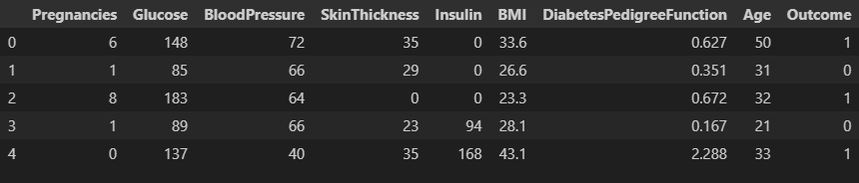
The dataset has 8 features, with binary classification target (1 or 0)

Slide 4
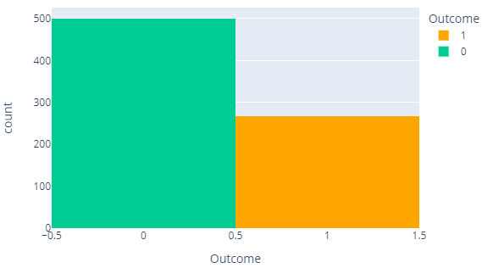
The dataset looks imbalanced, we will use stratify=y parameter when we split the dataset

Slide 5
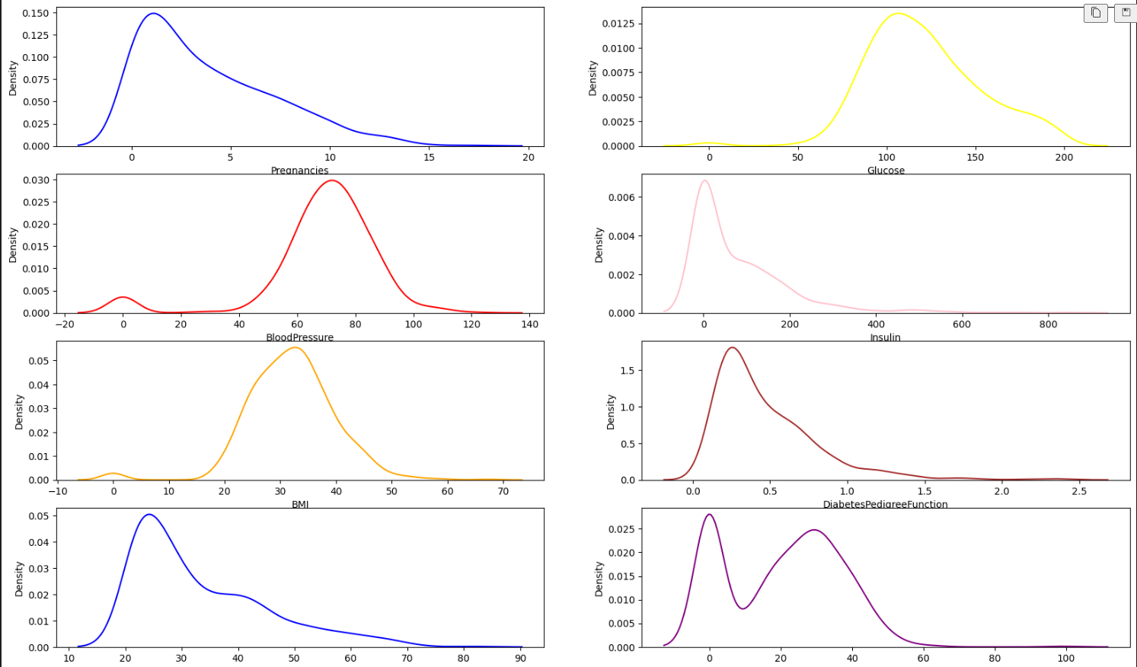
All the features are not normally distributed

Slide 6
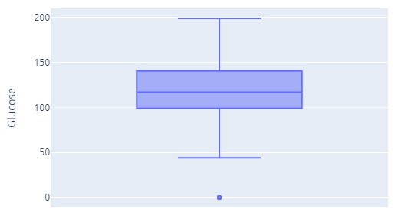
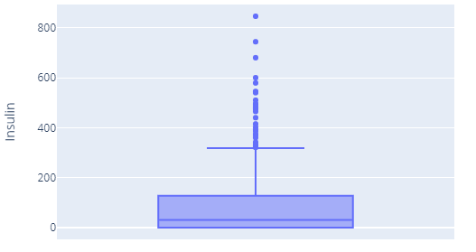
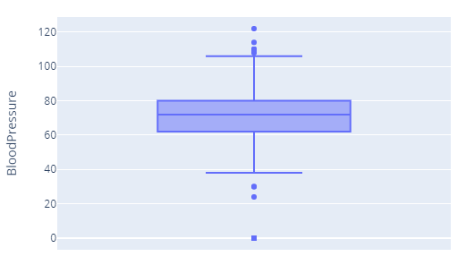
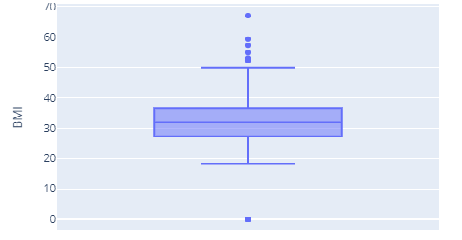
Some features like BloodPressure, Glucose, Insulin, BMI, SkinThickness have zero value which is not realistic, so we replaced it with the median value for each class

Slide 7
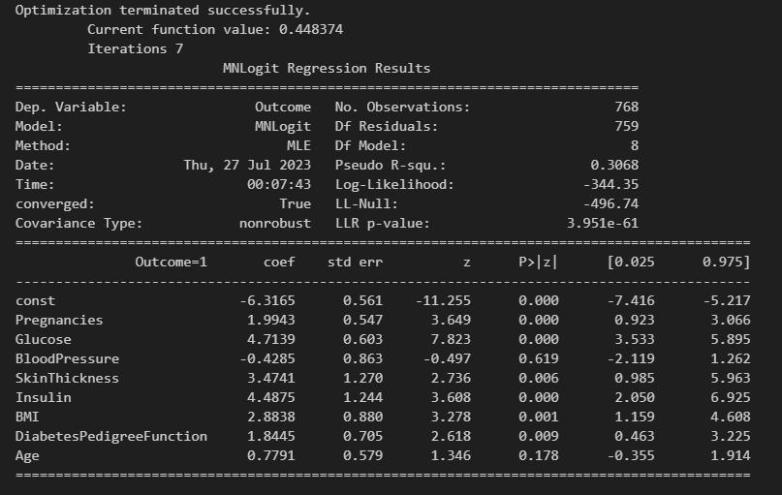
In the statistical model table we can see that Age and BloodPressure are not statistically significant, but we will keep them and see how they will do in the model

Slide 8
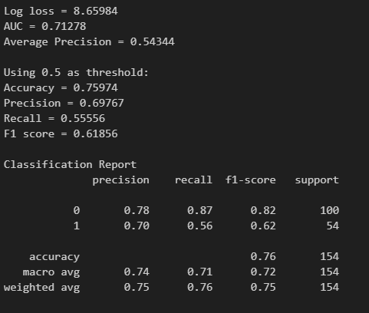
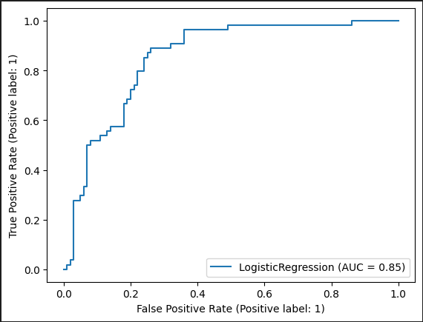
Logistic Regression Model - Result

Slide 9
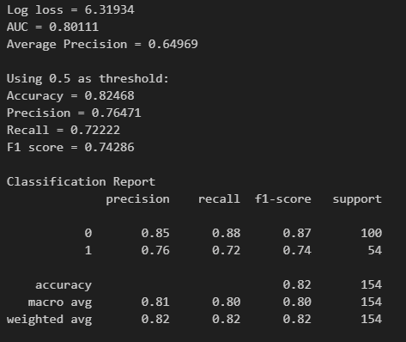
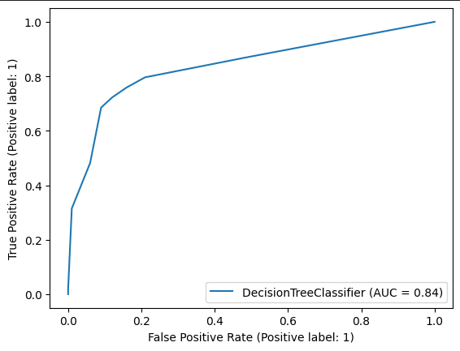
Decision Tree Model - Result

Slide 10
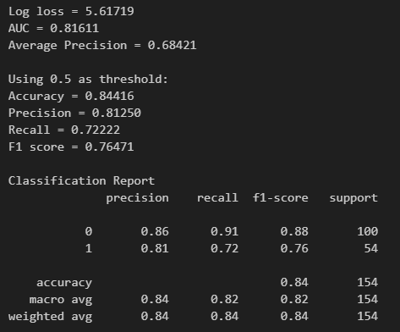
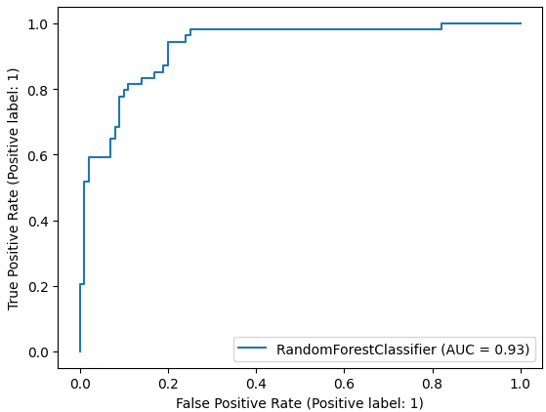
Random Forest Tree Model - Result

Slide 11
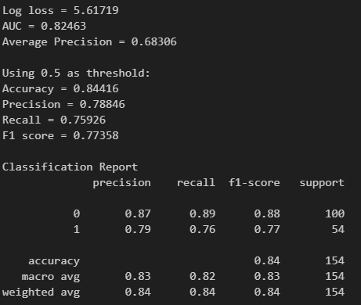
Here we removed the BloodPressure and Age features and build the model again using Random Forest Tree Before After F1-score is same for both

Slide 12
Conclusion
- The dataset has no missing values, but it has a lot of unrealistic information. e.g. BMI = 0.
- Random Forest Tree gives the best result with 84% accuracy.
- Insulin and glucose are the most important feature.
- Blood pressure is the least important, which surprise me!!

Slide 13
THANK YOU

