Slide 1
HEAT TRANSFER FROM A SPHERICAL REACTOR
By
SUMANTH HAGALAVADI GOPALAKRISHNA
KAVYA PRAKASH

Slide 2
GENETIC ALGORITHMS
Search algorithms based on the mechanics of natural selection and
genetics
Based of Darwinian theory – survival of the fittest , it simulates evolution for optimization
Robustness – balance between efficiency and efficacy is more important than finding the optimal value
GA can be applied to a varied number of problems to incorporate robustness in engineering problems

Slide 3
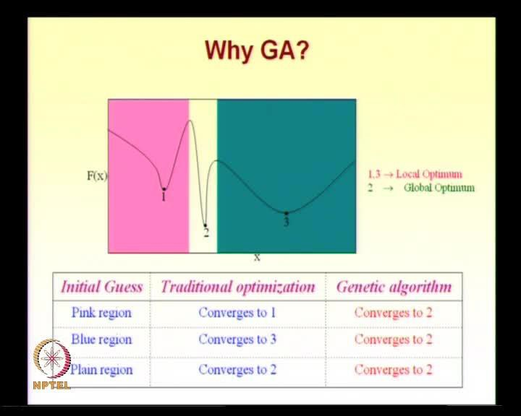
WHY GA ?
GA’s are more likely to find global optimum
Best when there many local minimums
Can be applied to huge data
Supports multi-objective optimization
No examples are required to learn and gets
better with time
Obtain good solutions quickly
Source : NPTEL

Slide 4

PROBLEM STATEMENT
The heat transfer Q for a spherical reactor of diameter D is given by the equation :
Q = hTA ------------- 1
where
h -> heat transfer co-efficient
T -> temperature difference from the ambient
A-> surface area of sphere given by $πD$²
To find the diameter for the minimum heat transfer for a spherical reactor using genetic algorithms

Slide 5
Converting it to a single variable equation by applying the constraint:
The strength equation is DT = 20
This is due to the material limitations
Applying this in 1 we get:
Q = 62.83(2D + 0.91D ^{-0.2})
The first term increases and the second decreases with increase in D value
Goal is to find the optimum value of D to obtain minimum Q

Slide 6
INITIAL POPULATION
CREATE GENERATION
Calculate fitness and heat transfer for each and sort
CULLING
Least fit S4 is removed
S1
S1
S2
S3
FLOWCHART
Crossover
S1|S2
S1|S2
S1|S3
S1|S3
Mutation
S5
S6
S7
S8
YES
Optimum?
NO
Not optimum
STOP

Slide 7
FITNESS FUNCTION
For various combinations of D , Y does not exceed 850 . So problem is converted to maximizing problem as below:
Y = 850 – Q

Slide 8
POPULATION AND CULLING
Based on relative fitness, the top diameter is considered twice for the next generation . The next two fit specimens are considered once each while the least fit specimen is killed
Therefore 25% of a generation is culled

Slide 9
CROSSOVER AND MUTATION
Both crossover and mutation is done for optimum results
After culling and selection of parents as described in previous slide , crossover is performed where first three digits are selected from one parent and the next three from the other parent
Mutation is done by shuffling the digits

Slide 10
CONCLUSION
The optimum solution for heat transfer is found to be 103 watts for diameter 0.65 using calculus.
We observe that the genetic algorithm applied to this problem performs really well and gives us the optimum D value as 104 Watts (850-746), very close to solution obtained by calculus

