Slide 1
OBJECT ORIENTED PROGRAMMING · COURSE PROJECT
Defence Logistics and Supply Chain Management System
built with Object-Oriented Design in Java
Vedant Pathak (R045) · Dhairya Shah (R057) · Kanishak Thakran (R046)
Faculty: Dr. Sakshi Ranjan · SVKM’s NMIMS MPSTME, Mumbai
GitHub: https://github.com/withvedantpathak/DLSCMS_using_ObjectOrientedProgramming
Notes:
Welcome. In this project we built a complete system, in Java, that moves stock between military supply bases: it takes a request, decides which base should give the stock, which vehicle should carry it, updates the inventory and reports the result. The talk follows the report: the problem, our idea, how the design uses the object-oriented concepts from the course, a live demo, then the evidence and the limits. Everything runs offline and all data is synthetic.

Slide 2
The right stock, in the right place, in time
THE PROBLEM
A defence network is a set of bases. Each base holds stock of medical kits, food, fuel, spares and shelter, and a fleet of trucks, vans and helicopters moves it around.
When a base runs short, someone has to decide who gives the stock, what carries it, and in what order, while keeping every other base above its safe level. Done by hand, that is slow, and one wrong call leaves a base empty.
1,000
requests in our largest generated scenario, over 60 days
60 vehicles
across 12 bases, with 35 stock shortages to start with
Our question:
Can one system choose the source and the vehicle for every request, and can we show which rule works best?
Synthetic data only, generated locally · results/dataset_summary.csv (large scale)
Notes:
Start with the picture: a network of bases. Each base holds stock such as medical kits, food, fuel, spares and shelter, and has a fleet of trucks, medical vans and helicopters. When a base falls short, a person has to decide which other base gives the stock, which vehicle carries it, and in what order to serve requests, without draining the donor. By hand that is slow. In our largest generated scenario there are 12 bases, 60 vehicles and 1,000 requests over 60 days, and 35 base-and-item pairs start below their safe level. All data is synthetic; no real defence data is used. So our question is: can one system make these choices for every request, and can we measure which rule works best?

Slide 3
One request in, six steps handled for you
THE SOLUTION
Our way
1
Request
2
Approve
3
Pick a source
A base asks for supplies
A commander says yes
A rule chooses the donor base
4
Pick a vehicle
5
Deliver
6
Report
A rule chooses what carries it
Stock leaves, the vehicle travels
Inventory and KPIs update
The obvious way
A person phones around, checks every stock sheet and every vehicle, and decides by gut feeling.
What it looks like
Pune holds 40 of its 120 safe-level medical kits and asks for 200. The system picks Mumbai as donor and helicopter HE-01 as carrier. Delivered in 1 hour.
Example network (small dataset), captured from the program · see the live demo, slide 8
Notes:
Think of a dispatcher's desk. The obvious way, on the left, is a person comparing every base with every other base and every vehicle, by hand. Our way, on the right, is six steps the system handles: a base raises a request, a commander approves it, one rule picks the donor base, another rule picks the vehicle, the delivery runs, and the reports update. Here is a real result from our example network. Pune is short of medical kits: it has 40 and its safe level is 120. A request for 200 kits is raised. The system picks Mumbai as the donor, 120 kilometres away, and helicopter HE-01 as the fastest carrier, and the delivery arrives in one hour. We will see this live in a moment.

Slide 4
Nine packages, one front door
THE DESIGN
ui
One front door
Terminal, CommandParser, Screens: the Bloomberg-style text terminal
The UI never touches a service directly, so rules can change without touching the screens.
service.LogisticsManager (facade)
The single entry point: the UI only ever talks to this class
Rules plug in
Strategies are handed to the manager through its constructor and can be swapped while it runs.
service
strategy
InventoryService · FleetService · RequestService · DeliveryService · ReportService · SimClock
Source rules: NearestFirst, MostSurplus, Balanced
Vehicle rules: SmallestFit, FastestFit
Data stays separate
Entities know nothing about files or screens. Saving and loading live in their own package.
model
persistence
exception
util
Base, Supply, Request, Delivery + model.vehicle (Vehicle and 4 subclasses)
CsvRepository<T>, DataStore: save and load as CSV
LogisticsException and 6 specific errors
Distance, Validator, IdGenerator, Table
Plus a sim package
It replays whole scenarios: the engine behind our 1,080 experiment runs.
Source: docs/design.md §1 · package com.dlscms with 9 sub-packages (model.vehicle counted separately)
Notes:
This is the shape of the program. At the top is the terminal screen. Everything the screen does goes through one class, the LogisticsManager. We call it a facade, like the front desk of an office: you do not walk into each department yourself. Behind it are five services, for inventory, fleet, requests, deliveries and reports, and the strategy package holding the rules that choose a donor base and a vehicle. At the bottom are the building blocks: the model classes such as Base, Supply, Request, Delivery and the Vehicle family, the persistence package that saves and loads CSV files, the exception package, and small utilities. A separate sim package replays whole scenarios, and it is what produced the 1,080 experiment runs we show later. Packages are one of the course concepts, and the next slide shows all eleven.

Slide 5
Eleven ideas, each with a job
THE OOP TOOLKIT
Classes & objects
Encapsulation
Inheritance
Polymorphism
A blueprint and the buildings made from it
A locked cabinet with a front desk
A family tree of vehicles
Same order, each vehicle does it its own way
Base, Supply, Vehicle, SupplyRequest, Delivery
Private fields and validated constructors
Truck, FuelTruck, MedicalVan, Helicopter extend Vehicle
estimateHours() and capacity differ per vehicle
Abstraction
Interfaces
Collections
Exceptions
Ask for “a vehicle”, not a make
A badge any role can wear
Shelves and lookup lists
A smoke alarm, not a crash
abstract Vehicle; strategy interfaces
Trackable, Deliverable, Persistable
ArrayList and HashMap for stock, fleet, requests
LogisticsException and 6 specific errors, shown not thrown at the user
File handling
Generics
Packages
Design patterns
A save game
A box labelled for what is inside
Departments of one company
Proven recipes
CSV save and load with java.io and NIO
CsvRepository<T>, Registry<T>
com.dlscms with 9 sub-packages
Facade, Strategy, template method, injection
Written in plain Java 17 with no libraries · Source: docs/requirements.md traceability matrix (O1 to O11)
Notes:
These are the eleven concepts from the project brief, and where each one lives in our code. Classes and objects: Base, Supply, Vehicle, Request and Delivery. Encapsulation: every field is private and constructors validate their input, like a locked cabinet with a front desk. Inheritance and abstraction: Vehicle is an abstract class, and Truck, FuelTruck, MedicalVan and Helicopter extend it. Polymorphism: we ask any vehicle how long a trip takes and each answers in its own way, a helicopter ignores roads, a fuel truck loads slowly. Interfaces: Trackable, Deliverable and Persistable can be worn by unrelated classes. Collections and generics: ArrayList and HashMap, and typed helpers such as CsvRepository of T. Exceptions: seven classes under LogisticsException, so a bad ID shows a message instead of crashing the program. File handling: save and load as CSV. Packages: nine sub-packages. On top of the eleven, the design uses Facade and Strategy patterns. Each of these has a test class behind it.

Slide 6
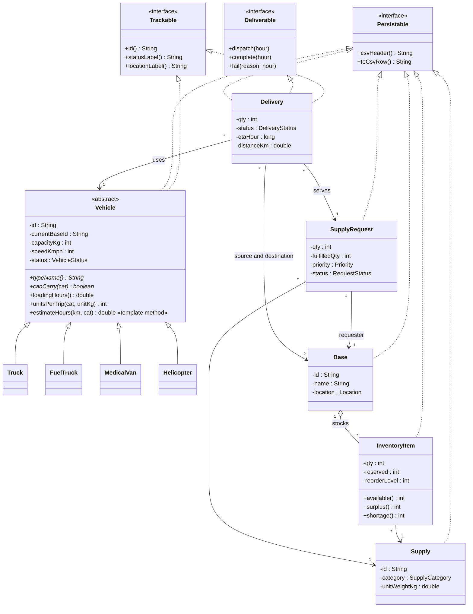
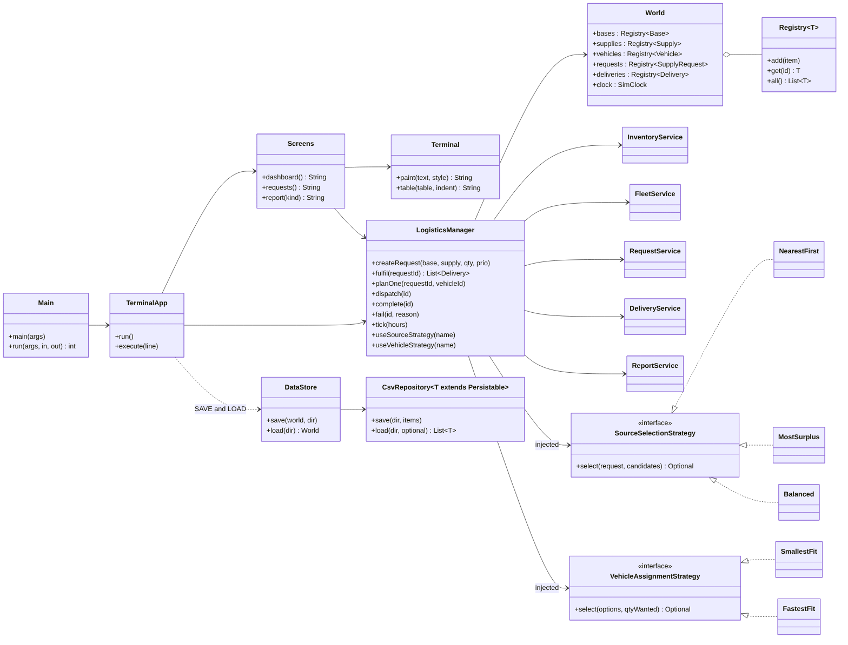
UML class diagrams
THE BLUEPRINT
Read it like this
Dashed arrows with hollow heads: a class wears an interface. Solid hollow heads: a subclass.
Look for
Vehicle in italics: abstract. Its four children override the behaviour.
Also drawn
An exception hierarchy and a sequence diagram of the Pune demo.
Domain model
Services, strategies and the facade
Source: docs/img/class_domain.png, class_services.png · generated from docs/diagrams/*.mmd · full set in the UML folder
Notes:
This is the blueprint. On the left is the domain model: the abstract Vehicle at the centre with its four subclasses, the entities Base, Supply, SupplyRequest and Delivery, and the three interfaces at the top. On the right are the services, the two families of strategies and the LogisticsManager that ties them together. Dashed arrows with hollow heads mean a class implements an interface; solid arrows with hollow heads mean inheritance. The exception hierarchy and the sequence diagram for the Pune scenario are in the UML folder.

Slide 7
Change the rule, not the code
SWAPPABLE RULES
Who gives the stock?
What carries it?
SourceSelectionStrategy: choose a donor base
VehicleAssignmentStrategy: choose a vehicle
NEAREST
Picks the donor with the shortest distance.
SMALLEST
Smallest vehicle that carries the whole load.
The closest shop
The snuggest fit
SURPLUS
Picks the donor with the most spare stock.
FASTEST
Vehicle with the fewest hours for the trip.
The fullest shelf
The quickest ride
BALANCED
Scores half on distance, half on spare stock.
RANDOM
A random pick, used only as a baseline to beat.
A bit of both
Our yardstick
Why it matters: each rule is a small class behind an interface. Adding a new rule means adding a class, and in the terminal you swap it live with STRAT SRC BALANCED.
Source: docs/design.md §5 · the same strategies drive both the terminal and the experiments
Notes:
This is polymorphism and abstraction put to work. Choosing a donor base is a rule, and we wrote three: nearest first, most surplus, and balanced, which scores half on distance and half on spare stock. Choosing a vehicle is a second rule: smallest fit, or fastest. There is also a random rule for each, used only as a baseline to beat. Each rule is a small class behind an interface, handed to the LogisticsManager when it is created, so changing the behaviour of the whole system means swapping one object. In the terminal you can do it live with the STRAT command, and the same rules drive the experiments you will see in a moment.

Slide 8
One command, start to finish
LIVE DEMO · ABOUT 5 MINUTES
> REQ NEW PUN MED-KIT 200 URGENT
Request R-0001 created (NEW)
> REQ APPROVE R-0001
Request R-0001 is now APPROVED
> REQ FULFIL R-0001
D-0001 MUM->PUN MED-KIT 200 HE-01 PLANNED
> DLV DISPATCH D-0001
Delivery D-0001 in transit, ETA DAY 00 01:00
> TICK 12
D-0001 DELIVERED · 1 delivery arrived
> RPT KPI
Fulfilment rate 100.0% · Avg lead time 1.0 h
1 · Request
2 · Plan and ship
3 · Time and report
Pune asks for 200 medical kits. A commander approves it.
The rules pick Mumbai and helicopter HE-01. Stock is reserved, then it leaves.
Time only moves on TICK. The KPI table shows the result.
Captured from java -jar dlscms.jar on the small dataset · run.bat starts it, run.bat --demo auto-plays it · docs/demo_script.md
Notes:
Live demo, about five minutes. Open a terminal in the project folder and run run.bat. The screen is the dashboard: shortages, open requests, deliveries and the fleet. Step one: type REQ NEW PUN MED-KIT 200 URGENT, then REQ APPROVE R-0001. Step two: REQ FULFIL R-0001. The donor rule and the vehicle rule choose, and you see delivery D-0001 from Mumbai to Pune on helicopter HE-01. DLV DISPATCH D-0001 sends it. Step three: TICK 12 moves the simulated clock twelve hours, the delivery arrives, and RPT KPI shows a fulfilment rate of 100 percent and a lead time of one hour. Finish by switching the rule with STRAT SRC BALANCED and raising another request to show a different donor can be chosen. If anything goes wrong, run.bat with the demo flag auto-plays the same scenario.

Slide 9
How we know it works
THE PROOF
tests
coverage map
119
66 of 66
unit tests, all passing, in 21 test classes
classes and types in the code have at least one test
experiments
statistics
1,080
74 of 93
simulation runs: 3 sizes × 30 random seeds × 12 rule pairs
paired comparisons still significant after Holm correction for multiple tests
Every experiment is reproducible: the same seed always gives the same result (scripts/check_repro.sh).
Source: results/test_matrix.csv, results/stats.txt, scripts/run_experiments.sh · 93 tests form one family; 81 are below 0.05 uncorrected
Notes:
Because our claim is that the system works and that one rule beats another, we put effort into checking it. There are 119 unit tests in 21 test classes, and a test matrix confirms that every one of the 66 classes and types has at least one test. For the findings we ran 1,080 simulations: three dataset sizes, 30 random seeds each, and 12 pairs of donor and vehicle rules, including random baselines. We compared the rules with paired Wilcoxon tests and corrected for running many tests at once with the Holm method: of 93 comparisons, 81 are significant before correction and 74 remain so after it. Finally, a script reruns the experiments and confirms the same seed gives the same result.

Slide 10
Coordination wins, and BALANCED is fastest
WHAT WE LEARNED
−6.3 h
BALANCED beats NEAREST on the large dataset (34.8 h down to 28.4 h)
84.5 h → 34.8 h
coordinated rules against a random baseline, large dataset
The trade-off
NEAREST drives the fewest kilometres. BALANCED costs 2.6% more distance but is faster once the network is medium-sized or larger.
Vehicle rule FASTEST · dataset sizes: 40, 200 and 1,000 requests. Bars are means over 30 seeds.
Source: results/summary.csv, results/stats.txt, docs/findings.md (F1, F2, F5) · synthetic data, so the model is tested, not real operations
Notes:
Now the payoff. The chart shows mean lead time, from request to full delivery, for each donor rule at three dataset sizes, with the fastest vehicle rule. The grey random baseline is slowest everywhere. On the large dataset BALANCED takes 28.4 hours against 34.8 for NEAREST, 6.3 hours faster, and that difference is significant after correction. On the small dataset the 1.4 hour gap is not significant, so we only claim BALANCED is best from medium size upward. Coordinated rules against the random baseline: 34.8 hours against 84.5 on the large dataset. The random baseline is deliberately weak, so that gap is an upper bound on practical benefit. There is a trade-off: NEAREST drives the fewest kilometres, BALANCED about 2.6 percent more.

Slide 11
A clean design that dispatches well, with honest limits
CONCLUSIONS
What we found
Limits
Next
One facade, swappable strategies and a vehicle hierarchy cover all eleven OOP concepts.
BALANCED is up to 6.3 h faster than NEAREST on larger networks.
Coordination cuts lead time by 47 to 59% against a random baseline.
All data is synthetic, with straight-line distances and constant speeds.
About 2% of requests stay open, mostly fuel requests: fuel trucks are few and slow.
The random baseline is weak by design.
Test a longer horizon and a bigger fuel fleet.
Try stronger baselines, such as a hand-written dispatcher rule.
Use a real road network and stock replenishment.
FAQs
Is this real defence data? No. Everything is generated, with only base names taken from real cities.
Why do some requests stay open? Donors keep a reorder floor, and fuel trucks are few. We did not test a longer horizon.
Defence Logistics and Supply Chain Management System · Pathak, Shah, Thakran · full report: Project_Report.pdf
Notes:
To conclude. The design uses a facade, swappable strategies and an abstract Vehicle hierarchy, which together cover all eleven object-oriented concepts in the brief. The experiments show BALANCED is up to 6.3 hours faster than NEAREST on medium and larger networks, and that coordination cuts the lead time by 47 to 59 percent against a random baseline. The limits: the data is synthetic, distances are straight lines, and the random baseline is weak by design. About two percent of requests remain open at the end of a run, mostly fuel requests, because the generator gives only about 15 percent of the fleet to fuel trucks and they are slow; we did not test a longer horizon or a bigger fuel fleet, so we cannot say how many would eventually be served. Next steps are a longer horizon, stronger baselines and a real road network. For questions: no, this is not real defence data, and the open requests are explained by the reorder floor and the small fuel fleet.

