Slide 1
DLSCMS
Defence Logistics and Supply Chain Management System
Object Oriented Programming mini project: a Java model that moves stock between bases, and a study of how well dispatch rules work
Vedant Pathak (R045) Dhairya Shah (R057) Kanishak Thakran (R046)
Faculty: Dr. Sakshi Ranjan | SVKM's NMIMS MPSTME, Mumbai
Notes:
Introduce the team and faculty. One sentence: we built a Java system that models moving supplies between defence bases, and we used it to test which dispatch rules work best. 15 minutes: about 8 on slides, 5 on live demo, 2 for questions.

Slide 2
The problem: right stock, right place, in time
The situation
What we built
What we asked
Bases hold stock of fuel, food, medical, ammunition and spares.
Requests arrive with a priority from ROUTINE to CRITICAL.
A donor base and a vehicle must be chosen every time.
A Java system with 16 terminal commands: bases, inventory, requests, fleet, deliveries, reports.
A simulated clock that moves hour by hour.
Save and load to CSV files.
Does the choice of donor base matter?
Does the choice of vehicle matter?
How does coordination compare with a random baseline, and does it scale?
DLSCMS | NMIMS MPSTME | 27/29 Oct 2026
Notes:
Context: bases hold stock (fuel, food, medical, ammunition, spares). Requests appear at different priorities. Someone has to decide which base donates, which vehicle carries it. Doing that by hand is slow and inconsistent. Our goals: model it with clean OOP, make the decision rules swappable, and measure them.

Slide 3
Architecture: nine packages, one facade
ui
Bloomberg-style terminal: 16 function codes
service
LogisticsManager (Facade), Inventory, Request, Fleet, Delivery, Report
strategy
Donor and vehicle selection rules, swappable at run time
model + exception
Base, Supply, Request, Delivery, Vehicle hierarchy; checked exceptions
persistence + util + sim
CSV repositories, Registry<T>, SimClock, experiment runner
DLSCMS | NMIMS MPSTME | 27/29 Oct 2026
Notes:
Walk top to bottom. The terminal UI only talks to LogisticsManager, the facade. Services hold the rules. Strategies are swappable. Model holds the data objects. Persistence reads and writes CSV. The sim package replays scenarios for the experiments. 66 types, about 5,700 lines of main code.

Slide 4
Where each OOP idea shows up
1
Encapsulation
Private state, validated changes, enums for status
2
Inheritance
Abstract Vehicle: Truck, FuelTruck, MedicalVan, Helicopter
3
Polymorphism
Each vehicle estimates its own travel time and what it can carry
4
Abstraction
Interfaces Trackable, Deliverable, Persistable
5
Generics
Registry<T> and CsvRepository<T extends Persistable>
6
Exceptions
Checked LogisticsException family, no silent failures
DLSCMS | NMIMS MPSTME | 27/29 Oct 2026
Notes:
Map concepts to concrete code. Encapsulation: private fields, validated setters. Inheritance and polymorphism: abstract Vehicle with Truck, FuelTruck, MedicalVan, Helicopter; estimateHours is a template method. Interfaces: Trackable, Deliverable, Persistable. Generics: Registry<T>, CsvRepository<T>. Exceptions: a LogisticsException hierarchy for domain refusals.

Slide 5
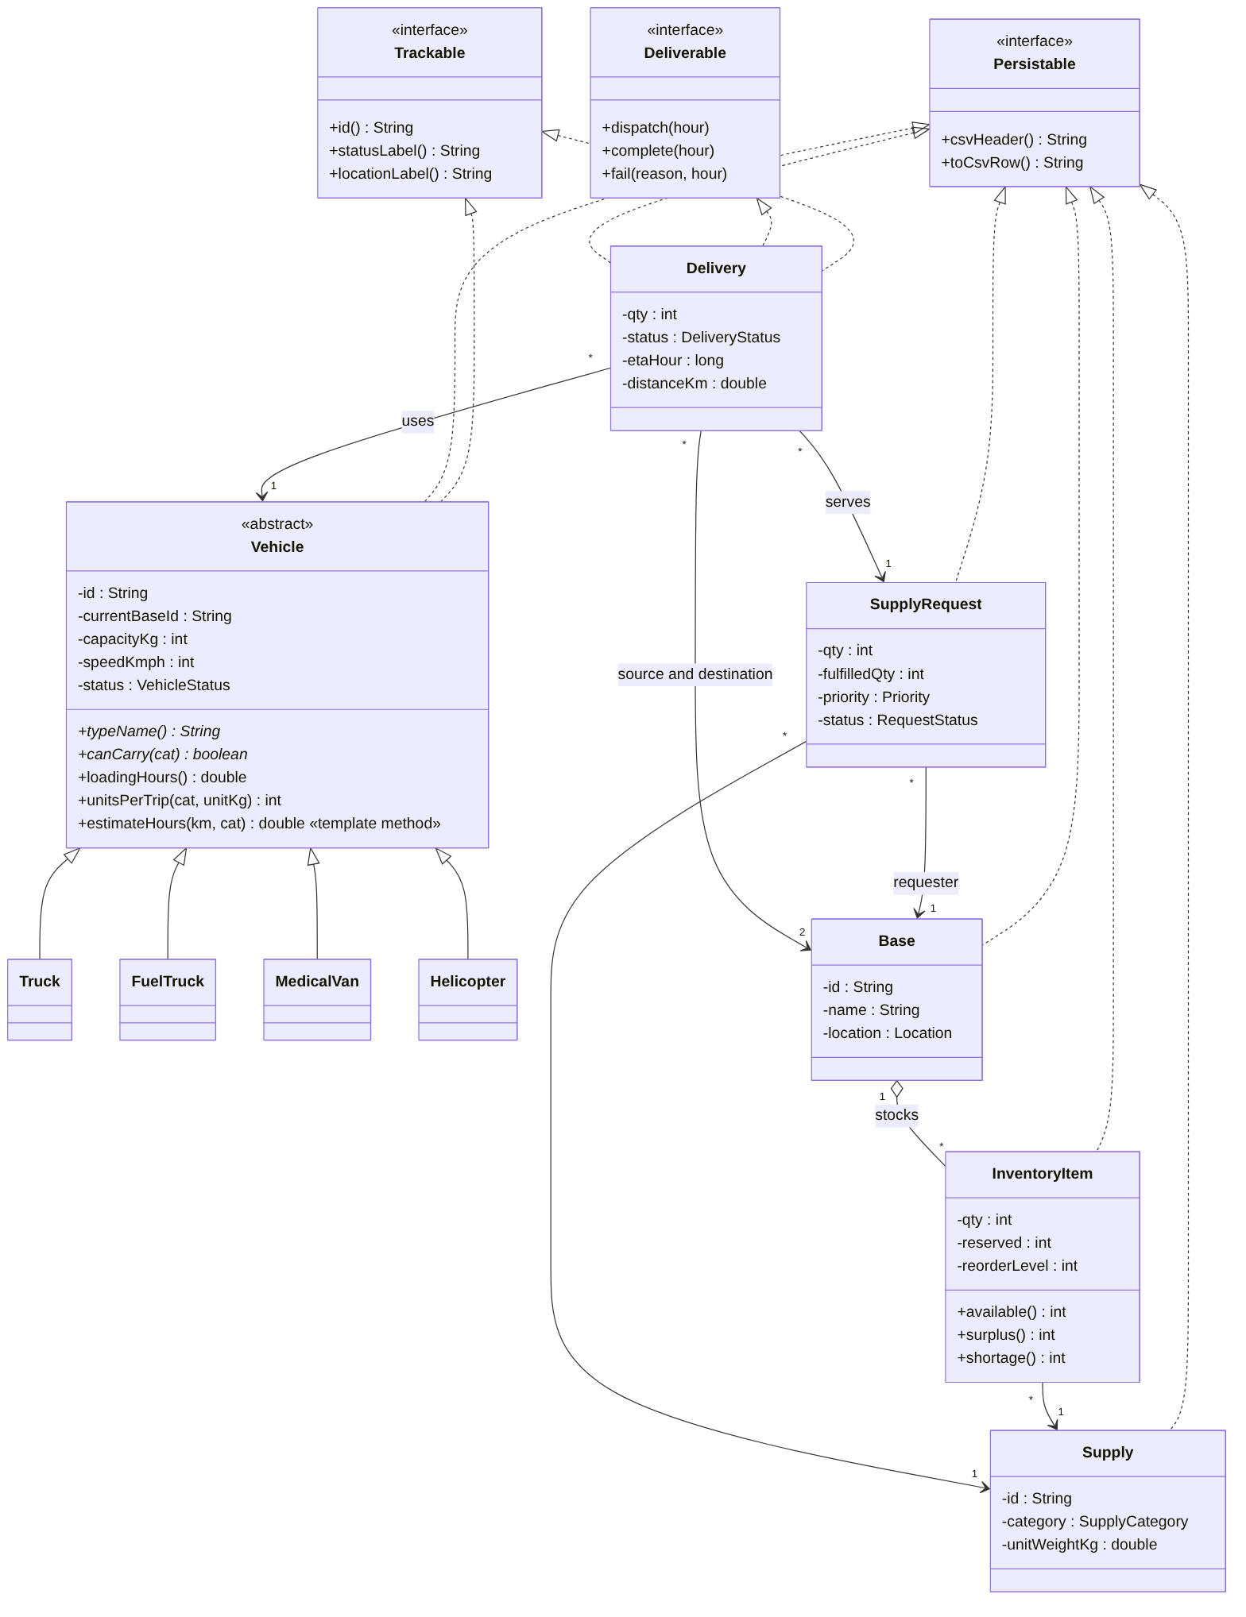
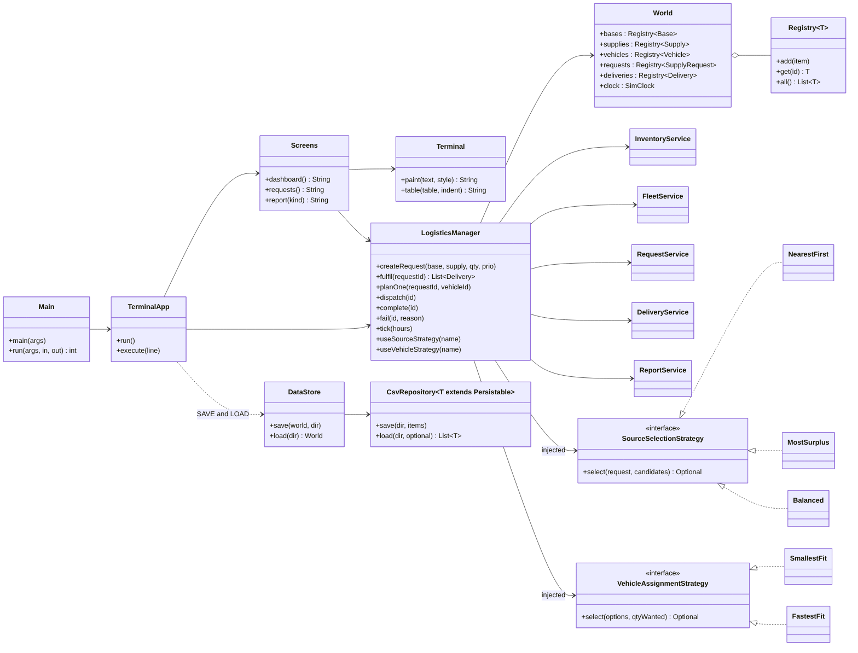
UML class diagrams
Services, strategies, facade. More diagrams on GitHub
Domain model
Notes:
Left: domain model, vehicle inheritance. Right: services, strategies and facade. The exception hierarchy and a sequence diagram of the demo are in the repository. Say: all diagrams are in the docs folder on GitHub, with the link on the last slide.

Slide 6
Design choices that make the rules swappable
Strategy
Facade
NEAREST, SURPLUS, BALANCED donors; SMALLEST, FASTEST vehicles; RANDOM as a baseline. Change with STRAT.
LogisticsManager is the single entry point for the UI, the scripts and the simulator.
Template Method
Domain safety rules
Vehicle.estimateHours is fixed; each subclass supplies speed and what it may carry.
Donors keep their reorder level. Stock is reserved on plan, removed on dispatch, added on delivery, returned on failure.
DLSCMS | NMIMS MPSTME | 27/29 Oct 2026
Notes:
Strategy is the core idea: donor selection (NEAREST, SURPLUS, BALANCED) and vehicle selection (SMALLEST, FASTEST) are objects you can swap at run time with the STRAT command. Facade keeps the UI simple. Template Method: Vehicle.estimateHours. Dependency injection makes everything testable. Key domain rule: donors only give stock above their reorder level.

Slide 7
Live demo
Scenario: Pune needs 200 medical kits, urgently
1
run.bat (opens the example network; --demo auto-plays it)
2
REQ NEW PUN MED-KIT 200 URGENT then REQ APPROVE
3
REQ FULFIL (donor and vehicle chosen by the strategies)
4
DLV DISPATCH then TICK 12 (time moves only on TICK)
5
RPT KPI then STRAT SRC BALANCED (swap the rule)
Notes:
DEMO, about 5 minutes. Have the terminal open and the jar already built. Backup: run.bat --demo auto-plays the same scenario. Say what you type before you type it. Point out the stock change at the donor and at Pune, the vehicle chosen, and the KPI report. If something fails, run SAVE and LOAD from the demo folder. Full script: docs/demo_script.md.

Slide 8
How we tested the dispatch rules
1,080
3 x 30
12
74 / 93
simulation runs
sizes x datasets
strategy pairs
tests significant after correction
Metrics: fulfilment rate, lead time (request to full delivery), critical requests within 24 h, distance, vehicle use.
Honest limits: synthetic data, straight-line distances, constant speeds, no breakdowns.
DLSCMS | NMIMS MPSTME | 27/29 Oct 2026
Notes:
1,080 simulation runs: 3 dataset sizes, 30 random datasets each, 4 donor rules, 3 vehicle rules. Each run replays a stream of requests hour by hour. We report averages with 95% confidence intervals and paired Wilcoxon tests with Holm correction. All data is synthetic, so results describe the model, not real operations.

Slide 9
Result 1: BALANCED is fastest from medium size upward
6.3 h
faster than NEAREST on large (p < 0.001 after correction)
NEAREST drives the fewest kilometres; SURPLUS about 42% more on large.
DLSCMS | NMIMS MPSTME | 27/29 Oct 2026
Notes:
Mean lead time in hours, fastest-vehicle rule. On large: BALANCED 28.4 h, NEAREST 34.8 h, SURPLUS 40.0 h, RANDOM 55.7 h. BALANCED beats NEAREST by 6.3 h on large (adjusted p about 1e-6). On small the gap is not significant. NEAREST uses the least distance; SURPLUS costs about 42% more distance than NEAREST on large.

Slide 10
Result 2: coordination beats the random baseline
24 h vs 46 h
35 h vs 85 h
lead time, small
lead time, large
84% vs 32%
-42%
critical requests within 24 h, large
distance travelled, large
Coordinated = NEAREST donor + FASTEST vehicle. Baseline = random donor + random vehicle. The baseline is deliberately weak.
Notes:
NEAREST with FASTEST versus fully random choices. Lead time roughly halves or better. CRITICAL requests delivered within 24 hours go from about a quarter or a third to about 75-85 percent. Distance is 35-42 percent lower. Caution: the baseline is deliberately weak, so this is an upper bound on practical benefit. Fulfilment rate on small does not differ.

Slide 11
Quality: tests, reproducibility and honest limits
119 tests
Reproducible
Known gaps
21 test classes cover all 66 types. Run with one command (com.dlscms.RunAll).
Fixed seeds; a script re-runs the grid and compares every number with the saved results.
1-3% of requests stay open: donors keep a reserve and fuel trucks are scarce. We explain it, we did not remove it.
DLSCMS | NMIMS MPSTME | 27/29 Oct 2026
Notes:
119 automated JUnit tests across 21 classes, every one of the 66 types is exercised. Experiments are deterministic: same seed, same result, checked by a script. Honest limits: about 2 percent of requests stay open in every run. We diagnosed it: mostly stock-limited because donors keep a reorder floor, and a backlog of slow fuel trucks on larger sizes. We did not test a longer horizon or more fuel trucks. This is listed in the report under Known inconsistencies.

Slide 12
Summary and links
Clean OOP design: facade, strategies, vehicle hierarchy, generics
Swappable dispatch rules, measured over 1,080 runs
BALANCED donor selection is fastest at scale; coordination clearly beats random
Next: longer horizons, bigger fuel fleet, real-world data
Source code and UML on GitHub
https://github.com/withvedantpathak/defence_logistics_and_supply_chain_management_system_using_objectorientedprogramming
Thank you. Questions?
Notes:
Close in 30 seconds. Repeat the one-line takeaway, point to the GitHub link, invite questions. Likely questions: why BALANCED wins (it avoids draining one donor), why 2% stay open (reorder floor and fuel trucks), how to load your own data (docs/bring_your_own_data.md).

