Slide 1

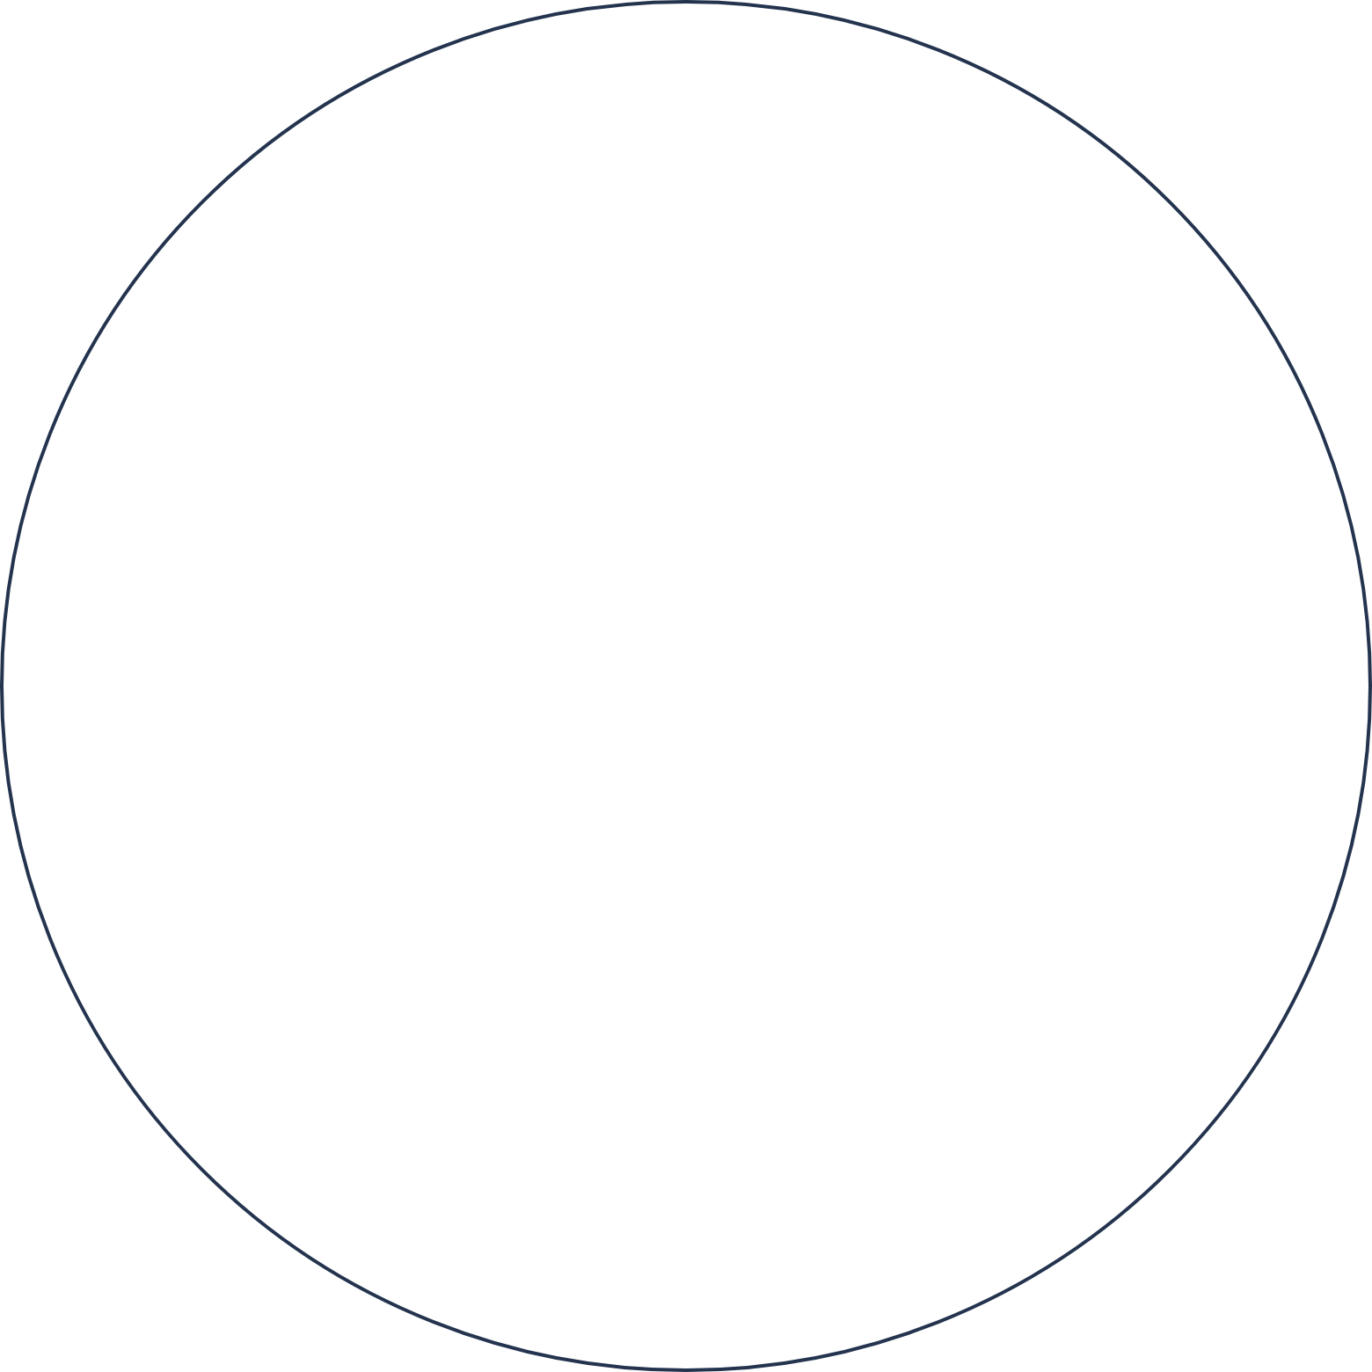
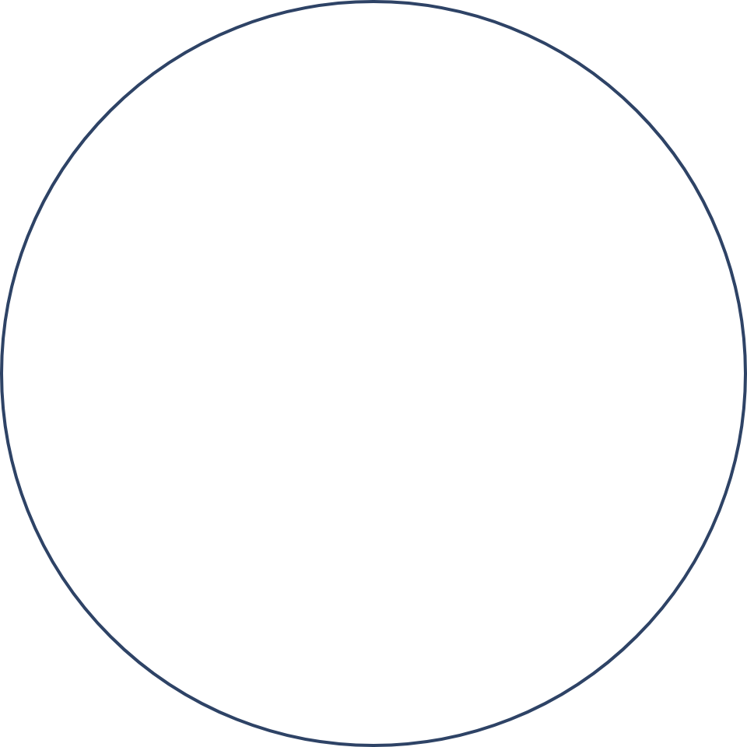

Space Debris Tracking and Avoidance
DATA STRUCTURES AND ALGORITHMS · COURSE PROJECT
using Data Structures and Algorithms
Vedant Pathak (R045) · Dhairya Shah (R057) · Kanishak Thakran (R046)
Faculty: Prateeksha Shanoj · SVKM’s NMIMS MPSTME, Mumbai
Notes:
Welcome. In this project we built a complete system that screens satellites and debris in low Earth orbit for close approaches, called conjunctions, using data structures we wrote ourselves in C. The talk follows the report: the problem, the idea that makes fast screening exact, the results, the verification, then a short live demo.

Slide 2
Earth’s orbit is crowded with junk
THE PROBLEM
Working satellites share space with debris: dead satellites and fragments of broken rockets, all moving at about 7 to 8 kilometres every second.
18,191
objects in our real catalogue to screen
One collision can destroy a satellite and create even more debris. So operators must predict, ahead of time, which pairs will pass dangerously close. This check is called conjunction screening.
59.6 billion
comparisons to check every pair, for just one hour of orbit
Our question:
Can we find every close pair without comparing every pair?
Real catalogue: CelesTrak, 20 October 2026 · low Earth orbit objects
2 / 11
Notes:
Start with the picture: Earth’s orbit is crowded. Besides working satellites there is debris, which means dead satellites and pieces of broken rockets, all moving at about 7 to 8 kilometres every second. One collision can destroy a satellite and create even more debris, so operators check ahead of time which pairs will pass dangerously close. That check is called conjunction screening. Why is it hard? The obvious way is to compare every object with every other object. In our real catalogue there are 18,191 objects in low Earth orbit, and doing that for just one hour of orbit takes 59.6 billion comparisons, and the work grows with the square of the number of objects. So our question is: can we find every close pair without comparing every pair, and be sure we missed nothing? (Technical detail if asked: 10 second time steps, brute force, CelesTrak snapshot of 20 October 2026, 19,440 objects before filtering to low Earth orbit.)

Slide 3
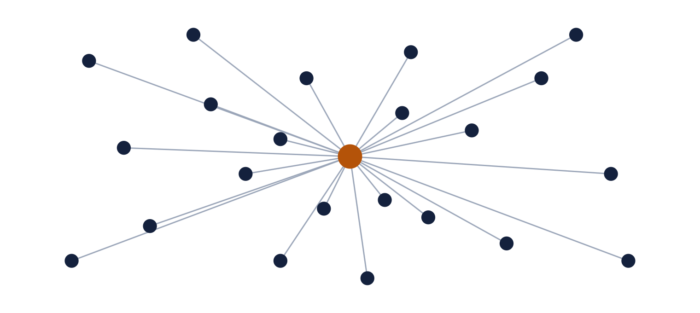
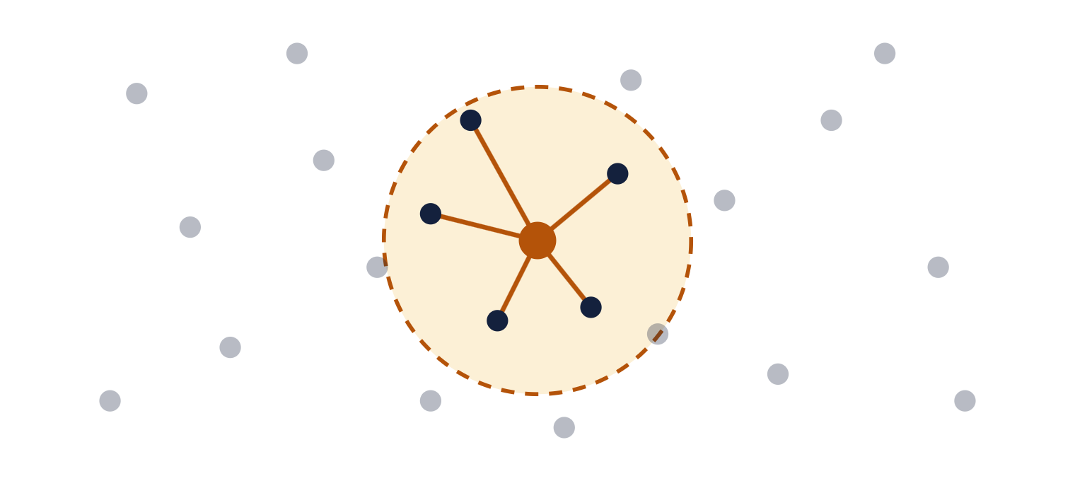
Check only the neighbours, not everyone
THE SOLUTION
The obvious way
Our way
Compare every object relative to all the others.
Compare only the objects close by. Far-away ones cannot collide soon.
A fast filing system for positions tells us who is nearby almost instantly. We built two: a grid (objects sorted into map squares) and a k-d tree (space split in half, again and again).
Diagram for schematic representations only
3 / 11
Notes:
Think of a crowded stadium. To find people who might bump into each other, you would not compare every person with every other person. You would ask each person who is standing near them. Left: the obvious way draws a line from one object to every other object. Right: our way draws a circle and only compares objects inside it, because objects far away cannot meet soon. To find the neighbours quickly we use a filing system for positions, and in the project we built two of them. The grid sorts objects into map squares, so you only look in the squares around an object. The k-d tree keeps splitting space in half until each piece holds only a few objects, so you can jump straight to the neighbours. The next question is the important one: how can we be sure that skipping the faraway objects never hides a real close approach? That is the next slide.

Slide 4
How we know we never miss one
THE PROOF
1 · The rule
2 · The test
Objects can only close the gap between them so fast. If a pair starts farther apart with no possibility of ever meeting, they cannot meet. So skipping them is safe.
We ran our fast methods and the slow "check-everything" method on the same data. The list of close-pairs was exactly the same every time:
88 of 88 runs on synthetic data (modeled over real data).
a 20,000-object synthetic catalogue
the real catalogue of 18,191 objects
Like two cars 100 km apart that can only drive so fast: they cannot meet in the next minute.
Faster, and not one close pair lost.
Source: report Section 7.1, results/c7_scaling.csv · “synthetic” = generated locally with a known answer
4 / 11
Notes:
Skipping pairs only works if we can be sure we never skip one that matters. We have two kinds of assurance. First, a rule we can prove: objects can only close the gap between them so fast, at the sum of their top speeds. If a pair is farther apart than the gap could shrink before the next time step, they cannot meet, so skipping them is safe. Think of two cars 100 kilometres apart: if neither can drive fast enough, they cannot meet in the next minute. Second, a test: we ran the fast methods and the slow check-everything method, brute force, on the same data, and the list of close pairs was exactly the same, byte for byte. That held in 88 of 88 synthetic runs, a 20,000-object synthetic catalogue and the real catalogue of 18,191 objects. If asked about the maths: the bound is distance now greater than threshold plus L times the step h, where L is the sum of the two objects’ maximum speeds; the schematic is in the report, Section 5.2.

Slide 5
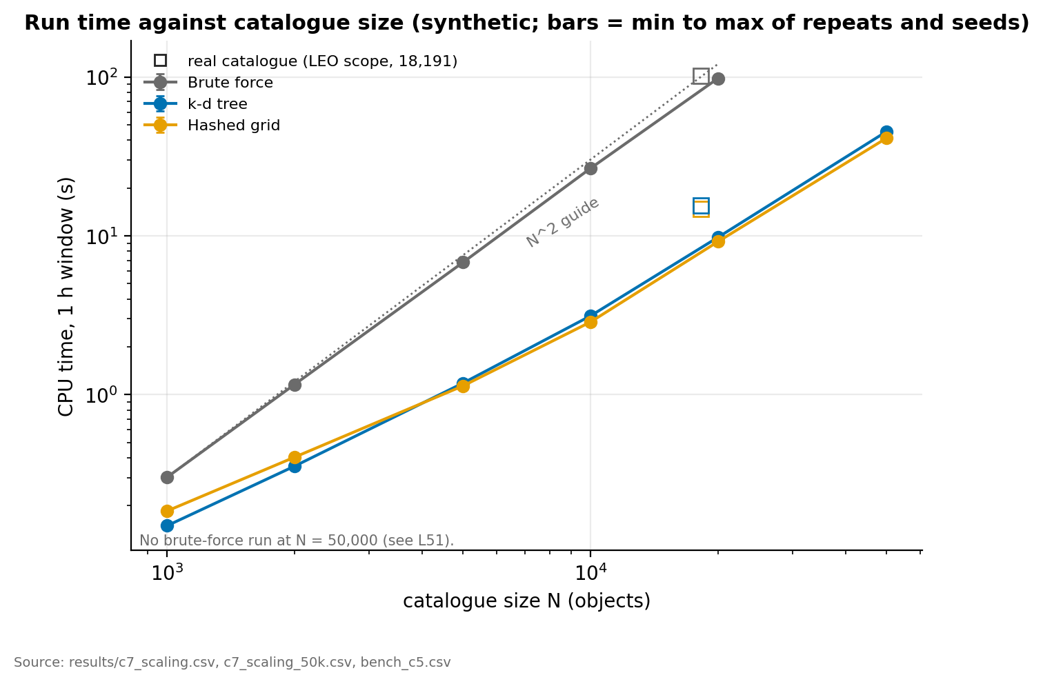
Same answer, up to 10× faster
BETTER THAN THE OBVIOUS WAY
10× faster
at 20,000 objects
with 15,000x fewer checks
98 seconds down to under 10
7× faster
on the real catalogue: 102 seconds down to about 15
What earlier work left open
Our base paper (Gómez et al., 2022) did not compare different filing systems, or measure how the cost grows as objects are added. We did both.
Lower is faster. Grey: "check-everyone". Blue and gold: our two methods.
Source: report Table 4 · one hour of orbit, 10 km screening distance, CPU seconds
5 / 11
Notes:
Now the payoff, and how it compares with what already exists. The obvious way, checking every pair, is the grey line, and it climbs very steeply as objects are added. Our two methods, the k-d tree in blue and the grid in gold, climb far more slowly. At 20,000 synthetic objects, checking everyone takes 98.2 seconds and our methods take 9.8 and 9.2 seconds, about 10 times faster. On the real catalogue of 18,191 objects it is about 7 times faster, 102 seconds down to about 15. The speed-up in time is smaller than the drop in comparisons, which is about 15,000 times fewer, because after filtering, computing the positions and refining each close pair take most of the time. Remember from the last slide that the answer is exactly the same. What earlier work left open: our base paper, Gómez and colleagues from 2022, tracked conjunctions in a long simulation but did not compare different spatial data structures and did not measure how cost grows with the number of objects. We did both. Details if asked: single-thread CPU seconds on one virtual machine, so ratios matter more than absolute times; exact figures are 10.0 and 10.7 times at 20,000 objects and 6.6 and 6.9 times on the real catalogue; at 50,000 objects we ran only the two fast methods, 45.4 and 41.3 seconds with the same 56,780 events, so we state no speed-up at that size.

Slide 6
Ten tools, all built by hand
THE DATA STRUCTURES
Dynamic array
Linked list
Hash table
Stack
Queue
A list that grows as needed
A chain, each link pointing to the next
A phone book: jump straight to an ID
A pile of plates: last in, first out
A waiting line: first in, first out
Holds the close calls and the network
Holds items sharing a lookup-table slot
Finds any object by its ID
Explores clumps; undoes steps in the search
Explores clumps level by level
Binary heap
AVL tree
k-d tree
Hashed grid
Union-find
A leaderboard: the top is always ready
A sorted index that keeps itself balanced
Cut space in halves again and again
City blocks: check only your own and next-door
A club register: who belongs to which group
Closest calls; the quick avoidance plan
Timeline of close calls in time order
Finds nearby objects fast
Finds nearby objects fast
Double-checks the clumps
For choosing which objects to move: a quick method (greedy) and a best-possible search (branch and bound).
Written from scratch in C. Nothing comes from a library.
6 / 11
Notes:
These are the ten data structures behind the six steps, all written from scratch. Dynamic array: a list that grows as needed, for the close calls and the network. Linked list: a chain of items, used for items that share a slot in the lookup table. Hash table: like a phone book, it finds any object by its ID instantly. Stack and queue: last-in-first-out and first-in-first-out, used to explore clumps in depth-first and breadth-first order, and to undo steps in the exact search. Binary heap: keeps the top item ready, used for the closest calls and the quick avoidance plan. AVL tree: a self-balancing sorted index, used for the timeline of close calls. k-d tree and hashed grid: two ways of finding nearby objects fast, and the two we compare. Union-find: tracks which group each object belongs to, used to double-check the clumps. For choosing which objects to move we wrote two algorithms: greedy, which is quick, and branch and bound, which finds the best possible plan. The costs are the standard textbook ones; the experiments measure what they add up to.

Slide 7
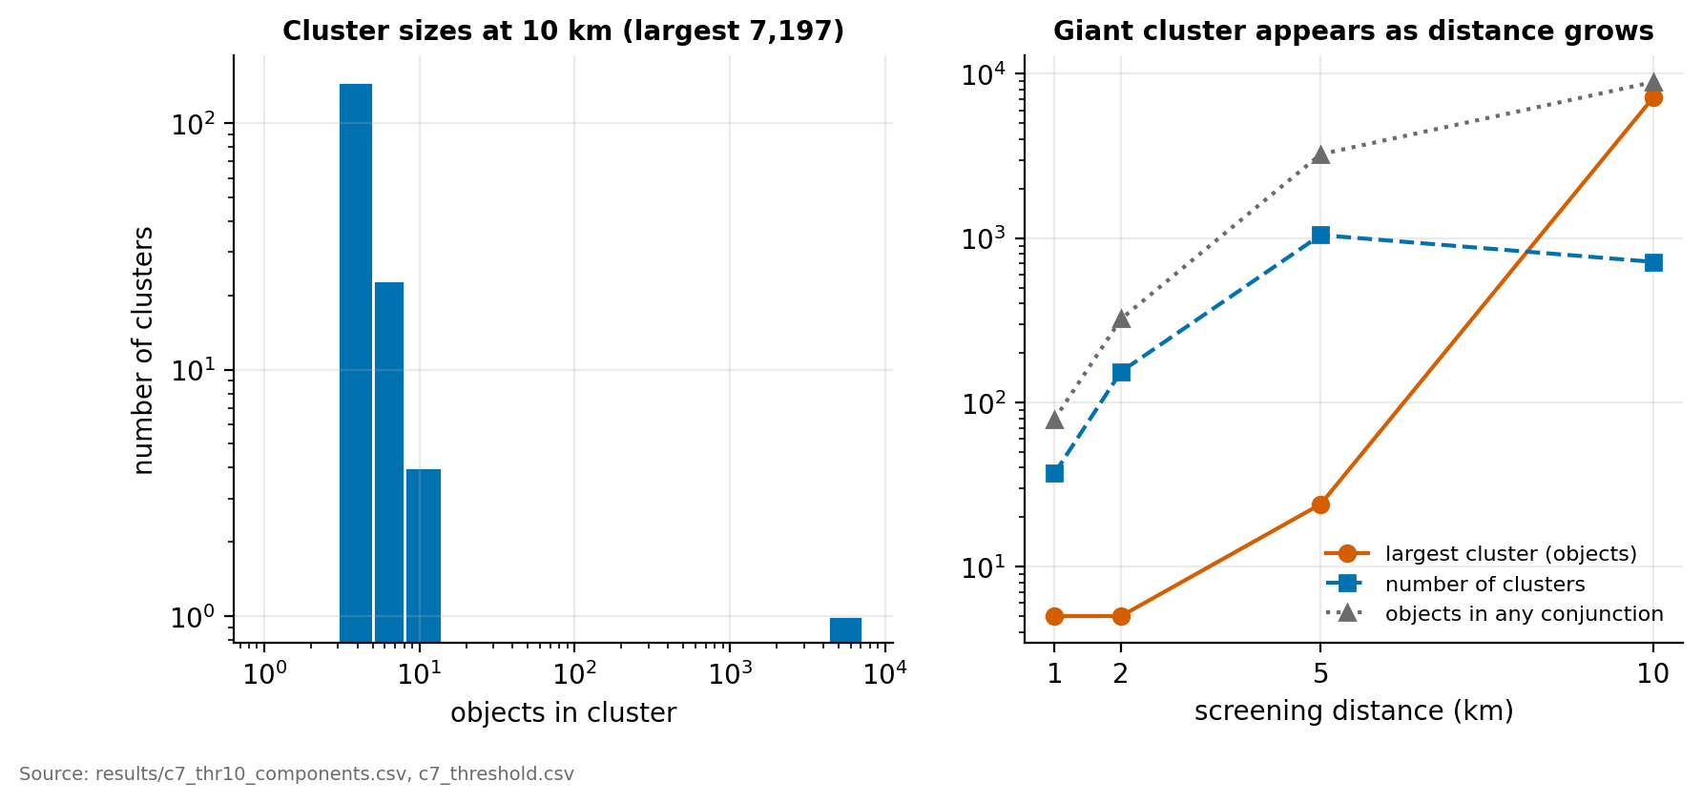
Close calls come in clumps
WHAT WE LEARNED
24 objects
in the biggest clump, flagging pairs in 5 km distance
7,197 objects
tangled in one giant clump, flagging pairs in 10 km distance
Right: the orange line, the biggest clump, shoots up as the flagged distance grows.
At 5 km the clumps stay small enough to plan around.
Source: results/c7_threshold.csv · real catalogue, one hour of orbit
7 / 11
Notes:
Once we have the list of close calls, a pattern shows up: they come in clumps. If object A is close to B, and B is close to C, they belong to the same clump. In the technical report this is called a cluster, found with a graph of objects and close calls. How big the clumps get depends on how close two objects must be before we flag them. Flagging pairs closer than 5 kilometres, the biggest clump has 24 objects. Flagging pairs closer than 10 kilometres, one giant clump swallows 7,197 objects. The practical lesson: a 5 kilometre distance keeps the clumps small enough to plan around exactly, while at 10 kilometres the picture is one big tangle. Details if asked: events at 1, 2, 5 and 10 km were 48, 174, 2,254 and 12,504; at 10 km there were 717 clumps, 542 of them single pairs; the closest crossing encounter was 0.383 km at 13.1 km/s. Real catalogue, one hour of orbit.

Slide 8
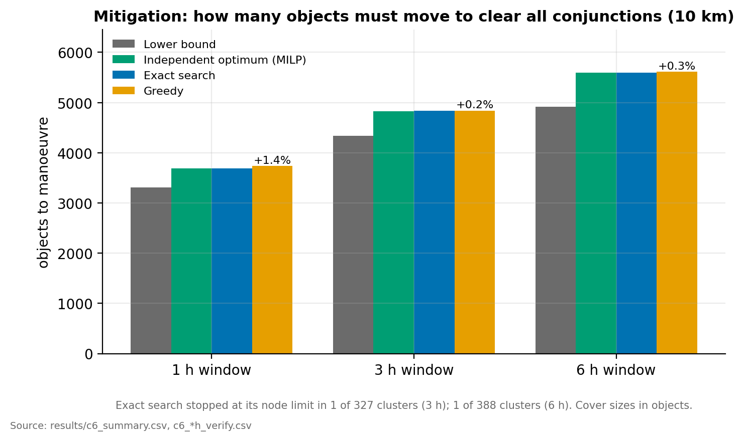
Choosing which objects to move
WHAT WE LEARNED
+1.4%
more objects to move than the best possible plan: 3,737 against 3,687
Confirmed
by an independent integer-programming solver, the best-possible numbers are right.
Our own best-possible search could have a bug, so we re-solved the same problem with separate, off-the-shelf software and got the same answers (checked at 1 and 6 hours).
Gold bar: our quick method. Blue bar: the best possible plan.
The perfect plan is only practical for small groups, but the quick method stays close to it regardless of group size.
Source: results/c6_summary.csv · real catalogue
8 / 11
Notes:
Finding the close calls is only half the job. Operators then have to decide which objects to move. To clear every close call, at least one object in every close pair has to move, and we want to move as few as possible. In the report this is a minimum vertex cover. We compared two approaches. The quick method, called greedy, repeatedly moves the object involved in the most close calls. The perfect method searches for the smallest possible set. For one hour of orbit, flagging pairs closer than 10 kilometres, the quick method moves 3,737 objects and the best possible plan moves 3,687, so the quick method needs only 1.4 percent more. For six hours it is 5,614 against 5,595, only 0.3 percent more. An independent integer-programming solver confirmed our best-possible numbers at one and six hours. The perfect search is only practical for small groups, because it can take very long on big ones. At three hours, and in one clump at six hours, it stopped at its time limit, so those figures are best found rather than proven.

Slide 9
Observed statistics
mutation check
line coverage check
36 of 39
100%
bugs we planted on purpose were caught by our tests
of our code lines run during the tests
fault injection check
SGP4 validation check
6,550
0.86 mm
times we ran the computer out of memory on purpose: the program either reported an error or gave the right answer, never crashing.
largest difference between our orbit calculation and a trusted reference (Python SGP4 library)
These tests pass on Linux and on Windows.
Source: docs/verification.md, results/c8_coverage.csv, c8_mutation.csv, sgp4_validation.csv
9 / 11
Notes:
Because our claim is that nothing is missed, we put effort into checking our own work. We deliberately planted 39 small bugs, one at a time, and our tests caught 36; the other three turned out not to change the behaviour. 99.9 percent of the code lines run during the tests. We made the computer run out of memory on purpose 6,550 times, and the program either reported an error or gave the right answer, never crashing. Our own hand-written orbit calculation differs from a trusted reference implementation, the Python SGP4 library, by at most 0.86 millimetres across 18,635 objects. In the report these are the mutation check, line coverage, fault injection and SGP4 validation. The unit and property tests pass on Linux, with extra memory-checking tools, and on Windows.

Slide 10
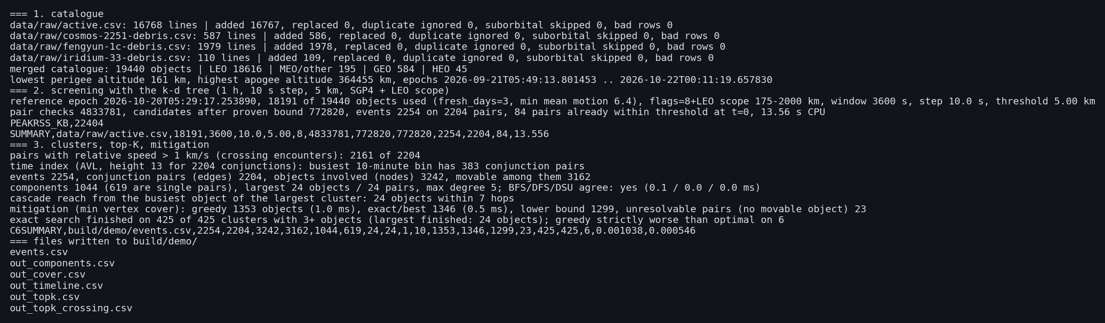
One command, start to finish
LIVE DEMO · ABOUT 30 SECONDS
1 · Loading
2 · Screening
3 · Planning
The four CelesTrak files, 19,440 objects with no bad rows, 18,616 of them in low Earth orbit.
Simulating the next hour of orbit at a 10 second step and a 5km threshold using SGP4; 18,191 objects are used, and it finds 2,254 events on 2,204 pairs.
1,044 clusters, the largest with 24 objects, greedy 1,353 objects against exact 1,346, and the exact search finished on all 425 clusters of three or more objects.
1 h window, 10 s step, 5 km threshold, SGP4, LEO scope · outputs in build\demo · Linux output so CPU time may vary
10 / 11
Notes:
Live demo. In Command Prompt, in the project folder, run scripts backslash demo.bat. It builds the program, then runs three steps. One: load the four CelesTrak files, 19,440 objects with no bad rows, 18,616 of them in low Earth orbit. Two: screen with the k-d tree for one hour at a 10 second step and a 5 kilometre threshold using SGP4; 18,191 objects are used, and it finds 2,254 events on 2,204 pairs. Three: build the graph and plan mitigation: 1,044 clusters, the largest with 24 objects, greedy 1,353 objects against exact 1,346, and the exact search finished on all 425 clusters of three or more objects. Results are written as CSV files to build backslash demo. The screenshot on the slide is a Linux run, so its CPU time differs slightly from a Windows run. Have the demo already built before presenting in case of delays.

Slide 11
CONCLUSIONS
Faster, and nothing missed
What we found
Limits
Next
Our fast methods (k-d tree and a hashed grid) find exactly the same close calls as checking every pair (brute force), with about 15,000× fewer checks.
Up to 10× faster; about 7× on the real catalogue.
A quick avoidance plan is within 1.4% of the best possible.
Objects are treated as points, with one fixed warning distance. No collision probability yet.
Low Earth orbit only. It tests the method, not real-world accuracy.
Checking every pair was not run at 50,000 objects but we guarantee our claims at that level too.
Cover higher orbits too.
Reuse orbit calculations to save time.
Add uncertainty and collision probability.
Is our algorithm correct and fast? - Yes, and we proved and measured it. That is the project’s contribution.
Are the close calls it reports true in the real sky? - That depends on how good the input data is. Better input data would improve it without changing our algorithm at all.
FAQs
Space Debris Tracking and Avoidance using Data Structures and Algorithms · Pathak, Shah, Thakran · full report: paper/Report.docx
11 / 11
Notes:
To conclude. With a proven distance bound, a k-d tree and a hashed grid return exactly the events of brute force while examining about 15,000 times fewer pairs. Measured time falls 10 times at 20,000 synthetic objects and 6.6 to 6.9 times on the real catalogue, because propagation and refinement then dominate. The two indexes are equally good here, and an altitude filter does not help in low Earth orbit. A greedy avoidance plan is within 1.4 percent of the optimum. Limits: objects are points with one fixed screening distance, there is no covariance or collision probability, the scope is low Earth orbit, events are SGP4 against SGP4, and brute force was not run at 50,000 objects. Future work: SDP4 and wider scope, caching SGP4 states, and adding uncertainty and collision probability. Thank you; questions?

