Slide 1


FUJITSU THAILAND (FTH) • EXECUTIVE KEYNOTE
Empowering Enterprise ERP with Microsoft Copilot AI
🎯 CORE STRATEGIC PILLARS
⚡ AUTONOMOUS FINANCE
System of Intelligence • >70% AP Cycle Reduction
🏛️ 100% THAI COMPLIANT
VAT 7% • WHT 1-5% • 50 Tawi • e-Tax Ready
🏆 STRATEGIC FTH IP ASSET
Proprietary Repeatable Solution • Japanese MNC Trust
OPTION 1: COPILOT FLUENT KEYNOTE • SLIDE 1 OF 4
Notes:
【Slide 1: Executive Welcome & Strategic Purpose】
Tone: Formal, Confident, Inspiring | Target Duration: ~40 seconds
"Good morning, members of the executive leadership team, esteemed colleagues, and distinguished guests.
On behalf of Fujitsu Thailand, it is my distinct privilege to welcome you to today’s executive keynote: 'Empowering Enterprise ERP with Microsoft Copilot AI.'
As organizations navigate accelerating digital transformation and tightening tax regulations in Thailand, traditional ERP systems must evolve beyond passive data entry. Today, we present Fujitsu’s strategic vision for Dynamics 365 Finance & Operations—natively enhanced by Microsoft Copilot Studio and Azure AI.
Our objective today is clear: to demonstrate how autonomous AI streamlines Accounts Payable and Thai tax compliance, while creating proprietary, high-margin Intellectual Property that solidifies Fujitsu Thailand as the premier digital transformation partner in the region.
Thank you for your time, and we look forward to an insightful session."

Slide 2
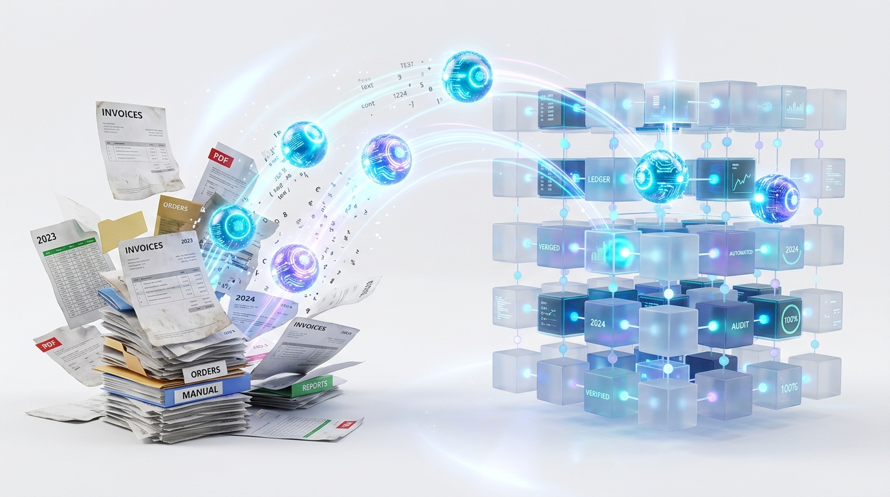
MARKET DRIVERS & LOCAL COMPLEXITY
The Shift: From System of Record to System of Intelligence
📊 OPERATIONAL REALITIES & DRIVERS
⚠️ 70% MANUAL OVERLOAD
Repetitive invoice verification • High month-end burnout
🏛️ MANDATORY e-TAX COMPLIANCE
Revenue Dept XML schemas • Zero tolerance for typos
🚀 PROACTIVE INTELLIGENCE
Pre-posting validation • Continuous automated subledger audit
OPTION 1: COPILOT FLUENT KEYNOTE • SLIDE 2 OF 4
Notes:
【Slide 2: Industry Shift & Local Regulatory Challenges】
Tone: Strategic, Analytical, Problem-Solving | Target Duration: ~45 seconds
"Turning to Slide 2, let us examine the operational realities and regulatory drivers shaping corporate finance today.
Historically, ERP systems functioned as Systems of Record—reliable at logging historical transactions, but fundamentally passive. In practice, finance and Accounts Payable teams across Thailand continue to bear an immense manual burden: spending over 70% of their time scrutinizing hundreds of PDF tax invoices, matching purchase orders, and validating 13-digit Tax IDs line by line.
Compounding this challenge is Thailand’s rapidly tightening compliance environment. The Revenue Department’s ongoing transition toward mandatory e-Tax Invoices, coupled with intricate Withholding Tax classifications, means that even minor clerical typos risk delayed filings and statutory penalties.
This friction represents a transformative opportunity. By elevating Dynamics 365 into a System of Intelligence, we deploy proactive AI agents that pre-validate data, match transactions, and flag discrepancies before posting—converting finance from a transactional cost center into a strategic growth driver."

Slide 3

PRODUCT EXCELLENCE & STRATEGIC VALUE
Strengthening Dynamics 365 & Maximizing Fujitsu Value
💎 DUAL-ENGINE VALUE PROPOSITION
🔒 ZERO DATA LEAKAGE
Copilot Studio + Dataverse • 100% Secure Enterprise Tenant
🛡️ HUMAN-IN-THE-LOOP
AI drafts & pre-validates • Accountants retain full sign-off
🚀 HIGH-MARGIN REUSABLE IP
First-mover localization moat • Repeatable commercial asset
OPTION 1: COPILOT FLUENT KEYNOTE • SLIDE 3 OF 4
Notes:
【Slide 3: Product Excellence & Fujitsu Strategic Value】
Tone: Visionary, High-Impact, Balanced | Target Duration: ~50 seconds
"On Slide 3, we illustrate how this initiative generates balanced value across both the Dynamics 365 product platform and Fujitsu Thailand’s commercial business.
From a product perspective, we natively embed Microsoft Copilot Studio and Azure AI into Dynamics 365 via Dataverse, guaranteeing zero external data leakage. Copilot functions as an autonomous drafting co-pilot: reading invoices, checking 3-way matching, and pre-populating draft journals—slashing cycle times by over 70%. Crucially, we enforce strict Human-in-the-Loop governance: no transaction is committed to the ledger without explicit approval from an authorized accountant.
From Fujitsu Thailand’s strategic perspective, this establishes a decisive first-mover advantage. By productizing our localization expertise into reusable, AI-infused Thai Localization IP, we accelerate implementation velocity while capturing higher consulting margins. This offering addresses the acute compliance needs of Japanese multinationals and major domestic enterprises, reinforcing Fujitsu’s legacy of Japanese engineering quality, robust governance, and trusted delivery."

Slide 4
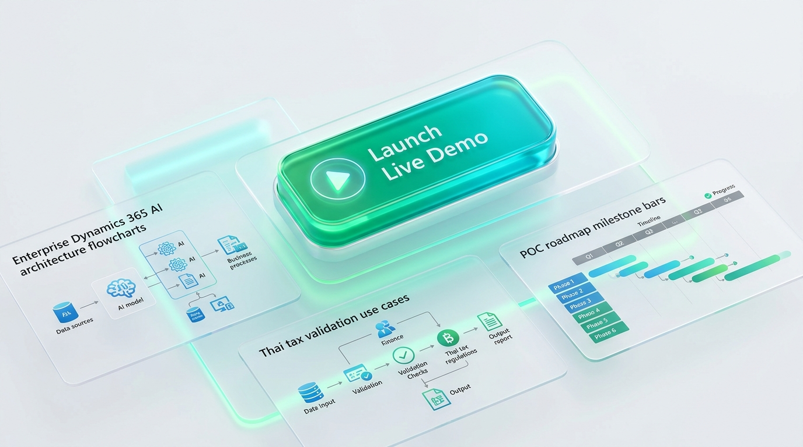
SOLUTION ROADMAP & LIVE DEMONSTRATION
Executive Agenda & Transition to Live Solution Pitch
🚀 READY FOR LIVE DEMONSTRATION
• 1. Official Architecture
Copilot Studio + Dataverse Multi-Agent framework
• 2. Top 5 Thai Use Cases
AP Invoice, Tax Copilot, e-Tax Gateway & Recon
• 3. 8-Week POC Delivery
Fast ROI • Low-risk implementation roadmap
• 4. Interactive Experience
Scenario simulations & dual-host executive speech
🌐 Direct Platform Link: https://wititgithub.github.io/fth-d365-fo-copilot-deck/
OPTION 1: COPILOT FLUENT KEYNOTE • SLIDE 4 OF 4
Notes:
【Slide 4: Executive Agenda & Transition to Live Solution Pitch】
Tone: Engaging, Action-Oriented, Inviting | Target Duration: ~30 seconds
"Finally, on Slide 4, let us outline today’s interactive agenda.
Following this opening briefing, we will transition directly into our production-grade Live Interactive Pitch Platform, which walks through four core pillars across twelve executive slides:
1. First, the official Microsoft Copilot Studio reference architecture, detailing enterprise security, Dataverse integration, and multi-agent coordination;
2. Second, an in-depth walkthrough of our top five Thai localization use cases—spanning AP Invoice Intelligence, Thai Tax Copilot, e-Tax Gateway pre-validation, Continuous Reconciliation, and Policy Q&A;
3. Third, a pragmatic 8-week Proof of Concept delivery roadmap, engineered to deliver measurable ROI and verified business value within two months; and
4. Fourth, an interactive presentation experience equipped with dual-host narration and real-time scenario simulation.
Without further delay, I invite our executive team to transition with me into the live interactive platform to witness the future of Dynamics 365 and Copilot AI in action.
Please join me as we launch the live demonstration."

