Slide 1


FUJITSU THAILAND (FTH) • EXECUTIVE BRIEFING
Empowering Enterprise ERP with Microsoft Copilot AI
>70%
CYCLE REDUCTION
Autonomous AP extraction & 3-way matching
100%
THAI COMPLIANCE
PP.30 VAT, PND 3/53, 50 Tawi & e-Tax XML
ZERO
DATA LEAKAGE
Grounded in secure Microsoft Dataverse
HIGH
STRATEGIC MARGIN
Repeatable enterprise IP asset for FTH
OPTION 2: EXECUTIVE MINIMALIST & METRICS • SLIDE 1 OF 4
Notes:
【Slide 1: Executive Welcome & Strategic Purpose】
Tone: Formal, Confident, Inspiring | Target Duration: ~40 seconds
"Good morning, members of the executive leadership team, esteemed colleagues, and distinguished guests.
On behalf of Fujitsu Thailand, it is my distinct privilege to welcome you to today’s executive keynote: 'Empowering Enterprise ERP with Microsoft Copilot AI.'
As organizations navigate accelerating digital transformation and tightening tax regulations in Thailand, traditional ERP systems must evolve beyond passive data entry. Today, we present Fujitsu’s strategic vision for Dynamics 365 Finance & Operations—natively enhanced by Microsoft Copilot Studio and Azure AI.
Our objective today is clear: to demonstrate how autonomous AI streamlines Accounts Payable and Thai tax compliance, while creating proprietary, high-margin Intellectual Property that solidifies Fujitsu Thailand as the premier digital transformation partner in the region.
Thank you for your time, and we look forward to an insightful session."

Slide 2
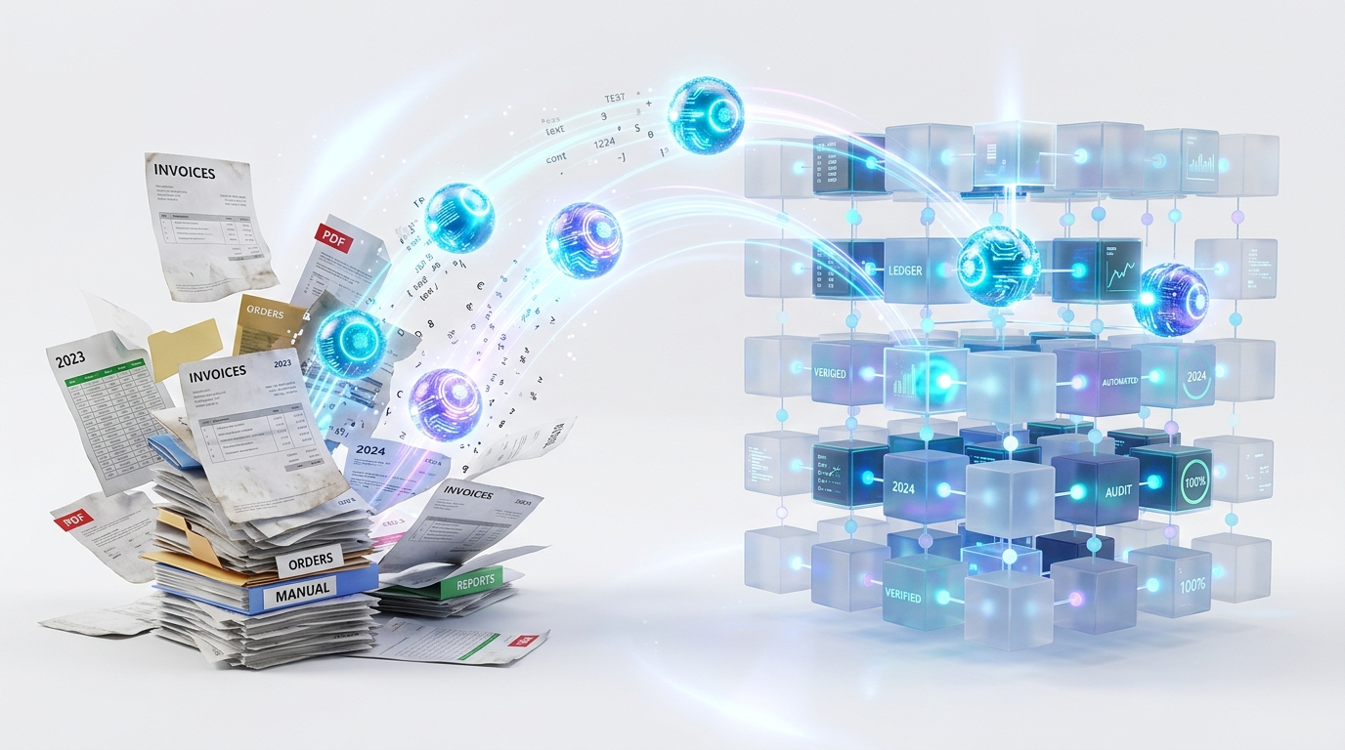
MARKET CHALLENGES & TRANSFORMATION
The Shift: From System of Record to System of Intelligence
70%+
MANUAL BURDEN
Unproductive time spent reviewing paper/PDFs
13-DIGIT
TAX ID PRECISION
Automatic verification eliminates filing errors
e-TAX
MANDATE READY
Pre-submission XML validation gate
PROACTIVE
CONTINUOUS AUDIT
Discrepancies caught before month-end close
OPTION 2: EXECUTIVE MINIMALIST & METRICS • SLIDE 2 OF 4
Notes:
【Slide 2: Industry Shift & Local Regulatory Challenges】
Tone: Strategic, Analytical, Problem-Solving | Target Duration: ~45 seconds
"Turning to Slide 2, let us examine the operational realities and regulatory drivers shaping corporate finance today.
Historically, ERP systems functioned as Systems of Record—reliable at logging historical transactions, but fundamentally passive. In practice, finance and Accounts Payable teams across Thailand continue to bear an immense manual burden: spending over 70% of their time scrutinizing hundreds of PDF tax invoices, matching purchase orders, and validating 13-digit Tax IDs line by line.
Compounding this challenge is Thailand’s rapidly tightening compliance environment. The Revenue Department’s ongoing transition toward mandatory e-Tax Invoices, coupled with intricate Withholding Tax classifications, means that even minor clerical typos risk delayed filings and statutory penalties.
This friction represents a transformative opportunity. By elevating Dynamics 365 into a System of Intelligence, we deploy proactive AI agents that pre-validate data, match transactions, and flag discrepancies before posting—converting finance from a transactional cost center into a strategic growth driver."

Slide 3

STRATEGIC TECHNOLOGY & MARKET FUSION
Strengthening Dynamics 365 & Maximizing Fujitsu Value
NATIVE
COPILOT FUSION
Deep integration into standard D365 processes
APPROVAL
HUMAN-IN-THE-LOOP
Accountants retain full journal sign-off authority
1ST MOVER
MARKET LEAD
Premier AI Thai Localization packaged solution
JAPANESE
QUALITY STANDARD
Fujitsu enterprise governance & delivery trust
OPTION 2: EXECUTIVE MINIMALIST & METRICS • SLIDE 3 OF 4
Notes:
【Slide 3: Product Excellence & Fujitsu Strategic Value】
Tone: Visionary, High-Impact, Balanced | Target Duration: ~50 seconds
"On Slide 3, we illustrate how this initiative generates balanced value across both the Dynamics 365 product platform and Fujitsu Thailand’s commercial business.
From a product perspective, we natively embed Microsoft Copilot Studio and Azure AI into Dynamics 365 via Dataverse, guaranteeing zero external data leakage. Copilot functions as an autonomous drafting co-pilot: reading invoices, checking 3-way matching, and pre-populating draft journals—slashing cycle times by over 70%. Crucially, we enforce strict Human-in-the-Loop governance: no transaction is committed to the ledger without explicit approval from an authorized accountant.
From Fujitsu Thailand’s strategic perspective, this establishes a decisive first-mover advantage. By productizing our localization expertise into reusable, AI-infused Thai Localization IP, we accelerate implementation velocity while capturing higher consulting margins. This offering addresses the acute compliance needs of Japanese multinationals and major domestic enterprises, reinforcing Fujitsu’s legacy of Japanese engineering quality, robust governance, and trusted delivery."

Slide 4
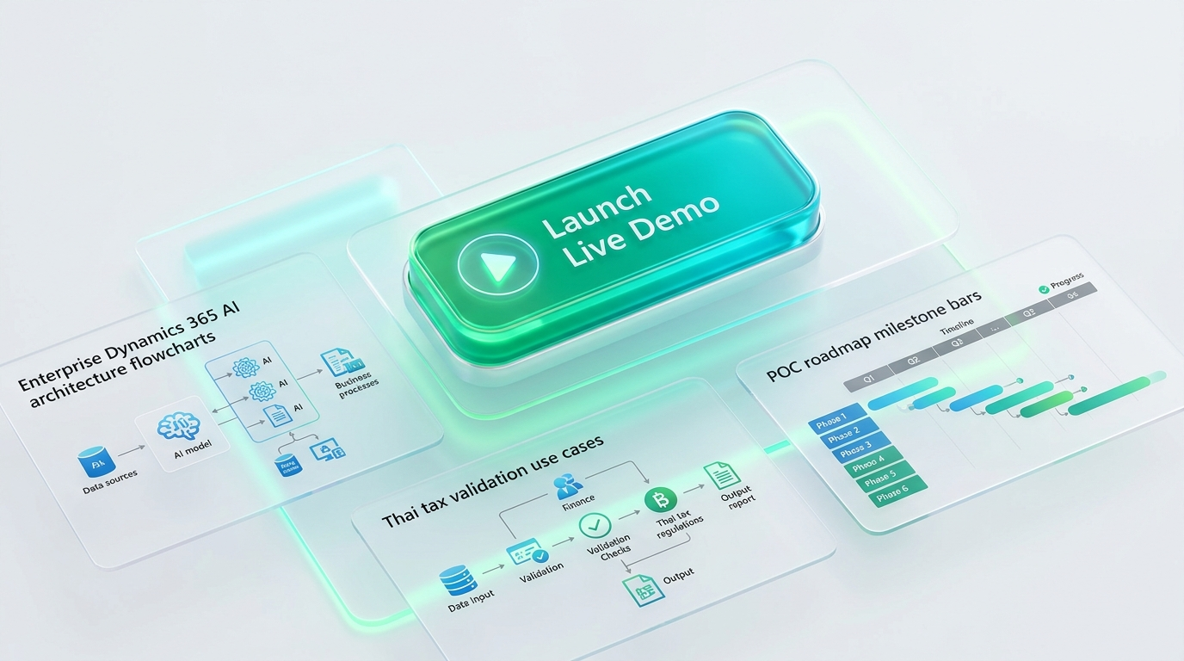
DEMONSTRATION ROADMAP & HANDOVER
Executive Agenda & Transition to Live Solution Pitch
STAGE 1
COPILOT ARCH
Multi-Agent Dataverse framework (Slide 3)
STAGE 2
5 USE CASES
AP, Thai Tax, e-Tax, Reconciliation (Slide 4)
8 WEEKS
POC DELIVERY
Low-risk, high-velocity ROI verification
LIVE NOW
PLATFORM LAUNCH
Interactive demonstration ready to begin
OPTION 2: EXECUTIVE MINIMALIST & METRICS • SLIDE 4 OF 4
Notes:
【Slide 4: Executive Agenda & Transition to Live Solution Pitch】
Tone: Engaging, Action-Oriented, Inviting | Target Duration: ~30 seconds
"Finally, on Slide 4, let us outline today’s interactive agenda.
Following this opening briefing, we will transition directly into our production-grade Live Interactive Pitch Platform, which walks through four core pillars across twelve executive slides:
1. First, the official Microsoft Copilot Studio reference architecture, detailing enterprise security, Dataverse integration, and multi-agent coordination;
2. Second, an in-depth walkthrough of our top five Thai localization use cases—spanning AP Invoice Intelligence, Thai Tax Copilot, e-Tax Gateway pre-validation, Continuous Reconciliation, and Policy Q&A;
3. Third, a pragmatic 8-week Proof of Concept delivery roadmap, engineered to deliver measurable ROI and verified business value within two months; and
4. Fourth, an interactive presentation experience equipped with dual-host narration and real-time scenario simulation.
Without further delay, I invite our executive team to transition with me into the live interactive platform to witness the future of Dynamics 365 and Copilot AI in action.
Please join me as we launch the live demonstration."

