Slide 1
Service
“ a method for exposing a network application that is running as one or more Pods in your cluster”

Slide 2
Demo k8s/03_service/02_multiple_services.yaml

Slide 3
Service vs Deployment

Slide 4
DevOps perspective:
microservice = k8s Service
Developer perspective:
microservice = k8s Deployment
Service = it’s mainly about networking
Deployment = it’s mainly about a workload

Slide 5
Ingress
“lets you map traffic to different backends”

Slide 6
Service = handles just 1 Deployment
Ingress – handles 1..N Deployments (via Services)

Slide 7
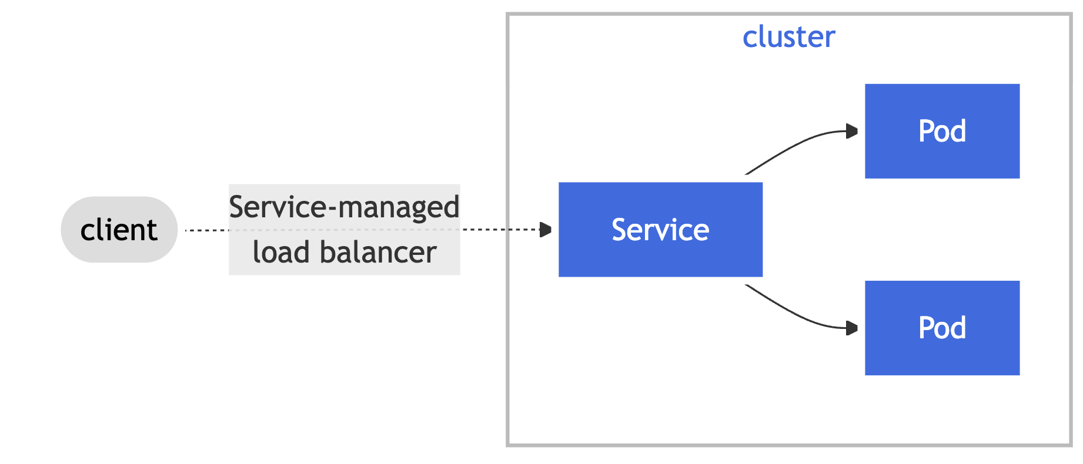
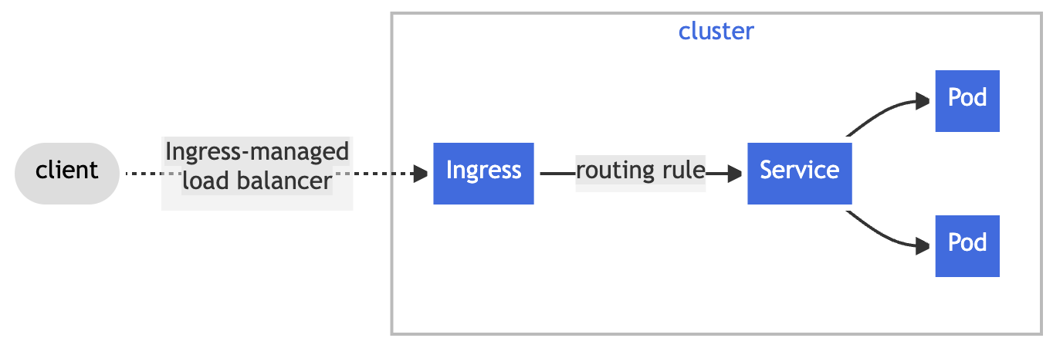
Service vs Ingress

Slide 8
Demo k8s/04_ingress/two_services.yaml

Slide 9
Service Accounts
“Application Pods, system components, […] can use a specific ServiceAccount's credentials to identify as that ServiceAccount.” i.e Pods can identify as a specific ServiceAccount

Slide 10
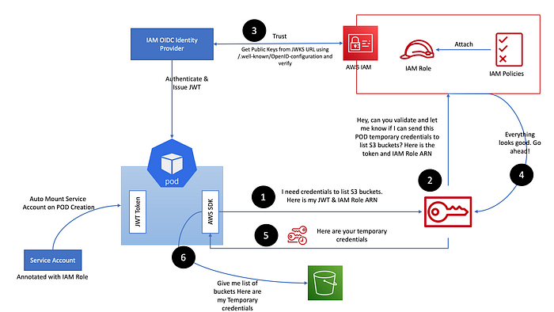
IRSA = IAM Roles for Service Accounts
Source: [Diagram1]

Slide 11
Amazon EKS Pod Identity Webhook
ServiceAccount (sa-test) annotated with:
eks.amazonaws.com/role-arn: "arn:aws:iam::{account-id}:role/{iam-role}"
(new) Pod using:
spec.serviceAccountName: sa-test
Injections (by web hook):
Environment variables:
- AWS_DEFAULT_REGION
- AWS_REGION
- AWS_ROLE_ARN
- AWS_WEB_IDENTITY_TOKEN_FILE
- AWS_STS_REGIONAL_ENDPOINTS
Volumes:
- var/run/secrets/eks.amazonaws.com/serviceaccount/token

Slide 12
val client = S3Client .builder().credentialsProvider( StsAssumeRoleWithWebIdentityCredentialsProvider.builder().build() ) .region(US_EAST_1) .build()
private StsWebIdentityTokenFileCredentialsProvider(Builder builder) { super(builder, "sts-assume-role-with-web-identity-credentials-provider"); Path webIdentityTokenFile = builder.webIdentityTokenFile != null
? builder.webIdentityTokenFile : Paths.get(trim(SdkSystemSetting.AWS_WEB_IDENTITY_TOKEN_FILE.getStringValueOrThrow()));

Slide 13
Demo aws/create/7_setup_irsa.sh k8s/05_irsa

Slide 14
Helm
package manager for Kubernetes

Slide 15
A Chart is a Helm package
(Helm uses a packaging format called charts. A chart is a collection of files that describe a related set of Kubernetes resources.)
[used by UP]
A Repository is the place where charts can be collected and shared
[not used by UP]
A Release is an instance of a chart running in a Kubernetes cluster.
[not used by UP]
Source: [Docs2]

Slide 16
User Platform facilitates only one command of Helm (under the hood – it is called by ArgoCD):
helm template

Slide 17
GO templates
https://pkg.go.dev/text/template (engine)
https://pkg.go.dev/github.com/Masterminds/sprig (extra template functions - supported out of the box)
"Actions"--data evaluations or control structures--are delimited by "{{" and "}}";
all text outside actions is copied to the output unchanged.
Source: [Docs2]

Slide 18
Demo aws/create/5_create_ingress_controller.sh aws/create/8_install_keda.sh (as regular package manager: helm install)

Slide 19
Demo k8s/06_helm (helm template)

Slide 20
ArgoCD
continuous delivery tool for Kubernetes

Slide 21
Target state (github)
Live state (kubernetes cluster)
Sync

Slide 22
Demo k8s/07_argo

Slide 23
UP applications setup in EKS
ApplicationSet – generator #1 (tenants)
(line 23: - path: "applications/eu-west-1/*.yaml” )
UP applications - input to #1 generator
ApplicationSet – generator #2
(line 18: {{- range $d := .Values.destinations }} )
UP environments – input to #2 generator

Slide 24
ApplicationSet
(use1-up)
Application
(use1-up-stream-concurrency)
ApplicationSet
(use1-up-stream-concurrency-environments)
Application
(use1-up-stream-concurrency-qa)
Link to ArgoCD
Generates 3 Applications
Application
(use1-up-stream-concurrency-perf)
Application
(use1-up-stream-concurrency-prod)
Generates 41 Applications
Application
(use1-up-synthetic-monitor)
ApplicationSet
(use1-up-synthetic-monitor-environments)
Application
(use1-up- synthetic-monitor-qa)
Generates 2 Applications
Application
(use1-up- synthetic-monitor-prod)
…

Slide 25
Demo apply change in GH repo (source) and see changes reflected in k8s cluster (target)

Slide 26
UP pull request merge

Slide 27
UP service restart (e.g. after configuration change)

Slide 28
UP service horizontal scaling up/down

Slide 29
UP autoscaling (Keda)

Slide 30
Keda

Slide 31
Sources
Docs1 - https://kubernetes.io/docs/home/
Docs2 - https://helm.sh/docs/topics/charts/
Diagram1 [IRSA] - https://mohaamer5.medium.com/iam-roles-for-service-accounts-with-eks-irsa-good-bye-aws-credentials-1cdf1fa5192

Slide 32
Terraform

