Slide 1
Service
“ a method for exposing a network application that is running as one or more Pods in your cluster”

Slide 2
Demo k8s/03_service/02_multiple_services.yaml

Slide 3
Service vs Deployment

Slide 4
DevOps perspective:
microservice = k8s Service
Developer perspective:
microservice = k8s Deployment
Service = it’s mainly about networking
Deployment = it’s mainly about a workload

Slide 5
Ingress
“lets you map traffic to different backends”

Slide 6
Service = handles just 1 Deployment
Ingress – handles 1..N Deployments (via Services)

Slide 7
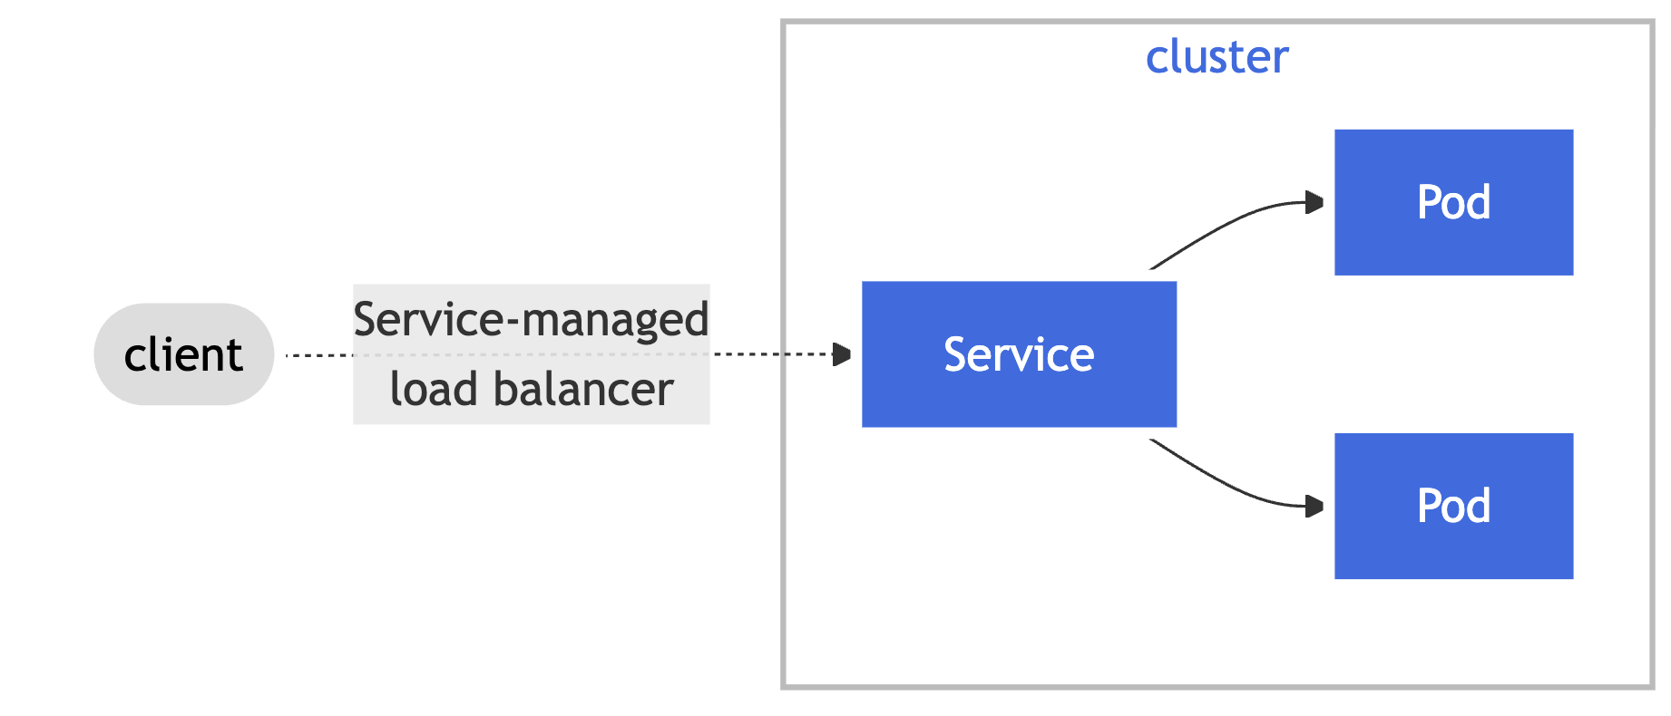
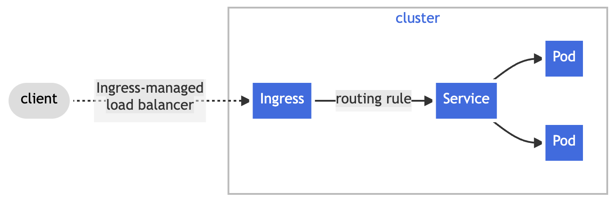
Service vs Ingress

Slide 8
Demo k8s/04_ingress/two_services.yaml

Slide 9
Service Accounts
“Application Pods, system components, […] can use a specific ServiceAccount's credentials to identify as that ServiceAccount.” i.e Pods can identify as a specific ServiceAccount

Slide 10
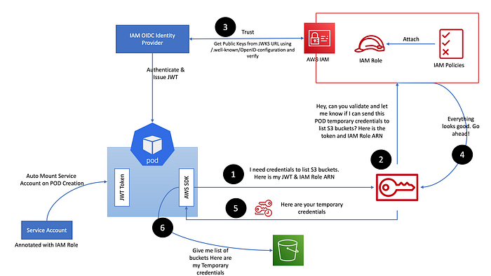
IRSA = IAM Roles for Service Accounts
Source: [Diagram1]

Slide 11
Amazon EKS Pod Identity Webhook
ServiceAccount (sa-test) annotated with:
eks.amazonaws.com/role-arn: "arn:aws:iam::{account-id}:role/{iam-role}"
(new) Pod using:
spec.serviceAccountName: sa-test
Injections (by web hook):
Environment variables:
- AWS_DEFAULT_REGION
- AWS_REGION
- AWS_ROLE_ARN
- AWS_WEB_IDENTITY_TOKEN_FILE
- AWS_STS_REGIONAL_ENDPOINTS
Volumes:
- var/run/secrets/eks.amazonaws.com/serviceaccount/token

Slide 12
val client = S3Client .builder().credentialsProvider( StsAssumeRoleWithWebIdentityCredentialsProvider.builder().build() ) .region(US_EAST_1) .build()
private StsWebIdentityTokenFileCredentialsProvider(Builder builder) { super(builder, "sts-assume-role-with-web-identity-credentials-provider"); Path webIdentityTokenFile = builder.webIdentityTokenFile != null
? builder.webIdentityTokenFile : Paths.get(trim(SdkSystemSetting.AWS_WEB_IDENTITY_TOKEN_FILE.getStringValueOrThrow()));

Slide 13
Demo aws/create/7_setup_irsa.sh k8s/05_irsa

Slide 14
Helm
package manager for Kubernetes

Slide 15
A Chart is a Helm package
(Helm uses a packaging format called charts. A chart is a collection of files that describe a related set of Kubernetes resources.)
[used by UP]
A Repository is the place where charts can be collected and shared
[not used by UP]
A Release is an instance of a chart running in a Kubernetes cluster.
[not used by UP]
Source: [Docs2]

Slide 16
User Platform facilitates only one command of Helm (under the hood – it is called by ArgoCD):
helm template

Slide 17
GO templates
https://pkg.go.dev/text/template (engine)
https://pkg.go.dev/github.com/Masterminds/sprig (extra template functions - supported out of the box)
"Actions"--data evaluations or control structures--are delimited by "{{" and "}}";
all text outside actions is copied to the output unchanged.
Source: [Docs2]

Slide 18
Demo aws/create/5_create_ingress_controller.sh aws/create/8_install_keda.sh (as regular package manager: helm install)

Slide 19
aws/create/5_create_ingress_controller.sh
aws/create/8_install_keda.sh

Slide 20
Demo k8s/06_helm (helm template)

Slide 21
ArgoCD
continuous delivery tool for Kubernetes

Slide 22
Target state (github)
Live state (kubernetes cluster)
Sync

Slide 23
Demo k8s/07_argo

Slide 24
Demo apply change in GH repo (source) and see changes reflected in k8s cluster (target)

Slide 25
Keda

Slide 26
Sources
Docs1 - https://kubernetes.io/docs/home/
Docs2 - https://helm.sh/docs/topics/charts/
Diagram1 [IRSA] - https://mohaamer5.medium.com/iam-roles-for-service-accounts-with-eks-irsa-good-bye-aws-credentials-1cdf1fa5192

