Slide 1
Service
“ a method for exposing a network application that is running as one or more Pods in your cluster”

Slide 2
Demo k8s/03_service/02_multiple_services.yaml

Slide 3
Service vs Deployment

Slide 4
DevOps perspective:
microservice = k8s Service
Developer perspective:
microservice = k8s Deployment
Service = it’s mainly about networking
Deployment = it’s mainly about a workload

Slide 5
Ingress
“lets you map traffic to different backends”

Slide 6
Service = handles just 1 Deployment
Ingress – handles 1..N Deployments (via Services)

Slide 7
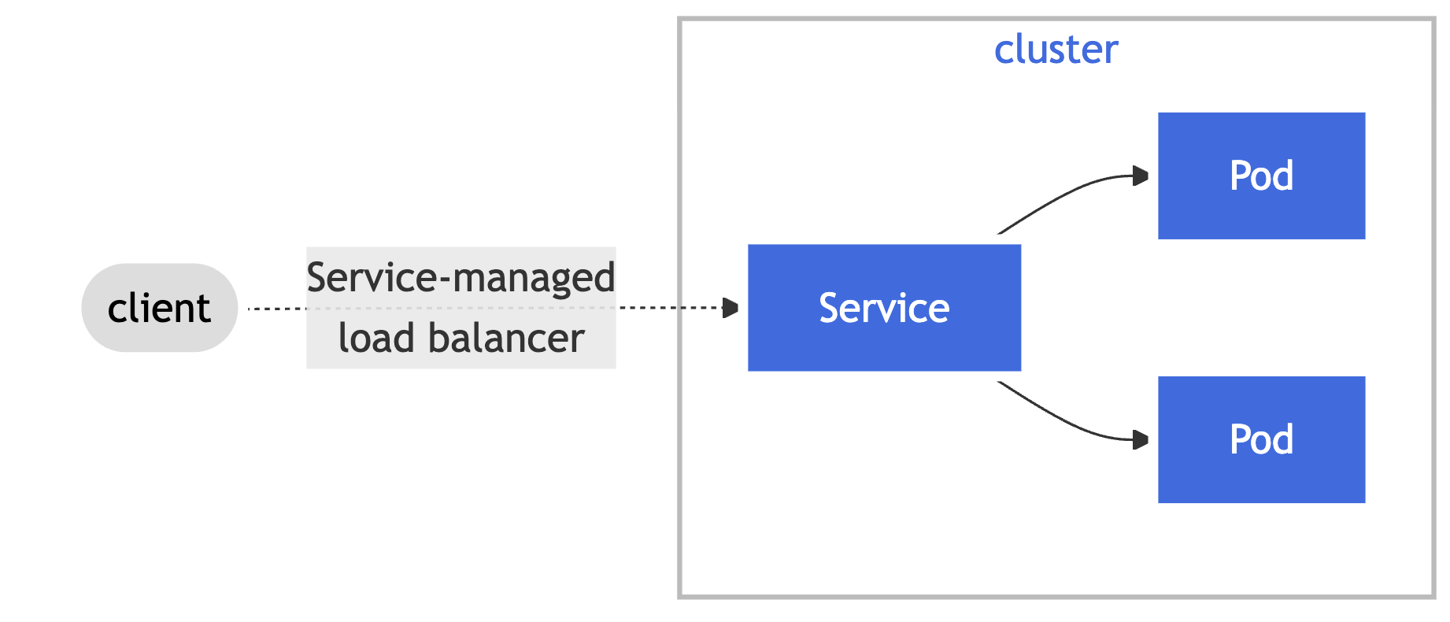
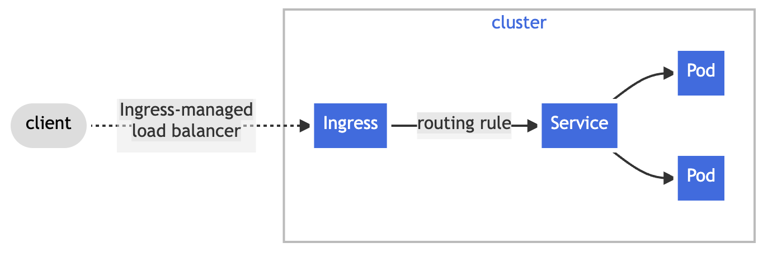
Service vs Ingress

Slide 8
Demo k8s/04_ingress/two_services.yaml

Slide 9
Service Accounts
“Application Pods, system components, […] can use a specific ServiceAccount's credentials to identify as that ServiceAccount.” i.e Pods can identify as a specific ServiceAccount

Slide 10
Service Accounts / IRSA

Slide 11
TODO

Slide 13
GO templates
https://pkg.go.dev/text/template (engine)
https://pkg.go.dev/github.com/Masterminds/sprig (extra template functions - supported out of the box)
The input text for a template is UTF-8-encoded text in any format.
"Actions"--data evaluations or control structures--are delimited by "{{" and "}}";
all text outside actions is copied to the output unchanged.

Slide 14
Helm webooks
Used by devops
In UP were used in pluto-api-service https://github.com/viacomcbs/up-pluto-api-service/blob/a7c19e9322268936ee864666a70ff84639f98418/deploy/helm/v2/ups-pluto-api-service/templates/secret.yaml
{{- if not .Values.serviceAccount.forceDisabled | default false }}
---
apiVersion: v1
kind: Secret
type: kubernetes.io/service-account-token
metadata:
name: {{ include "k8s.secretServiceAccountTokenName" . }}
annotations:
helm.sh/hook: "pre-install, pre-upgrade"
helm.sh/hook-delete-policy: "before-hook-creation"
helm.sh/hook-weight: "-5"
kubernetes.io/service-account.name: {{ include "k8s.serviceAccountName" . }}
{{- end }}

