Slide 1
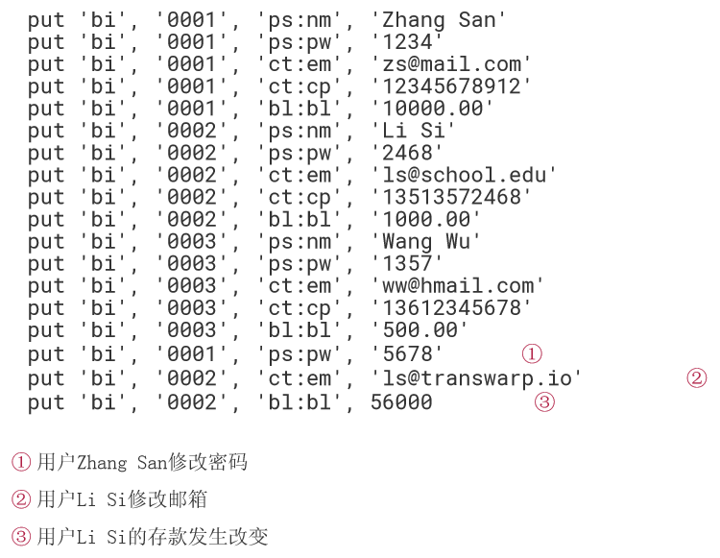

Slide 2
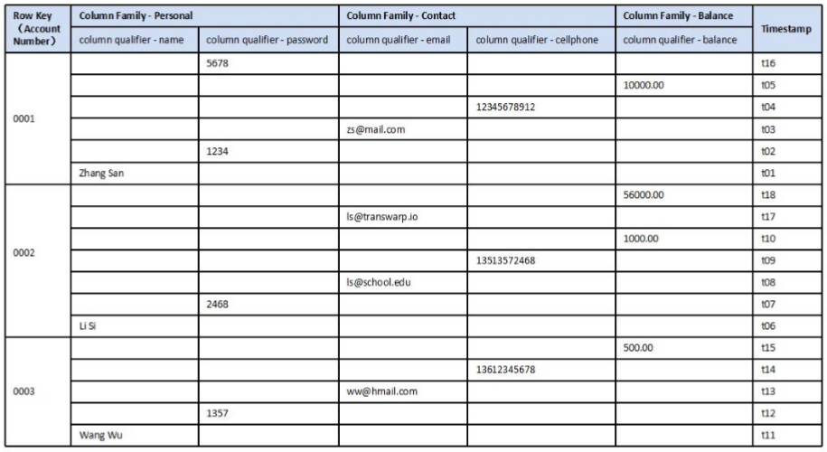

Slide 3
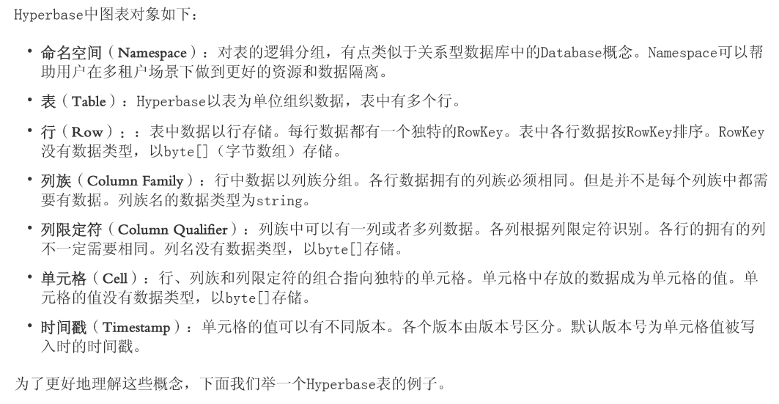

Slide 5
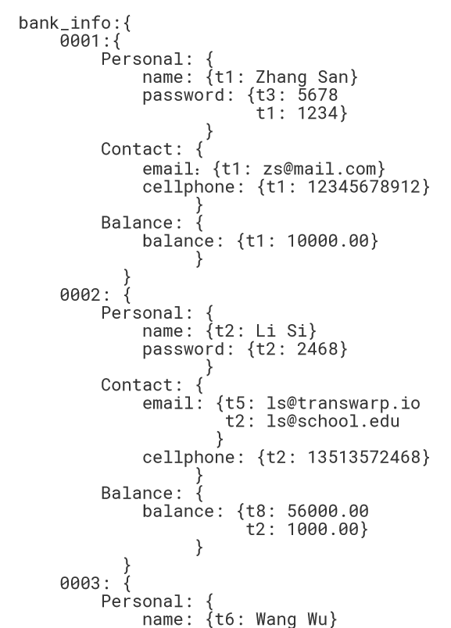

Slide 6
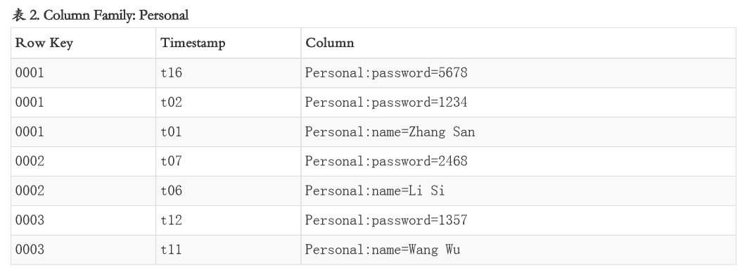
Notes:
在实际的存储上，概念上的银行用户表bank_info中空出的单元格是不存在的，物理上的bank_info如 下，bank_info中的数据的存储按Column Family组织

Slide 7
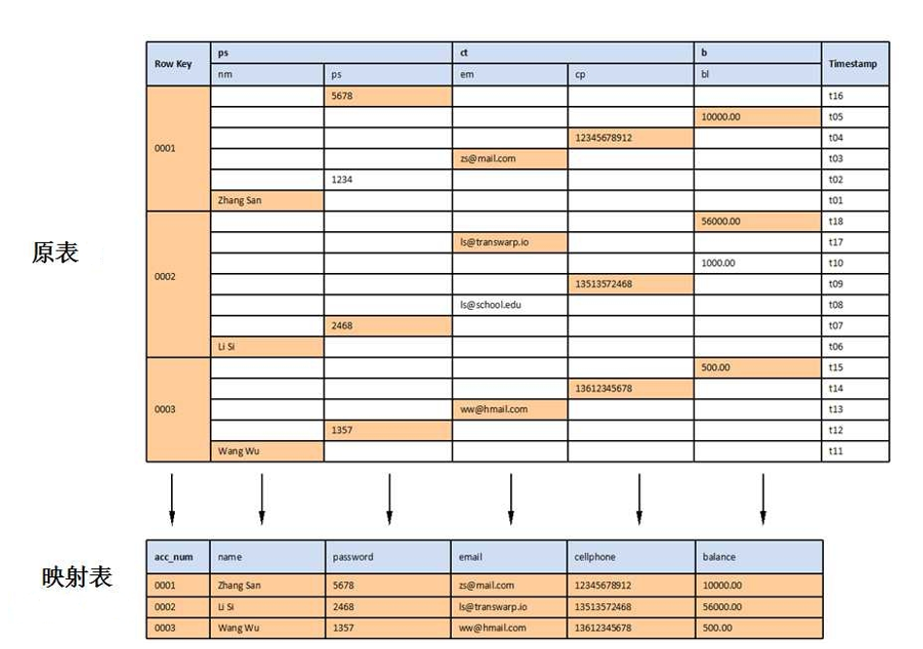

Slide 8
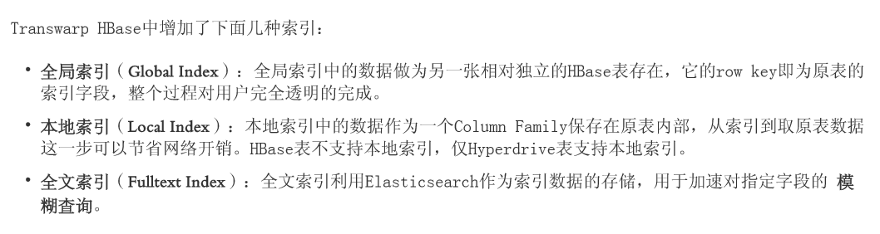

Slide 9
curl -XPUT 'tdh-master:9200/employee/dev/1?pretty' -d '{
"firstname": "San",
"lastname": "Zhang",
"age": 26,
"on_board_date": "2015-10-31",
"hometown": "Beijing",
"school": "Nanjing University"
}'

Slide 10
curl -XPUT 'tdh-master:9200/employee/dev/2' -d '{
"firstname": "Si",
"lastname": "Li",
"age": 28,
"on_board_date": "2014-09-16",
"hometown": "Nanjing",
"school": "Beijing University"
}'

Slide 11
curl -XGET 'tdh-master:9200/employee/dev/1?pretty'

Slide 12
curl -XGET 'tdh-master:9200/employee/dev/1?_source=firstname,lastname,age&pretty'

Slide 13
curl -i -XHEAD 'tdh-master:9200/employee/dev/1'

Slide 14
curl -XDELETE 'tdh-master:9200/employee/dev/1?pretty'

Slide 15
curl -XPOST 'tdh-master:9200/employee/sales?pretty' -d '{
"firstname": "Lei",
"lastname": "Li",
"age": 28,
"on_board_date": "2013-10-03",
"hometown": "Hangzhou",
"school": "Zhejiang University"
}'
Notes:
http://www.tuicool.com/articles/rUvYRzm

Slide 16
curl -XGET 'tdh-master:9200/employee/dev/_search?pretty'

Slide 17
curl -XGET 'tdh-master:9200/employee/_search?pretty&q=firstname:Si'

Slide 18
curl -XPUT 'tdh-master:9200/test/?pretty'
curl -XDELETE 'tdh-master:9200/test/?pretty'

Slide 19
curl -XGET 'tdh-master:9200/_search?pretty‘
陶阳在这里加了一行字

Slide 20
在employee Index下的所有Type中检索
curl -XGET 'tdh-master:9200/employee/_search'
在employee Index下的dev和sales Type中检索
curl -XGET 'tdh-master:9200/employee/dev,sales/_search'
在employee, new_employee这两个Index下的dev和sales Type中检索
curl -XGET 'tdh-master:9200/new_employee,employee/dev,sales/_search'

Slide 21
Request Body检索 将查询放在 <BODY> 中，例如：
curl -XPOST 'tdh-master:9200/employee/dev/_search?pretty' -d '
{
"query" : {
"match_phrase" : {
"lastname" : "Li"
}
}
}
'

