Slide 1
CAPSTONE PROJECT · MASTER'S REPORT
Relational Alpha Factors with
Graph Attention Networks
A dual-track study on US equities and European power markets
Wentao Ma
One shared GAT kernel over two structurally different graphs — what does learned relational structure add?
github.com/witold-andelie/quant-foundation-gat · July 2026

Slide 2
MOTIVATION
The core premise: assets are not islands
Classical quantitative signals score each asset in isolation — read one stock's own prices and volumes, emit one number.
But the assets are coupled:
Equities co-move within sectors and supply chains (statistical coupling).
European power prices are literally wired together by cross-border transmission lines (physical coupling).
The premise: this coupling structure is information.
The project measures how much — as a graph, where nodes are assets and edges are the couplings a model may exchange information along.
TWO FACTOR FAMILIES
Island factor
scores a node from its own history alone (e.g. 5-day price reversal, volume shocks).
Relational factor
may also read the node's neighbours in a graph.
The relational model's only privilege is topological:
permission to exchange information along edges, with every other input held fixed. Each headline number is that margin.
Relational Alpha Factors with Graph Attention Networks · Master's Capstone
2

Slide 3
PRIMER · FOR A NON-FINANCE AUDIENCE
What is an “alpha factor”?
An alpha factor is a rule that assigns every asset a score at every point in time, built so that higher-scored assets should subsequently outperform lower-scored ones.
The prediction is about relative performance, not price levels. The object of interest is the cross-section — all assets at one timestamp — and whether today's ranking of scores anticipates tomorrow's ranking of returns.
1 Score the cross-section
2 Rank the scores
3 Check the ordering
At each date, every asset gets a number from the factor rule.
Convert to a within-day ranking. Absolute magnitude is discarded.
Did high-ranked assets out-return low-ranked ones over the next k days?
Individual factors are weak and correlated by design — the field builds them in large numbers and studies how to combine them. That combination step is where this project's graph lives.
Relational Alpha Factors with Graph Attention Networks · Master's Capstone
3

Slide 4
PRIMER · FOR A NON-FINANCE AUDIENCE
How we grade a factor: two numbers
Rank-IC (information coefficient)
Sharpe ratio (of a long–short book)
The (Spearman) correlation between the scores issued today and the returns realised afterwards, averaged over all dates.
1.0 = perfect ordering
0.0 = no predictive skill
Reality check: real factors are weak.
This project's best equity composite reaches rank-IC ≈ 0.015 out-of-sample — small, but real and usable in combination.
Grade the factor as a strategy: buy the top-ranked assets, short the bottom-ranked ones, then divide mean return by its volatility (annualised).
Long–short largely cancels overall market direction — what remains is the factor's own edge.
Key subtlety: rank-IC and Sharpe can disagree.
Ranking well says nothing about the magnitude of wins and losses — a disagreement the energy track turns into a main finding.
Relational Alpha Factors with Graph Attention Networks · Master's Capstone
4

Slide 5
THE AIM
Why a graph model? What we are actually after
What the GNN is NOT
What the GNN IS
A bigger model bolted on to push prediction accuracy up.
A way to feed extra data into prediction — every exogenous driver (load, wind, solar, fuel) also goes to the graph-free baselines.
A demo that “a graph beats a non-graph” — easy to show, hard to interpret.
A measurement instrument: it isolates the marginal value of relational structure — the coupling between assets — with the information set held fixed.
The model's only privilege is topological: permission to exchange information along edges (correlations for equities, the physical grid for power).
So every headline number is a margin — the value of that permission, everything else equal.
The aim, in one line: measure what the coupling structure of markets is worth — and whether learning to read it beats reading it naively.
Relational Alpha Factors with Graph Attention Networks · Master's Capstone
5

Slide 6
THE QUESTION
Three questions the aim breaks into
With the information set held fixed, the aim decomposes into three concrete, separately-measurable questions:
RQ1
Does learned attention add value over unlearned relational propagation, holding inputs and topology fixed?
RQ2
Does one GAT kernel transfer across structurally different graphs without manufacturing false positives?
RQ3
On real power data, does the physical topology improve forecast skill, and where does its value concentrate?
Relational Alpha Factors with Graph Attention Networks · Master's Capstone
6

Slide 7
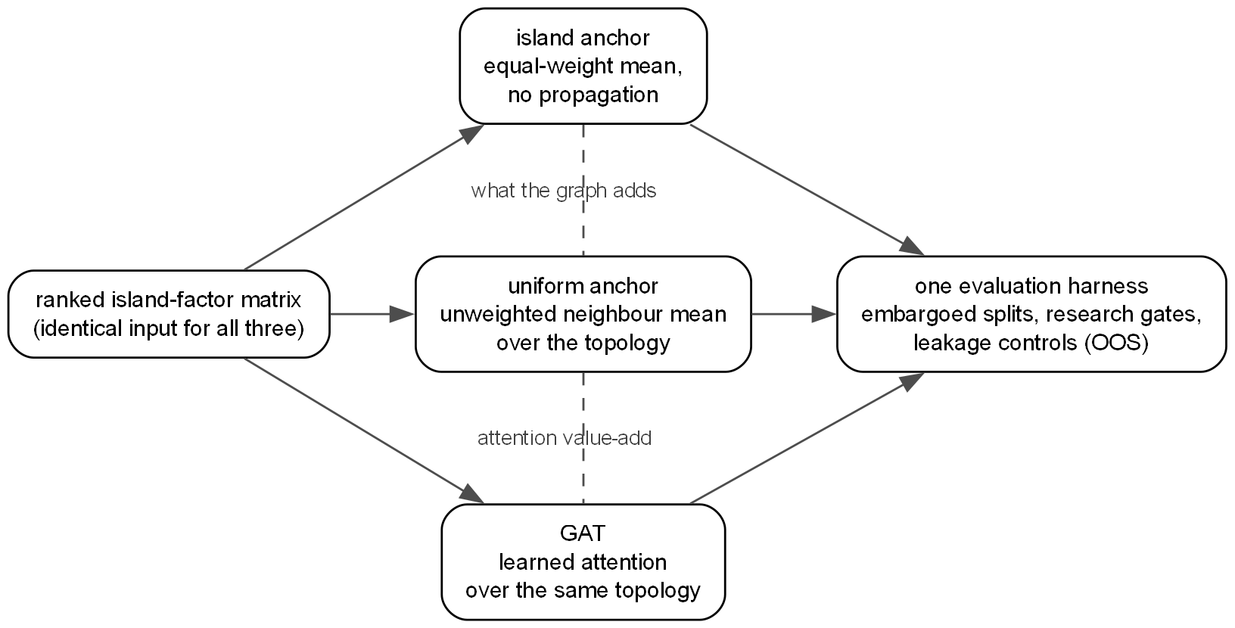
METHOD · THE CENTRAL TEST
The attention A/B: two no-learning anchors
Every run carries three constructions on one input matrix, scored by one harness:
Island anchor — equal-weight mean, no graph.
Uniform anchor — same mean, averaged over the graph, nothing learned.
GAT — learned attention on the same graph.
island → uniform = what the graph adds
uniform → GAT = what learned attention adds
This isolates a mechanism, not a whole architecture — the price is smaller headline numbers.
Relational Alpha Factors with Graph Attention Networks · Master's Capstone
7

Slide 8
PLATFORM
How the GNN plugs in — two seams, not a fork
The relational track joins an existing analytics platform (ingest → DuckDB warehouse → dbt marts → Streamlit) through two narrow interfaces, fixed in design records before implementation.
SEAM 1 The propagator
SEAM 2 The factor contract
One snapshot's node features + topology in, one factor value per node out.
Both the uniform baseline and the trained GAT are adapters on this one seam — so the A/B is a one-line swap, not two code paths.
A characterisation test pins it: uniform propagation on a full graph reproduces the platform's existing cross-market mean exactly.
One Factor contract over the (time, entity) panel absorbs both idioms.
At the registry / apply / gate layer, island and relational factors are indistinguishable.
That is what makes the four-gate comparison a fair one — every factor reaches evaluation through the same code.
Research runs flow back into the warehouse as marts; 115 tests (55 in the capstone modules) pin the leakage-critical logic.
Relational Alpha Factors with Graph Attention Networks · Master's Capstone
8

Slide 9
METHOD
Leakage was treated as the #1 risk
Controls are structural — asserted in code, not remembered by the experimenter. One split date is computed once and passed to every consumer.
train
embargo
valid
embargo
out-of-sample
Validation is embargoed on both sides — labels reach k steps forward, so the trailing embargo (easy to forget) stops best-epoch selection leaking OOS returns.
Negative control
Shuffle each snapshot's labels → validation IC must collapse to zero. It does.
Positive control
Plant a recoverable signal → the same loop must recover it. It does (IC → 0.99).
IC-loss objective
Optimise −Pearson(pred, label) per snapshot; deploy the best-validation-epoch weights.
Relational Alpha Factors with Graph Attention Networks · Master's Capstone
9

Slide 10
METHOD
The four research gates
A relational composite is only interesting if it survives comparison against the island factors it was built from — all scored out-of-sample.
GATE
DEFINITION
THRESHOLD (equity)
RESULT
Value-added
composite OOS Sharpe vs. best single alpha
composite > max
FAIL
Consistency
IS / OOS IC same sign, magnitude retained
score ≥ 0.5 (0.63)
PASS
Uniqueness
max |correlation| vs. each single alpha
< 0.7 (0.26)
PASS
Robustness
blend: OOS coverage, IC info-ratio, drawdown
score ≥ 0.5 (0.68)
PASS
The composite is real, unique and consistent — it beats 9 of its 10 inputs — but never clears the strictest bar (beat the single best alpha). We report the open gate rather than soften it.
Relational Alpha Factors with Graph Attention Networks · Master's Capstone
10

Slide 11
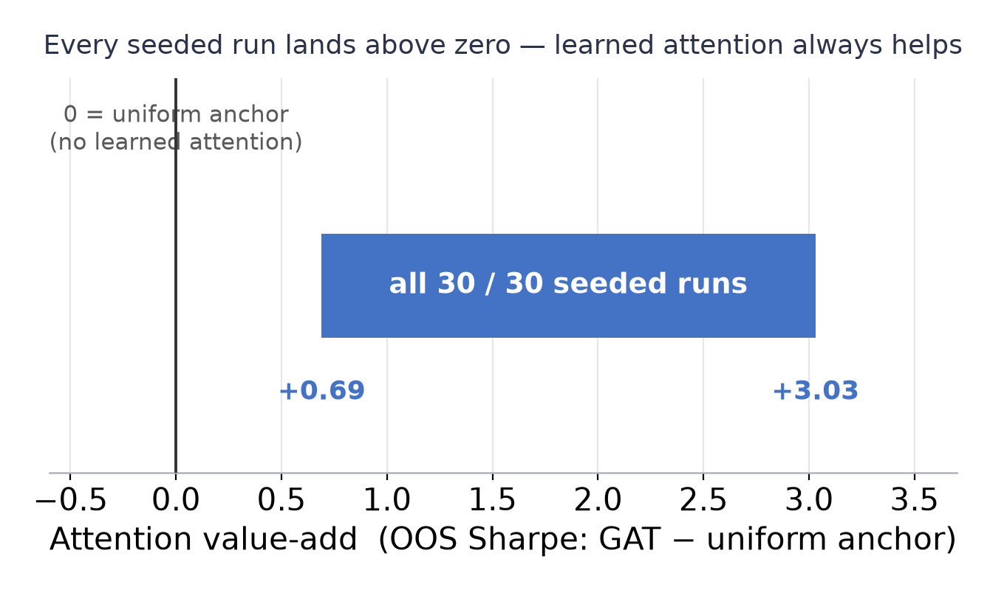
RESULT · EQUITY TRACK
Learned attention reliably beats naive propagation
30 / 30
seeded runs with positive attention value-add
2 HP configs · 2 devices · +0.69 to +3.03 Sharpe
What the number means
The value-add is the GAT's OOS Sharpe minus the uniform anchor's — same inputs, same topology, differing only in whether the edge weights are learned.
Both no-learning anchors are negative out-of-sample; the learned model is consistently positive.
It is not learning to smooth: its scores are near-uncorrelated with the uniform anchor (Spearman −0.29..−0.14) — it learns where the graph matters.
Data: real yfinance, 49 names, 2021–2026, 10 island alphas, correlation-top-k + sector graph.
+0.0148
best-config OOS IC (± 0.0043)
all 5 seeds positive · mean 3.4σ above zero
3 / 4
research gates pass on real data
Value-added is the one honest failure
Relational Alpha Factors with Graph Attention Networks · Master's Capstone
11

Slide 12
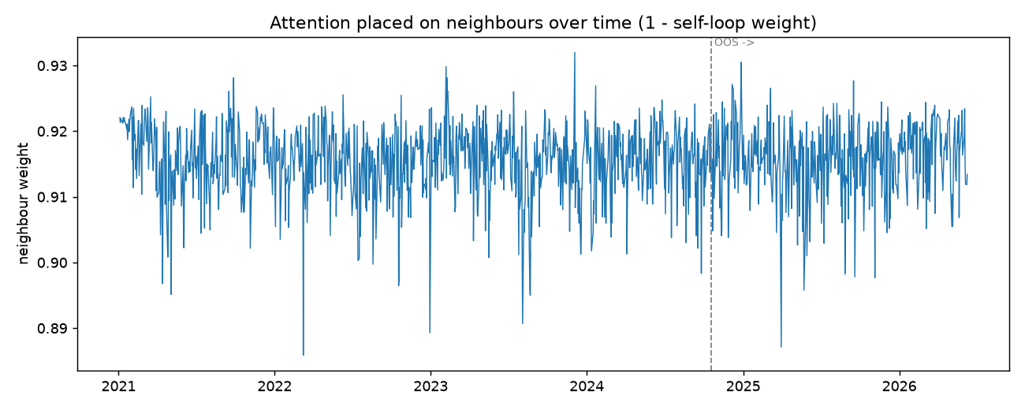
RESULT · EQUITY TRACK
What did the attention actually learn?
Attention analysis on 919,336 edge-weight rows over 1,364 dates:
Genuinely relational — self-loop weight only 0.084, so 91.6% of attention mass sits on neighbours (the graph is not decoration).
But nearly uniform — across ~12.5 neighbours, entropy 0.956, sector-homophily lift just +0.019. A gentle re-weighting of mean pooling, not a sharp selector.
The mechanism, in one line
Small learned tilts on top of broad pooling — which is exactly why the GAT's edge is consistent yet modest.
Temporally stationary: the neighbour share holds at 0.91–0.92 across 2021–2026, with no break at the IS/OOS line (chart).
The design hypothesis — attention adapts to macro regimes — is not supported at this level, and we say so.
Validity check: the biggest attention sinks are mega-cap bellwethers (AMZN, NVDA, MSFT, GS…) — the names the universe co-moves with.
Relational Alpha Factors with Graph Attention Networks · Master's Capstone
12

Slide 13
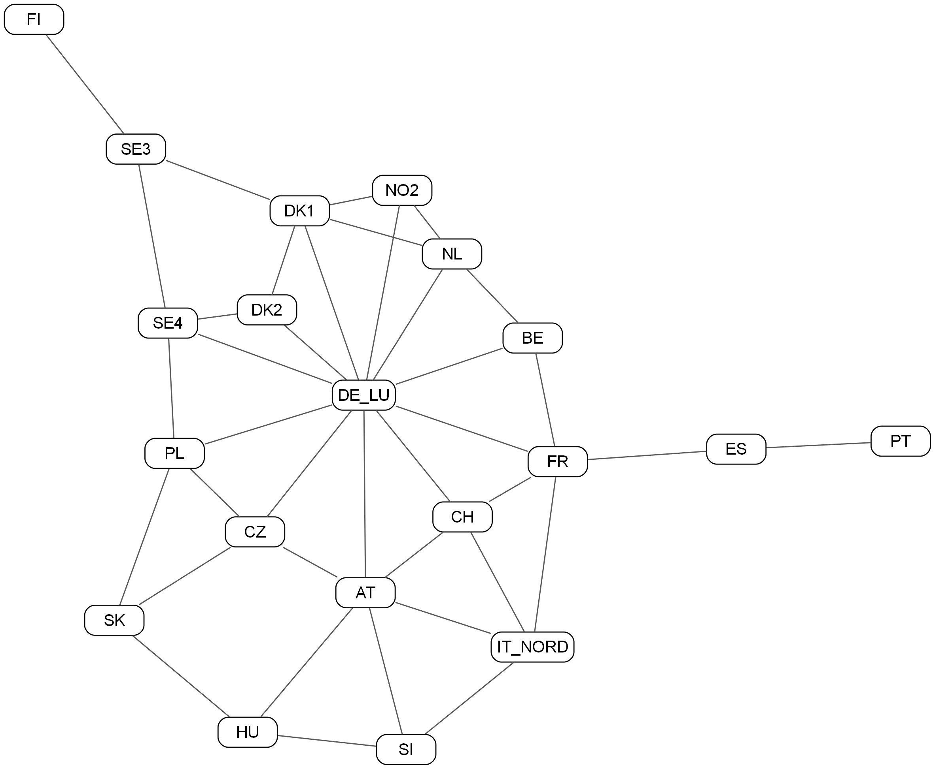
TRACK 2 · ENERGY
The energy graph is physical, not estimated
The plan: repeat the equity experiment on a physically grounded graph.
20 European bidding zones (day-ahead spot prices from ENTSO-E).
38 physical borders — land interconnectors and HVDC cables.
Nothing is estimated — the topology is the grid itself.
DE_LU is the natural hub (11 interconnectors) — the physical layout, not a choice.
Same GAT kernel, training loop, gates and A/B as the equity track — only the graph, label horizon (24h) and node set differ.
Relational Alpha Factors with Graph Attention Networks · Master's Capstone
13

Slide 14
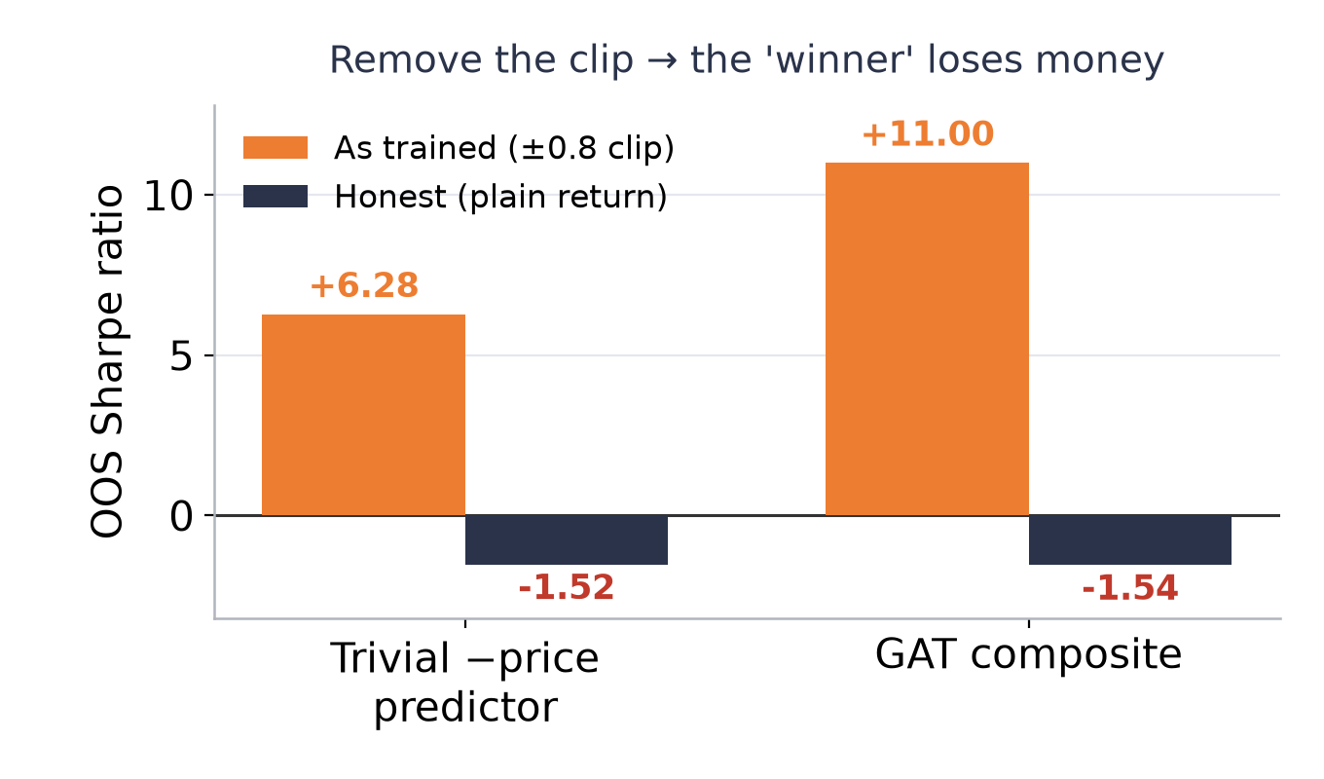
TRACK 2 · ENERGY
A worked cautionary tale: three nested artifacts
The first real-data run looked spectacular: OOS IC 0.20, Sharpe 8.25, 4/4 gates. The same kernel earns ~1.4 on equities — a symptom, not a discovery.
Overlapping labels — 24h returns sampled hourly share 23/24 hours (autocorr 0.91); Sharpe treats them as independent.
Wrong annualisation — the equity constant (252) applied to hourly data (8,760).
A clip on the evaluation return — a ±0.8 clip capped exactly the short-leg scarcity spikes where the money is lost.
Under honest returns the strategy loses money (Sharpe ≈ −1.5) — yet rank-IC stays ≈ 0.21.
Lesson: never transform the evaluation return, and never read rank quality as profitability.
Relational Alpha Factors with Graph Attention Networks · Master's Capstone
14

Slide 15
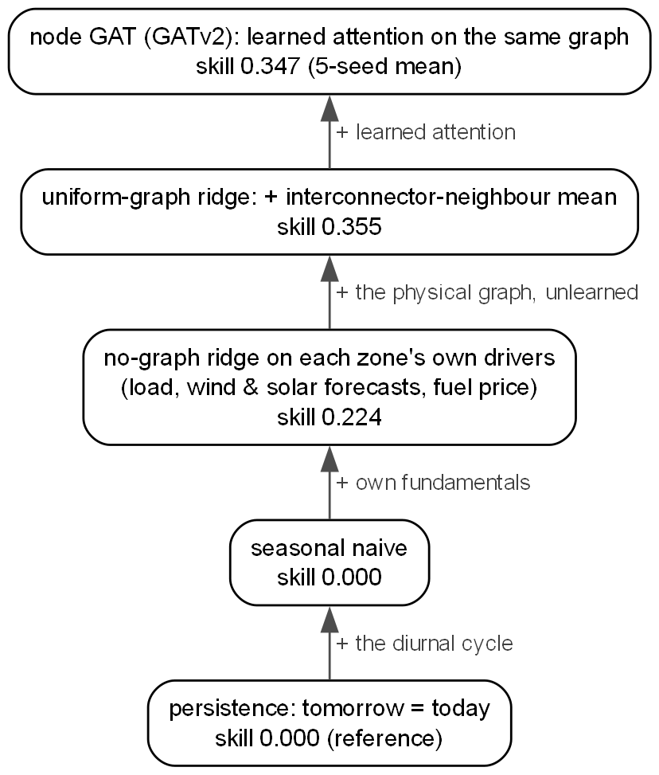
TRACK 2 · ENERGY REFRAME
Does the physical graph improve forecasts?
Reframed from “is there alpha?” to “does the interconnector graph improve forecast skill?” — a skill ladder where each rung adds exactly one ingredient.
+0.131
skill from the graph alone (uniform neighbour mean vs. no-graph ridge)
pure numpy, no learned model — the hardest number to argue with; synthetic uncoupled zones show no such lift
Attention vs. uniform — wins on ranking (5/5 seeds) but is a wash on MSE skill: uniform pooling is already near-optimal here.
Congestion as an edge feature — an honest null under two operationalisations and two GAT backends.
Relational Alpha Factors with Graph Attention Networks · Master's Capstone
15

Slide 16
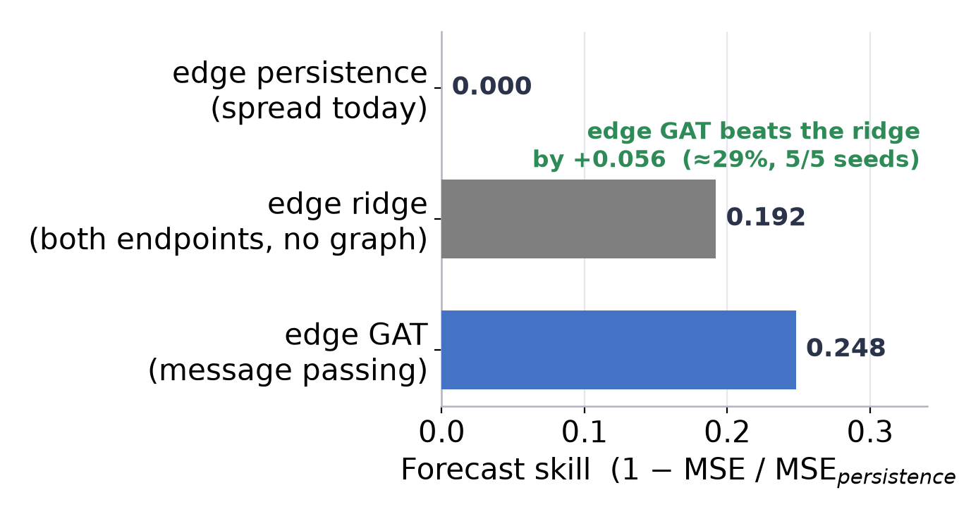
TRACK 2 · ENERGY REFRAME
The relational payoff: cross-border spreads
A cross-border spread (price$_a$ − price$_b$) is irreducibly relational — it does not exist for a single node, and it is what transmission rights actually price.
The GAT message-passes over the grid; a small head predicts each border's next-day spread.
The baseline already sees both endpoints' drivers + the current spread — so any gain is whole-network context, not missing data.
+0.056 skill (≈29%), 5/5 seeds — and the synthetic control inverts: on independent zones the GAT is worse than the ridge.
The GNN's value concentrates precisely on the target that cannot be defined without the relation.
Relational Alpha Factors with Graph Attention Networks · Master's Capstone
16

Slide 17
CONCLUSION
Three questions, answered directly
RQ1 Learned attention? Yes on equities — positive value-add in 30/30 runs against a matched anchor. The mechanism is a modest, stationary tilt on broad pooling; the composite beats 9 of 10 inputs but not the best single alpha.
RQ2 One kernel, two graphs? Yes — the same code finds a real margin on equities and correctly finds nothing on synthetic random walks and uncoupled zones. Implausible magnitudes were treated as alarms, not results.
RQ3 Physical topology helps forecasts? Yes, where it should — +0.131 node skill, and +0.056 on cross-border spreads (5/5), while a synthetic control inverts. Congestion edge features: an honest null.
The most transferable output is methodological: evaluate on untransformed returns; treat rank correlation and profitability as different claims; distrust magnitudes that outrun their plausibility; require seeds, fixed devices and cross-implementation replication; and keep negative controls running — they are what give positive results their meaning.

