Slide 1
Data Structures & Algorithms
Data Abstract Type: TREE
Lecture 10
National College of Ireland
Lecturer: Dr. Muhammad Iqbal
Email: Muhammad.Iqbal@ncirl.ie

Slide 2
Linear Data Structures
Here are some of the data structures we have studied so far:
ArrayList
Single linked list, Double Linked list
Stack, Queue, Priority Queue
These all have the property that their elements can be adequately displayed in a straight line.
Binary trees are one of the simplest nonlinear data structures.

Slide 3
Tree Introduction
An example of Tree - The organizational structure of a fictional corporation.
Electronics R Us
R&D
Sales
Purchasing
Manufacturing
Domestic
International
TV
CD
Tuner
Canada
Overseas
Africa
Europe
Asia
Australia

Slide 4
Tree Example
In computer science, a tree is an abstract model of a hierarchical structure
A tree consists of nodes with a parent-child relation
Applications:
Organization charts
File systems
Programming environments
Root
Internal node
Computers”R”Us
Sales
Manufacturing
R&D
US
International
Laptops
Desktops
Europe
Asia
Canada
Notes:
An internal node (also known as an inner node, inode for short, or branch node) is any node of a tree that has child nodes. Similarly, an external node (also known as an outer node, leaf node, or terminal node) is any node that does not have child nodes.

Slide 5
Tree Introduction
Tree structures are a breakthrough in data organization.
They allow us to implement algorithms much faster than using linear data structures (e.g. lists).
Trees provide a natural organization for data, and consequently have become ubiquitous structures in the file systems, graphical user interfaces, databases, Web sites, and other computer programs.
Tree is a hierarchy of levels - no cycles.

Slide 6
Tree Terminology
Root: node without parent (A)
Internal node: node with at least one child (A, B, C, F)
External node (a.k.a. leaf ): node without children (E, I, J, K, G, H, D)
Ancestors of a node: parent, grandparent, grand-grandparent, etc.
Depth of a node: The depth of a node is the number of edges from the node to the tree's root node.
Height of a tree: The height of a node is the number of edges on the longest path from the node to a leaf.
Descendant of a node: child, grandchild, grand-grandchild, etc.
Subtree: tree consisting of a node and its descendants
A
subtree
B
C
D
E
F
G
H
I
J
K
Notes:
The depth of a node is the number of edges from the node to the tree's root node. A root node will have a depth of 0.
The height of a node is the number of edges on the longest path from the node to a leaf. A leaf node will have a height of 0.

Slide 7
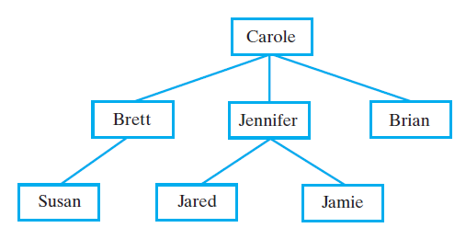
Hierarchical Organizations Example: Family Trees
FIGURE: Carole’s children and grandchildren

Slide 8
Tree Definition
A tree is an abstract data type that stores elements hierarchically (non-linear).
A binary tree is defined as:
A tree T is a finite collection of elements. One (if any) of these elements is called the root, and the remaining elements (if any) are partitioned into trees, which are called sub-trees of T.
It consists of a root, a left sub-tree, and a right sub-tree.
The top element is called the root node.
A tree is composed of zero or more nodes.
With the exception of the top element, each element in a tree has a parent element and zero or more children elements.
The degree of an element - is the number of children an element has.
Binary trees => all elements are of degree 2.

Slide 9
Tree More definitions...
The descendents of a node are its children and the descendents of its children
The ancestors of a node are its parent (if any) and the ancestors of its parent
The sub-tree rooted at a node consists of the given node and all its descendents
An ordered tree is one in which the order of the children is important;
An unordered tree is one in which the children of a node can be thought of as a set ( no order implied)

Slide 10
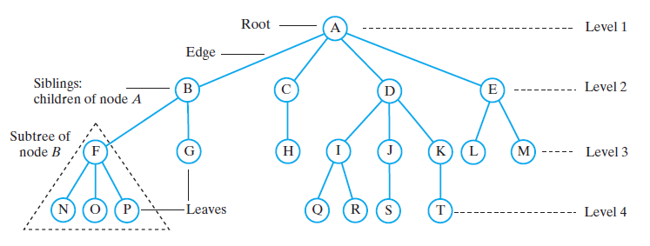
Tree Task
Which nodes are the leaves?
Which nodes are the siblings of node K?
Which nodes are the children of node B?
Which nodes are the descendants of node B?
Which nodes are the ancestors of node N?
Which nodes are parents?
Notes:
N, O, P, G, H, Q, R, S, T, L, M.
I, J.
F, G.
F, G, N, O, P.
F, B, A.
A, B, C, D, E, F, I, J, K

Slide 11
Characteristics of a tree Size, Depth, Height
The size of a (binary) tree is the number of nodes in it
The depth of a (binary) tree is the depth of its deepest node
The depth of a node is its distance from the root
The height of a (binary) tree is the number of levels in the tree.
The height of a node is the distance to its furthest descendant.

Slide 12
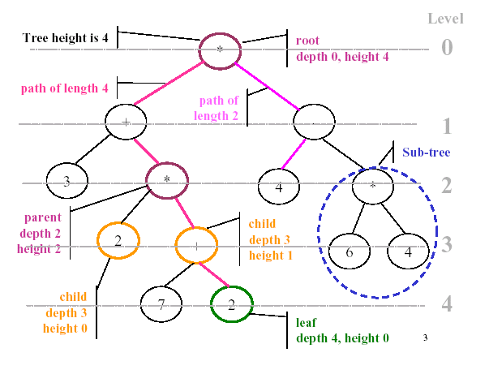

Slide 13
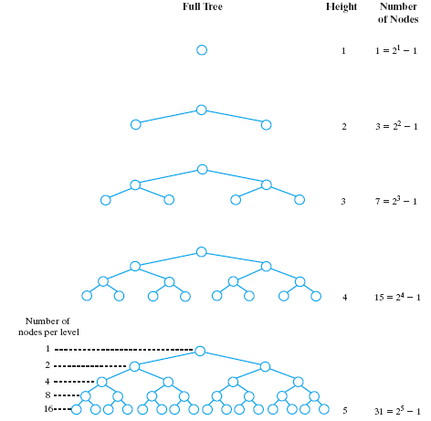
Binary Trees
FIGURE: The number of nodes in a full binary tree as a function of the tree’s height
Assumed the height of first level is 1 in this case.

Slide 14
Binary Trees
A binary tree is a tree with the following properties:
Each internal node has at most two children (exactly two for proper binary trees)
The children of a node are an ordered pair
We call the children of an internal node left child and right child
Alternative recursive definition: a binary tree is either
a tree consisting of a single node, or
a tree whose root has an ordered pair of children, each of which is a binary tree
Applications:
arithmetic expressions
decision processes
searching
A
B
C
D
E
F
G
H
I

Slide 15
Binary Tree Example
Root
a
Right Sub-tree
b
c
d
e
f
g
h
i
j
k
1. Is this tree full?
No
l
2. Descendents of “e” ?
h, i, l
3. Ancestors of “e” ?
b, a

Slide 16
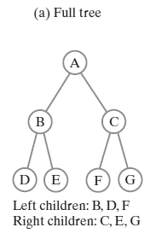
Binary Tree Definitions
A Full Binary Tree is one in which every node has either two children or no children.
A Binary Search Tree is one in which
each node N stores an entry with a key value K such that
nodes in the left sub-tree of N have values less than K
and nodes in the right sub-tree of N are greater than K.

Slide 17
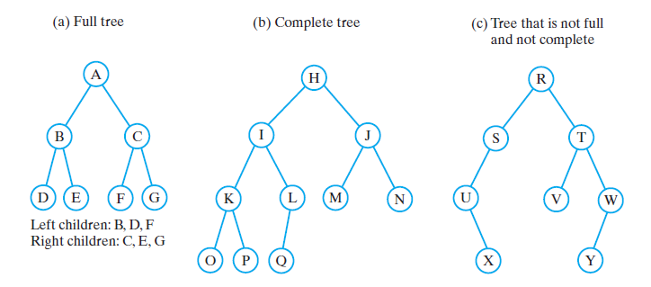
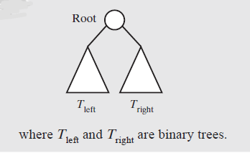
Binary Trees
What are the heights of the trees in Figures?
A full binary tree (sometimes proper binary tree or 2-tree) is a tree in which every node other than the leaves has two children.
A complete binary tree is a binary tree in which every level, except possibly the last, is completely filled, and all nodes are as far left as possible.

Slide 18
Binary Tree Balance
a
a
b
b
c
c
e
d
e
f
g
d
f
h
i
j
g
h
A balanced binary tree
i
j
An unbalanced binary tree
A binary tree is balanced if every level above the lowest is “full”
A tree is balanced if all of the leaves of the tree are on the same level or within one level of each other
In most applications, a reasonably balanced binary tree is desirable

Slide 19
Binary Tree Inserting items to a binary search tree
Insert the following elements in an ordered / search binary tree:
Dan, Ali, Bill, CJ, Ella, Flo, Gill
Insertion procedure:
Compares value to be inserted with data field
If value < data
If left link is null, assign to new node (containing value)
Else go deeper to the left
if value > data
If right link null, assign to new node (containing value)
Else go deeper to the right

Slide 20
Binary Tree Inserting items to a binary search tree
Is the resulting tree balanced?
Why?
How many “steps” to find Gill

Slide 21
Binary Tree ADT
It must be possible to:
Construct a new tree
Add a node
Get (iterate through) the nodes
Access the value in a node
Remove a node
Get the left/ right child of a node
Get the parent of a node
BTNode
BTNode.java
BinaryTree
BinaryTree.java
Tester Main Application
Tester.java

Slide 22
Binary Tree ADT Node – BTNode class
Each node contains an element and links to its two children.
The node in this example will store integer type elements
A node in a binary tree can be represented as follows:
class BTNode { int item; BTNode left;
BTNode right;
}
item
left
right

Slide 23
Binary Tree ADT Binary Tree Node’s methods
A node object (BTNode.java) for a tree supports the methods:
getItem() - Returns the object stored in this node.
getLeft () - Returns the left child node (null if there is no left child node) Output: node.
getRight () - Returns the right child node (null if there is no right child node) Output: node.
isInternal () - Test whether this node is internal Output: boolean.
isExternal () - Test whether this node is external Output: boolean.
isRoot() - Test whether this node is the root Output: boolean.
parent() - Return the parent of this node (null if this node is the root) - Output: BTNode.

Slide 24
Binary Tree ADT Binary Tree methods (accessors)
BinaryTree.java class
root() - Return the root of Tree (T); if T is empty an error occurs Output: BTNode
size() - Return the number of nodes in T Output: int
isEmpty() - Test whether T has any nodes or not Output: boolean
elements() - Return an enumeration of all the elements stored at nodes of T
contains(v) - Test whether this object exists in the tree Output: boolean

Slide 25
Binary Tree ADT Binary Tree methods (accessors)
inorder() - Print out a sequence of nodes in the tree Output: void
postorder() - Print out a sequence of nodes in the tree Output: void
preorder() - Print out a sequence of nodes in the tree Output: void
toString() - Return a String representation of the tree Output: String

Slide 26
Binary Tree ADT Binary Tree methods (mutators)
add(v) - Add the element v to the tree Input: Comparable Output : boolean
remove(v) - Remove the element v from the tree Input: Comparable Output: boolean
In the next class, we will work on implementing some of these methods

Slide 27
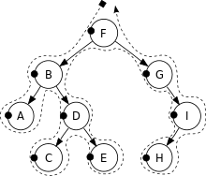
Traversals of A Tree
A tree traversal is a form of graph traversal and refers to the process of visiting each node in a tree data structure, exactly once.
Traversals of a binary tree are somewhat easier to understand
We use recursion
To visit all the nodes in a binary tree, we must
Visit the root
Visit all the nodes in the root’s left subtree
Visit all the nodes in the root’s right subtree

Slide 28
Tree Traversals
For linear structures, the process of iterating through the elements is fairly obvious (forwards or backwards)
For non-linear structures like a tree, the possibilities are more interesting
Let's look at four classic ways of traversing the nodes of a tree
All traversals start at the root of the tree
Each node can be thought of as the root of a subtree

Slide 29
Tree Traversal Binary Tree
Root order | Left before right | Reverse – right before left
In-order | Left, root, right | Right, root, left
Pre-order | Root, left, right | Root, right, left
Post-order | Left, right, root | Right, left, root

Slide 30
Tree Traversal In-order Traversal (Left, Root, Right)
x
-
/
+
6
+
1
4
5
2
3
First Visit

Slide 31
Tree Traversal In-order Traversal (Left, Root, Right)
The in-order traversal of a binary tree (T) can be informally viewed as visiting the nodes of T “ from left to right”.
left, root, right
The in-order traversal of a tree is
the in-order traversal of its left sub-tree
followed by its root
followed by the in-order traversal of its right sub-tree
In in-order, the root is visited in the middle

Slide 32
Tree Traversal Pre-order Traversal(Root, Left, Right)
The pre-order traversal of the tree associated with a document, as shown below, examines an entire document sequentially, from beginning to end.
Paper
Title
Abstract
§ 1
§ 1
References
§ 1.1
§ 1.1
§ 1.1
§ 1.1
§ 1.1

Slide 33
Tree Traversal Post-order Traversal (Left, Right, Root)
The post-order traversal method is useful for solving problems where we wish to compute some property for each node v in a tree, but computing that property requires that we have already computed that same property for v’s children.
Consider a file system tree whose external nodes represent files, and whose internal nodes represent directories.
To compute the amount of disk space allocated to a directory get the sum of the sizes of the files in the sub-tree rooted at the directory plus the size of the directory itself.

Slide 34
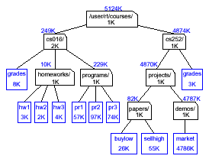
Tree Traversal Post-order Traversal (Left, Right, Root)
First Visit

Slide 35
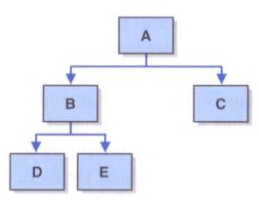
Binary Tree ADT Binary Tree methods
Preorder: visit the root, then traverse the subtrees from left to right
Inorder: traverse the left subtree, then visit the root, then traverse the right subtree
Postorder: traverse the subtrees from left to right, then visit the root
Level-order: visit each node at each level of the tree from top (root) to bottom and left to right
Preorder: A B D E C
Inorder: D B E A C
Postorder: D E B C A
Level-Order: A B C D E

Slide 36
Tree Traversal
Exercise
10
2
12
1. Pre-Order Traversal?
2. In-Order Traversal?
3. Post-Order Traversal?
1
5
11
7

Slide 37
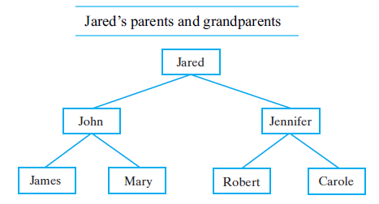
Suppose that visiting a node means simply displaying the data in the node. What are the results of each of the following traversals of the binary tree in Figure? Preorder, postorder, inorder, and level order.

Slide 38
Other traversals
The other traversals are the reverse of these three standard ones
That is, the right sub-tree is traversed before the left sub-tree is traversed
Reverse pre-order: root, right sub-tree, left sub-tree
Reverse in-order: right sub-tree, root, left sub-tree
Reverse post-order: right sub-tree, left sub-tree, root

Slide 39
Implementing Binary Trees
Binary trees can be implemented in at least two ways:
As arrays
As linked structures
To implement a tree as an array, a node is declared as an object with an information field and two “reference” fields

Slide 40
Array-Based Representation of Binary Trees
Nodes are stored in an array A
0
A
A
B
D
…
G
H
…
1
2
0
1
2
9
10
B
D
Node v is stored at A[rank(v)]
rank(root) = 0
if node is the left child of parent(node), rank(node) = 2 ⋅ rank(parent(node)) + 1
if node is the right child of parent(node), rank(node) = 2 ⋅ rank(parent(node)) + 2
3
4
5
6
E
F
C
J
9
10
G
H

Slide 41
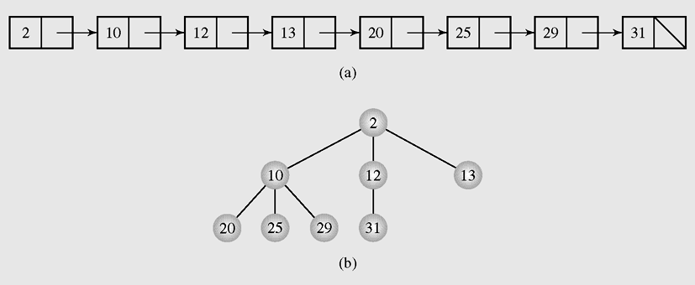
Linked List Representation of Binary Trees
An orderly tree is where all elements are stored according to some predetermined criterion of ordering
Figure: Transforming (a) a linked list into (b) a tree

Slide 42

Resources/ References
Dr. Muhammad M Iqbal*
Thanks to Dr. Cristina Muntean (NCI) for providing the lecture Slides for this presentation
Introduction to Algorithms, Thomas H. Cormen, Charles E. Leiserson, Ronald L. Rivest and Clifford Stein 3rd, 2009, MIT Press and McGraw-Hill.
Data Structures: Abstraction and Design Using Java, Elliott B. Koffmann, 2nd, 2010, Wiley.
Data Structures and algorithm analysis in java, Mark A. Weiss, 3rd, 2011, Prentice Hall.
Frank M. Carrano, Data Structures and Abstractions with Java™, 3rd Edition, Prentice Hall, PEARSON, ISBN-10: 0-13-610091-0.
This lecture may use some images and videos from the Google search repository to raise the understanding level of students. https://www.google.ie/search or Wikipedia

