Slide 1

Understanding Customer Satisfaction in the Airline Industry Master of Science in Analytics September, 2016 Steven Simecek

Slide 2
Agenda
Problem of Practice
Analytic Question(s) of Interest to Pursue
Literature Review
Practitioner – How is it being done today?
Academic – What is the underpinning models?
Analytical Project Plan
Summary

Slide 3
Problem of Practice (Stated)
Airline customers are largely dissatisfied with the service they receive (Channick, 2016)
Factors which drive customer satisfaction remain difficult to identify (intangibles) (Channick, 2016)
How can we better understand the factors affecting customer dissatisfaction in the airline industry?
Notes:
Increasing our understanding of customer dissatisfaction will allow airlines to implement pertinent policy changes which improve the customer experience. Improved customer experience and increased satisfaction will drive cost and efficiency savings for airlines which can translate to lower prices for the customers.

Slide 4
Problem of Practice (Background)
Airline customers are frustrated with the level of service they are receiving (Channick, 2016)
On time performance
Luggage handling
Excessive fees
Customer dissatisfaction costs airlines a significant amount of money (Anderson, 1994)
Lost market share
Notes:
Despite improvements by airlines in key areas, customer dissatisfaction continues to rise.

Slide 5

Stranded on
About 1,000 passengers on 9 aircraft were stranded on the tarmac at JFK for about 8 hours
One flight was stranded for almost 11 hours
Passengers were not allowed to leave
Prompted “Passenger Bill of Rights” in 2010
(Zeller, 2007)

Slide 6

Problem of Practice (Background)
Annual Airline Quality Rating (Bowen, 2016)
13 Top airlines in the US
Produced by:
Dr. Brent D. Bowen
Dr. Dean E. Headley
Measures
On Time
Denied Boardings
Mishandled Baggage
Customer Complaints

Slide 7
Problem of Practice (Background)
The Department of Transportation recorded a 38 percent increase in customer complaints from 2014 to 2015 (Channick, 2016)
This was despite improvements in:
On time performance (76% - 80%)
Mishandled baggage (dropped by 10%)
Overbookings (dropped by 17%)
(Bowen, 2016)
Notes:
Despite improvements by airlines in key areas, customer dissatisfaction continues to rise.

Slide 8
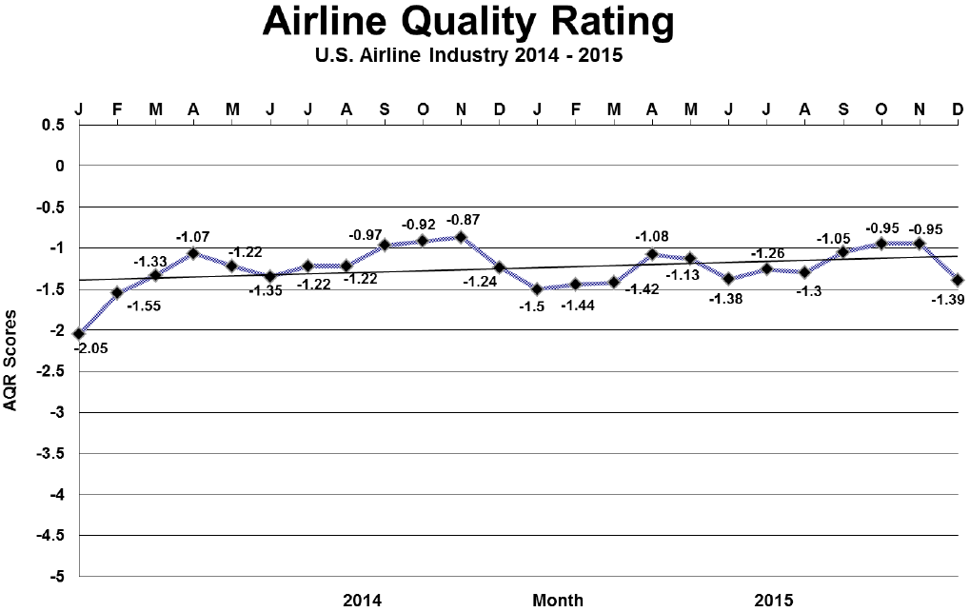
(Bowen, 2016)
Notes:
Customer complaints is actually a factor in AQR

Slide 9
(Bowen, 2016)

Slide 10
Analytic Questions of Interest to Pursue
What factors truly drive customer satisfaction/dissatisfaction?
Unconventional explanatory variables
How do we measure customer satisfaction?
Social media? Customer complaints?
What is the true cost of customer dissatisfaction for airlines?
Financial impact of service failures
What is the cost of improving customer satisfaction?
Customer service costs

Slide 11
Literature Review
Conflicting results regarding overall customer satisfaction
J.D. Power reports recent increase (seven factors)
cost & fees; in-flight services; boarding/deplaning/baggage; flight crew; aircraft; check-in; and reservation
(J.D. Power, 2016)

Slide 12
Literature Review
Practitioner reports show discrepancies in variables used to measure customer satisfaction, examples:
American Customer Satisfaction Index
J.D. Power
Airline Quality Rating

Slide 13



Consistent Winners

Slide 14



Consistent Losers
Notes:
There is something that these airlines aren’t getting right

Slide 15
Literature Review
Airlines operating in competitive markets are more adversely affected by poor customer satisfaction in terms of profits
Customers have a greater choice
(Steven, 2012)

Slide 16
Literature Review
Companies are better off providing error free service than providing superior error recovery after a service failure
(McCollough, 2000)

Slide 17
Literature Review
A large number of passengers post to social media regarding their flight experience
17% business travelers
7% leisure travelers
Majority of posts are positive
Customer satisfaction is improved when airlines respond to customer posts
(J.D. Power, 2016)

Slide 18
Analytics Project Plan
Describe the Plan
Initiating
Planning
Executing
Monitoring & Controlling
Closing

Slide 19
Initiating (by Oct 31)
Establish objective (better understand customer satisfaction in the airline industry)
Identify possible benefits to airline industry
Customer loyalty
Increased efficiency
Lower costs (and prices)
Will conduct deductive analysis – explanatory variables for customer satisfaction
Will conduct Inductive analysis – exploratory
Notes:
Analytics can certainly be used to

Slide 20



Initiating (by Oct 31)
Identify sources of data
Government
Other organizations
Data will be limited to domestic flights and top 15 U.S. airports (by number of flights)
Flight data including airport, carrier, date, time, delay status, number of passengers, etc.
Social media skimmed using R to identify customer sentiments
Notes:
Will need to find a suitable subset of data to allow processing.
Will limit to united states

Slide 21
Planning (by Jan 31)
Acquiring data
Correspondence with MITRE and other organizations and subject matter experts
Prep data for use
Data exploration and cleaning (R, Minitab)
Coding (R) will be used where possible to track process

Slide 22
Executing (by May 31)
Modeling (regression) will be used to identify which variables explain customer satisfaction/dissatisfaction
Inductive research to identify new trends
Resources
Airline performance data
Customer satisfaction data (surveys, social media)
Statistical software (R, Minitab, SAS, SAP HANA)
Analytical results verified/confirmed

Slide 23
Monitoring & Controlling (Ongoing)
Assess the feasibility of the project
Compare project status to the project plan
Formulate new plans for findings resulting from inductive analyses
Adjust the plan/scope of project as necessary

Slide 24
Closing (by July 22)
Summarize findings of the project
Compare findings to literature to identify new ideas
Make recommendations regarding how airlines can improve and track customer satisfaction
Identify and present key insights
Identify lessons learned and possible areas for improvement
Make recommendations for future data analyses
Notes:
Overarching goal (product, process, or solve problem). Begin with end in mind.

Slide 25
Summary
Customer satisfaction in the airline industry can be improved (particular carriers)
Methods for influencing and measuring customer satisfaction are not well established/agreed upon by experts
Better understand what drives customer satisfaction/dissatisfaction in the airline industry
Make suggestions for possible ways to improve/influence customer satisfaction
Increase customer satisfaction and drive customer loyalty

Slide 26
References
Anderson, E. W., Fornell, C., & Lehmann, D. R. (1994). Customer satisfaction, market share, and profitability: Findings from Sweden. The Journal of Marketing, 53-66.
Bowen, B. D., Headley, D. E. (2016). Airline Quality Rating 2016.
Channick, R. (2016). Airlines doing better, but passengers are more unhappy. Retrieved September 08, 2016 from http://www.chicagotribune.com/business/ct-airline-performance-0405-biz-20160404-story.html
McCollough, M. A., Berry, L. L., & Yadav, M. S. (2000). An empirical investigation of customer satisfaction after service failure and recovery. Journal of service research, 3(2), 121-137.
North American Airline Satisfaction Climbs to 10-Year High on Improved In-Flight Services and Growing Customer Acceptance of Extra Fees, Says J.D. Power Study. J.D. Power
Steven, A. B., Dong, Y., & Dresner, M. (2012). Linkages between customer service, customer satisfaction and performance in the airline industry: Investigation of non-linearities and moderating effects. Transportation Research Part E: Logistics and Transportation Review, 48(4), 743-754.
Zeller, T. (2007). Held Hostage on the Tarmac: Time for A Passenger Bill of Rights? Retrieved September 08, 2016, from http://thelede.blogs.nytimes.com/2007/02/16/held-hostage-on-the-tarmac-time-for-a-passenger-bill-of-rights/

