Slide 1
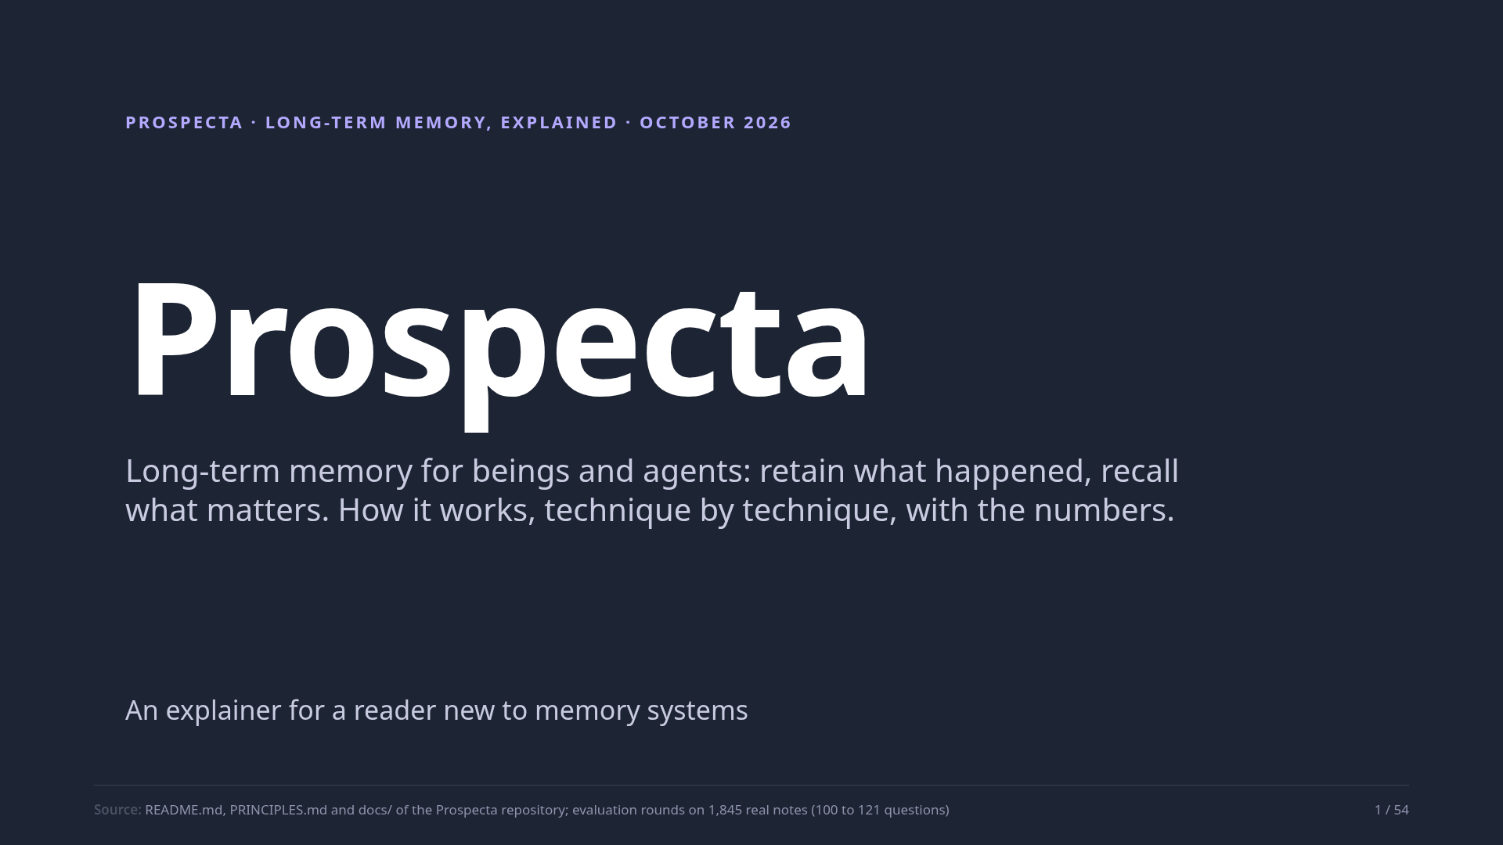
Notes:
Prospecta is long-term memory for beings and agents. A being, or a program with a job, writes down what happens, and later asks questions of that record. This deck explains how Prospecta does it, one technique at a time, with a made-up diary as the running example, and with real measurements from tests on a real corpus. You need no background in memory systems.
Source: README.md, PRINCIPLES.md and docs/ of the Prospecta repository; evaluation rounds on 1,845 real notes (100 to 121 questions)

Slide 2
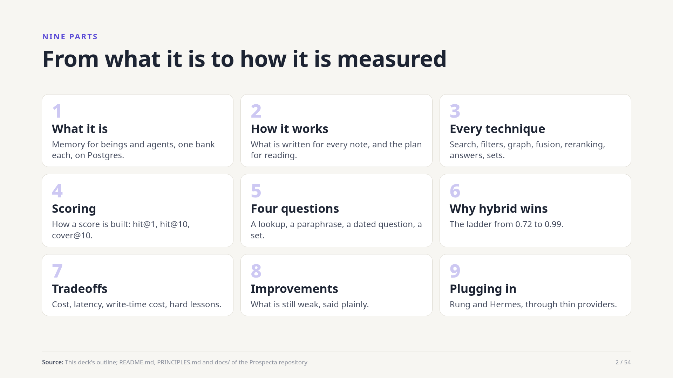
Notes:
Nine short parts. First what Prospecta is, then how it works from end to end. The longest part walks through every technique one by one, each with what it is good and bad at. Then how scores are built, four kinds of question walked through, the case for combining techniques, the costs, the weak spots, and how it plugs into the agent runtimes.
Source: This deck's outline; README.md, PRINCIPLES.md and docs/ of the Prospecta repository

Slide 3
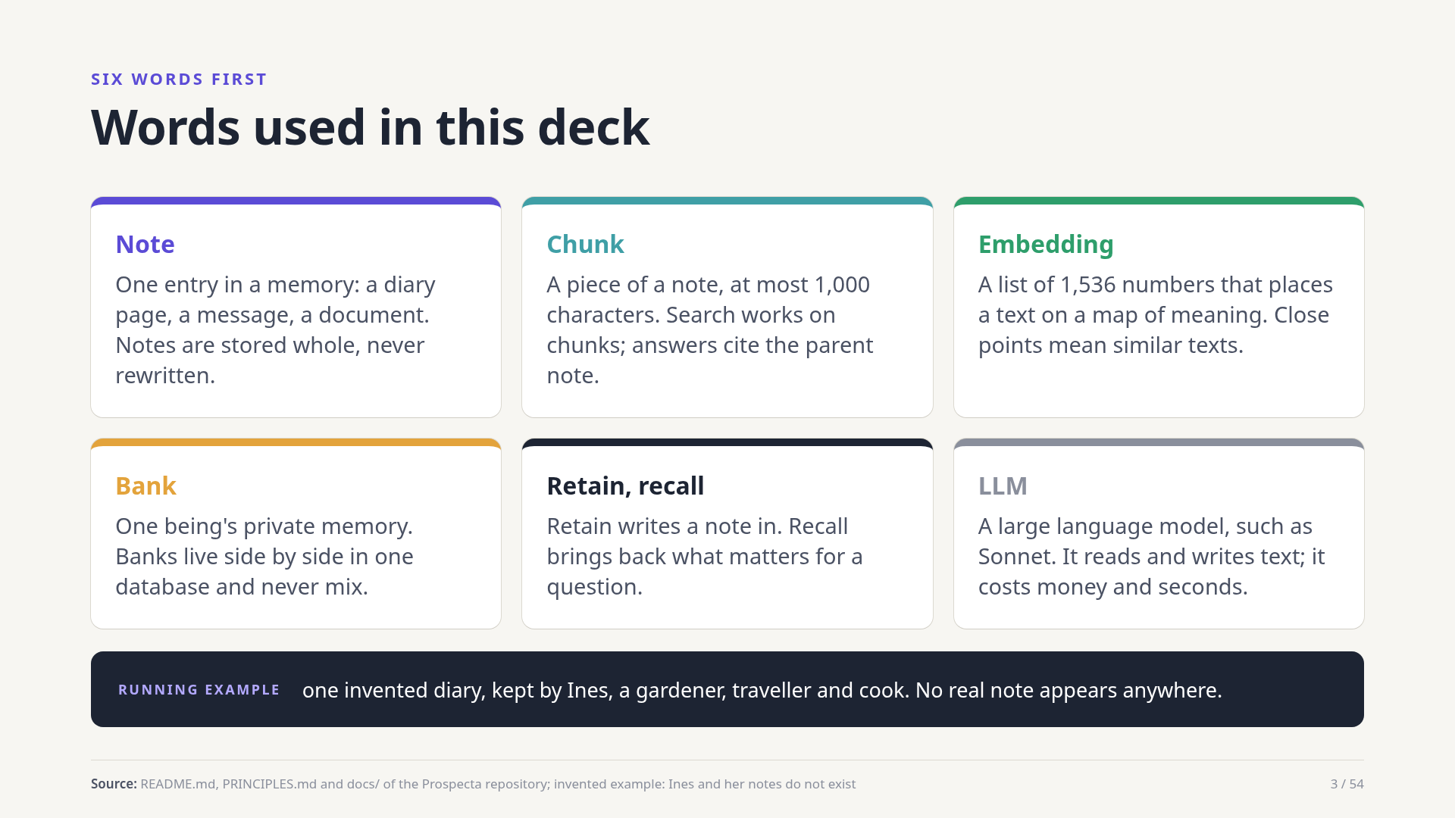
Notes:
Six words carry the deck. A note is one entry. A chunk is a small piece of it. An embedding is a list of numbers that places a text on a map where similar texts sit close together. A bank is one being's private memory. Retain and recall are the two verbs. And an LLM is a language model: smart, but it costs time and money, so we use it where it earns its place.
Source: README.md, PRINCIPLES.md and docs/ of the Prospecta repository; invented example: Ines and her notes do not exist

Slide 4
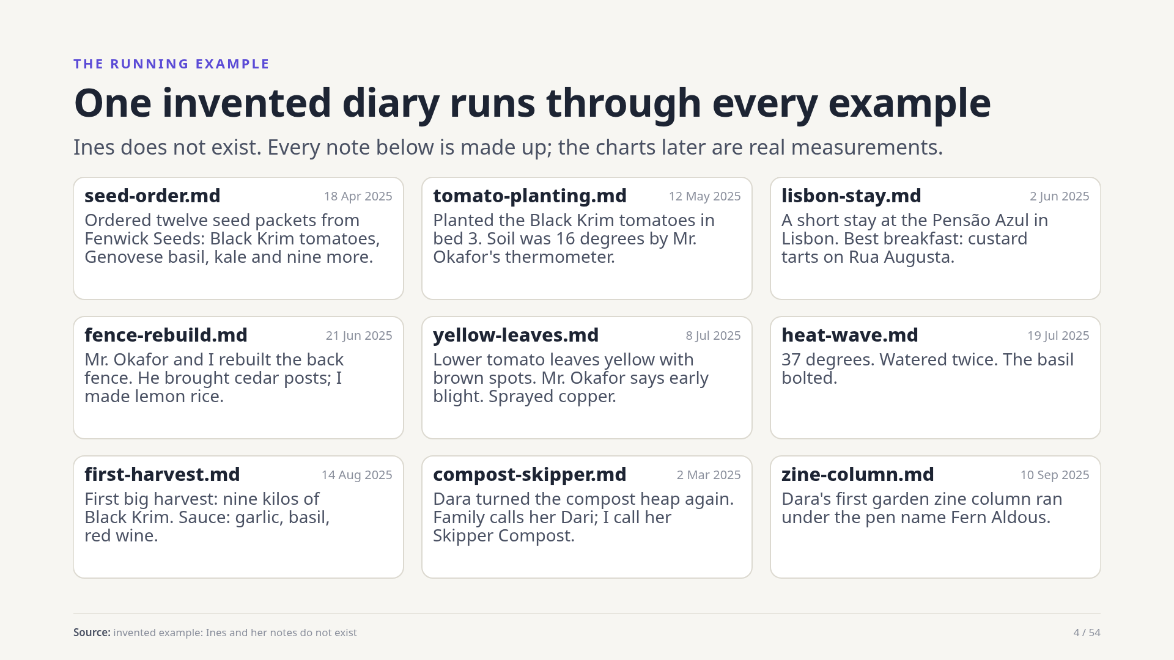
Notes:
Ines keeps a diary: seeds and tomatoes, a trip to Lisbon, a neighbour called Mr. Okafor, and her sister Dara, who has several names. Nine notes are enough to show every technique. None of these is real. When a slide shows a measured number, it comes from tests on a real corpus of 1,845 notes, and it says so.
Source: invented example: Ines and her notes do not exist

Slide 5
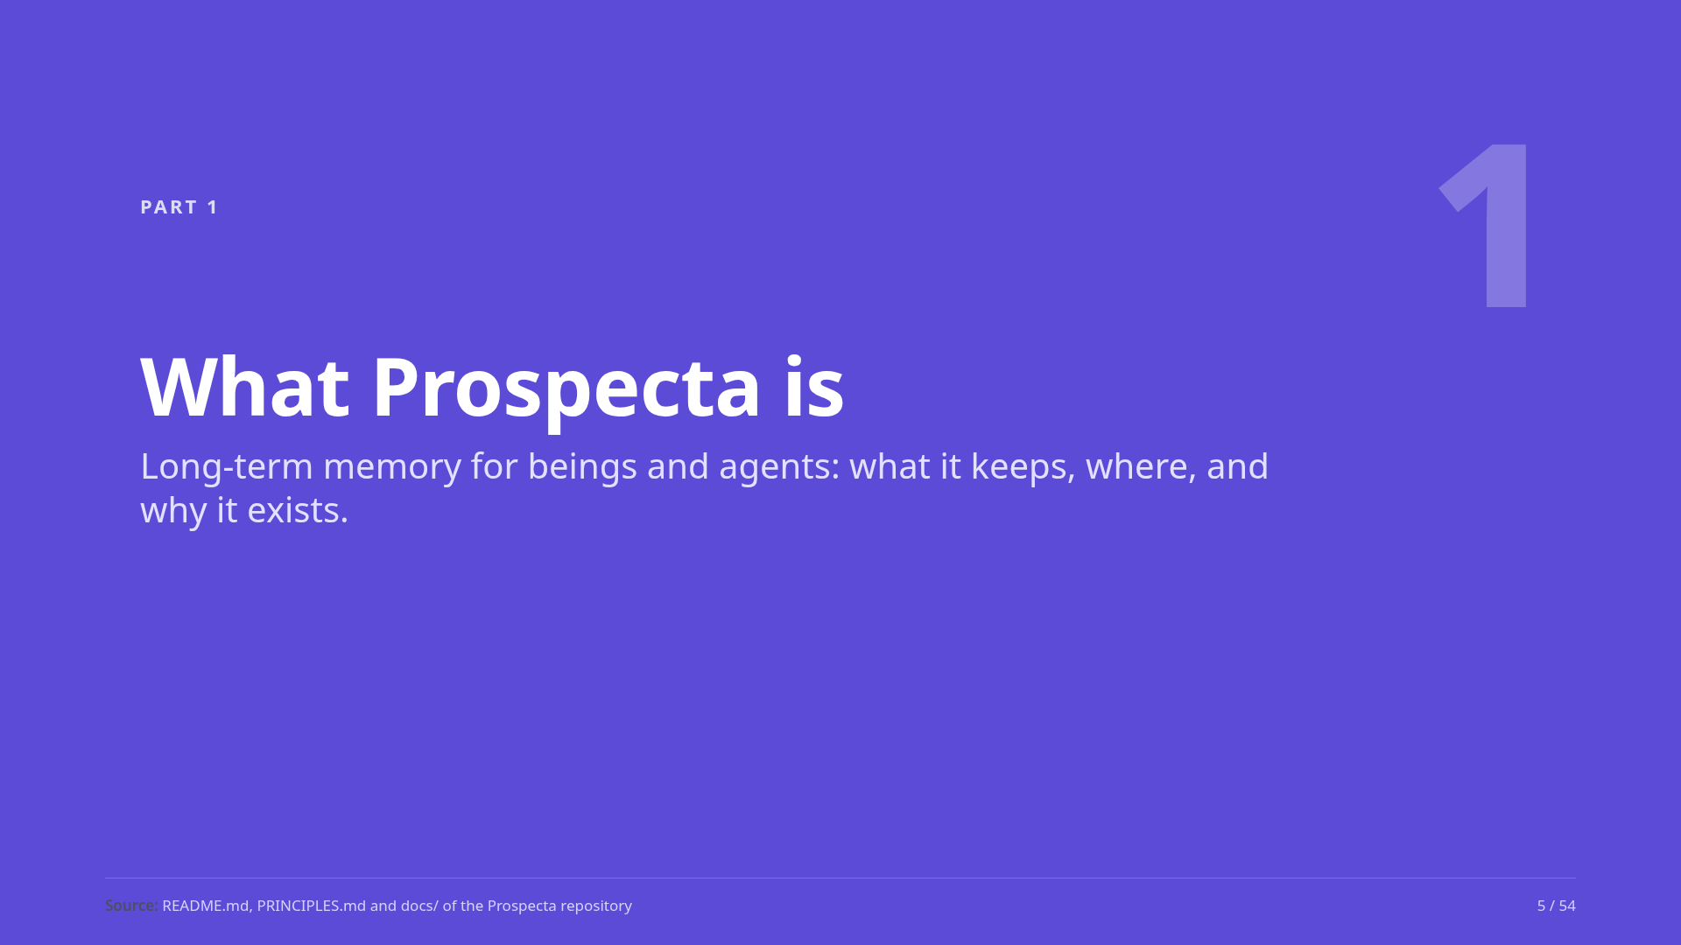
Notes:
Part one: what Prospecta is, in three slides.
Source: README.md, PRINCIPLES.md and docs/ of the Prospecta repository

Slide 6
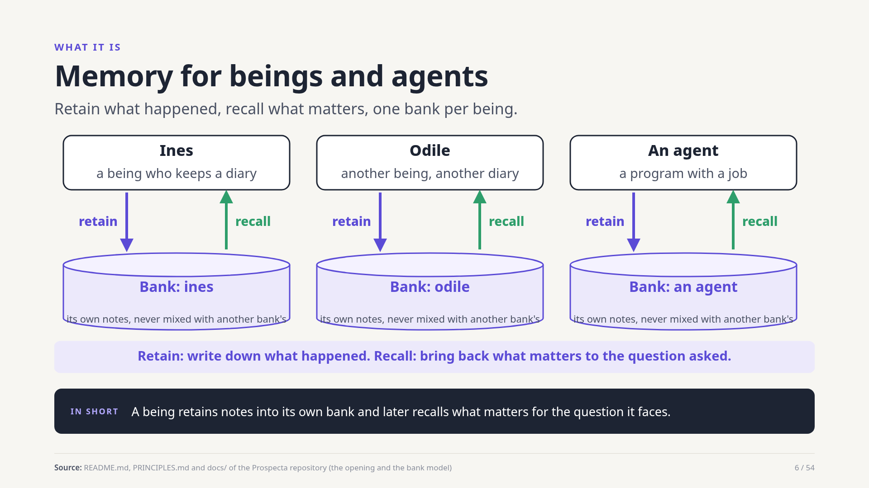
Notes:
Prospecta gives a being or an agent a long-term memory. Each one has its own bank. When something happens, it is retained: written into the bank. Later, when a question comes up, recall brings back the notes that matter, or a short cited answer built from them. Banks never mix, so one being's memory never leaks into another's.
Source: README.md, PRINCIPLES.md and docs/ of the Prospecta repository (the opening and the bank model)

Slide 7
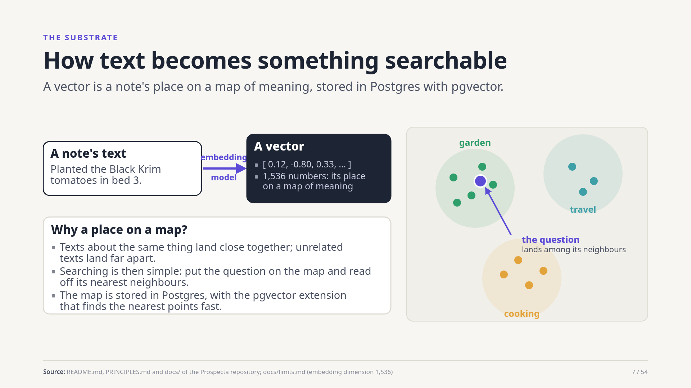
Notes:
Prospecta runs on Postgres, an ordinary database, with an extension called pgvector. An embedding model turns a text into a list of 1,536 numbers: its place on a map of meaning. Texts about the same thing land close together, so finding relevant notes becomes finding the nearest points to the question. Postgres does that quickly, and also stores everything else.
Source: README.md, PRINCIPLES.md and docs/ of the Prospecta repository; docs/limits.md (embedding dimension 1,536)

Slide 8
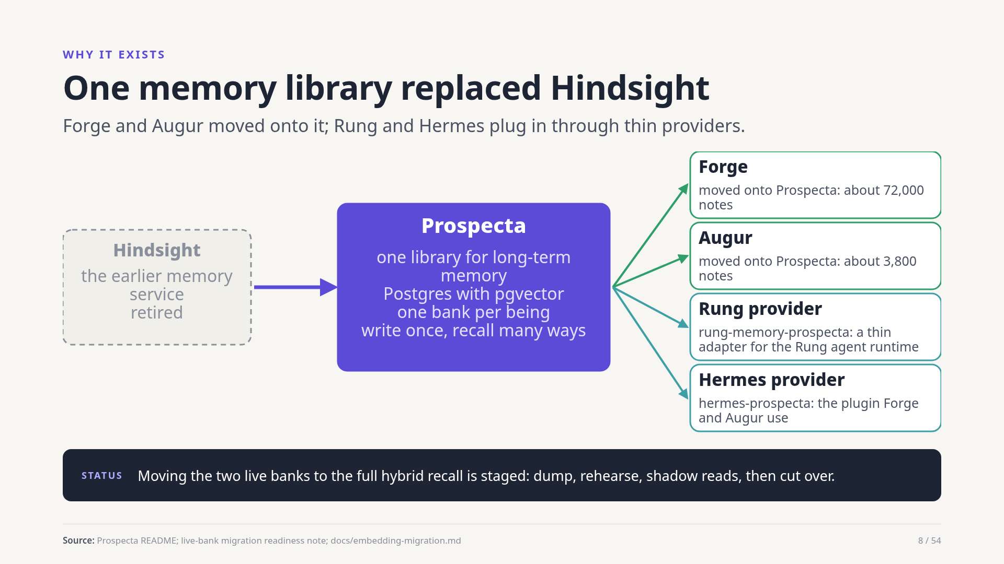
Notes:
Hindsight, the earlier memory service, is retired. Prospecta is one library on Postgres that Forge and Augur now use, with providers for the Rung agent runtime and for Hermes. Bank sizes are about 72,000 notes for Forge and 3,800 for Augur. Upgrading those banks to the full recall described here is a staged plan with a measured cost, not a switch already flipped.
Source: Prospecta README; live-bank migration readiness note; docs/embedding-migration.md

Slide 9
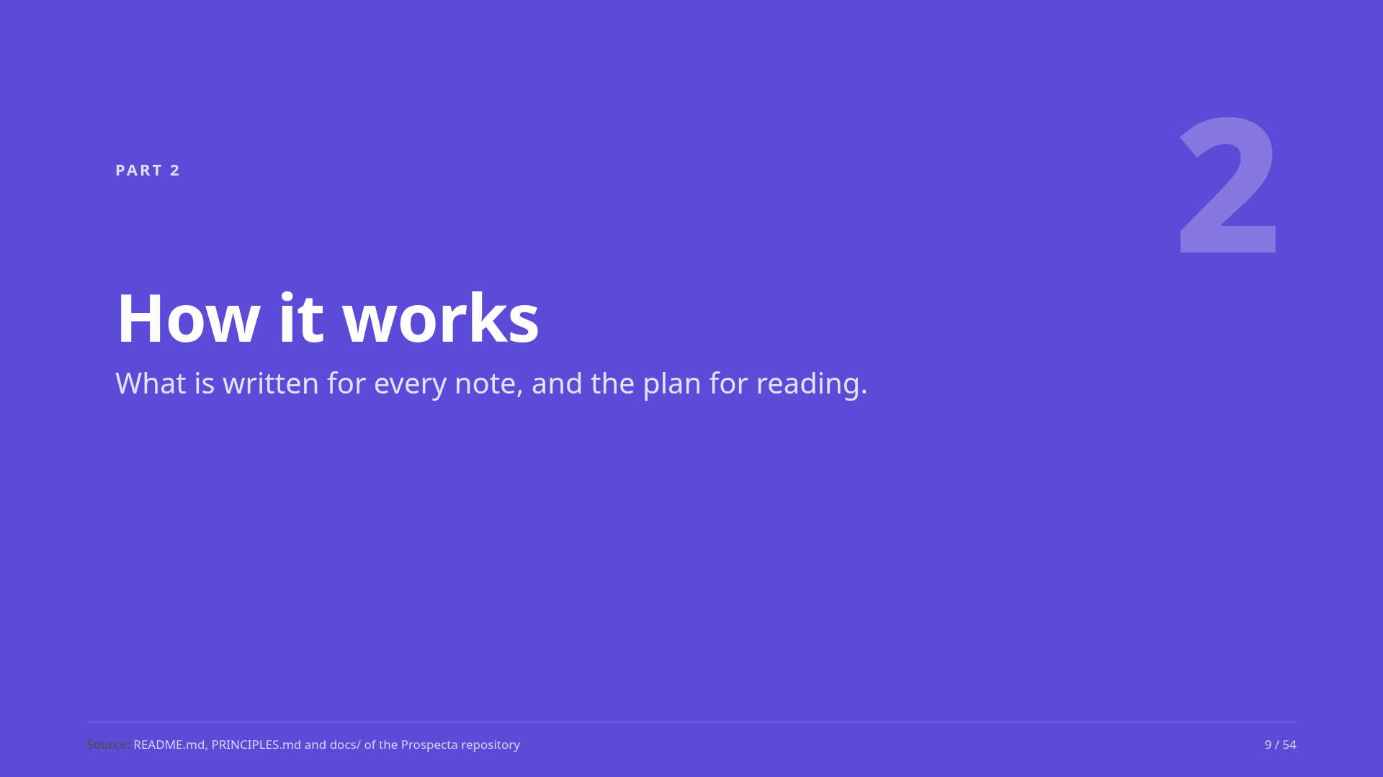
Notes:
Part two: the write side, retain, then the read side, recall, as one plan.
Source: README.md, PRINCIPLES.md and docs/ of the Prospecta repository

Slide 10
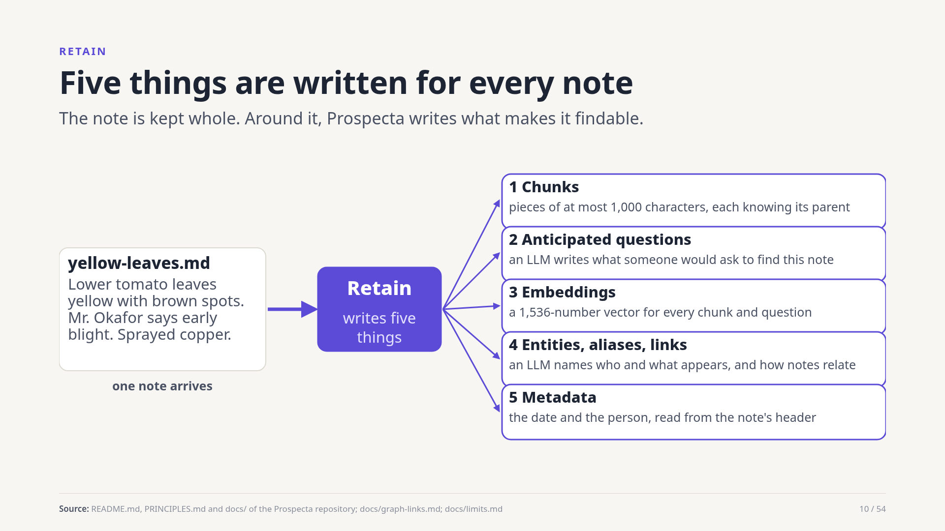
Notes:
When a note is retained it is stored verbatim. Prospecta also writes five derived things: chunks of at most a thousand characters, each knowing its parent; questions an LLM expects someone to ask; an embedding for each chunk and question; entities, aliases and links, also by an LLM at write time; and metadata, the date and the person, read from the note's header.
Source: README.md, PRINCIPLES.md and docs/ of the Prospecta repository; docs/graph-links.md; docs/limits.md

Slide 11
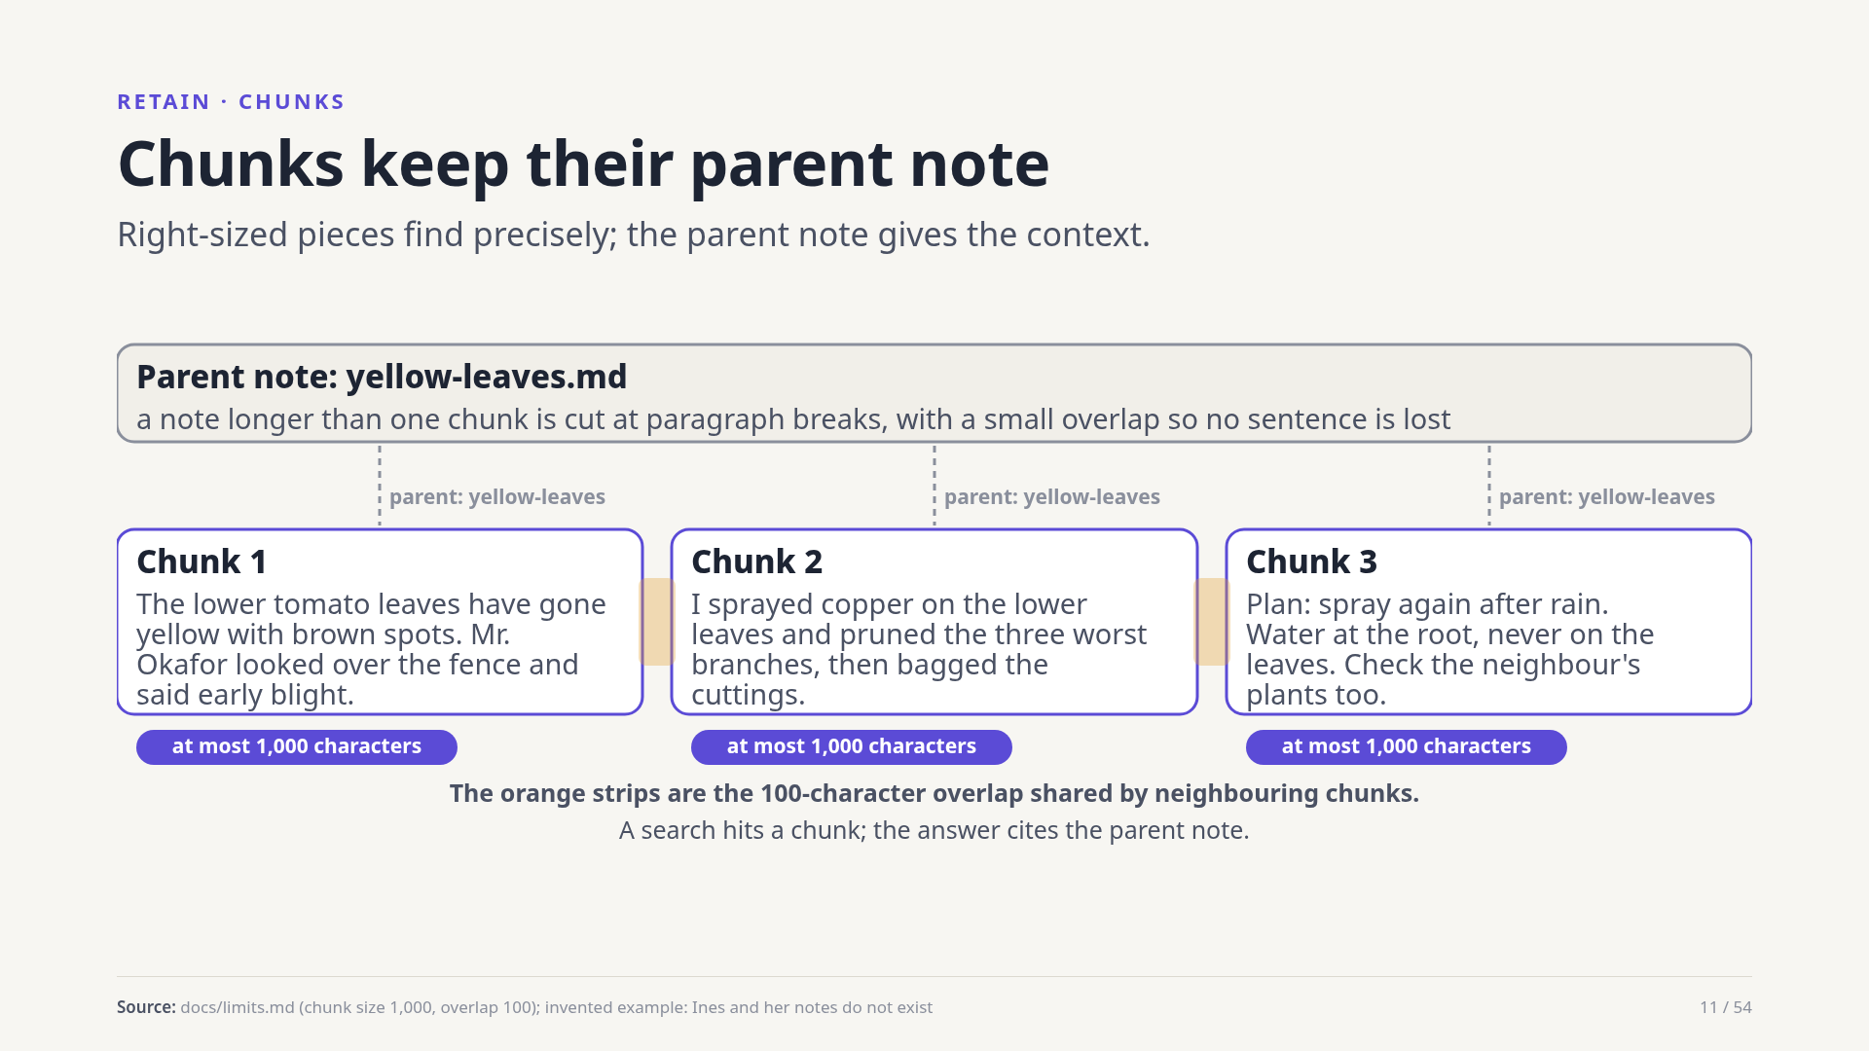
Notes:
A long note is cut at paragraph breaks into chunks of at most a thousand characters with a hundred characters of overlap, so no sentence is lost at a cut. Search matches chunks, which is precise. Results are reported per note, using the best chunk, and answers cite the parent note.
Source: docs/limits.md (chunk size 1,000, overlap 100); invented example: Ines and her notes do not exist

Slide 12
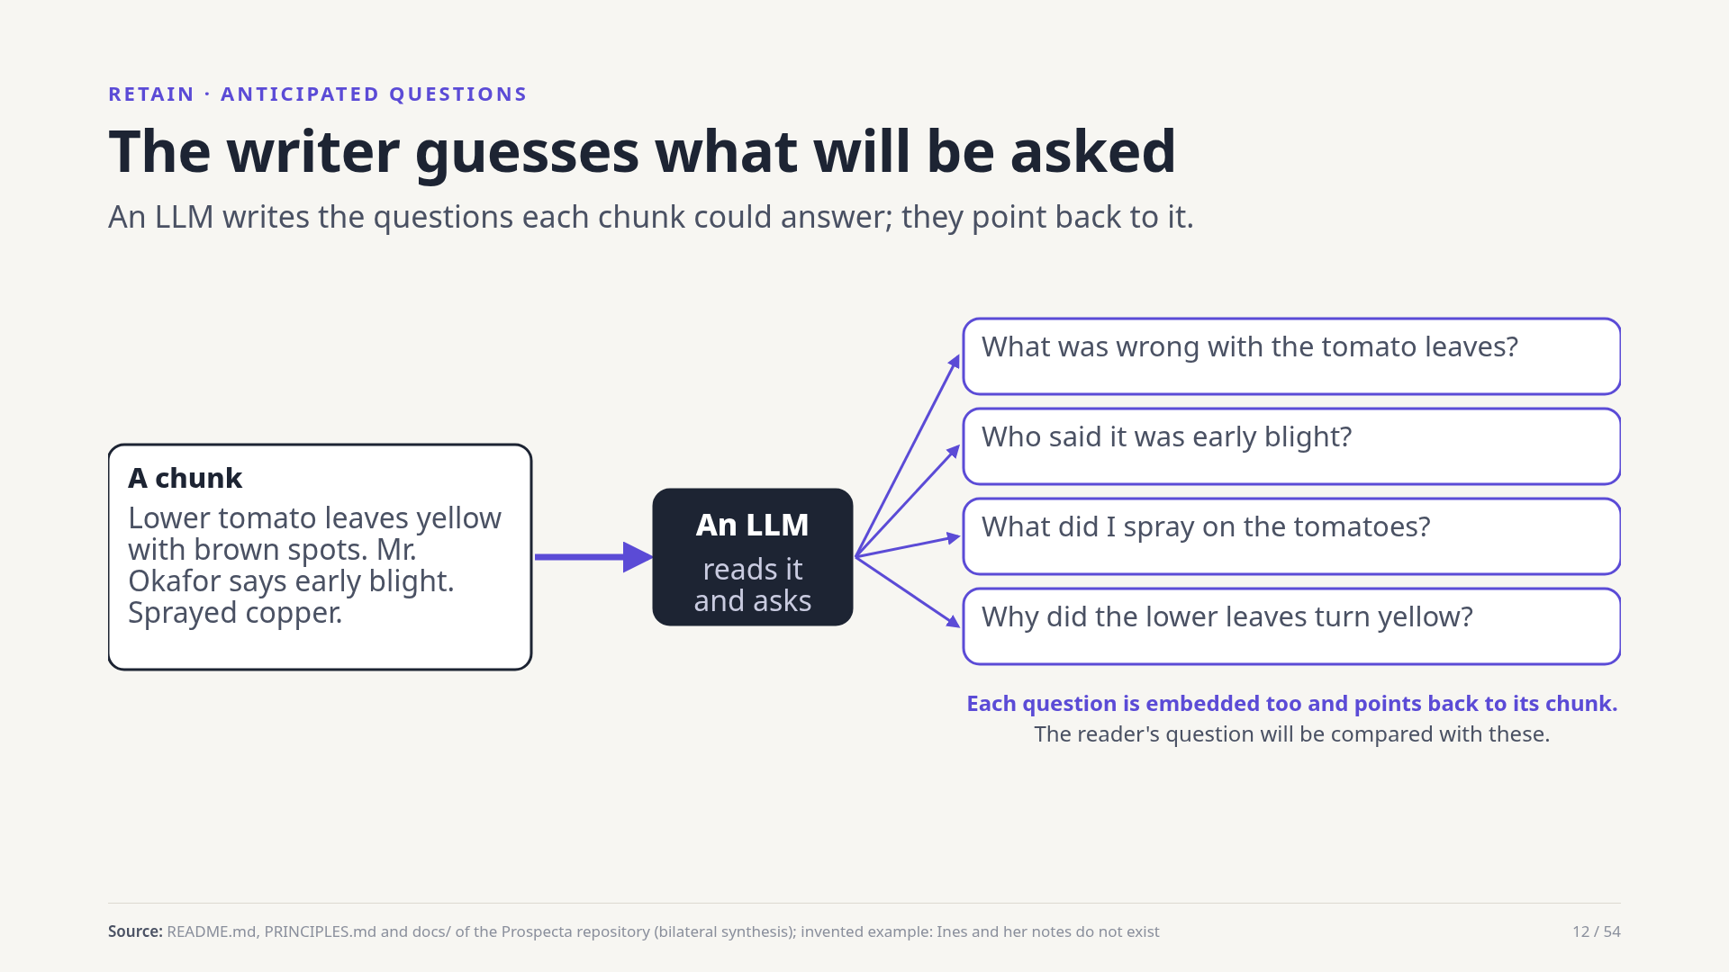
Notes:
Prospecta's founding idea: when a note is written, a language model also writes the questions someone might ask to find it. Those questions are embedded and point back to their chunk. At reading time the reader's question is matched against them. Both ends speak the same register, a question, which helps when the reader's words differ from the writer's.
Source: README.md, PRINCIPLES.md and docs/ of the Prospecta repository (bilateral synthesis); invented example: Ines and her notes do not exist

Slide 13
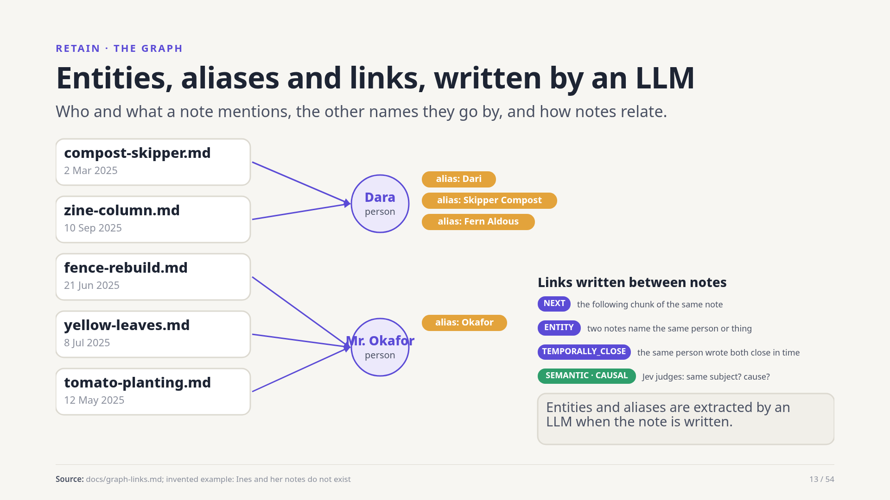
Notes:
A language model reads each note and lists the people and things in it, with aliases: Dara is also Dari, Skipper Compost and Fern Aldous. Links join notes: the next chunk, two notes naming the same entity, two notes close in time, and links judged by Jev, a small model that decides whether two notes share a subject or one led to the other.
Source: docs/graph-links.md; invented example: Ines and her notes do not exist

Slide 14
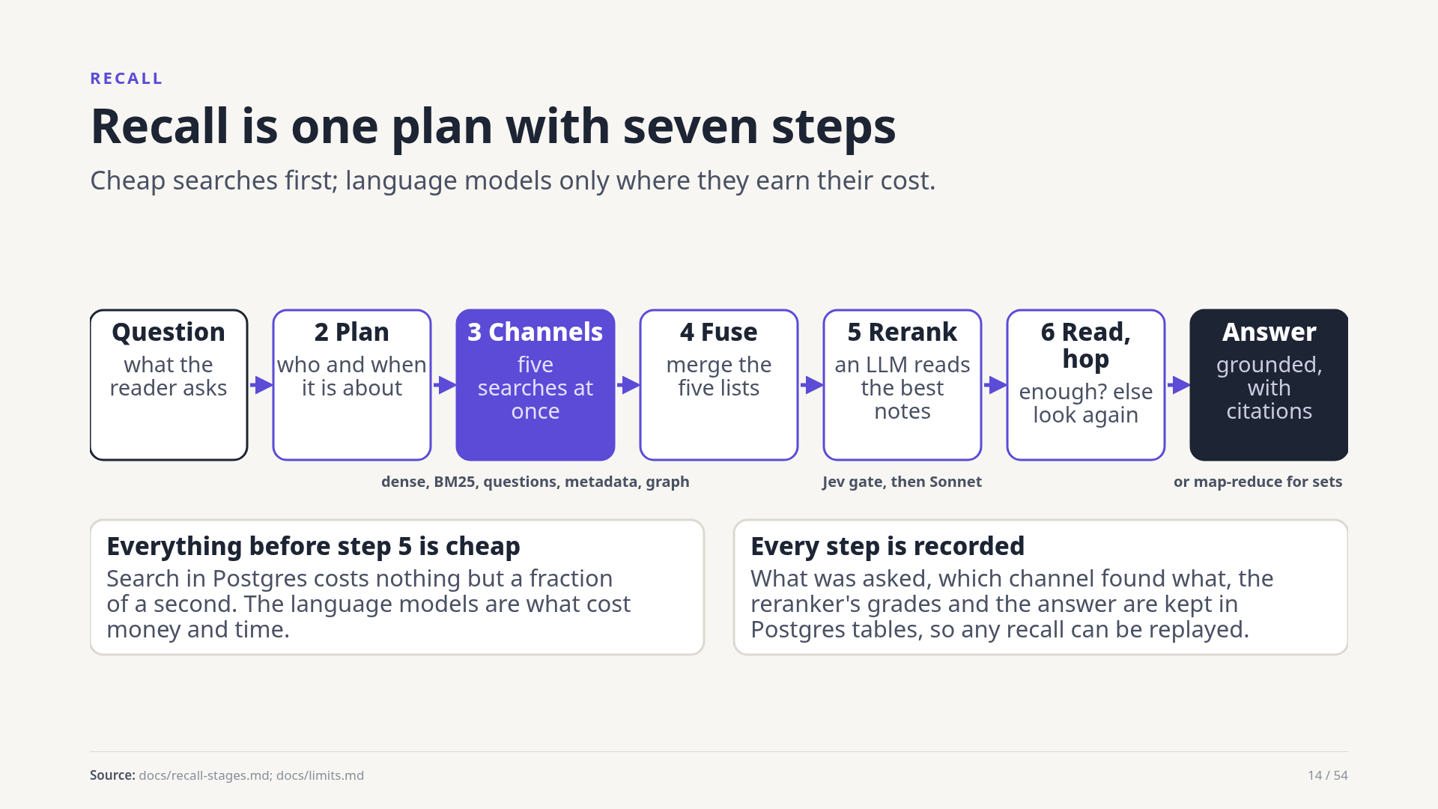
Notes:
Recall runs a fixed plan. The question is read for people and dates. Five searches run at once. Their lists are fused into one. An LLM reads the best notes and reorders them. A reader checks that the evidence is enough and may look once more. Finally an answer is written, grounded and cited, or for set questions a map-reduce reads every related note. Everything is recorded.
Source: docs/recall-stages.md; docs/limits.md

Slide 15
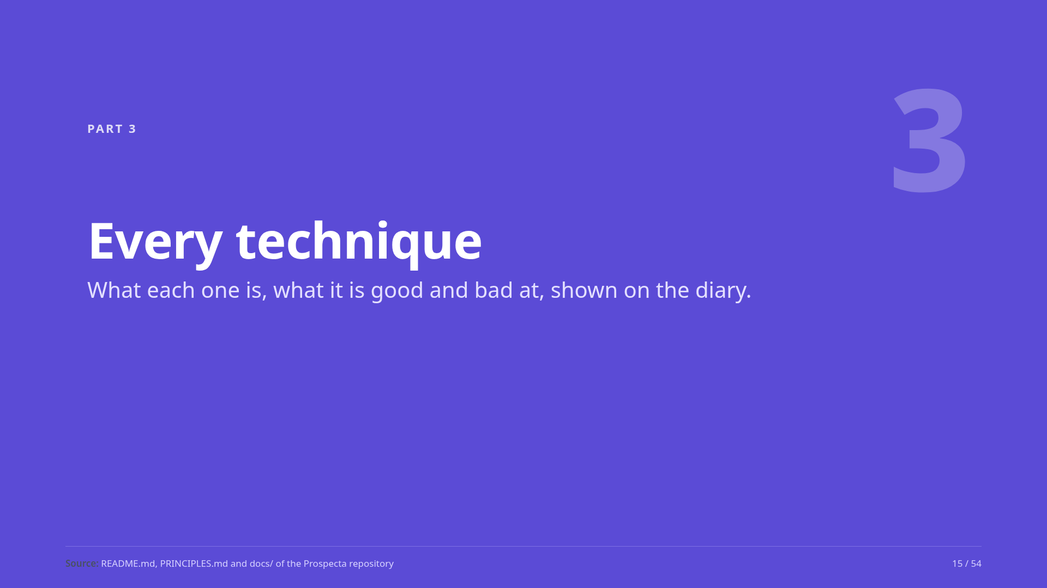
Notes:
Part three: every technique in the recall plan, one slide each, with what it does well and badly.
Source: README.md, PRINCIPLES.md and docs/ of the Prospecta repository

Slide 16
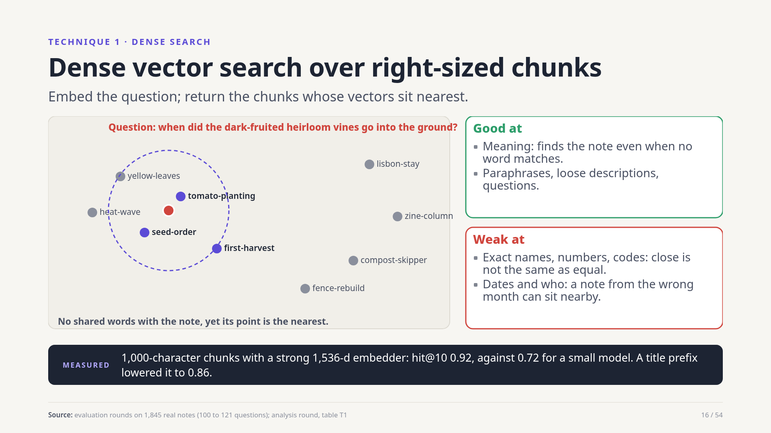
Notes:
Dense search is the workhorse. The question becomes a vector and the nearest chunk vectors come back. It finds a note even when no word is shared. It is weak where exactness matters: names, numbers, dates. Chunk size matters: pieces of up to a thousand characters beat whole notes, and a strong embedder took hit at ten from 0.72 to 0.92. Adding a title and date prefix made it worse.
Source: evaluation rounds on 1,845 real notes (100 to 121 questions); analysis round, table T1

Slide 17
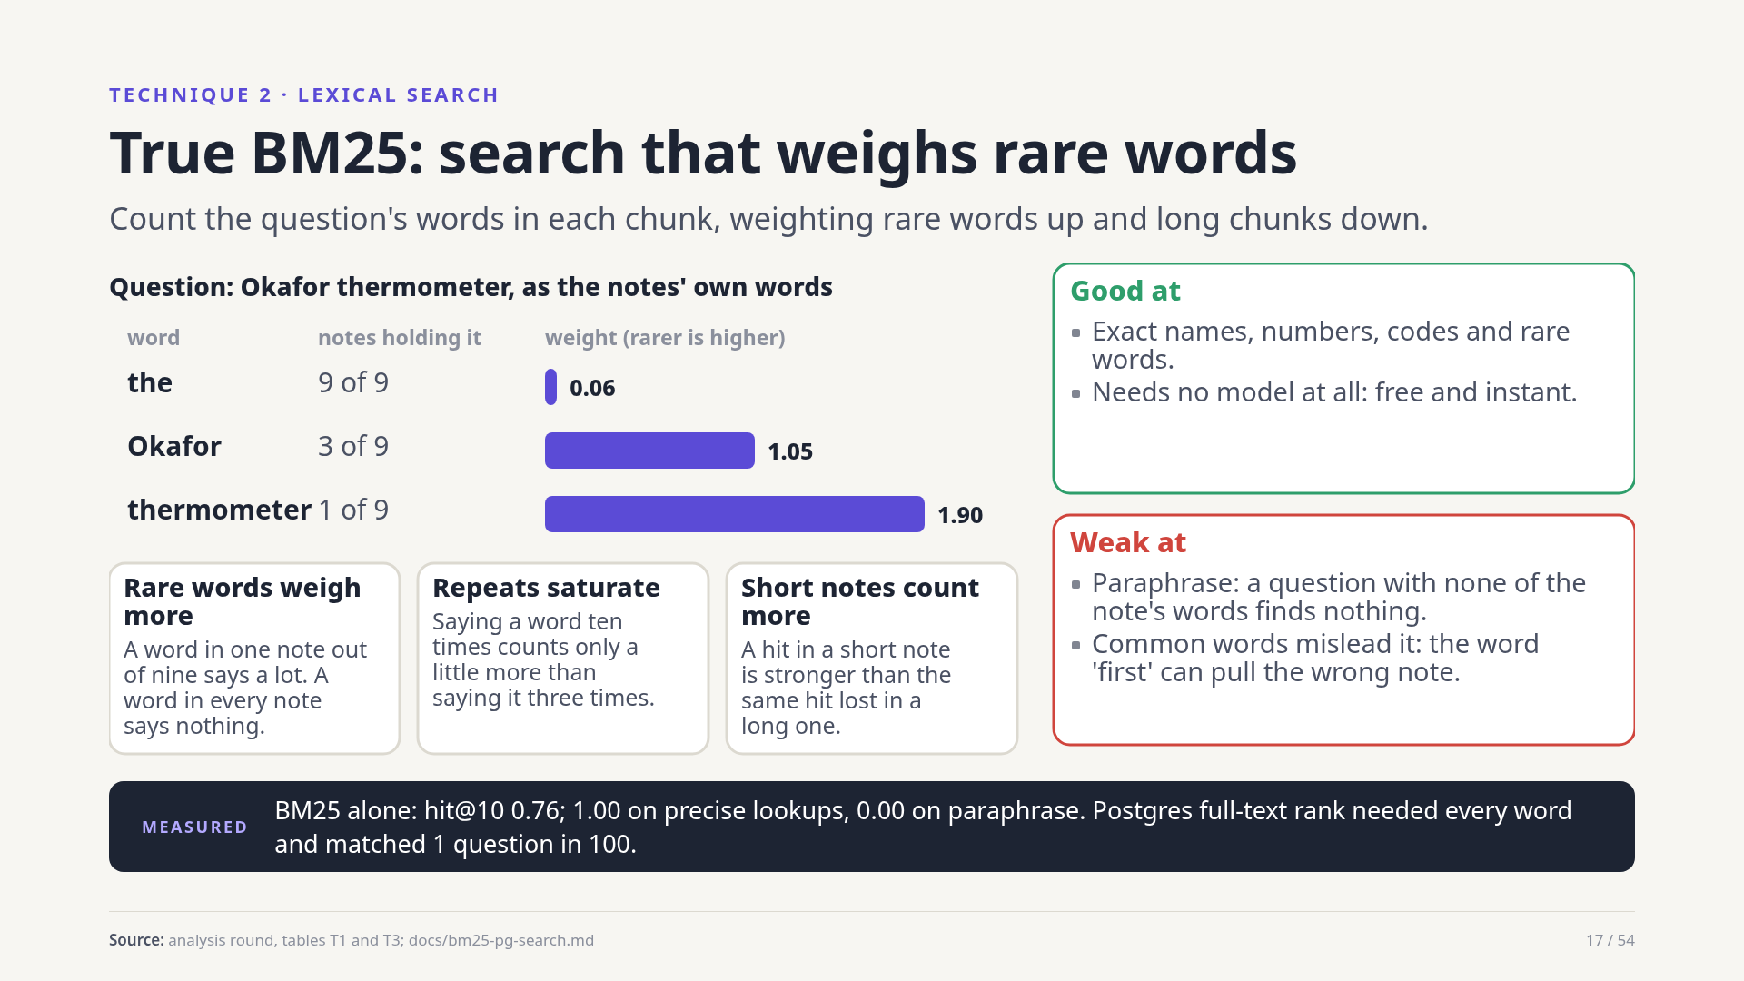
Notes:
BM25 is the classic word-matching formula. A word found in few notes weighs a lot; repeats count with diminishing returns; a short note counts more than a long one. It is perfect when the question carries the note's own rare words and useless on a paraphrase. Prospecta's first lexical channel was Postgres's built-in rank, which needed every word and matched one question in a hundred; a true BM25 replaced it.
Source: analysis round, tables T1 and T3; docs/bm25-pg-search.md

Slide 18
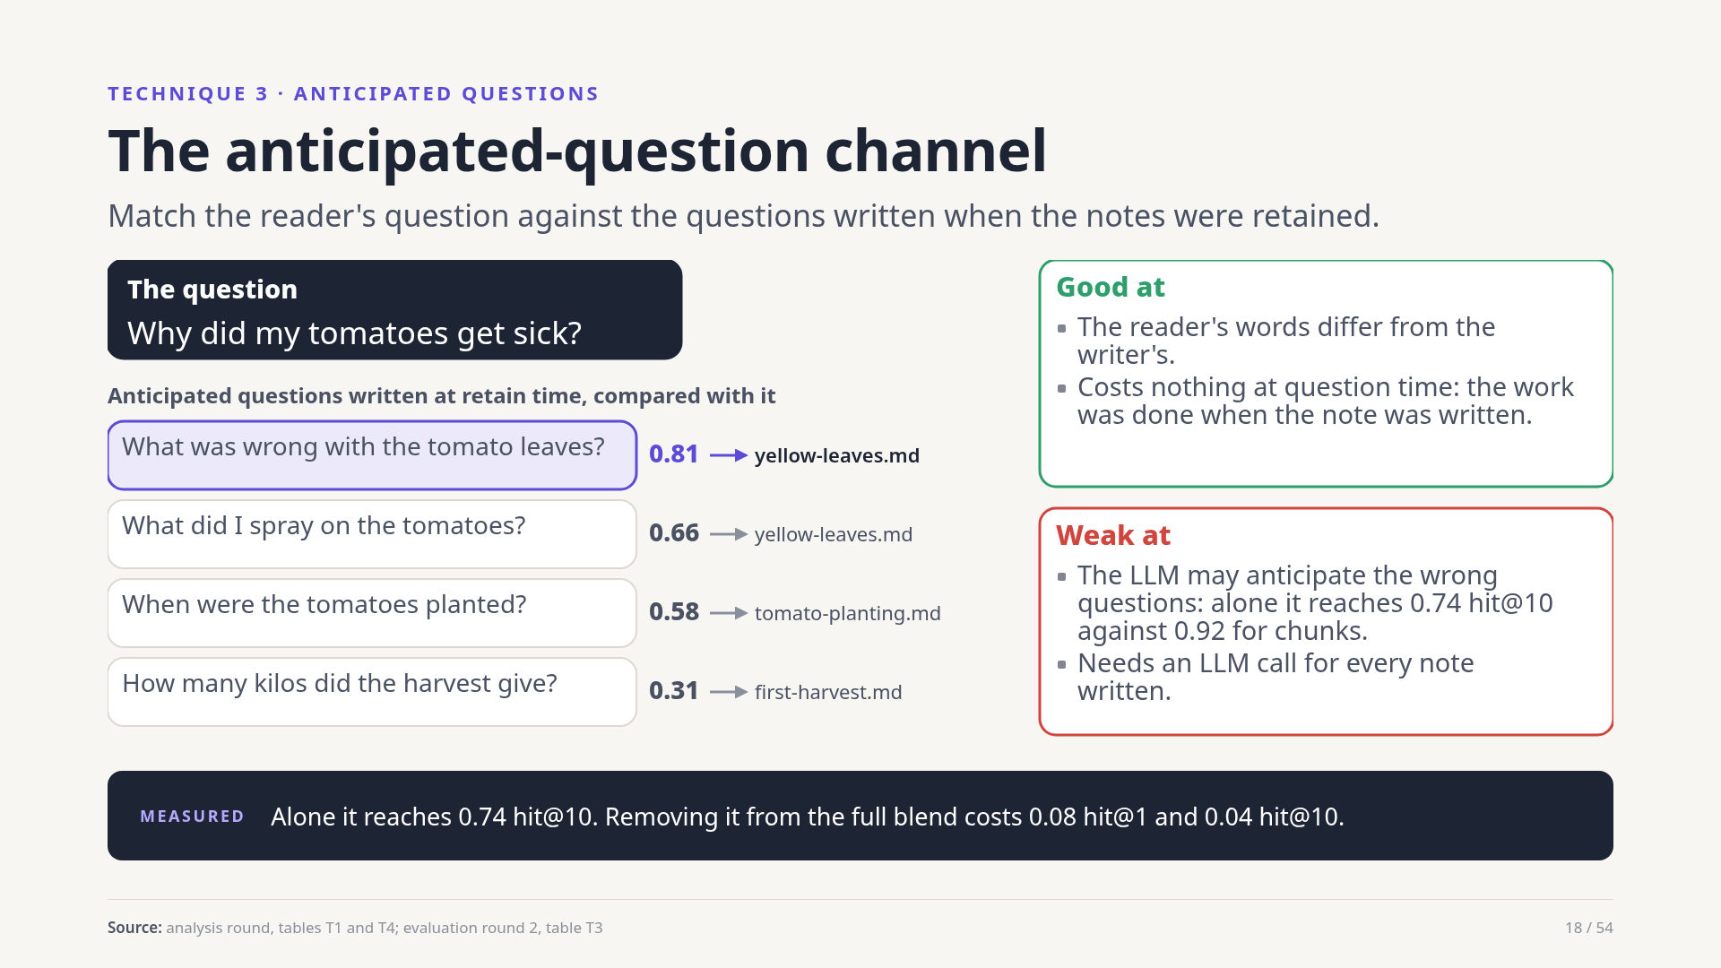
Notes:
The question channel compares the reader's question with the anticipated questions stored for each chunk. It shines when the reader's wording differs from the writer's, and it costs nothing at question time because the questions were written at write time. Alone it is weaker than plain chunks, since the model may guess the wrong questions, but in the blend it earns its place.
Source: analysis round, tables T1 and T4; evaluation round 2, table T3

Slide 19
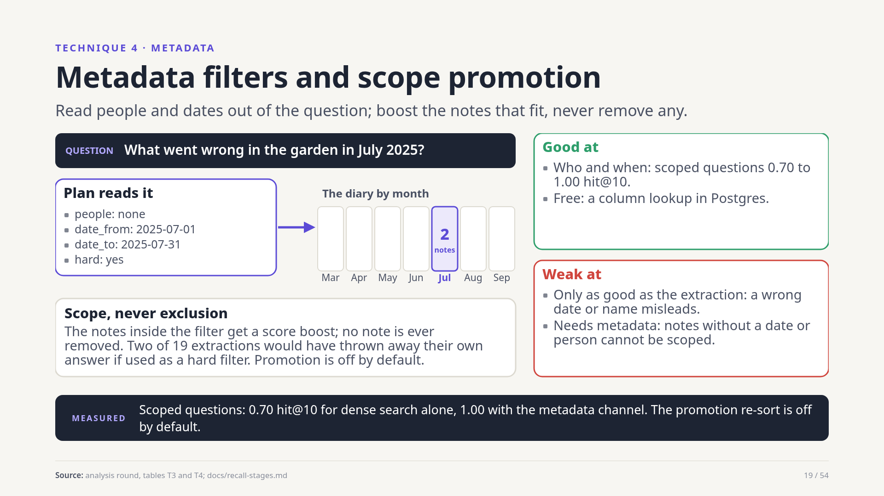
Notes:
Many questions are about a person or a time: what went wrong in July. The plan step asks a model to read the question for people and dates, then a metadata channel returns exactly the notes inside that scope, with weight three. It boosts, it never excludes: two of nineteen extractions would have discarded their own answer as hard filters. A separate re-sort that promotes the scope set is switched off because it once hurt the ordering.
Source: analysis round, tables T3 and T4; docs/recall-stages.md

Slide 20
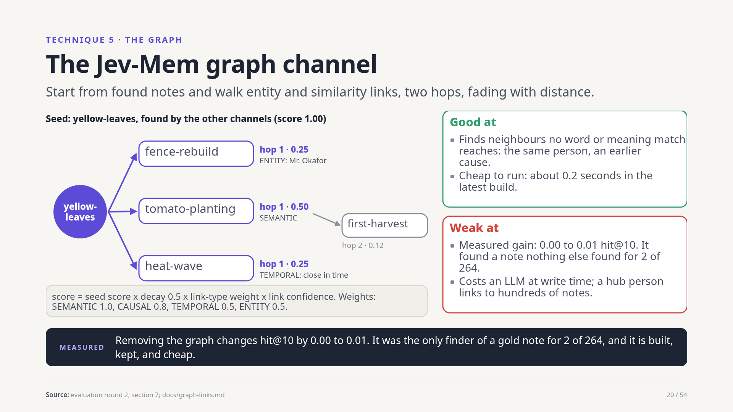
Notes:
Jev-Mem is a memory system whose ideas Prospecta ported into Postgres: entities, typed links, and a walk along those links. From the notes the other channels found, the graph channel walks two hops, multiplying by a decay of one half, a weight per link type and the link's confidence. It can reach a note no word or meaning match reaches. Honestly, on the real corpus it added almost nothing to the top ten, because the questions tested were answered by direct retrieval.
Source: evaluation round 2, section 7; docs/graph-links.md

Slide 21
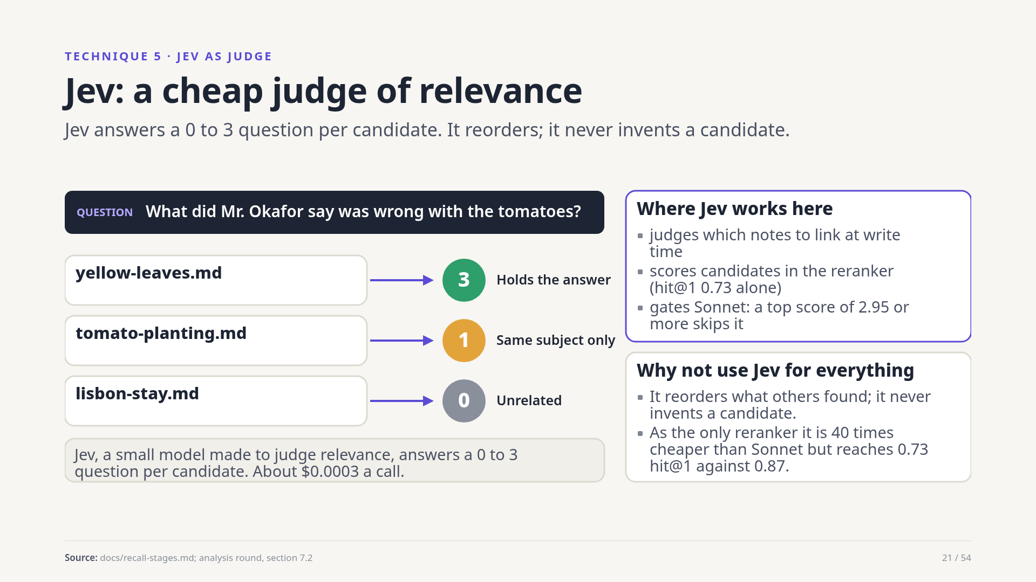
Notes:
Jev is a small model built to judge relevance. For a question and a candidate note it returns a score from zero, unrelated, to three, holds what is needed. Prospecta uses it in three places: to judge which notes to link at write time, to score candidates in the reranker, and to gate the expensive reranker. It costs about three hundredths of a cent a call.
Source: docs/recall-stages.md; analysis round, section 7.2

Slide 22
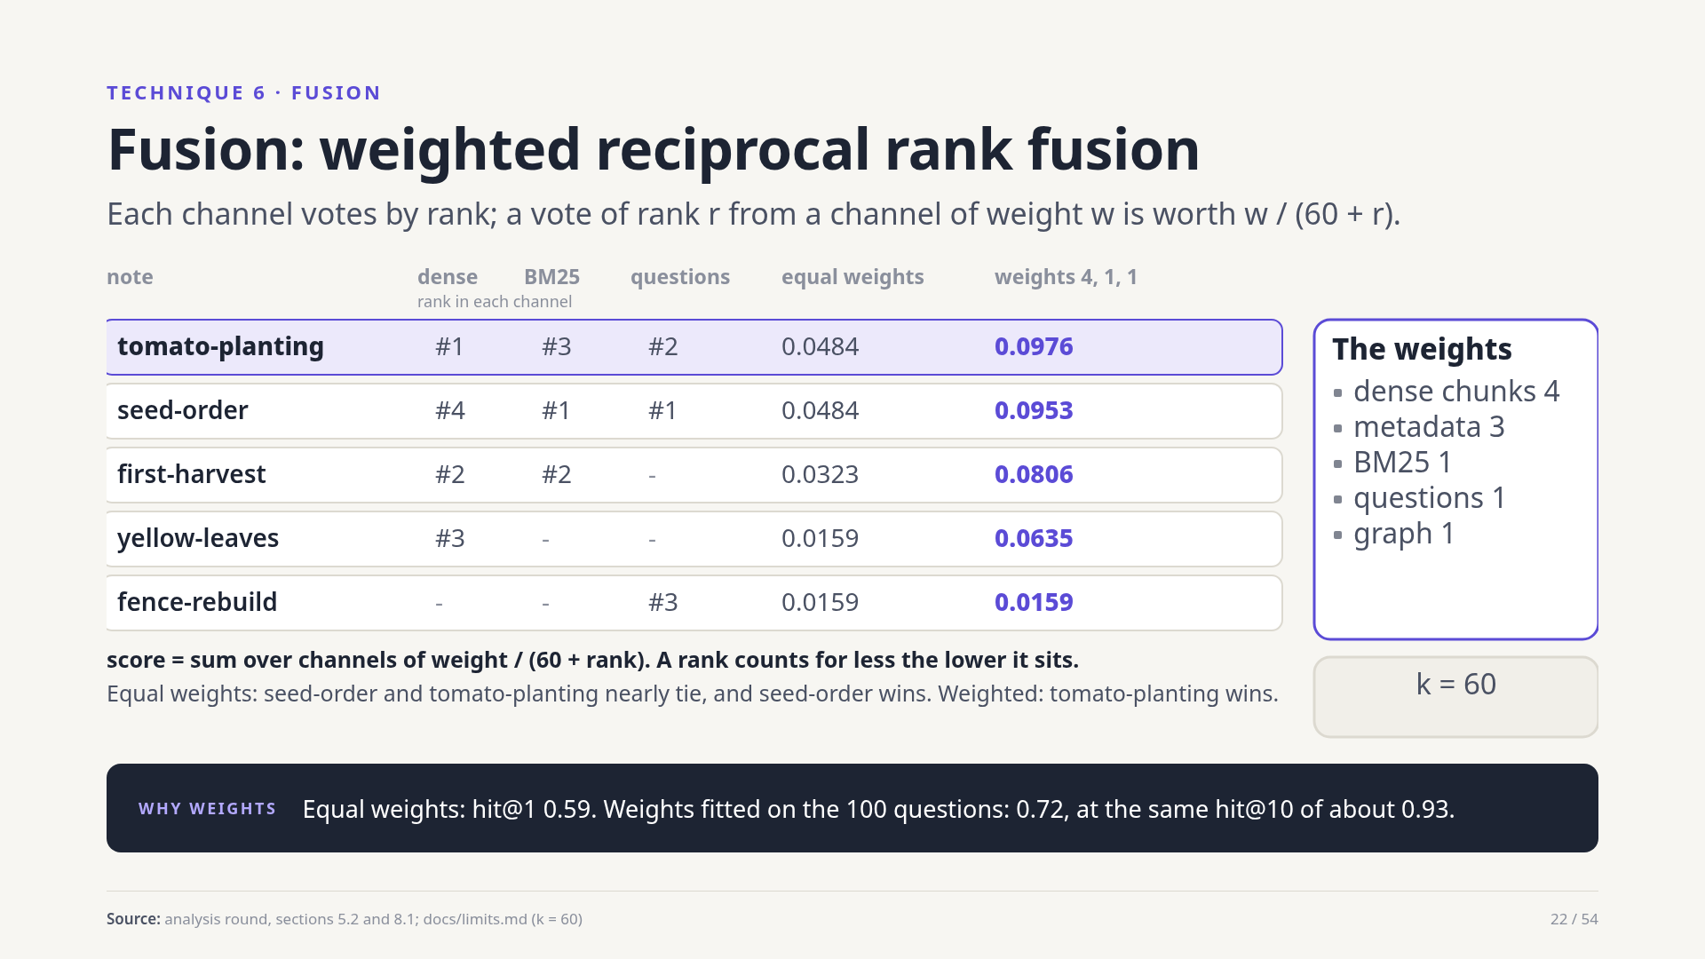
Notes:
Five channels return five ranked lists with incomparable scores, so Prospecta fuses ranks, not scores. A note ranked r by a channel of weight w gets w over sixty plus r; the votes are summed. In the example, equal weights nearly tie two notes and the wrong one wins; weights of four for dense, three for metadata and one for the rest put the right one first. Fitting the weights raised hit at one from 0.59 to 0.72.
Source: analysis round, sections 5.2 and 8.1; docs/limits.md (k = 60)

Slide 23
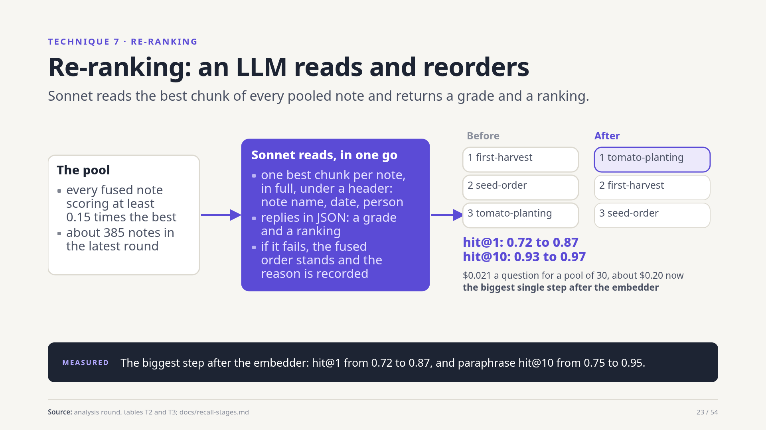
Notes:
After fusion, a listwise reranker reads. Every fused note scoring at least fifteen percent of the best goes into the pool, one best chunk each, uncut, under a header with note name, date and person. Sonnet replies with grades and a ranking. If it fails, the fused order stands and the reason is logged. It lifted hit at one from 0.72 to 0.87 and fixed most paraphrase misses.
Source: analysis round, tables T2 and T3; docs/recall-stages.md

Slide 24
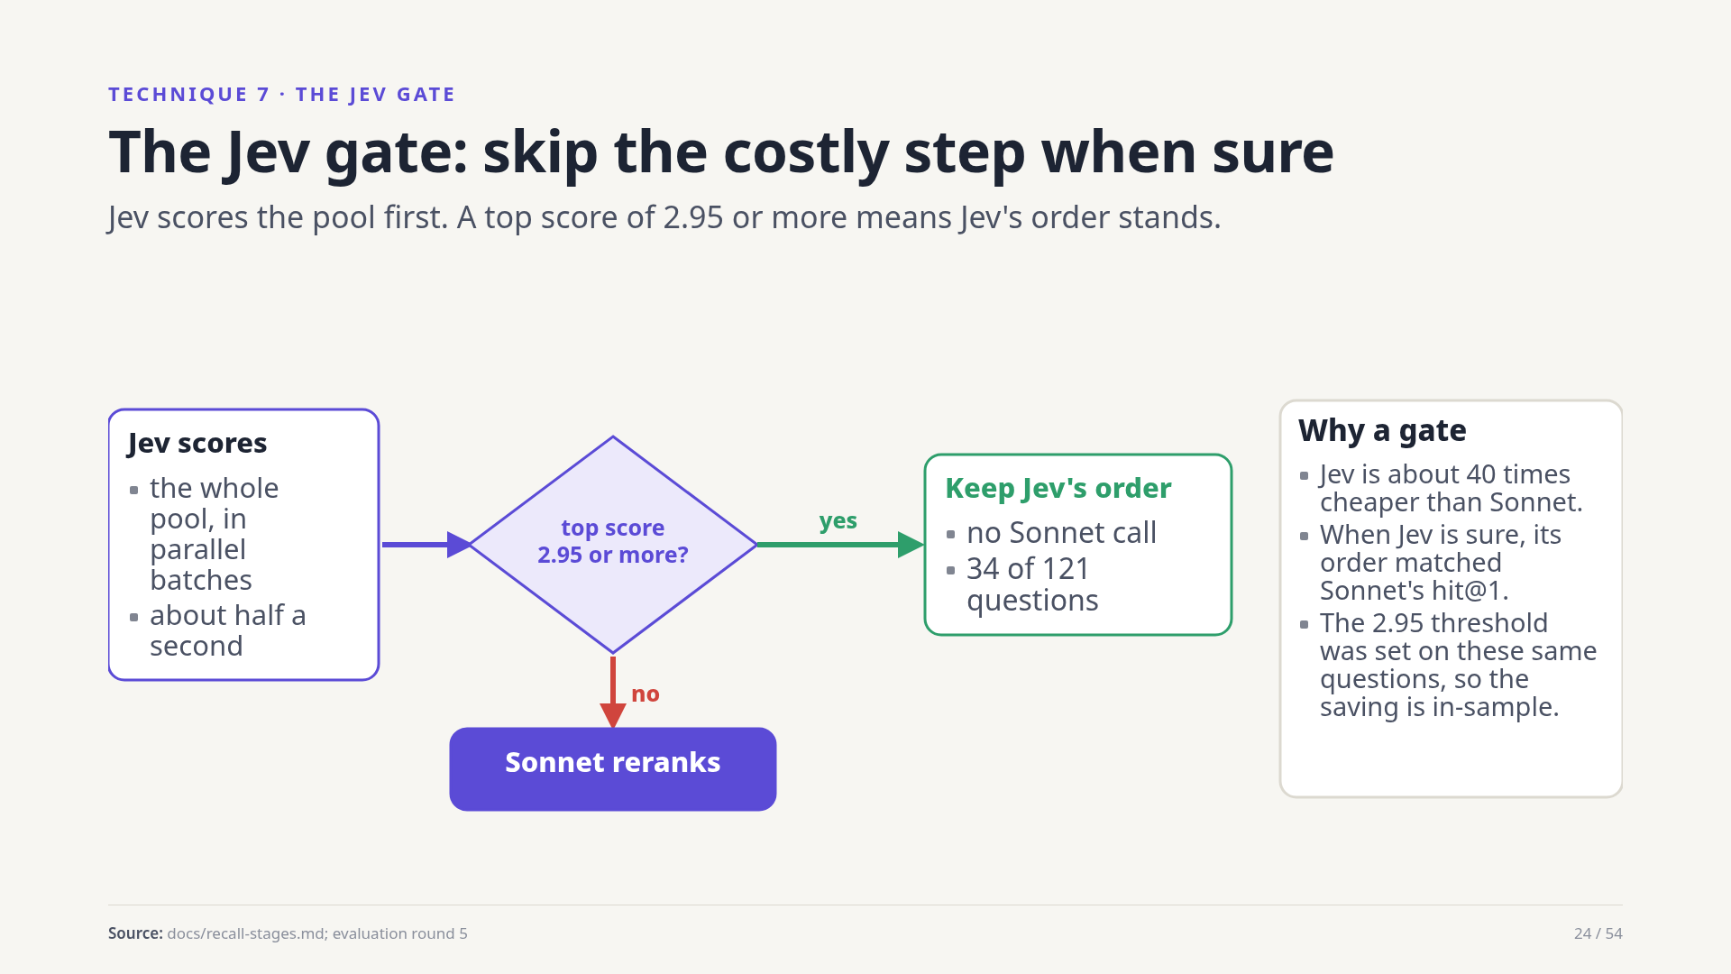
Notes:
Sonnet is expensive, Jev is cheap. So Jev scores the pool first. If its best score is at least 2.95 out of three, it is confident, and its order is kept with no Sonnet call. That happened on 34 of 121 questions with the same top-one accuracy. The threshold was chosen on these same questions, so treat the saving as in-sample.
Source: docs/recall-stages.md; evaluation round 5

Slide 25
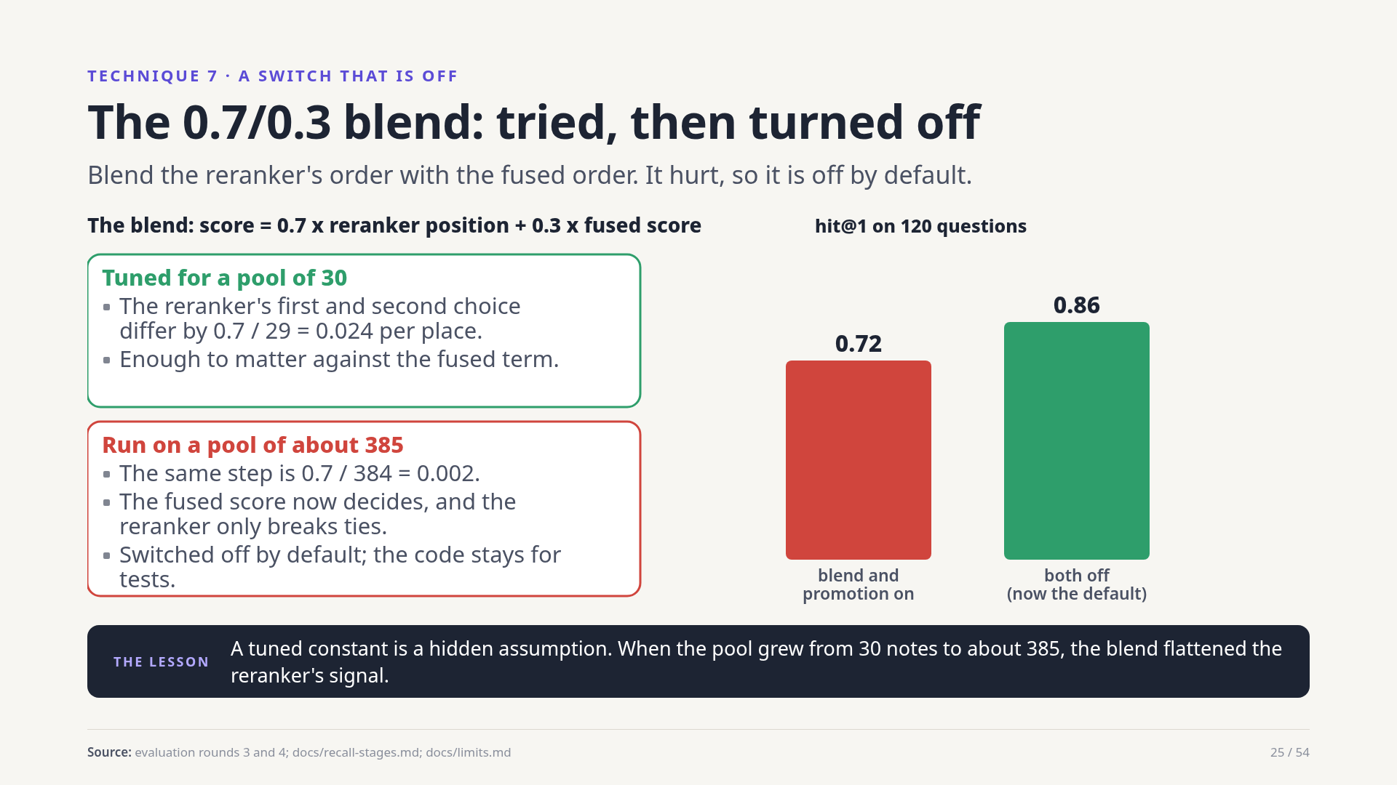
Notes:
The blend mixed seventy percent of the reranker's position with thirty percent of the fused score, to keep the strong dense hit from being dislodged. It was tuned for a pool of thirty. When pools grew to hundreds of notes, a place in the reranker's list was worth almost nothing, and the fused score decided. Hit at one fell from 0.86 to 0.72 together with the promotion re-sort. Both are off by default; the code stays for tests.
Source: evaluation rounds 3 and 4; docs/recall-stages.md; docs/limits.md

Slide 26
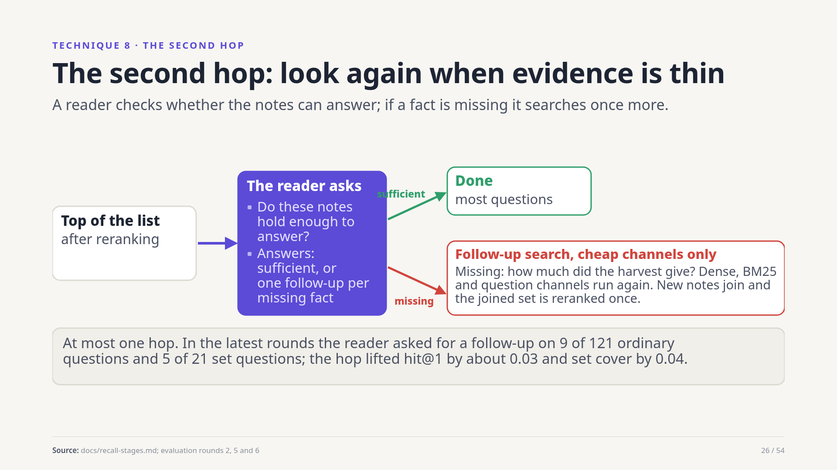
Notes:
After reranking, a reader model looks at the best notes and says sufficient, or names each missing fact with a follow-up query. Follow-ups run only the cheap channels; any new notes join and the set is reranked once. There is at most one hop. It fires on a minority of questions, and it lifted hit at one by about three hundredths and set cover by four.
Source: docs/recall-stages.md; evaluation rounds 2, 5 and 6

Slide 27
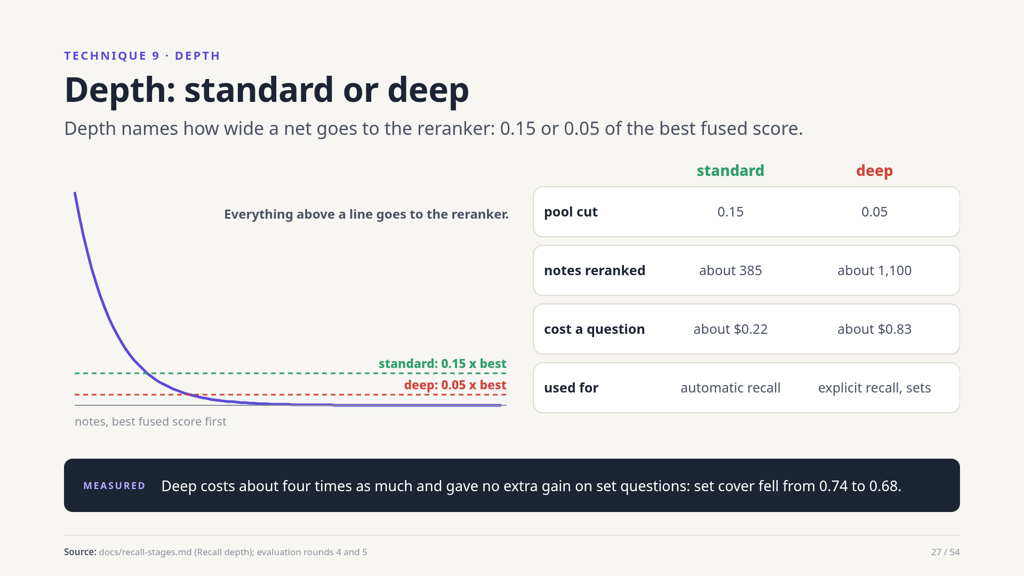
Notes:
Depth is the cut that decides which notes reach the reranker. Standard keeps every note scoring at least fifteen percent of the best, about 385 notes, and is the default for automatic recall. Deep goes down to five percent: roughly a thousand notes, about eighty-three cents a question. It is for explicit recall. On set questions it did not help, since more notes meant a worse ranking.
Source: docs/recall-stages.md (Recall depth); evaluation rounds 4 and 5

Slide 28
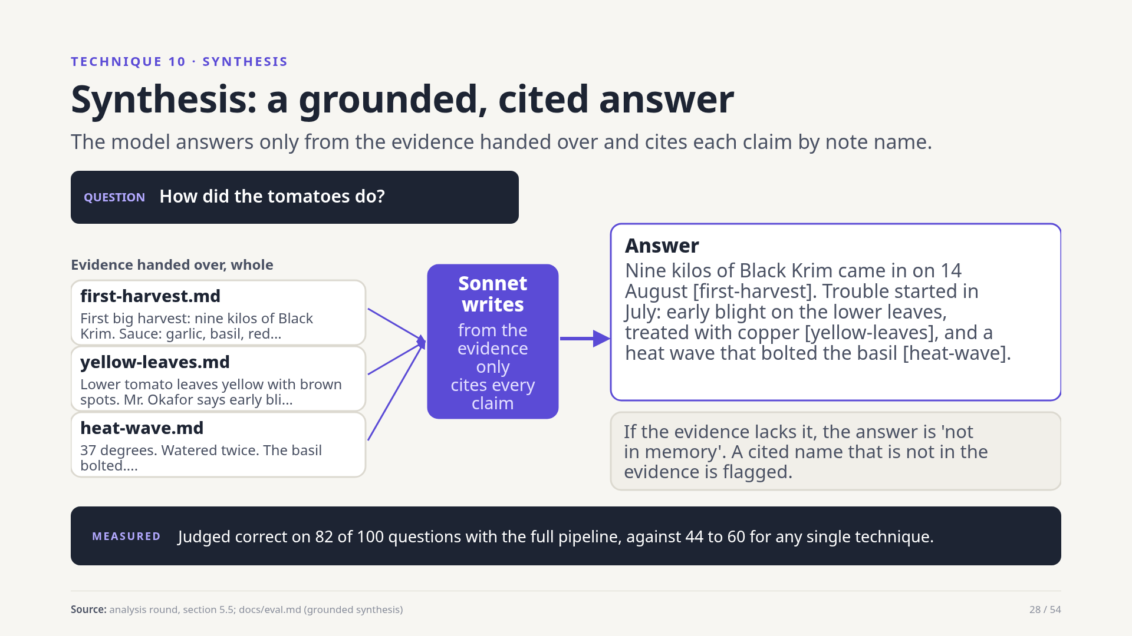
Notes:
The last step turns notes into an answer. The synthesizer gets the best chunks whole and must cite every claim in square brackets by note name, or say not in memory. Cited names that are not in the evidence are flagged. With full retrieval, 82 of 100 answers were judged correct, against 44 to 60 when the same writer was fed by a single technique.
Source: analysis round, section 5.5; docs/eval.md (grounded synthesis)

Slide 29
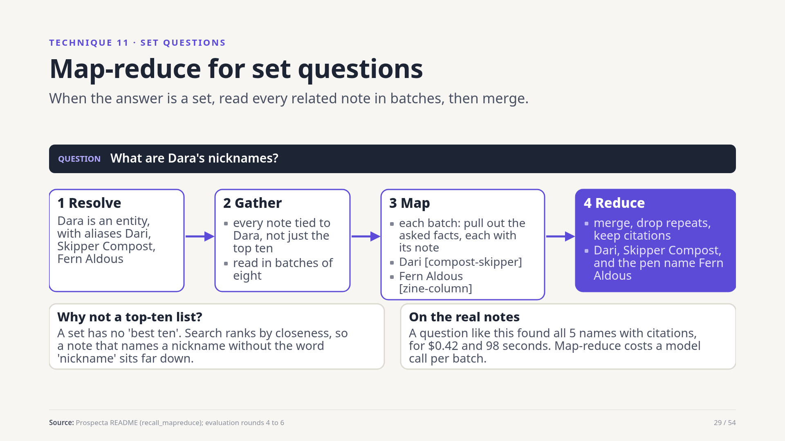
Notes:
Some questions ask for everything: what are Dara's nicknames. No ten best notes can answer that. Map-reduce resolves the entity and its aliases, gathers every note tied to it, reads them in batches extracting the asked facts with citations, and merges one deduplicated cited list. On the real notes it found all five names of the test question for forty-two cents.
Source: Prospecta README (recall_mapreduce); evaluation rounds 4 to 6

Slide 30
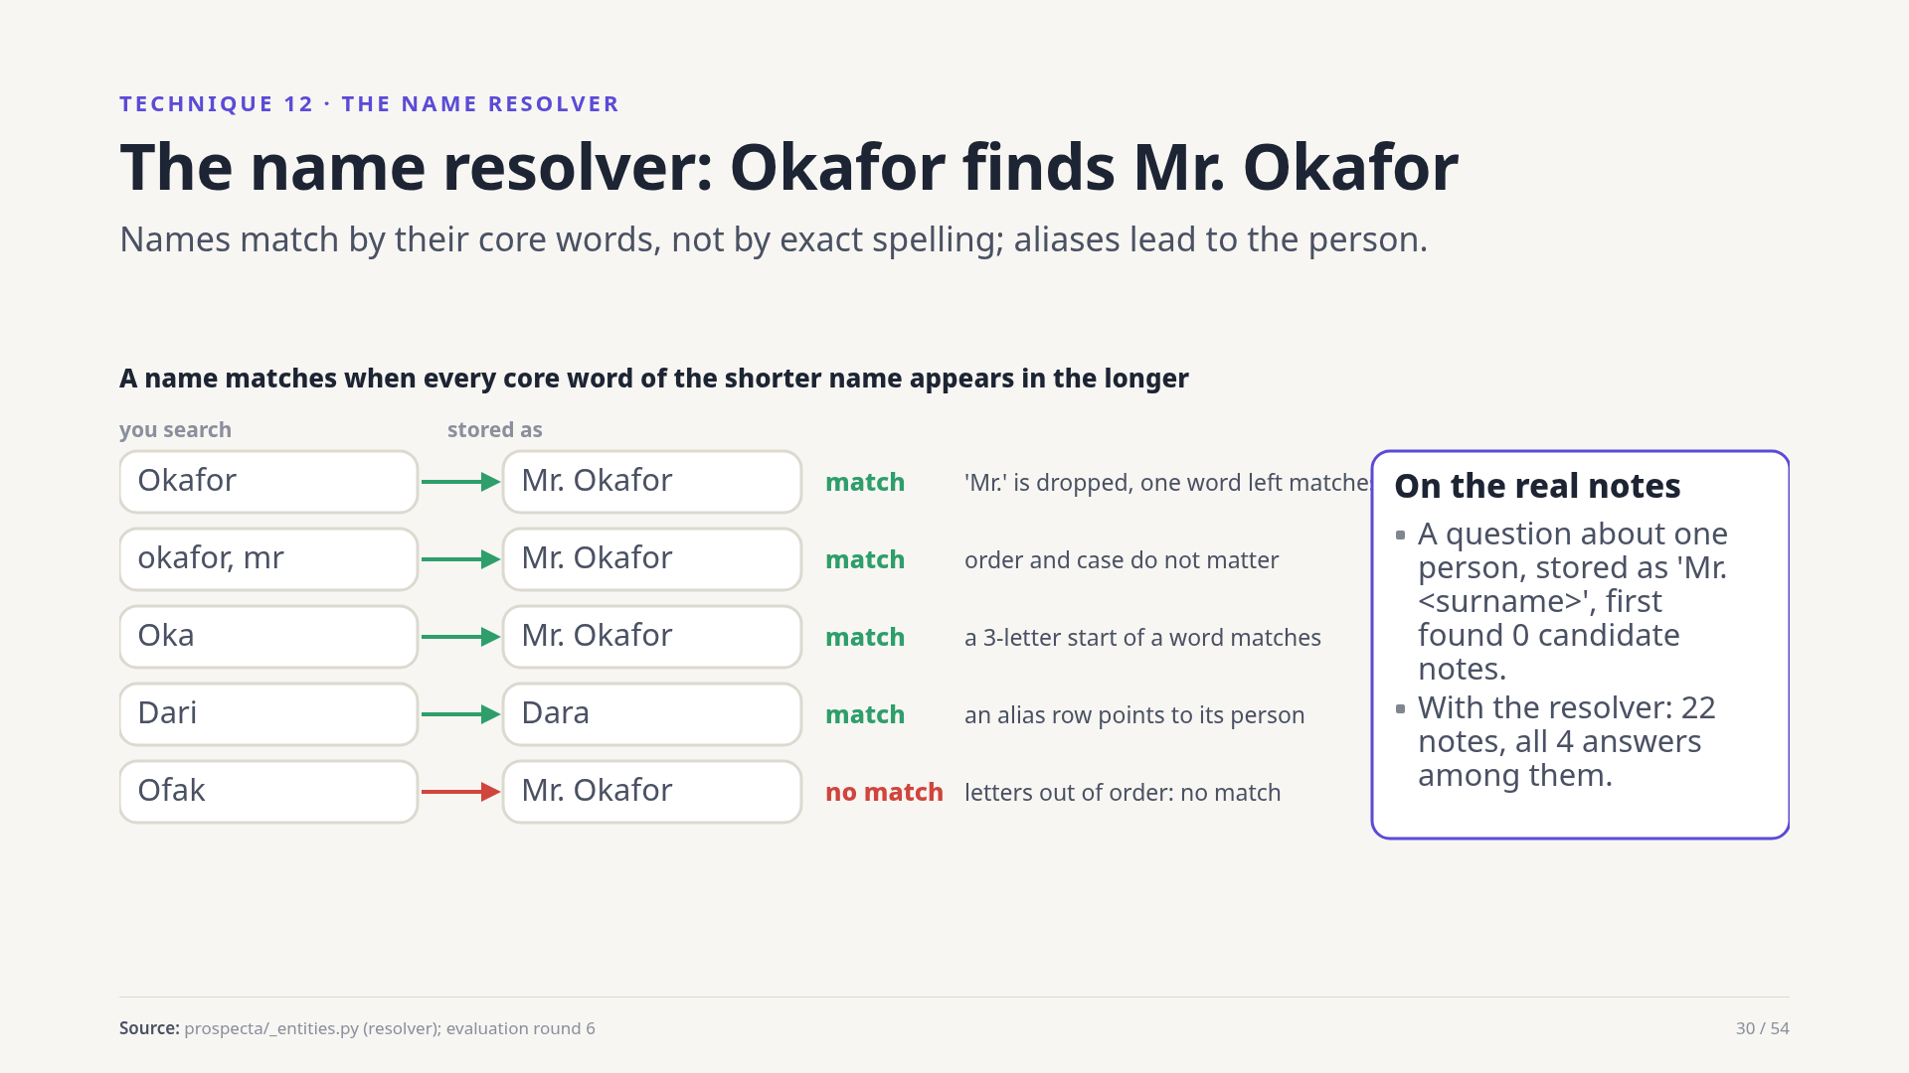
Notes:
People are stored with titles and varied spellings. A search for Okafor must find Mr. Okafor. The resolver folds case and accents, drops titles like Mr. and Dr., ignores word order, and matches when every core word of the shorter name equals or starts a word of the longer. Alias rows lead to their person. On the real notes one such question went from zero candidate notes to twenty-two, with all four answers among them.
Source: prospecta/_entities.py (resolver); evaluation round 6

Slide 31
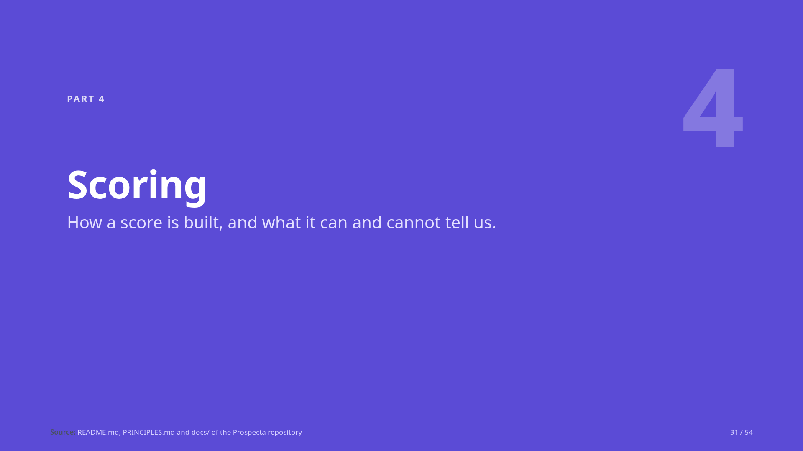
Notes:
Part four: scoring. Before any number means anything, we need to know how it is made.
Source: README.md, PRINCIPLES.md and docs/ of the Prospecta repository

Slide 32
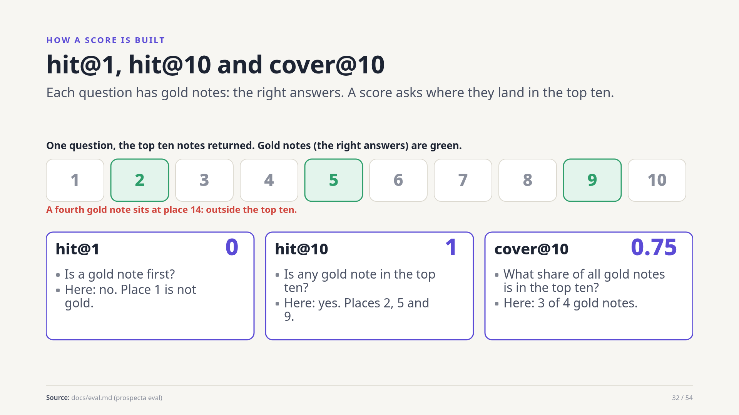
Notes:
Every test question comes with gold notes, the notes that hold the answer. Hit at one asks whether a gold note is first. Hit at ten asks whether any gold note is in the top ten. Cover at ten asks what share of all the gold notes is in the top ten, which matters for set questions with several right notes.
Source: docs/eval.md (prospecta eval)

Slide 33
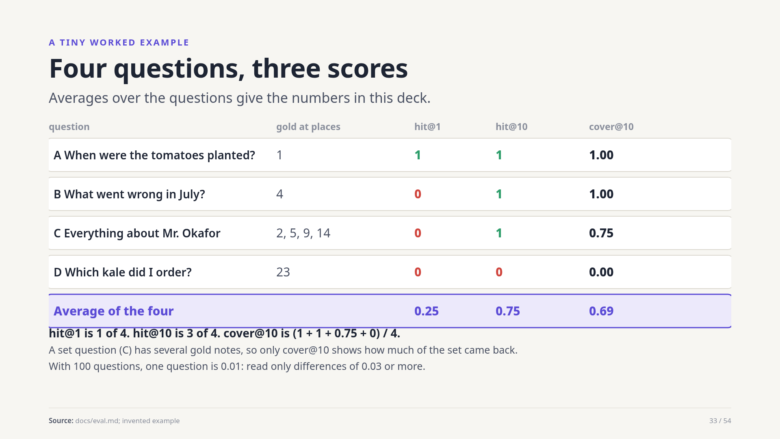
Notes:
Four invented questions. A has its gold note at place one: hit at one, hit at ten and cover all one. B has it at place four. C is a set with four gold notes, three of them in the top ten: cover is zero point seven five. D misses. Averaged, hit at one is a quarter, hit at ten three quarters, cover sixty-nine hundredths. With a hundred questions, one question is a hundredth.
Source: docs/eval.md; invented example

Slide 34
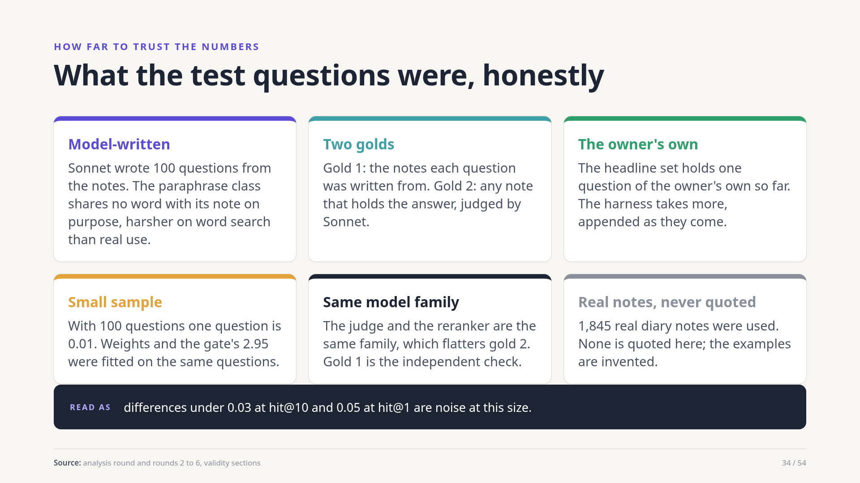
Notes:
Be honest about the evidence. Questions were written by a model from the notes. A second, looser gold counts any note holding the answer. Only one question so far is the owner's own. A hundred questions is small, and some settings were tuned on the same set. The judge and the reranker share a model family. Read small differences as noise.
Source: analysis round and rounds 2 to 6, validity sections

Slide 35
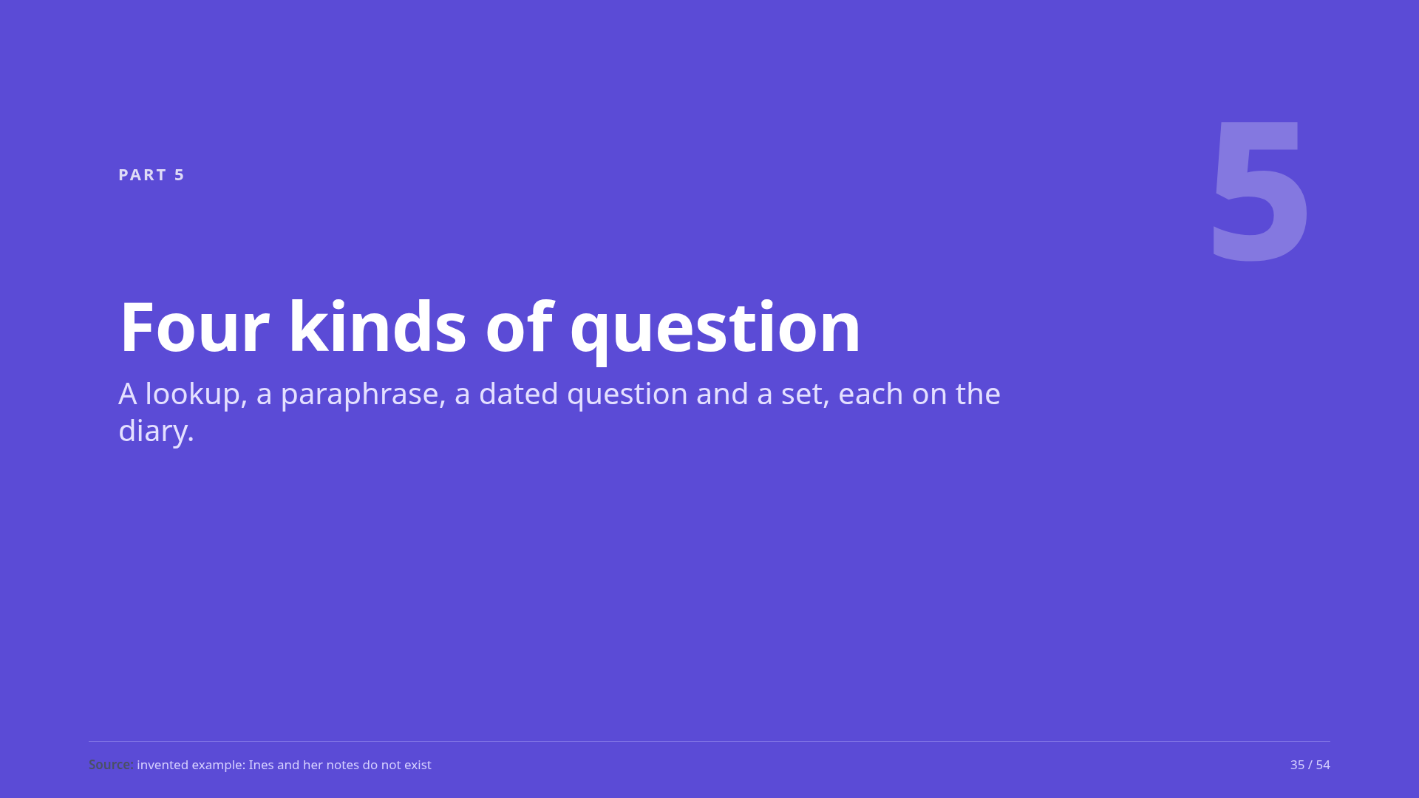
Notes:
Part five: four kinds of question, and which techniques carry each. The ranks shown are an invented illustration of the mechanism.
Source: invented example: Ines and her notes do not exist

Slide 36
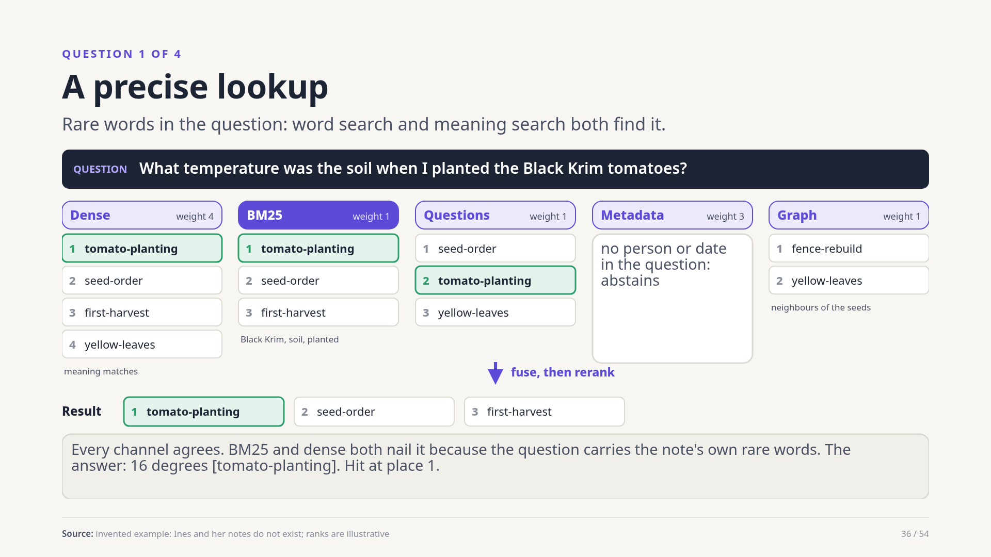
Notes:
A precise question about one fact: what temperature was the soil when I planted the Black Krim tomatoes. Black Krim and soil are the note's own rare words, so BM25 and dense search both put it first and every channel agrees. This is the easy case, and hit at ten is one on the real notes.
Source: invented example: Ines and her notes do not exist; ranks are illustrative

Slide 37
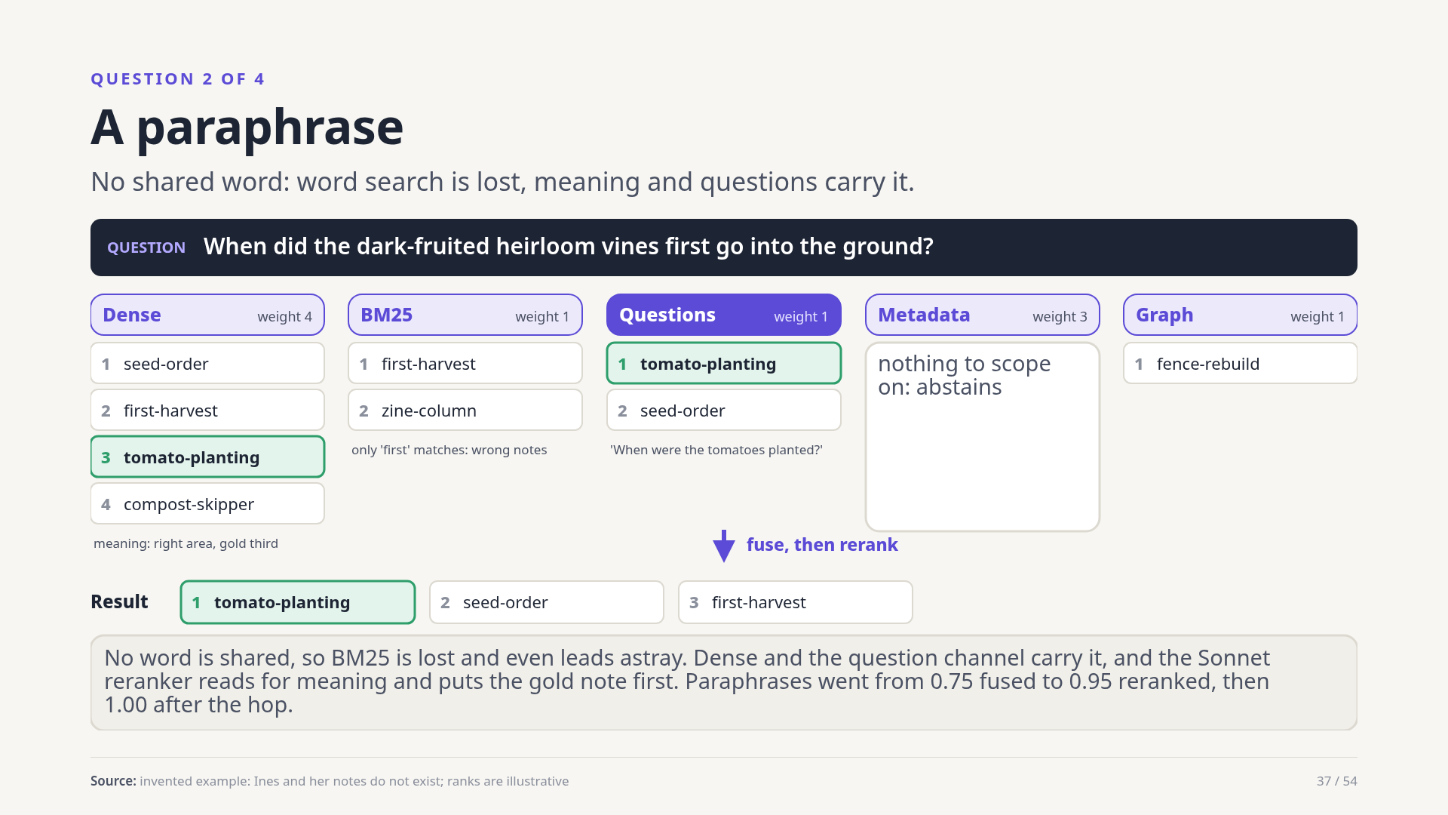
Notes:
The same fact asked with none of the note's words: dark-fruited heirloom vines, into the ground. BM25 matches only the word first, and leads astray. Dense search lands near; the question channel matches the anticipated question about planting. The reranker reads for meaning and puts the gold note first. On the real notes paraphrase went from 0.75 fused to 0.95 reranked.
Source: invented example: Ines and her notes do not exist; ranks are illustrative

Slide 38
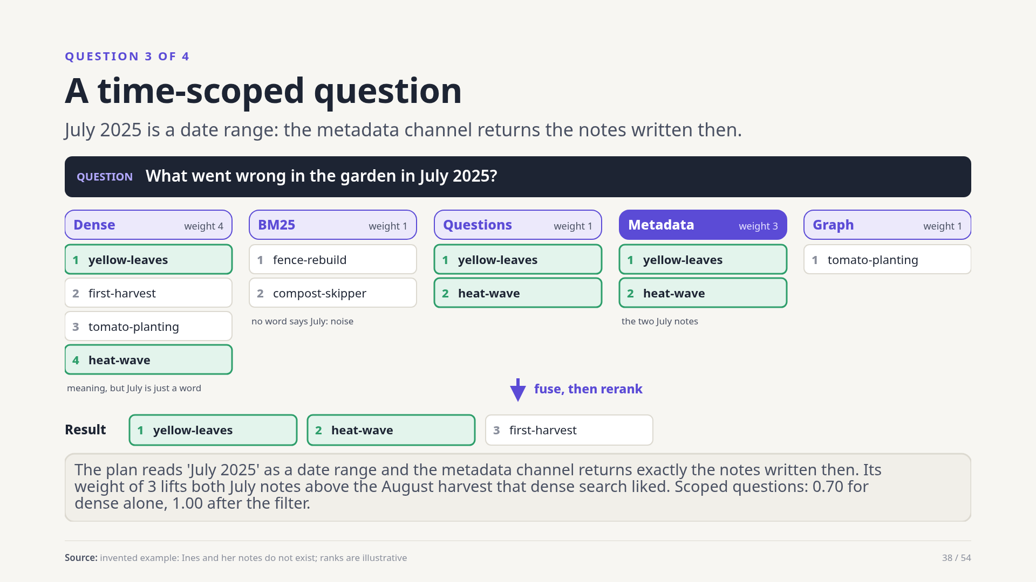
Notes:
What went wrong in the garden in July 2025. Meaning search knows nothing about July. The plan reads it as a date range and the metadata channel returns the two July notes, with weight three, lifting both above an August harvest note. On the real notes scoped questions went from 0.70 with dense alone to 1.00.
Source: invented example: Ines and her notes do not exist; ranks are illustrative

Slide 39
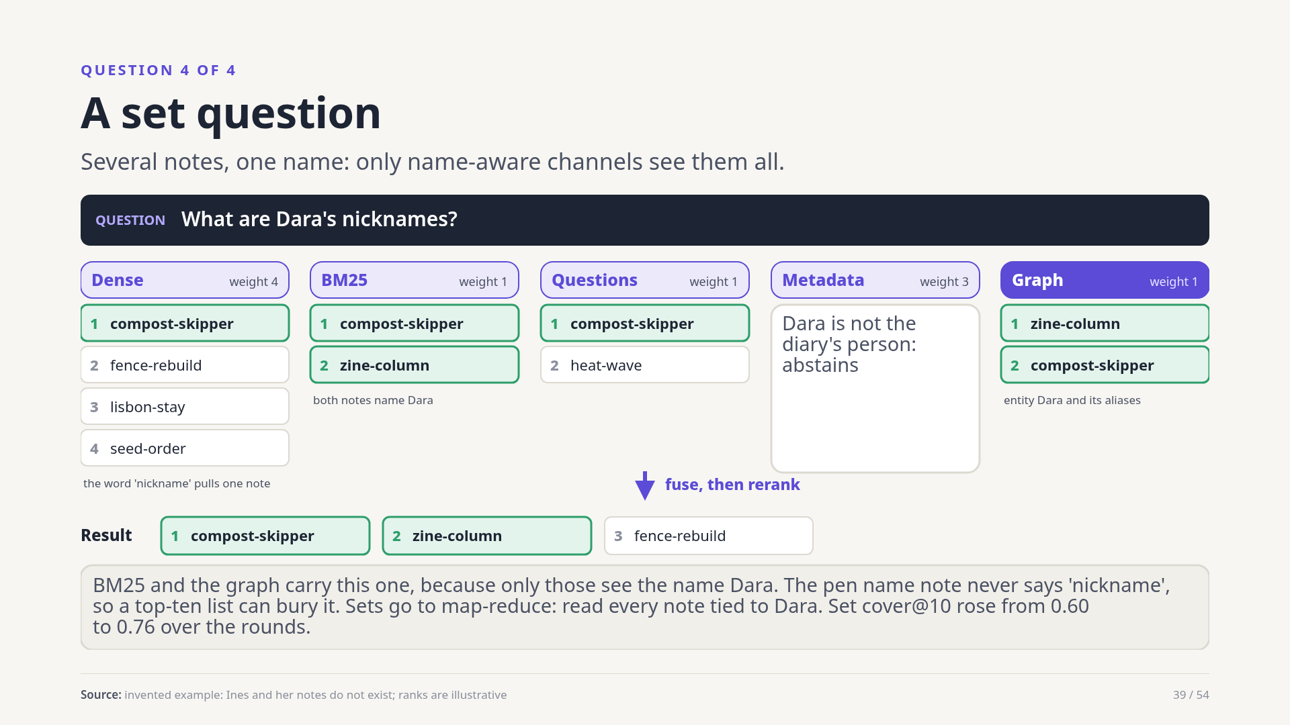
Notes:
What are Dara's nicknames. The answer is spread over notes that never say the word nickname. BM25 sees Dara; the graph sees the entity and its aliases; dense search finds one note. A top-ten list can bury the rest, so set questions go to map-reduce. On the real notes, set cover at ten rose from 0.60 to 0.76 over the evaluation rounds.
Source: invented example: Ines and her notes do not exist; ranks are illustrative

Slide 40
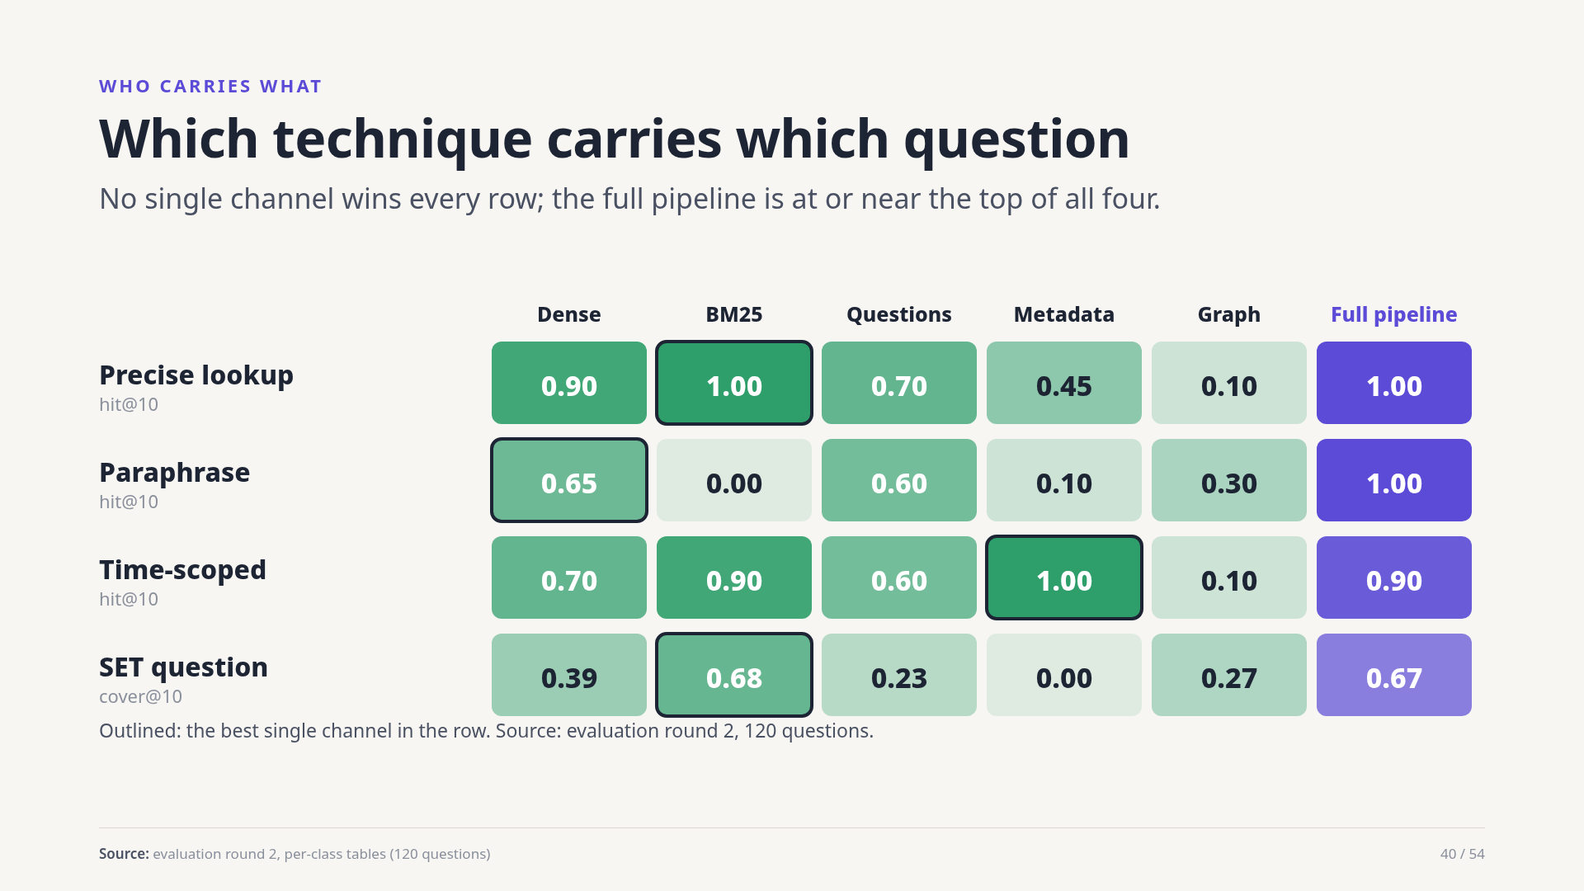
Notes:
Real measurements, by kind of question. Word search is best on precise lookups and zero on paraphrase. Dense search is the all-rounder. Metadata alone is perfect on dated questions and useless elsewhere. For sets, word search beats dense search by a wide margin. The full pipeline is at or near the top in every row, which is the case for combining them.
Source: evaluation round 2, per-class tables (120 questions)

Slide 41
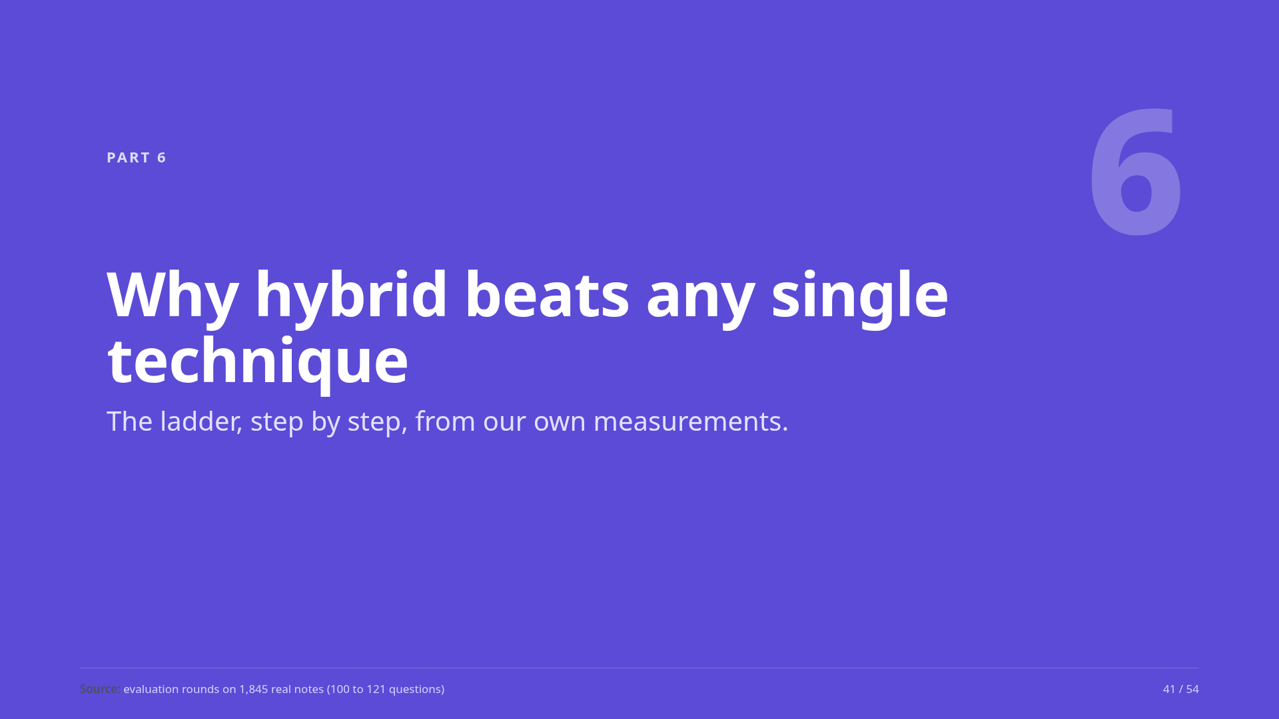
Notes:
Part six: why we combine techniques.
Source: evaluation rounds on 1,845 real notes (100 to 121 questions)

Slide 42
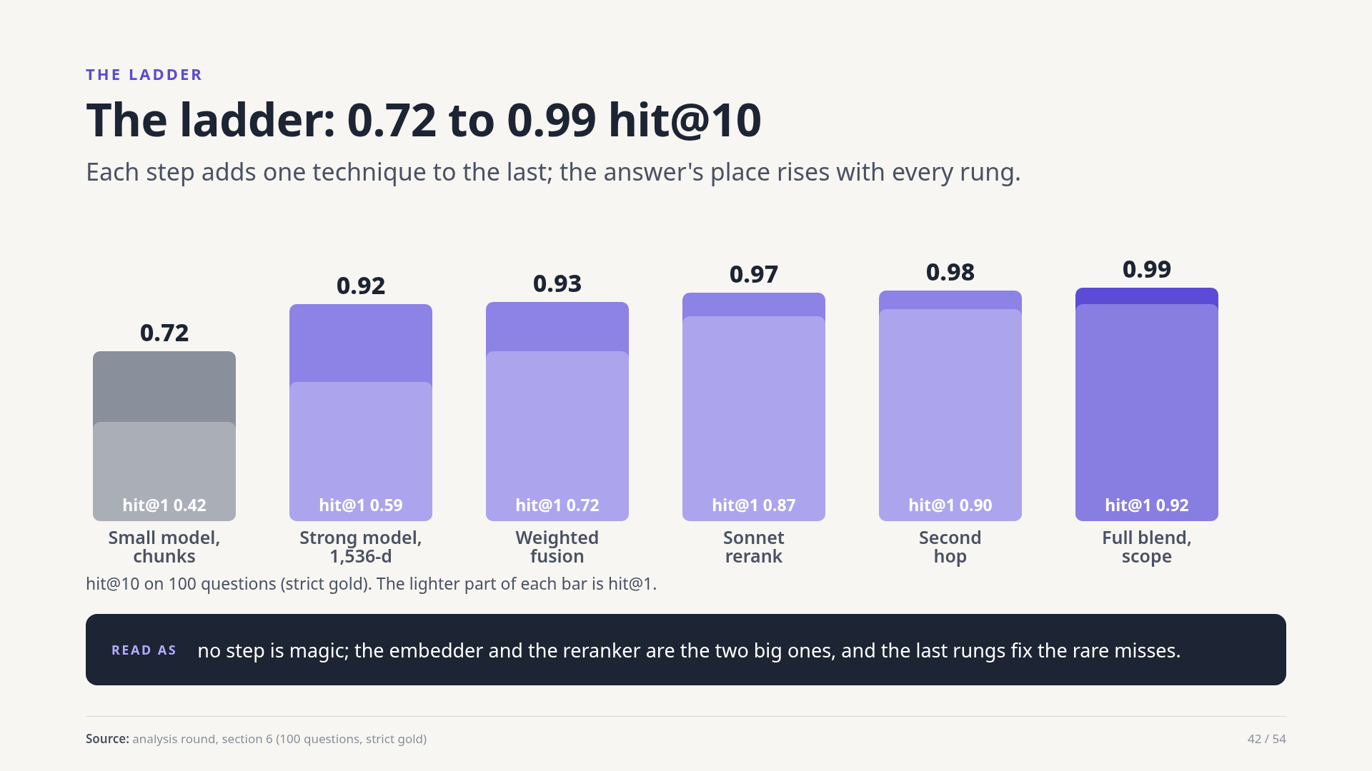
Notes:
Start with a small embedding model over chunks: hit at ten 0.72. A strong 1,536-dimension embedder: 0.92. Weighted fusion of the channels: 0.93, though hit at one jumps from 0.59 to 0.72. The Sonnet reranker: 0.97 and hit at one 0.87. The second hop: 0.98. The full blend with scope promotion: 0.99.
Source: analysis round, section 6 (100 questions, strict gold)

Slide 43
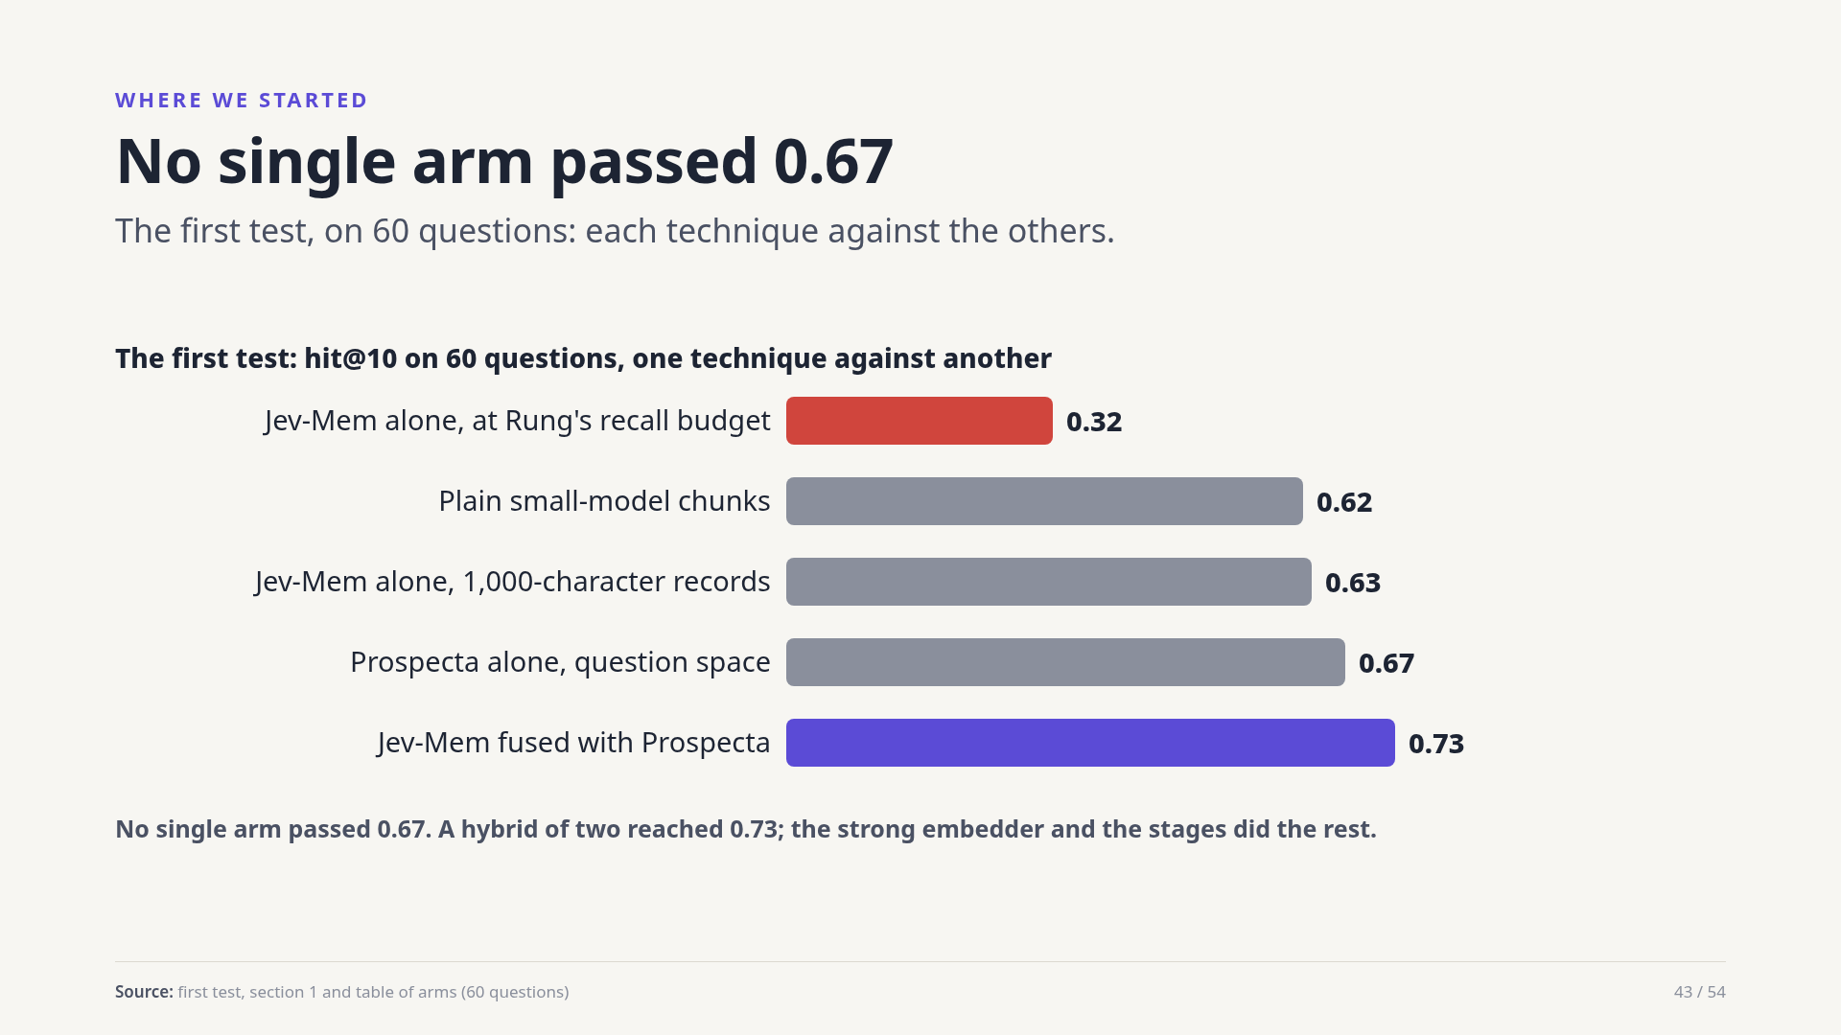
Notes:
The first test compared Jev-Mem, plain small-model chunks and Prospecta alone. Jev-Mem as shipped reached 0.32 at Rung's recall budget and 0.63 with smaller records. Plain chunks 0.62, Prospecta alone 0.67. Fusing Jev-Mem with Prospecta gave 0.73. Nothing alone was enough, which is what the ladder then fixed.
Source: first test, section 1 and table of arms (60 questions)

Slide 44
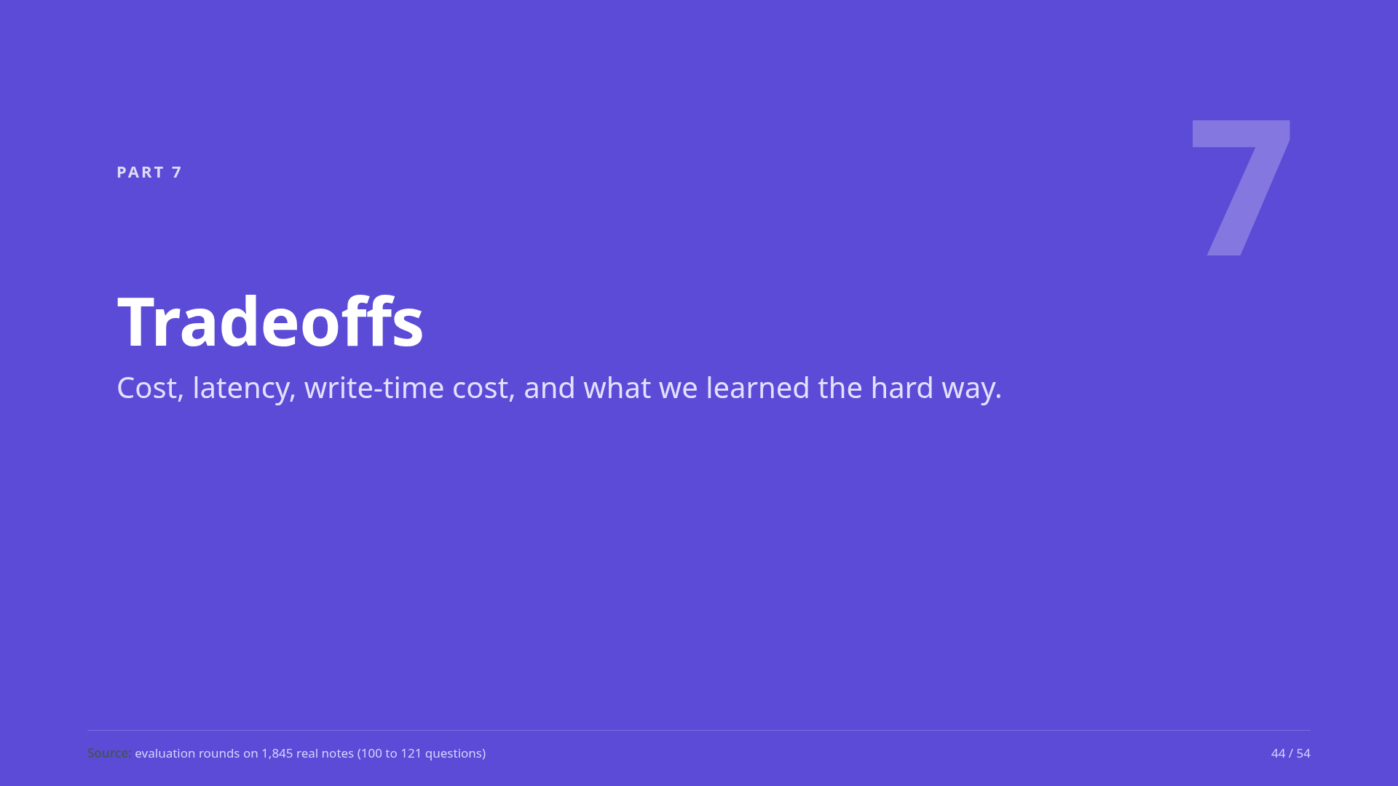
Notes:
Part seven: what the pipeline costs, and what went wrong on the way.
Source: evaluation rounds on 1,845 real notes (100 to 121 questions)

Slide 45
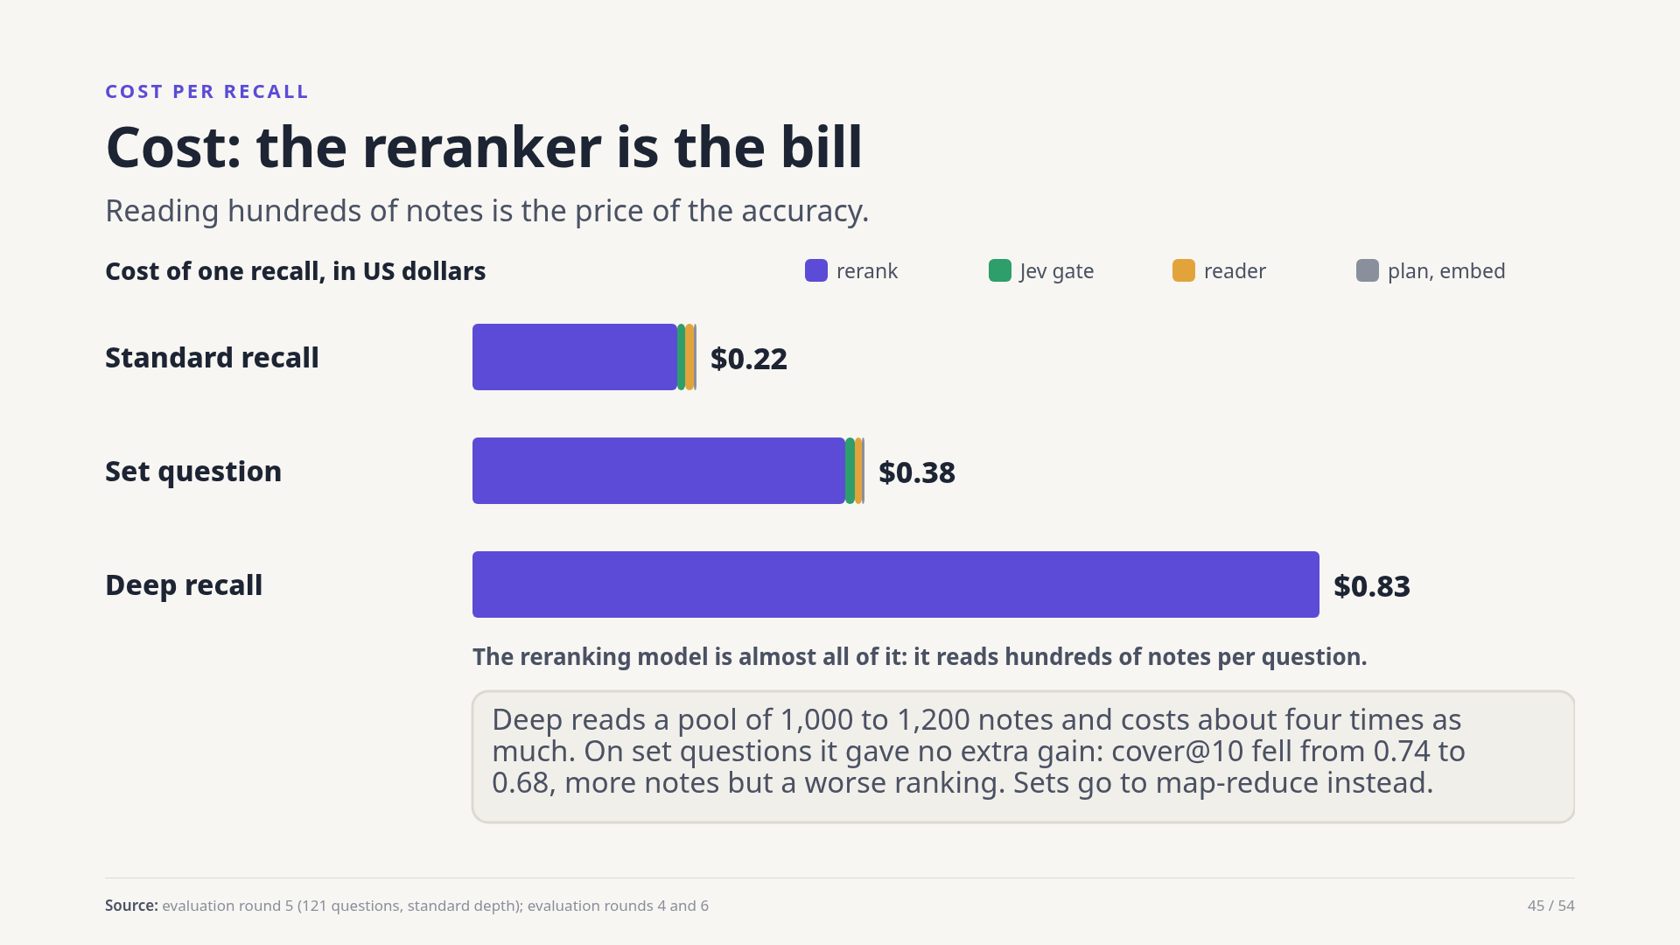
Notes:
A standard recall costs about twenty-two cents, and ninety percent of that is the reranking model. A set question is about thirty-eight cents. A deep recall is about eighty-three cents and, on set questions, gave no extra gain. Searching in Postgres is effectively free.
Source: evaluation round 5 (121 questions, standard depth); evaluation rounds 4 and 6

Slide 46
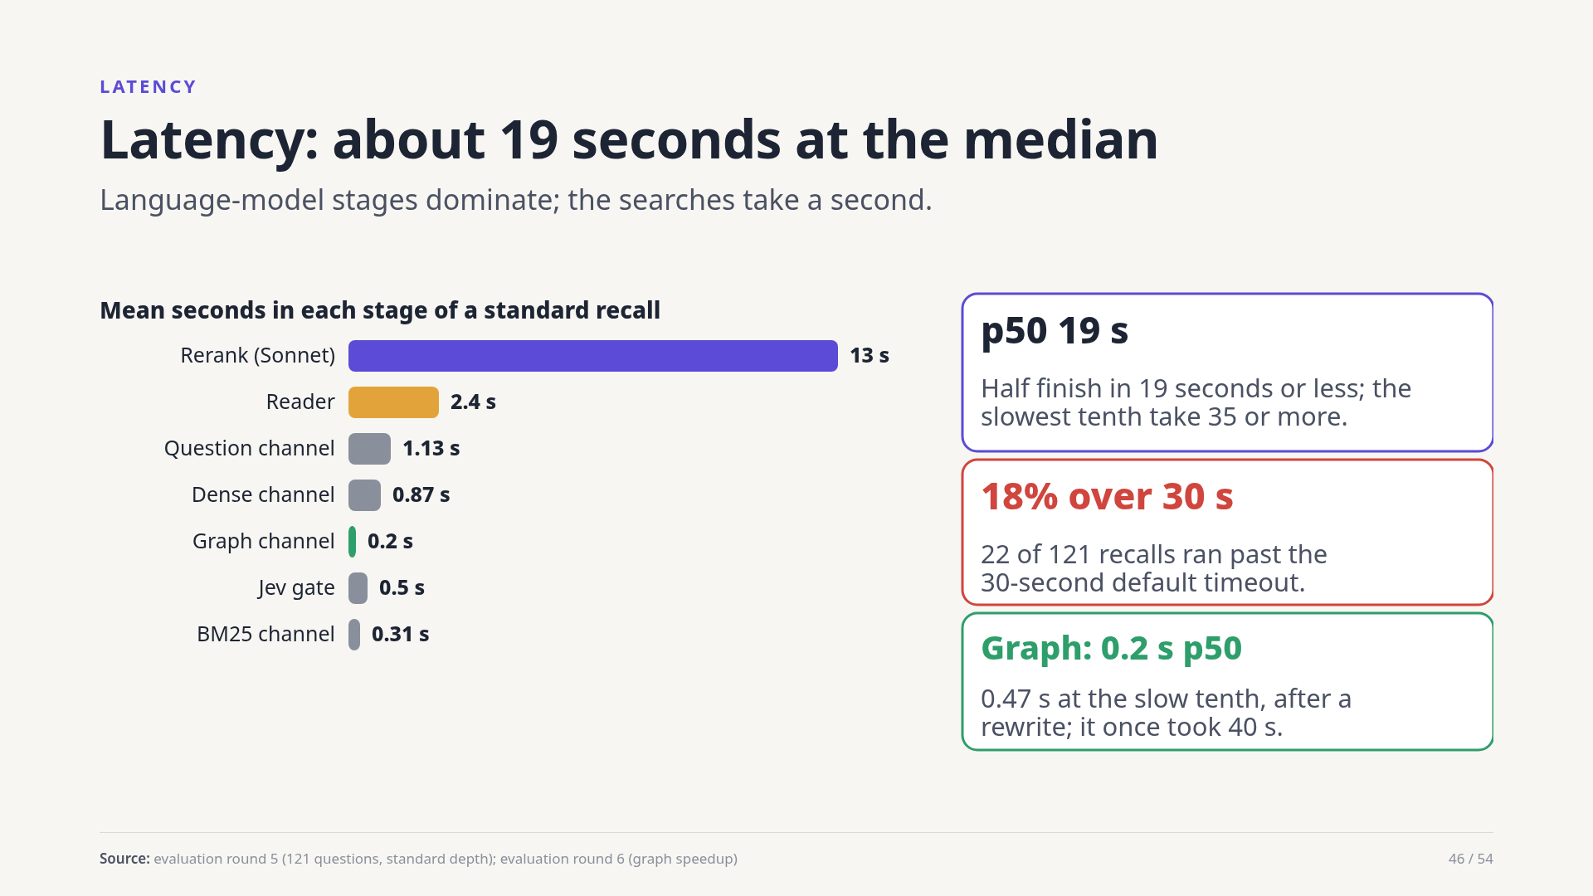
Notes:
The median recall takes about nineteen seconds; the slowest tenth take thirty-five. Eighteen percent ran past the thirty-second default timeout. The reranker is thirteen seconds on average. The graph channel, once forty seconds, is now about a fifth of a second at the median after a rewrite.
Source: evaluation round 5 (121 questions, standard depth); evaluation round 6 (graph speedup)

Slide 47
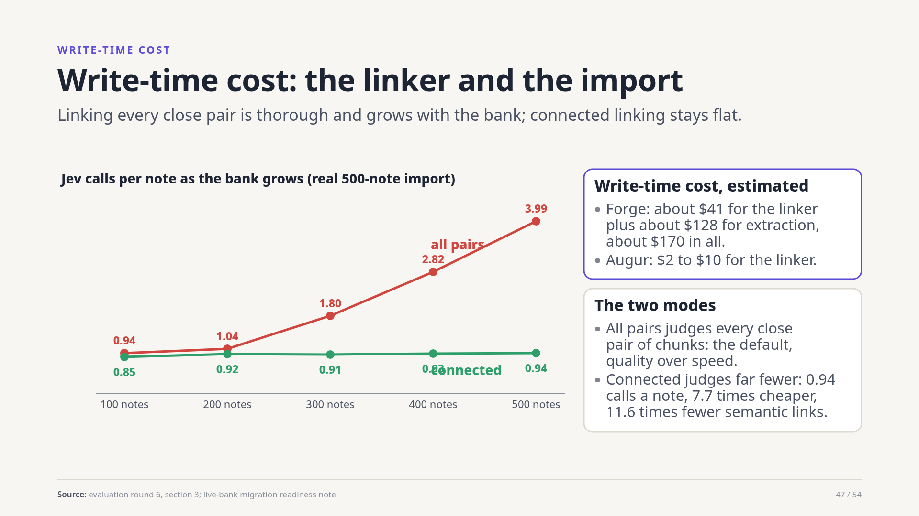
Notes:
Writing notes costs too. The linker asks Jev to judge pairs. In the all-pairs default, calls per note grew from under one to almost four over a five-hundred-note import; the connected mode stayed under one, at seven times lower cost and eleven times fewer semantic links. For Forge the estimate is about forty-one dollars of linking plus a hundred and twenty-eight for entity extraction, about a hundred and seventy in all; Augur two to ten dollars.
Source: evaluation round 6, section 3; live-bank migration readiness note

Slide 48
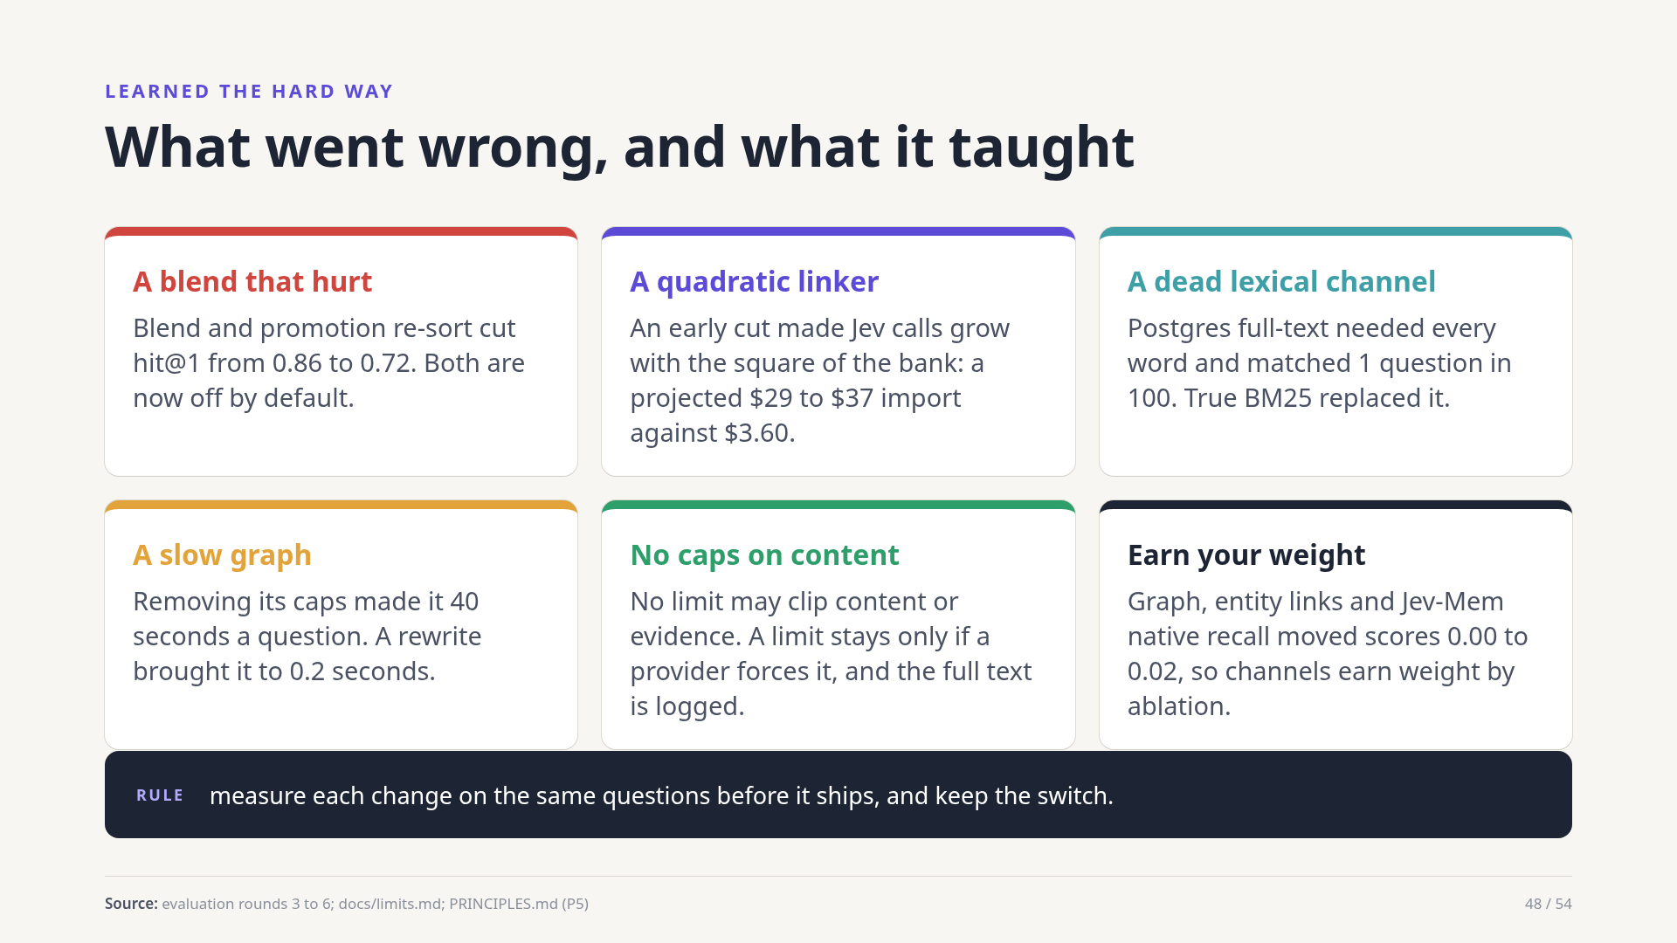
Notes:
Six lessons. A tuned blend and a re-sort quietly cost fourteen points of hit at one. An early linker rule made write-time cost grow with the square of the bank. The first lexical channel almost never matched. Removing caps made the graph slow until it was rewritten. A standing rule: no limit clips content. And channels only keep their weight if removing them hurts.
Source: evaluation rounds 3 to 6; docs/limits.md; PRINCIPLES.md (P5)

Slide 49
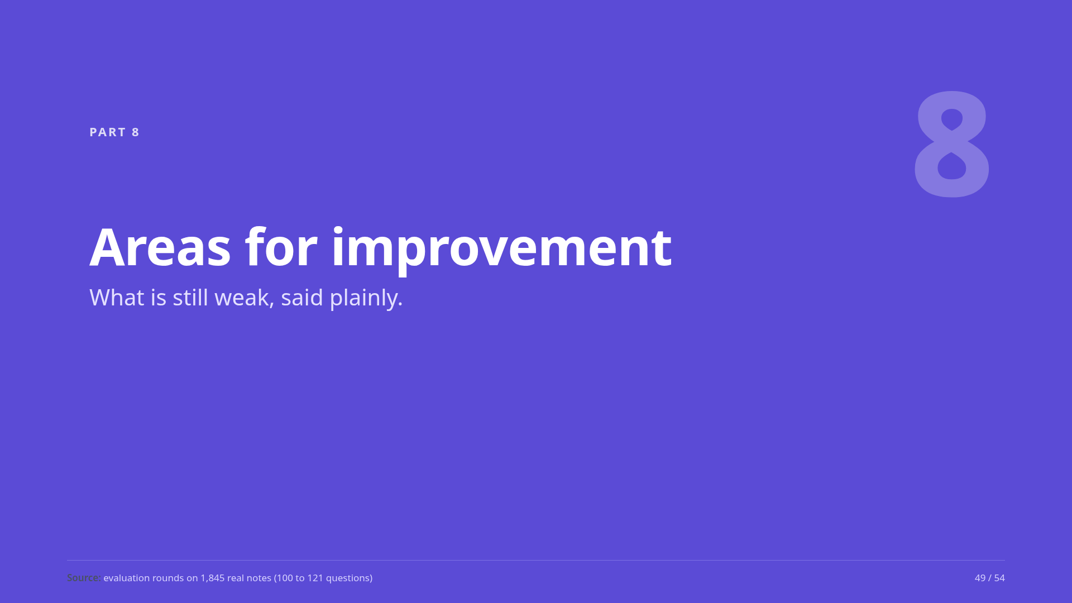
Notes:
Part eight: honest weaknesses.
Source: evaluation rounds on 1,845 real notes (100 to 121 questions)

Slide 50
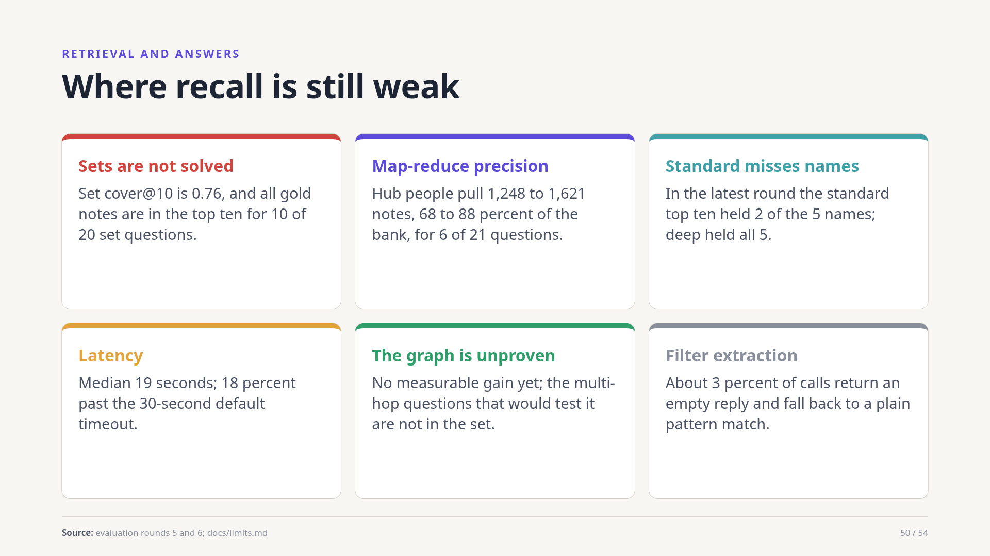
Notes:
Set questions are the biggest gap: cover is 0.76. Map-reduce finds the right notes but pulls in far too many when a name is a hub. Standard depth misses names that deep finds. Latency is long. The graph has not shown value on the tested questions, and about three percent of date extractions fall back to a plain pattern match.
Source: evaluation rounds 5 and 6; docs/limits.md

Slide 51

Notes:
The test set needs more real questions. Several thresholds are our own starting choices. Forge's bank has not been converted and needs an expensive link pass. A concurrency bug was fixed but the safety net stays. Stemming is English only, calls block, and a deep recall can overrun a caller's cost budget.
Source: live-bank migration readiness note; evaluation rounds 5 and 6; Prospecta README (caveats)

Slide 52

Notes:
Part nine: how agents plug into Prospecta.
Source: README.md, PRINCIPLES.md and docs/ of the Prospecta repository

Slide 53

Notes:
Two providers wrap Prospecta. For the Rung agent runtime, rung-memory-prospecta recalls automatically before a turn at standard depth, offers explicit search and recall tools with a depth argument, and a gather tool for set questions. For Hermes, which Forge and Augur run on, hermes-prospecta exposes retain, recall and search. Both stay thin on purpose: retrieval belongs inside Prospecta.
Source: rung-memory-prospecta README; hermes-prospecta README

Slide 54

Notes:
To close. Prospecta gives a being a long-term memory in its own bank on Postgres. Hybrid recall beats any single technique: the ladder runs from 0.72 to 0.99 hit at ten. A standard recall costs about twenty-two cents, almost all of it the reranker. And set questions, at 0.76 cover, are the gap we still have to close.
Source: evaluation rounds on 1,845 real notes (100 to 121 questions); README.md, PRINCIPLES.md and docs/ of the Prospecta repository

