Slide 1
How a community tool shed runs
WORKED EXAMPLE · AN INVENTED TOPIC
Lend a drill on Saturday, get it back by Friday: a shed that stays stocked.
Example Author
1 / 11
Notes:
This deck is an invented example. It shows every kind of slide in the explainer format: title, statement, diagram, cards, story, mapping table, contrast, two columns, section, quote and closing. The tool shed is made up, and so is every number in it.

Slide 2
A tool shed lends tools, and expects them back
THE POINT
Neighbours borrow a tool for a week, free, with a name in the ledger.
They use it, clean it and hang it back on its own hook.
Every tool has a ledger line: what it is, its condition, who gave it.
Because tools come back, the shed needs no budget beyond blades and oil.
Nothing is sold; the only currency is a tool returned clean.
Source: Invented example; no real shed
2 / 11
Notes:
Four ideas carry the deck: borrow for a week, clean it, hang it back, and the ledger line that lets the next borrower trust the tool. All of it is an invented example.
Source: Invented example; no real shed

Slide 3
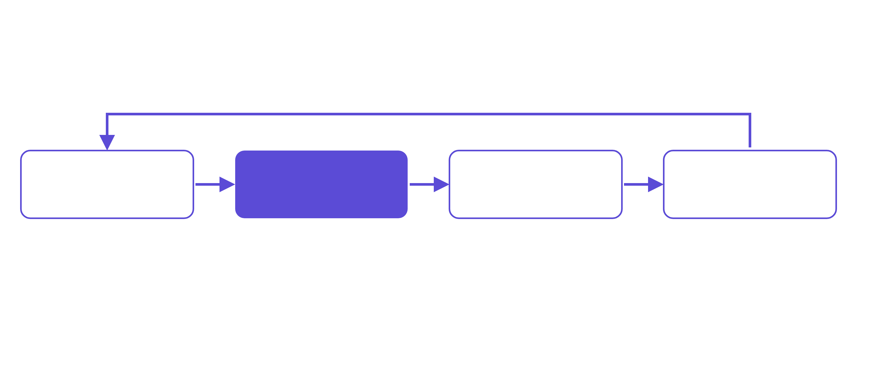
Tools go out on Saturday and come back by Friday
THE LOOP IN ONE PICTURE
every tool comes back within the week
Neighbours
The ledger
The shed
Borrowers
give spare tools
one line per tool
tools hung on labelled hooks
use it, clean it, return it
Source: Invented example; diagram drawn for this deck
3 / 11
Notes:
Read it left to right. Neighbours give spare tools. The ledger gets one line per tool. The shed hangs them on labelled hooks. Borrowers use them and bring them back along the top arrow. That arrow is the whole idea: it is why the hooks never stay empty.
Source: Invented example; diagram drawn for this deck

Slide 4
Three volunteers keep the shed open
THREE JOBS
The registrar
The checker
The host
Writes one ledger line per tool: its name, its condition and who gave it. A tool with no line is not hung.
Looks at each returned tool: clean, dry, nothing loose. Anything damaged goes to the repair bench, never back on a hook.
Opens the shed on Saturday mornings, hands out tools and explains the one rule: bring it back by Friday.
WHY IT WORKS
Each job is small and has one test, so a new volunteer can start in an hour.
Source: Invented example
4 / 11
Notes:
The three jobs. The registrar writes ledger lines. The checker decides what is fit to hang. The host opens the shed. The lesson: every job has a single test, which is why a new volunteer is useful quickly.
Source: Invented example

Slide 5
A rule that came from one loose handle
A LESSON, WITH A MADE-UP EXAMPLE
A hammer went out with a cracked handle.
WHAT WENT WRONG
WHY IT GOT THROUGH
THE RULE NOW
A returned hammer was hung back on its hook with a hairline crack in the handle. A borrower swung it and the head came off.
The checker looked at the head, which was fine, and trusted the note the borrower had left.
A returned tool is hung only after the checker has tried every moving part, and the ledger line says who checked it.
LESSON
Test the tool with your hands, not only your eyes.
Source: Invented example; no real incident
5 / 11
Notes:
This story is invented. The point is its shape: what went wrong, why it got through, and the rule that came out of it. A good story slide ends with a rule a newcomer can apply next time.
Source: Invented example; no real incident

Slide 6
A tool shed borrows its habits from a book library
THE MAPPING
BOOK LIBRARY
TOOL SHED
SAME OR DIFFERENT?
A catalogue entry per book
→
A ledger line per tool
same idea
A due date stamped inside
→
A Friday deadline, said aloud
looser here
A fine for a late book
→
A reminder and a cup of tea
kinder here
Damaged books are mended
→
Damaged tools go to the bench
same idea
A card to join
→
A name in the ledger
simpler here
Opening hours all week
→
Saturday mornings only
fewer hours
Source: Invented example
6 / 11
Notes:
A mapping table helps the audience reuse what they already know. Same means the habit carries over unchanged; differs means we chose another way; ahead and behind mark where the shed is simpler or thinner.
Source: Invented example

Slide 7
From a shared garage to a labelled shed
BEFORE AND AFTER
BEFORE
NOW
Tools lived in one garage. Nobody knew what was there, so people bought a second drill and the first went missing.
Every tool has a hook, a ledger line and a Friday deadline, so anyone can see what is in and what is out.
FINDING
TRUSTING
RETURNING
A shelf of hooks, each labelled with the tool's name.
A ledger line says its condition and who checked it last.
A tool hung back clean is the only sign-off it needs.
Source: Invented example
7 / 11
Notes:
The contrast has two cards, then three small examples of the change in practice. Say the before in one breath, the now in one breath, and let the examples carry the detail.
Source: Invented example

Slide 8
Keep the rules few and the hooks labelled
WHAT WORKS, WHAT DOES NOT
What works
What does not
A hook for every tool
Tools with no home
A ledger line for every hook
Rules on a long notice board
One rule said out loud
Fines nobody collects
Saturday mornings, always
Opening whenever someone is free
Source: Invented example
8 / 11
Notes:
Two columns, one for what works and one for what does not. Keep each list to four short lines.
Source: Invented example

Slide 9
Starting your own
2
PART TWO
Three weeks from an empty garage to an open shed.
9 / 11
Notes:
A section slide marks a change of subject. Say what comes next in one sentence.

Slide 10
What a first-time borrower said
IN THEIR WORDS
“
I came for a ladder and left with the confidence to ask for a second tool next week.
An invented borrower
Source: Invented example; no real person
10 / 11
Notes:
A quote slide: read it slowly, then say why it matters. This quote is invented.
Source: Invented example; no real person

Slide 11
A shed runs on returns
TO REMEMBER
Three numbers from an invented shed in its first year.
40
312
1
tools given by neighbours in the first month
loans in the year, all of them returned
volunteer hour to learn any of the three jobs
Source: Invented example; every figure is made up
11 / 11
Notes:
Close on the three figures. They are invented: forty tools, three hundred and twelve loans, and one hour to learn a job.
Source: Invented example; every figure is made up

