Slide 1

Group 23
GUO Yuqi 55202880
WU Yidu 56767955

Slide 2
-
Pawpularity prediction on images
Reflection
Visualization and analysis of datasets and features
Methodology
Machine learning methods in our project
Conclusion
Prediction result

Slide 3
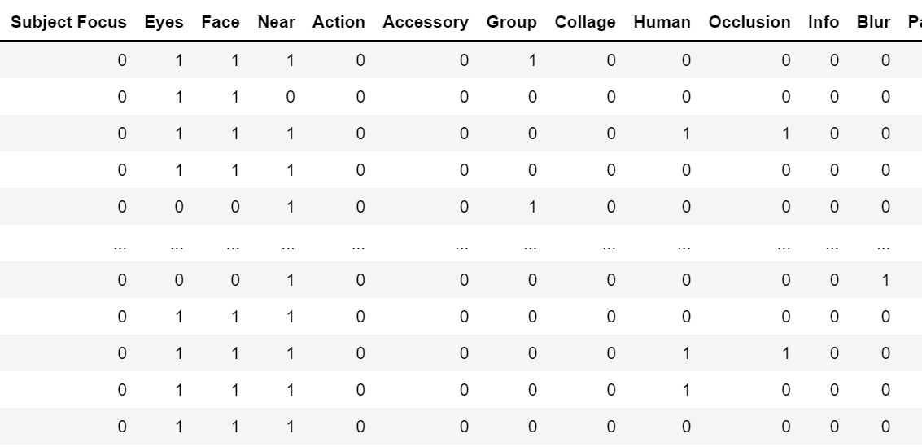
-
Discovery in data
Metadata
12 columns metadata to describe features of pet images

Slide 4
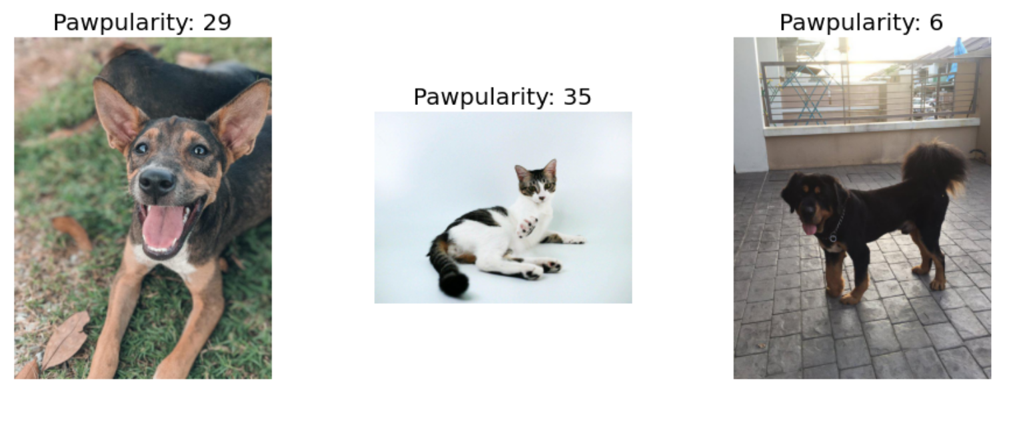
-
Discovery in data
Imagedata
Totally 9912 images of different height and width

Slide 5
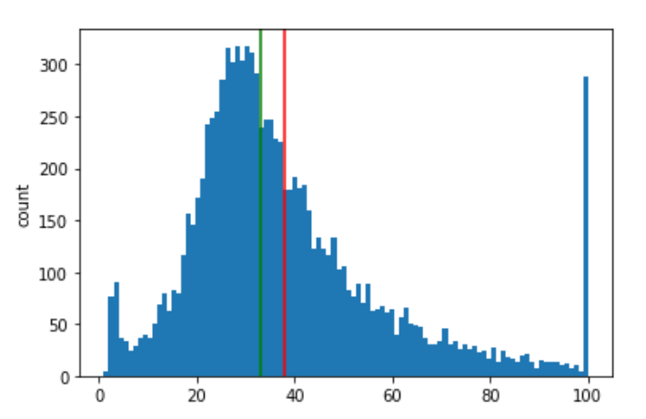
-
Discovery in data
Normal distribution of Pawpularity
Density peak on two sides

Slide 6
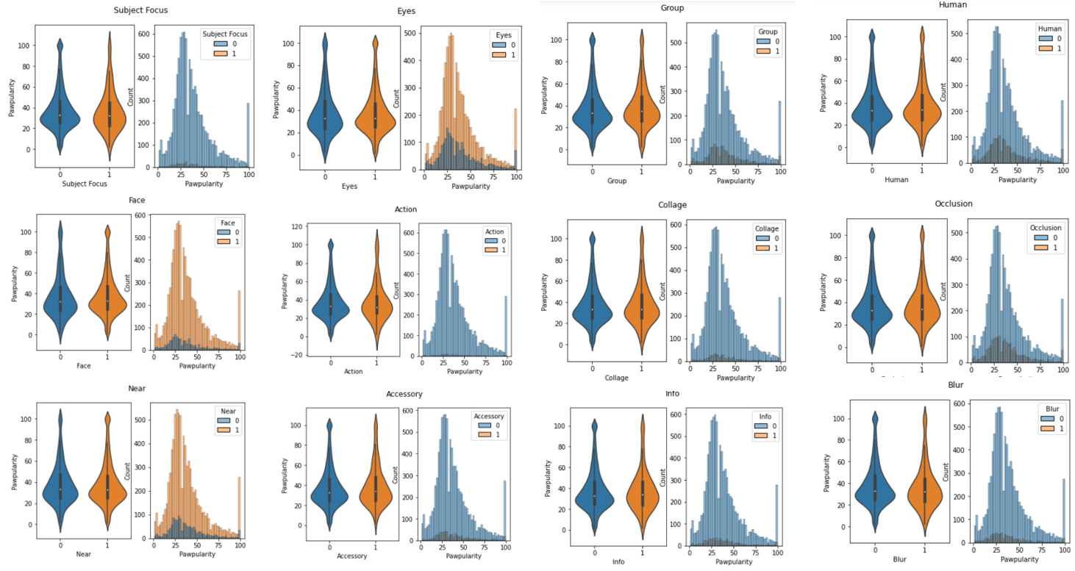
-
Discovery in data
Distribution of metadata:
Almost data of every column follows normal distribution with density peak on 2 sides.
Some values are sparse in a column, for example, only a little part of pet images have actions.

Slide 7
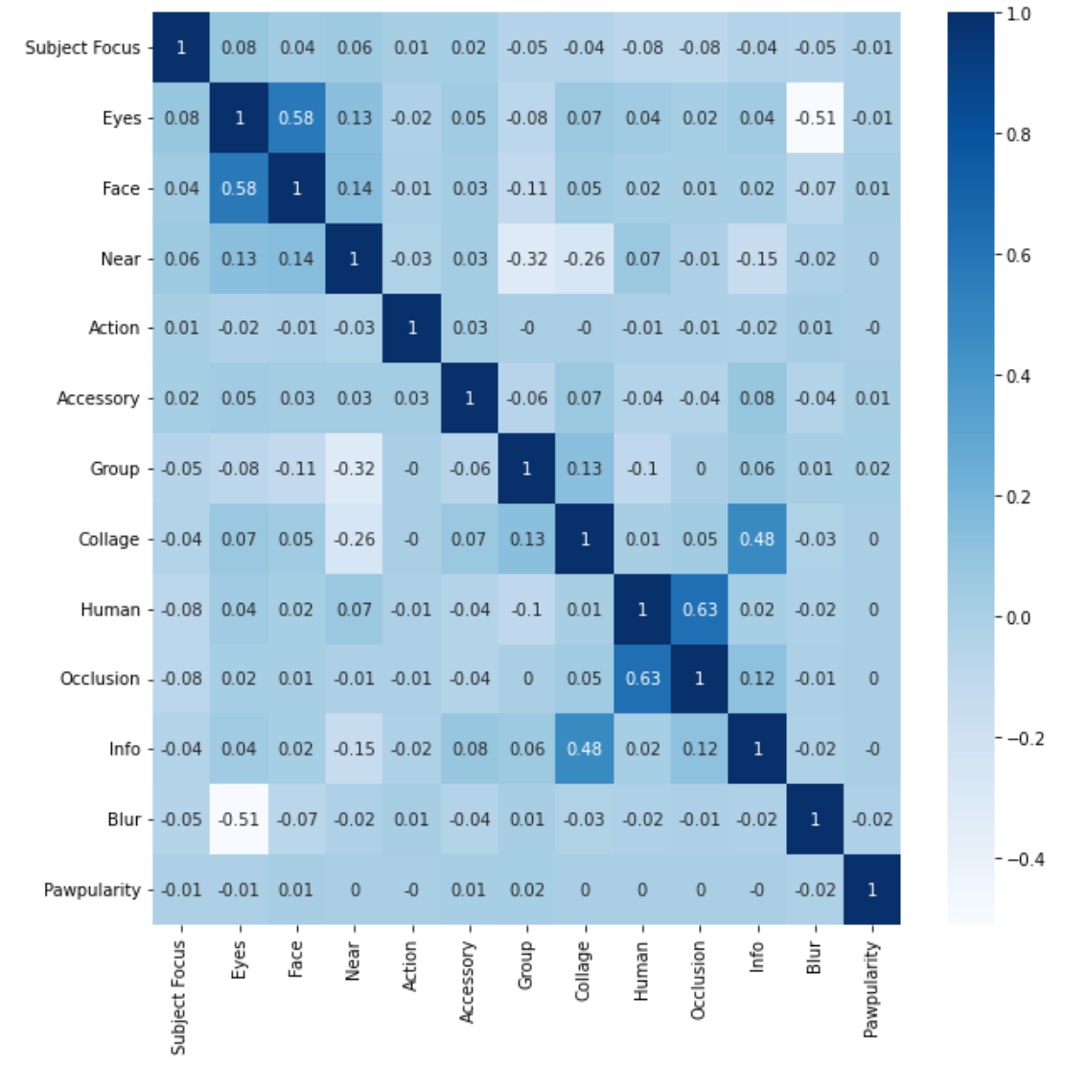
-
Discovery in data
Correlations：
1. Face and Eyes
2. Human and Occlusion
3. Collage and Info
4. Blur and Eyes
Since the Eyes-feature is highly correlated with two other features, we might consider dropping it as opposed to dropping the Face- and Blur-features.

Slide 8
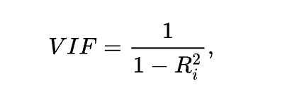
-
Discovery in data
Calculate VIF
VIF is a measure of the severity of complex (multiple) collinearity in multiple linear regression models.
Some metadata features have very high VIF, and we can eliminate these features to achieve the purpose of data dimension reduction. We eliminate the metadata features of VIF > 6, The remaining features were reduced to 9 dimensions.

Slide 9
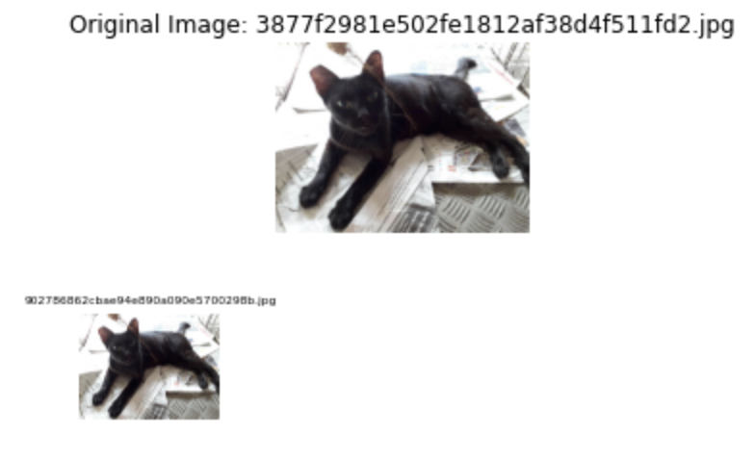
-
Data process
1. About 90 images were duplicated and need to be removed.
2.Kfold cross-validation
-Divide the data into 5 folds for cross-validation

Slide 10
-
Methodology
Metadata with traditional machine learning regression
Train and calculate the Pawpularity score from pure metadata.
Convolutional Neural Network with images
1. User-defined CNN
2. Pre-trained ImageNet(EfficientNetB5) + FC
Images and metadata fusion training
PyTorch + EfficientNetB0

Slide 11
-
Methodology
We train the image to extract image embeddings at first, then link the image embeddings and metadata features in the full connection layer to obtain new feature representation, and finally train the new joint features to produce output
MetaData
Image
Prediction
EfficientNet
EfficientNet
Image
Embeddings
As shown in the figure:
firstly send an image into a model to extract image embeddings
Then, concatenate image embeddings & metadata features in dense layer for fusion training

Slide 12
-
Results
Metadata with traditional machine learning regression
RMSE = 20.8
Convolutional Neural Network with images
1. User-defined CNN ----> RMSE=21
2. Pre-trained ImageNet(EfficientNetB5) + FC ---> RMSE=20.6
We use OOF(Out of fold predictions) to calculate the RMSE. Predict and calculate RMSE for the valid-set data by using models trained by K-fold. The results were not significantly improved.

Slide 13
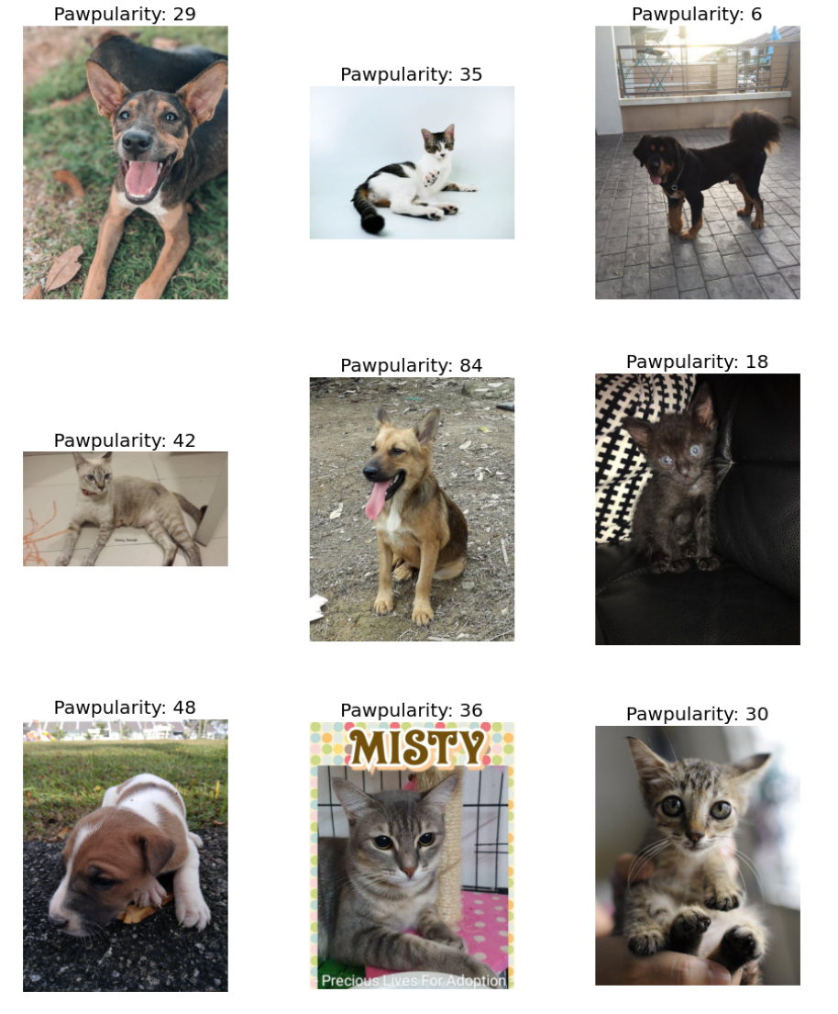
-
Conclusion
Traditional ML algorithms on pure metadata have similar performance with dummy regression(the baseline)
Convolutional neural network is more powerful to extract features from raw images, and the prediction results are more reasonable.
We did not do well in model transfer learning and did not make great breakthroughs in results. But using image and metadata fusion training must be the best feature representation method.

