Slide 1






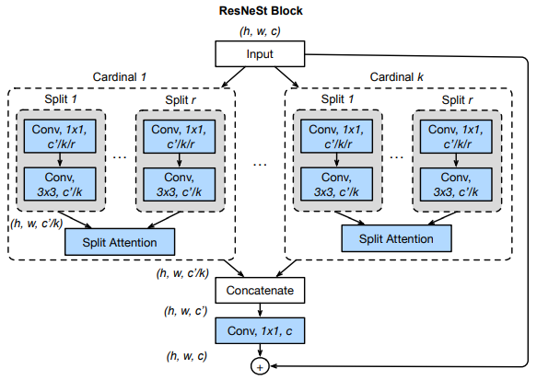
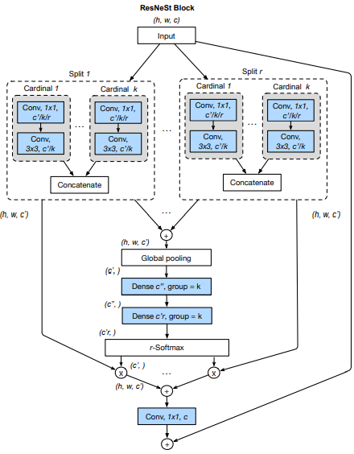
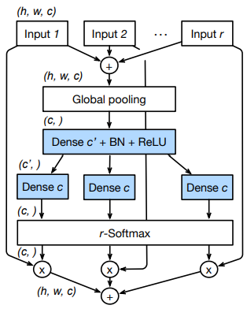




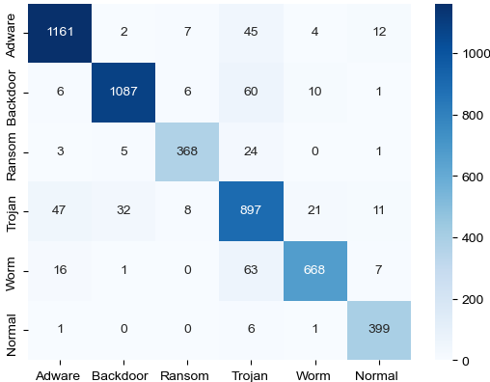

Malware Detection and Classification Based on ResNeSt
Group 2 黃海茵、許智超、徐培修
1. Motivation
In recent years, the amount of malware has increased dramatically, posing a huge threat to computer security.
There are several ways to detect malware. For example, the static and dynamic analysis both have high accuracy, but they require information security technicians and a lot of time to complete. Another method is to compare the database of anti-virus software, but the database is often not updated in time, malware can still bypass the detection of anti-virus software.
One of the most famous research about this is STAMINA (Static Malware-as-Image Network Analysis), which was launched by Microsoft and Intel in 2020. Their method is to convert the malware into images and do transfer learning.
However, STAMINA can only determine whether a program is a malware, but not its type. Therefore, in this project, we use a similar method to achieve fast and effective malware classification.
Moreover, the current malwares often have multiple characteristics, so we also implement multi-label classification, that is, the model can output several categories that the program may belong to.
4. ResNeSt
ResNeSt Block: Feature Map Groups as in ResNeXt +
Split Attention as in Squeeze-and-Excitation Net
K = 1 Feature Map Group, called Cardinal.
R = 2 Splits in Each Groups, called Radix.
Cardinality-Major View Radix-Major View
The Split Attention
Within Each Cardinal
2. Visualization method
Entropy
5. Result
Using CNN and ResNet as benchmark in both single label tasks and multi labels ones. In addition, the false positive(FP) of normal class should be serious issues in malware detection, so we tried to apply penalty in loss function when training, and conducted additional experiments on the penalty with ablation consideration.
Hilbert curve
5.1 Single Label
Method | CNN | ResNet | ResNest
Macro/Micro F1 | 0.86/0.87 | 0.90/0.90 | 0.92/0.92
Single label F1 scores
3. Dataset – Malware Knowledge Base
Single label penalty count
Malware Type Selection (Single)
ResNeSt | w/ penalty | w/o penalty
FP cnt | 12 | 32
Adware | Backdoor | Ransom | Trojan | Worm | Normal
Malware Type Selection (Multi)
Single Label ResNeSt
confusion matrix
Adware | Backdoor | Ransom | Trojan | Worm | Normal
V
 | V
 |  | V
 |  |  | V
 |  |  |  | V
 |  |  |  |  | V
V |  |  | V
 | V |  | V
 | V |  | V | V
 |  | V | V
 |  |  | V | V
5.2 Multi Label
Method | CNN | ResNet | ResNest
Macro/Micro F1 | 0.87/0.85 | 0.90/0.88 | 0.91/0.89
Multi label F1 scores
Multi label penalty count
ResNeSt | w/ penalty | w/o penalty
FP cnt | 22 | 37

