Slide 1
tables

Slide 2
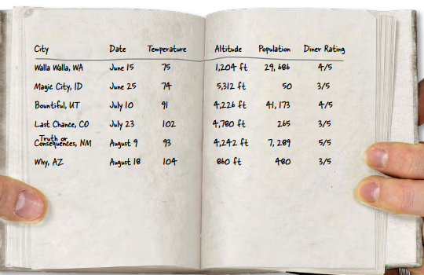
HTML Tables
Sometimes you need to present tabular data, perhaps for inventory of products or a catalog of albums.

Slide 3
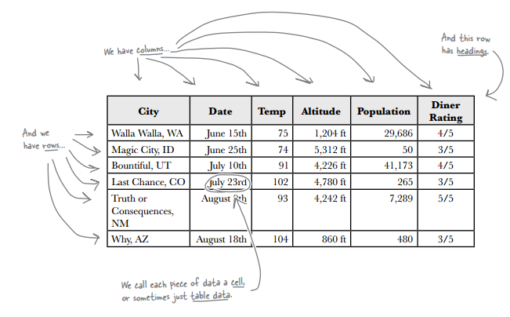
HTML Tables
HTML has a <table> element to take care of marking up tabular data.

Slide 4
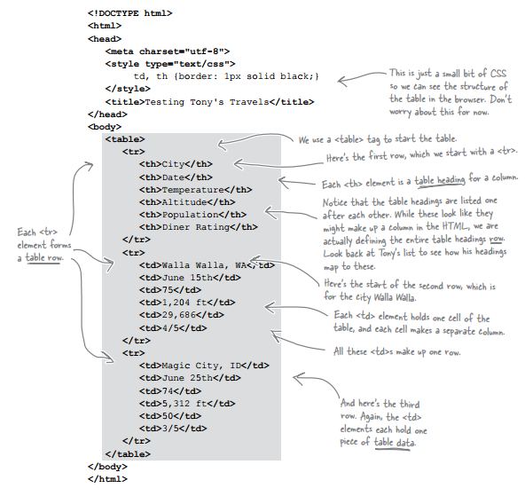
HTML Tables
Rows
Columns
Headers

Slide 5
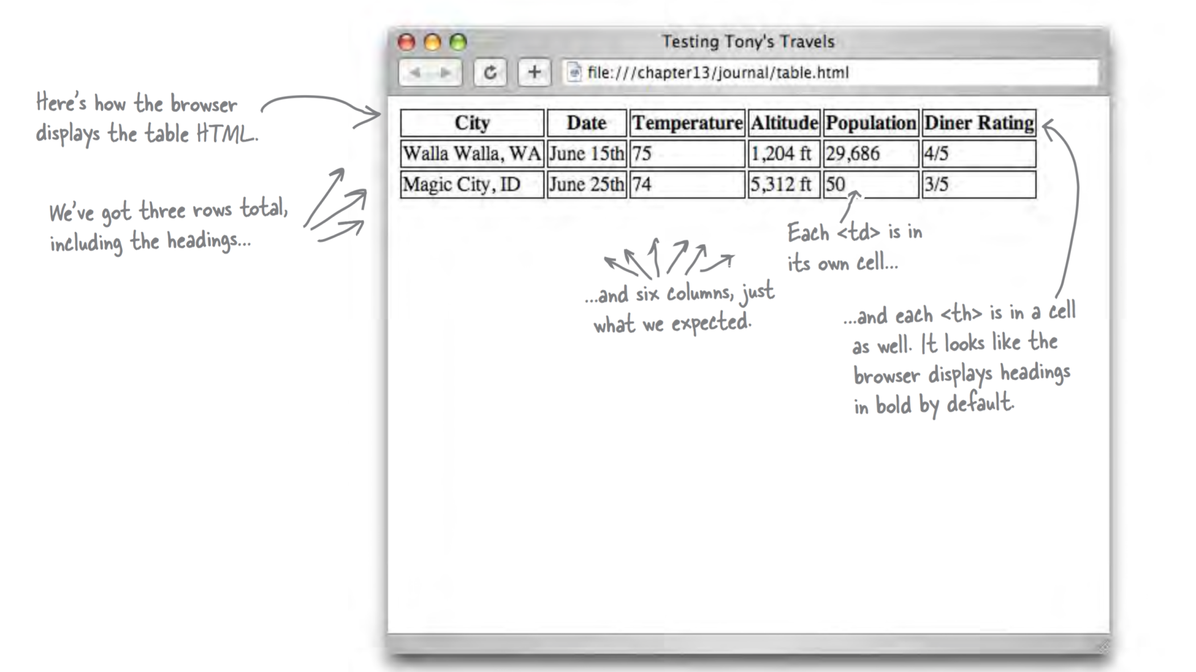
HTML Tables

Slide 6
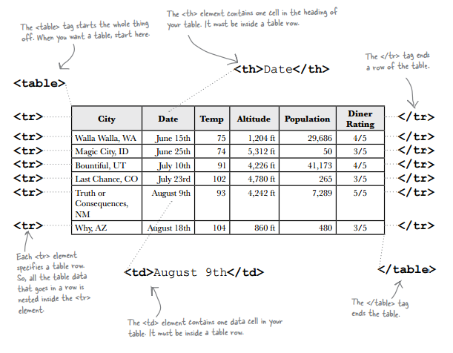
HTML Tables
We’ve seen four elements used to create a a single table:
<table>
<tr>
<th>
<td>.

Slide 7
HTML Tables
A table gives you a way to specify tabular data in your HTML.
Tables consist of data cells within rows. Columns are implicitly defined within the rows.
The number of columns in your table will be the number of data cells you have in a row.
In general, tables are not meant to be used for presentation: that’s the job of CSS.

Slide 8

HTML Tables
Adding a caption – you can improve your table by adding a caption.
The caption is displayed in the browser. By default, most browsers display this above the table. If you don’t like the default location of the caption, you can use CSS to reposition it.

Slide 9

HTML Tables
Table with caption added:

Slide 10


Styling HTML tables
To add a border, use:
To move the caption use:
To specify a single or double border around cells, use border-collapse.
When you have a double border , you can increase or decrease the space between each cell using border-spacing.

Slide 11
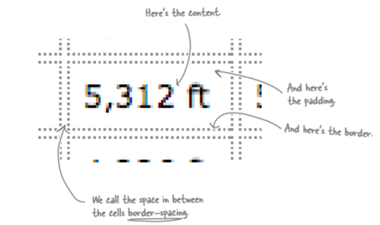
Styling HTML tables
By default each cell has a double border with some space between the borders:

Slide 12

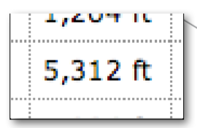
Styling HTML tables
The border-collapse property is set to separate by default (double border ). We can collapse the borders and have a single border:

Slide 13

Styling HTML tables
If the border-collapse property is not set (remember it is separate by default); or is set to separate, you can also use the border-spacing property:

Slide 14
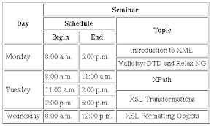
HTML tables
Sometimes tables have varying size cells. This is possible to define in HTML.

Slide 15

colspan
To make a cell span multiple columns, add the attribute colspan="n“ (where n is the number of columns to span) to the <td> (or <th>) tag of that cell.
The total number of cells has to be the same in all rows, where any cells that span n columns are counted as n cells.

Slide 16
rowspan
To make a cell span multiple rows, add the attribute rowspan="n" (where n is the number of rows to span) to the <td> (or <th>) tag of that cell.

Slide 17
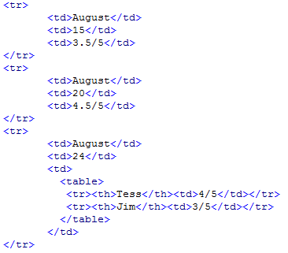
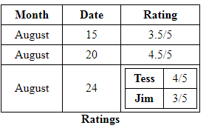
nested tables
What about displaying two (or more) values in one cell?

Slide 18
Grouping Rows
You can group together rows and split a table into a header, footer, and body by organising rows into thead, tfoot, and tbody elements.
Grouping rows can also provide a handy block to latch CSS on to, for example, if you wanted to change the background colour of a block of rows in a table.
You can have more than one tbody elements but only one thead and tfoot elements.

Slide 19
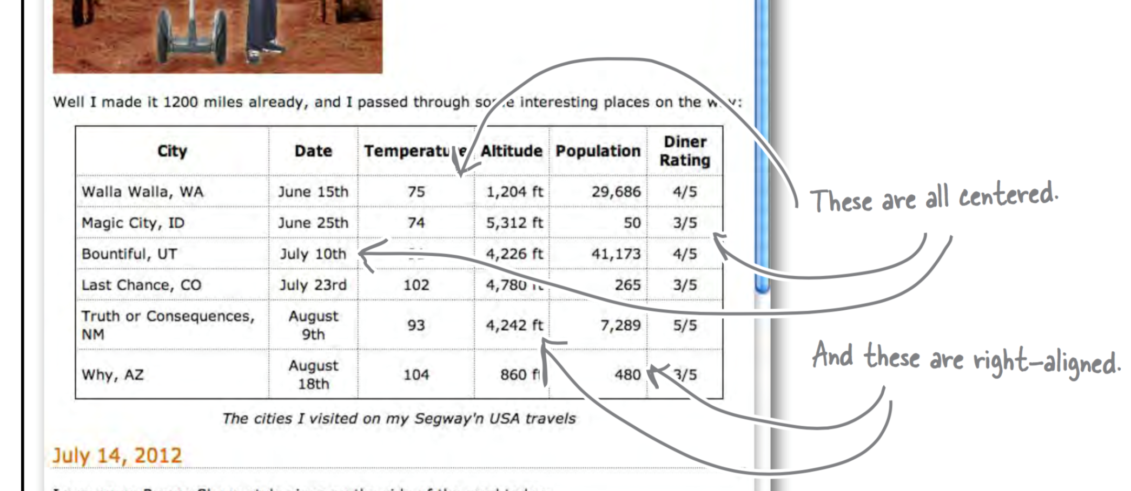
Target cells
How do we select or target cells in a column or row?

Slide 20
nth-of-type
The nth-of-type selector finds every nth element of a specific type using either keywords or a formula.
Keywords
:nth-of-type(odd)
:nth-of-type(even)
:first-of-type
:last-of-type
:hover

Slide 21
nth-of-type
Formula
The nth-of-type selector can use formulas instead of keywords. The formula is an + b, where b is the offset, and a is a multiple.
tr:nth-of-type(n) // Each row
tr:nth-of-type(2) // Second row
tr:nth-of-type(2n) // Every second row
tr:nth-of-type(n+2) // Every row starting at the second

Slide 22
nth-of-type
Formula
tr:nth-of-type(-n+2) // First 2 rows
tr:nth-last-of-type(2) // Second last row
tr:nth-last-of-type(-n+2) // Last 2 rows

