Slide 1
Bootstrap 4 Part two

Slide 2
Bootstrap 4
We will look at a subset of content, utilities and components, including:
Tables
Images and Buttons
Spacing
Navs
Dropdowns
Navbars

Slide 3
tables
For basic styling such as light padding and only horizontal dividers, we will add the base class table to any <table> tag.
Other Classes include:
table-striped adds zebra-striping to any table row within the <tbody>.
table-bordered adds borders on all sides of the table and cells.
table-hover enables a hover state on table rows within a <tbody>.
table-sm makes tables more compact by cutting cell padding in half.

Slide 4
tables
Responsive Tables
Create responsive tables by including the following table-responsive class any <table> tag.
Or you can pick a maximum breakpoint with which to have a
responsive table up to by adding
.table-responsive{-sm|-md|-lg|-xl}..
Other table styling
Use thead-light or thead-dark classes to style the table head.
Use table-dark to invert the table.

Slide 5
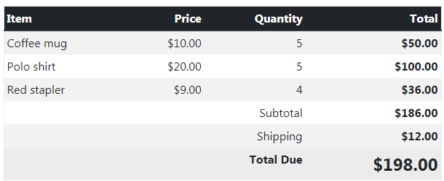
tables
thead (with.thead-dark)
.table-striped
.table-bordered
.table-hover
.table-sm

Slide 6

Images
Images can include many classes such as:
.img-fluid for responsive images
.rounded for rounded corners
.rounded-circle for a circular image
.img-thumbnail for a thumbnail image (I pixel border)

Slide 7
buttons
To style a button, use Bootstrap's .btn class, followed by the desired style class.
Primary,
Secondary,
Info,
Success,
Warning,
Danger,
Light,
Dark, and
Link

Slide 8
spacing
Assign responsive-friendly margin or padding values to an element or a subset of its sides with shorthand classes.
Property is one of m for classes that set margin and p for classes that set padding.
Where sides is one of t (top), b (bottom), l (left), r (right), x (left and right), y (top and bottom), or blank ( all sides).
Size can be one of 0, 1, 2, 3, 4 or 5.
Examples:
mt-0 (margin top 0)
ml-1 (margin left 1)
px-2 (padding left and right 2)
p-3 (padding top, bottom, left and right 3)

Slide 9
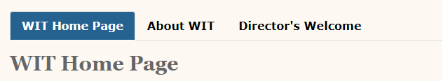
Nav – Nav-tabs
All nav components share the same base markup and styles through the .nav class.
For a tabbed effect we use the .nav-tabs class. Note the .nav-tabs class requires the .nav base class.
<ul class="nav nav-tabs">
<li class ="link-item"><a class= "nav-link active" href = "index.htm">WIT Home Page</a></li>
<li class ="link-item"><a class= "nav-link " href = "aboutwit.htm">About WIT</a></li>
…
</ul>

Slide 10

Nav – Nav-pills
For a Pills effect we use the .nav-pills class. Note the .nav-pills class requires the .nav base class.
<ul class="nav nav-pills">
<li class ="link-item"><a class= "nav-link active" href = "index.htm">WIT Home Page</a></li>
<li class ="link-item"><a class= "nav-link " href = "aboutwit.htm">About WIT</a></li>
…
</ul>

Slide 11
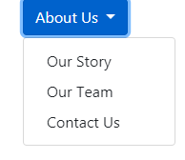
Dropdown Menu
Key steps for creating a Bootstrap dropdown:
Wrap the dropdown trigger element within an element with Bootstrap's .dropdown class.
Add Bootstrap's .dropdown-toggle class and add data-toggle="dropdown" to the trigger element. (i.e. the element that users click on to expand the dropdown).
Wrap all dropdown items in a <div> with .dropdown-menu applied.
Each dropdown item has a class of .dropdown-item.

Slide 12
Dropdown Menu
<div class="dropdown">
<button class="btn btn-primary dropdown-toggle" type="button" id="about-us" data-toggle="dropdown"
aria-haspopup="true" aria-expanded="false">About Us
</button>
<div class="dropdown-menu" aria-labelledby="about-us">
<a class="dropdown-item" href="#">Our Story</a>
<a class="dropdown-item" href="#">Our Team</a>
<a class="dropdown-item" href="#">Contact Us</a>
</div>
</div>

Slide 13
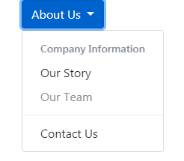
Dropdown Menu
Options include (via classes):
dropdown-header
dropdown-divider
Disabled

Slide 14

Navbar
Key steps for creating a Navbar:
Wrap everything inside a <nav> element with the .navbar class and a .navbar-expand{-sm|-md|-lg|-xl} class, along with a colour scheme.
For a togglable menu on smaller devices, use a button element with .navbar-toggler. To display the "hamburger", use the .navbar-toggler-icon class on a span element.
For a list of links, use a <ul> with the .navbar-nav class.
For each individual list item, use <li> with .nav-item.
For the individual links use <a> with .nav-link.
Use .navbar-brand for your company, product, or project name.

Slide 15
navbar
Options include (via classes):
.active
mr-auto / ml-auto
fixed-top / fixed-bottom
Colour options:
You specify light or dark (via .navbar-light or .navbar-dark), then specify a colour. Colour can be specified either via one of Bootstrap's colour classes (eg, .bg-primary, .bg-dark), or by specifying your own colour with CSS (eg, using background-color).

