Slide 1
Bootstrap 4

Slide 2
What is Bootstrap?
Bootstrap is a free front-end framework for faster and easier web development.
Bootstrap includes HTML and CSS based design templates for typography, forms, buttons, tables, navigation, modals, image carousels and many other, as well as optional JavaScript plugins.
Bootstrap also gives you the ability to easily create responsive designs.

Slide 3
Why use Bootstrap?
Easy to use: Anybody with just basic knowledge of HTML and CSS can start using Bootstrap.
Responsive features: Bootstrap's responsive CSS adjusts to phones, tablets, and desktops.
Mobile-first approach: In Bootstrap 4, mobile-first styles are part of the core framework.
Browser compatibility: Bootstrap is compatible with all modern browsers (Chrome, Firefox, Internet Explorer, Safari, and Opera).

Slide 4
Getting started
I have downloaded Bootstrap (version 4.0.0-beta.2) for you and it is available and used in all the examples.
The download is composed of two subfolders:
css subfolder
js subfolder
From the css subfolder, we will use bootstrap.min.css. . From the js subfolder, we will use bootstrap.min.js and popper.min.js.
Because we are using a javascript file (bootstrap.min.js), we will require the jQuery library. For our examples, we will use jquery-3.2.1.slim.min.js.

Slide 5
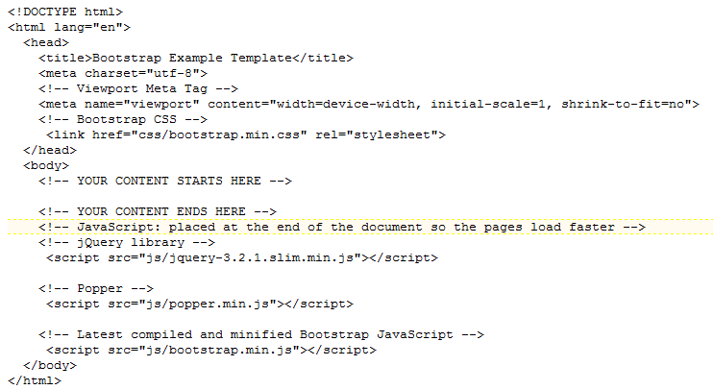
Getting started
Include these tags as normal
CSS file required
Need this tag for proper
rendering
JS files required

Slide 6
Getting started
The viewport is the user's visible area of a web page.
The viewport varies with the device, and will be smaller on a mobile phone than on a computer screen.
<meta name="viewport" content="width=device-width, initial-scale=1, shrink-to-fit=no">
A <meta> viewport element gives the browser instructions on how to control the page's dimensions and scaling.
The mobile first strategy of Bootstrap means that the code is optimised for mobile devices first. CSS media queries are used to add more features for larger screen sizes.

Slide 7

container
Containers provide the foundation for page layout.
Bootstrap requires a containing element to wrap elements and contain its grid system. Bootstrap's container classes were created specifically for this purpose.
Bootstrap containers can be either fixed or fluid.

Slide 8
The grid system
At the core of Bootstrap lies its grid system. The grid system basically allows you to create a structured template based on the grid.
The grid scales up to 12 columns by default, which can be altered for five devices
Extra small devices (portrait phones, less than 576px)
Small devices (landscape phones, 576px and up
Medium devices (tablets, 768px and up)
Large devices (desktops, 992px and up)
Extra large devices (large desktops, 1200px and up)

Slide 9
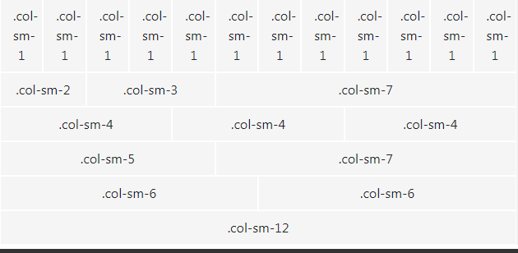
The grid system
Bootstrap includes a responsive, mobile first fluid grid system that appropriately scales up to 12 columns as the device or viewport size increases.

Slide 10
The grid system
Here's how the Bootstrap grid system works:
Rows must be placed within a container for proper alignment and padding.
Use rows to create horizontal groups of columns.
Content should be placed within columns, and only columns may be immediate children of rows.

Slide 11
The grid system
Here's how the Bootstrap grid system works (continued):
Predefined grid classes like .row and .col-sm-4 are available for quickly making grid layouts.
Columns create gutters (gaps between column content) via padding. That padding is offset in rows for the first and last column via negative margin on .rows.
Grid columns are created by specifying the number of twelve available columns you wish to span. For example, four equal columns would use four (.col-sm-3) columns.

Slide 12
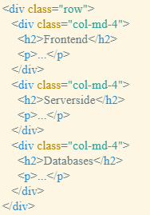
The grid system
Here we have 1 row.
The row is made up of 3 equally sized columns.

Slide 13
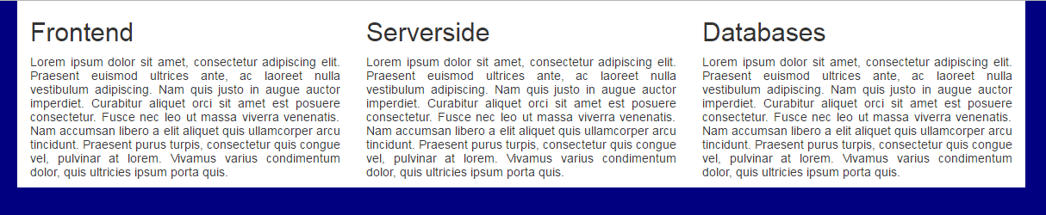
The grid system
Columns of content

Slide 14
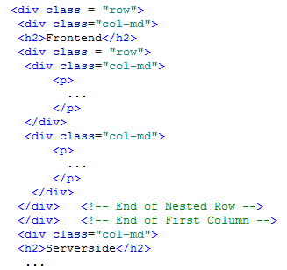
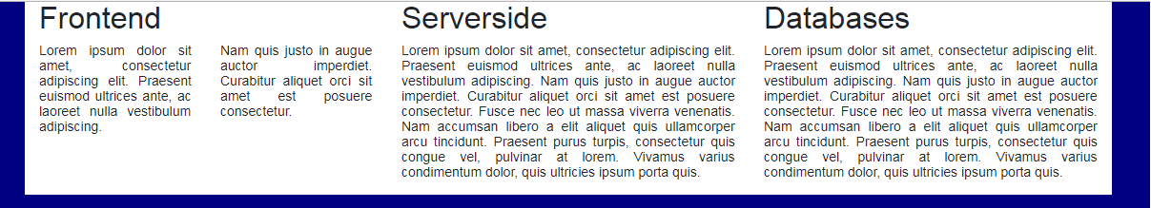
The grid system
Nested rows

Slide 15
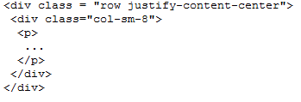
The grid system
Justify-content
Other options are:
Start
End
Space-around
Space-between

Slide 16
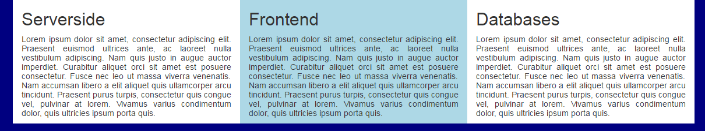
The grid system
You can order columns using order-n, where n is a positive number.
The default value is 0.
Notes:
Go through this on the board

Slide 17
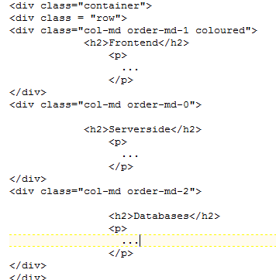
The grid system
In this example, on medium and larger viewports Serverside is the first column, Frontend in the second, and Databases is the third.
On small and extra small viewports, the layout is fluid and the order is per the markup.

Slide 18
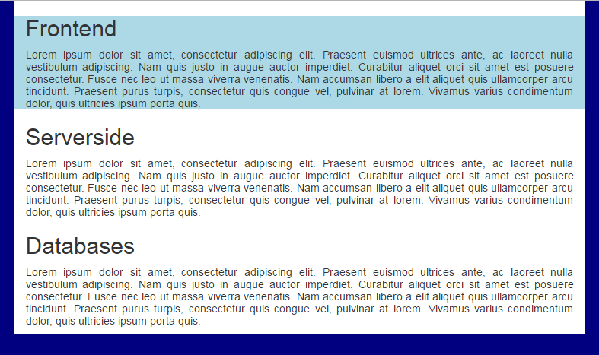
The grid system
Notes:
Go through this on the board

