Slide 1
Html basics
Website development 1

Slide 2
overview
Module introduction
The nature of the Web
HTML basics:
Page structure
Formatting
Adding an image
Adding lists
Linking pages
Validation
Structure of practical classes

Slide 3
Website Development 1
Tuition Team:
Dr. Rosanne Birney (rbirney@wit.ie)
Catherine Fitzpatrick (cfitzpatrick@wit.ie)
Mary Lyng (mylng@wit.ie)
Deirdre O’Halloran (dohalloran@wit.ie)
12 Week Module
1 lecture
3 hours supervised lab
100% Continuous assessment
2 Assignments during term

Slide 4
The nature of the web

Slide 5

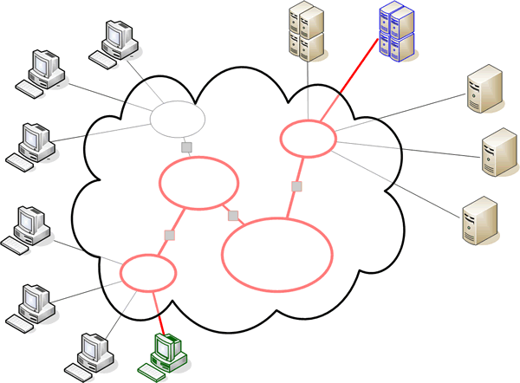
The Internet

Slide 6
The Internet
Global network infrastructure connecting millions of computers.
More than 190 countries linked
3,885,567,619 Internet users; 51.7% of the world’s population (30/06/2017 www.internetlivestats.com)
Over one billion websites.

Slide 7

World Wide Web
The world wide web is a huge globally distributed collection of information and data that can be accessed via the internet with the help of of http: Hypertext Transfer Protocol
WWW has made the Internet the most important communication medium of our days.
Thanks to the simple to use graphical interface – The Web Browser – the WWW provides everyone with simple access to information

Slide 8
The Web
Protocols & Standards
Protocol : agreed vocabulary to enable two programs to communicate
Standard: an agreed definition of the structure and meaning of a document
Web Protocol
Hyper Text Transfer Protocol - HTTP
Web Standard
Hyper Text Markup Language – HTML
Cascading Style Sheets - CSS
Web Servers and Web Browsers use HTTP to exchange HTML documents

Slide 9

Clients and Servers
Client/Server Computing:
The interaction between two programs when they communicate across a network.
A program at one site sends a request to a program at another site and awaits a response.
The requesting program is called a client; the program satisfying the request is called the server.

Slide 10
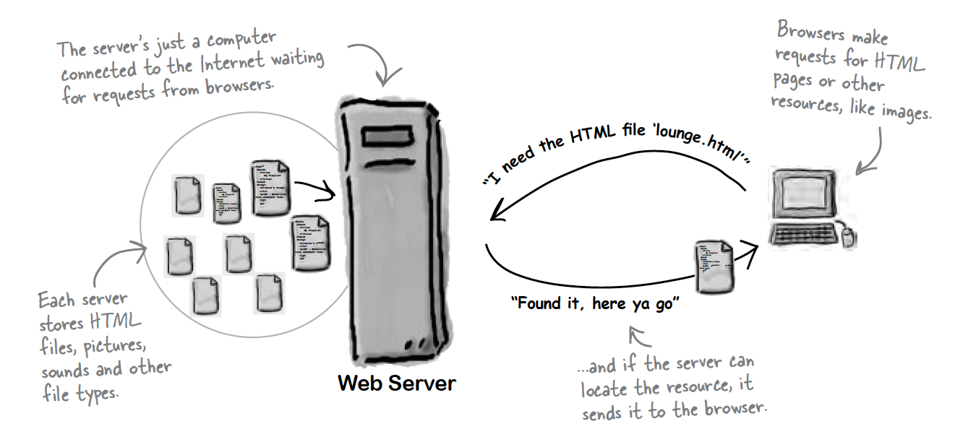
Role of Server

Slide 11
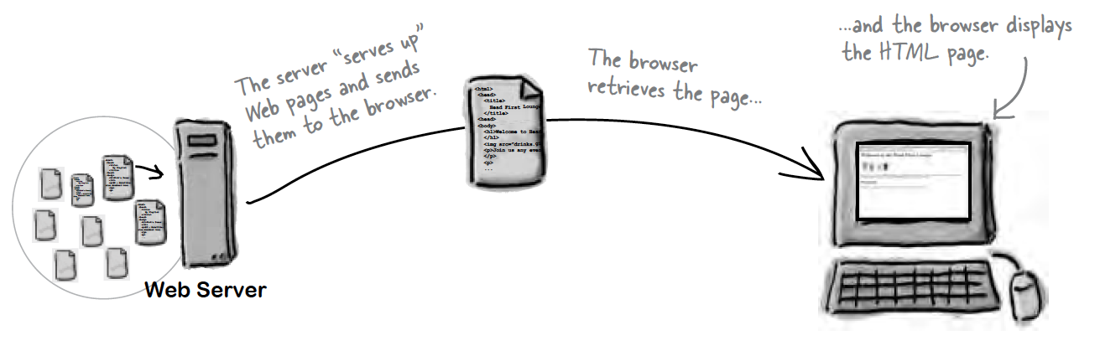
Role of Client

Slide 12
Hyper Text Markup Language
HTML tells your browser about the structure of your document:
where the headings are,
where the paragraphs are,
what text needs emphasis, etc
what text needs to linked
what images to be displayed
Given this information, browsers have built-in default rules for how to display each of these elements.
This information is conveyed using “Tags”, this denote the intention of the author regarding the structure and display of the document.

Slide 13
HTML
An HTML document is called a ‘page’
The starting page of a site is called the ‘homepage’
Markup language should only be used for the description of the document structure and not to describe the document presentation
Every HTML document consists of two parts:
Document ‘header’: contains information about the document.
Document ‘body’: contains the content of the document.

Slide 14
HTML Tags (more correctly called Elements)
<html>
<head>
<title>
<body>
<h1>
<h2>
<p>
<a>
<img>
Grouped by purpose:
Structural
<html>, <head>, <title>, <body>
Text
Heading
<h1>, <h2>
Text
<p>, <b>, <i>
Hypertext
<a>
Image
<img>
Tags for this week

Slide 15
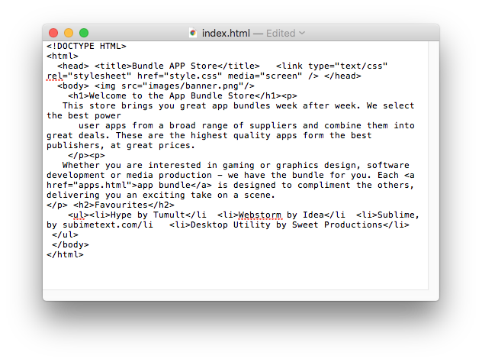
The Code in a Conventional Editor
The actual document text - but poorly structured (indented)

Slide 16
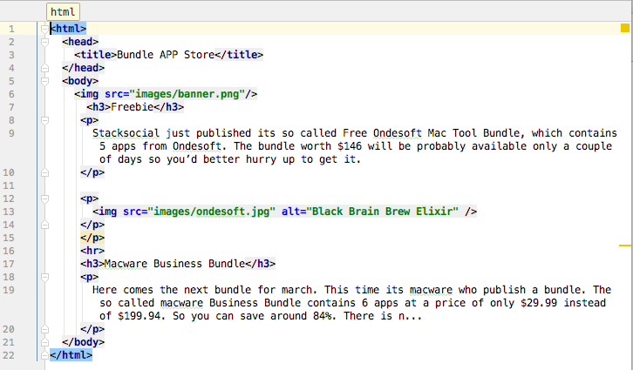
The Code in a Programmer’s Editor
Same document - pleasingly indented and syntax highlighted
16

Slide 17
HTML Basics:
HTML elements

Slide 18
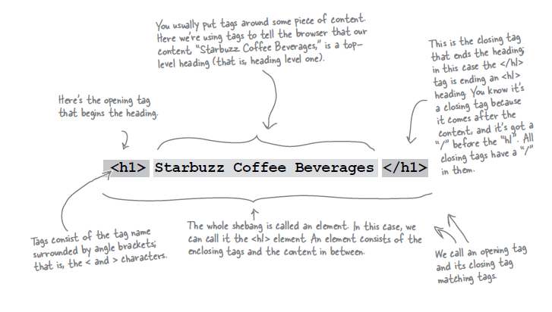
Components of an HTML Element

Slide 19
Components of an HTML Element
<ElementName >
Content
</ElementName>
Start Tag
End Tag

Slide 20
Example: <title>
<title>My App Store</title>
ElementName: <title>
Content: My App Store
ElementName: </title>

Slide 21
HTML Basics:
page structure

Slide 22
Structural Elements - <html>
<html>
<head> <title>Page title goes here</title>
</head>
<body> <!-- content goes here -->
</body>
</html>
The html element is the outer container for everything that appears in an HTML document.
It can only contain two elements as direct descendants, namely the head element and the body element.
As it is the outermost element in the document, it’s also known as the root element.
This element will have a place on every single web page you ever create. There’s no case in which you would not use this element when crafting a web page.

Slide 23
Structural Elements - <head>
The head element is the wrapper for all the head elements that:
instruct the browser where to find style sheets,
define relationships that the document has to others in the web site;
provide essential meta information;
point to or include scripts that the document will need to apply later on.
<html>
<head> <title>Page title goes here</title>
<link type="text/css" rel="stylesheet" href="style.css" media="screen"/>
</head>
<body> <!-- content goes here -->
</body>
</html>

Slide 24

Head Elements - <title>
Displaying a title in the browser toolbar or in the task bar (on Windows)
Providing for the document a name that’s used by the browser when you add the page as a favorite or bookmark
Displaying a title of the page when it appears in search engine results
<html>
<head>
<title>
FAQ
</title>
</head>

Slide 25
Structural Elements - <body>
The body element wraps around all of the content that will be displayed on screen.
You should not place character data (text) or inline elements such as em, or q directly into the body.
Instead, these should be contained inside block-level elements such as p elements, headings h1 - h6 and so on.
<html>
<head> <title>Page title goes here</title>
<link type="text/css" rel="stylesheet" href="style.css" media="screen"/>
</head>
<body
<h1>101 Ways to make a paper aeroplane</h1>
<p>Let's start with the basics …</p>
</body>
</html>

Slide 26
Block vs Inline Elements
Block elements are always displayed as if they have a line break before and after them
inline elements appear “in line” within the flow of the text in your page.
“Block elements stand on their own; inline elements go with the flow.”

Slide 27
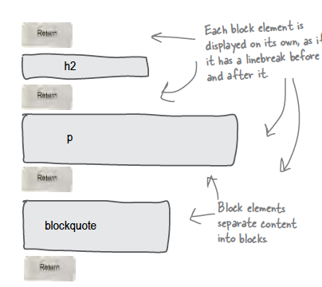
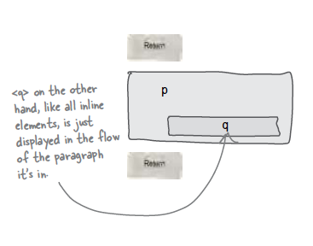
Examples
Block - h1, h2, p, blockquote
Inline - a, em, q

Slide 28
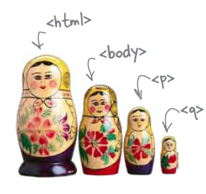
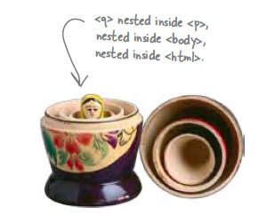
Nesting
When we put one element inside another element, we call that nesting.
We say, the <p>element is nested inside the <body>element.
We put a <body>element inside an <html>element, a <p>element inside a <body>element etc.

Slide 29
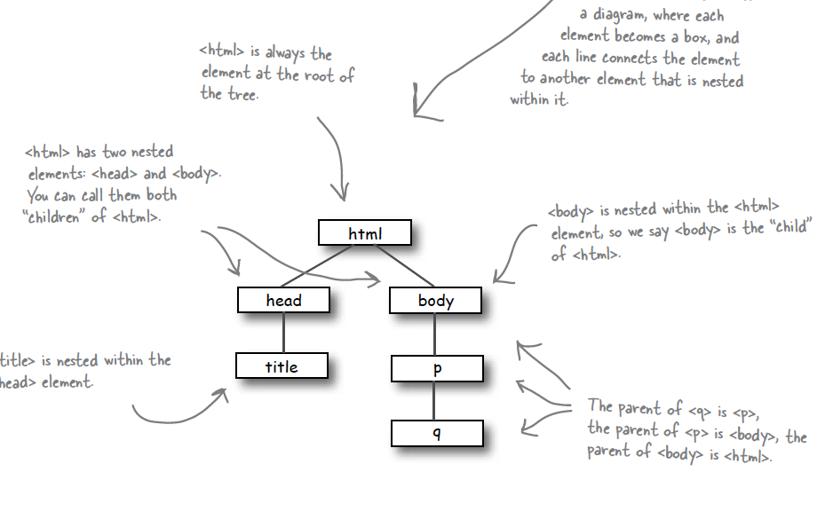
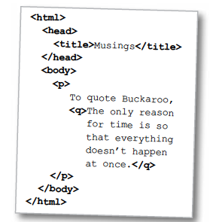
Nesting - Tree Structure

Slide 30
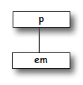
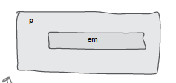
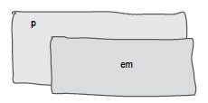
Nesting can be Incorrect!
<p>I’m so going to blog <em>this</em></p>
Good
<p>I’m so going to blog <em>this</p></em>
Bad
?

Slide 31
HTML Basics:
Formatting text

Slide 32
Structural Elements - <p>
One of the most commonly used building blocks of HTML.
When you use the p element to begin a new paragraph in HTML, it automatically creates some space above and below the content.
Can only contain inline elements
<p>
We endeavour to give you your most wanted DVD and/or Game from your rental
queue depending on our stock situation. All DVDs and Games are posted out at noon
FIRST CLASS, and should be at your doorstep by the next morning.
When we dispatch your DVD/Game we'll send you an e-mail to advise you on which
DVD/Game was dispatched to you. There are no late fees so you can watch or play at your leisure
</p>

Slide 33
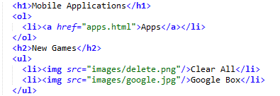
Structural Elements – <h1-h6>
The h1 element is used to indicate the most important (or highest-level) heading on the page.
There are six heading levels h1 to h6—to add structure to the web page.
A document’s first heading should be an h1, followed by one or more h2 headings; each of these h2 headings can then have a further series of h3 headings below them, and so on
They may contain any text content, but it can’t include any block-level elements: only inline elements can be included

Slide 34
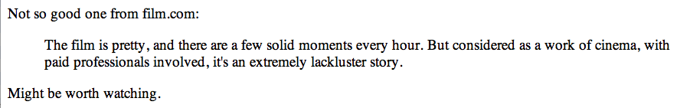
Structural Elements - <blockquote>
The blockquote element is a mechanism for marking up a block of text quoted from a person or another document or source.
It may be just a few lines, or it may contain several paragraphs - which must be marked up using nested p elements).
<p>Not such a good one from film.com:</p>
<blockquote>
The film is pretty, and there are a few solid moments every hour.
But considered as a work of cinema, with paid professionals involved,
it's an extremely lackluster story.
</blockquote>
<p>Might be worth watching.</p>

Slide 35
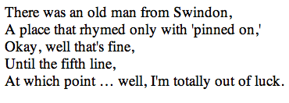
Structural Elements - <br>
Creates a line break within a block of text, leaving no padding or margins between the two blocks of text created by the line break
<p>
There was an old man from Swindon,<br>
A place that rhymed only with 'pinned on,'<br>
Okay, well that's fine,<br>
Until the fifth line,<br>
At which point … well, I'm totally out of luck.
</p>

Slide 36
Text Formatting Elements - <i> and <b>
The i element is used to italicise text content, and displays in italics in all current browsers.
The b element works in the same way, but displays bold text.
This week we recommend <em>the Crazies</em>.

Slide 37
Text Formatting Elements - <q>
Used for inline quotations (instead of blockquote, which sets the quotation in its own block.
It is intended that the browser should insert the necessary quotation marks, the style of which should depend on the language of the document or that section of the document, rather than the author adding quotation marks
This can sometimes cause double sets of quotation marks to appear.
<p>
Not so good one from film.com: <q>The film is pretty, and there are a few
solid moments every hour. But considered as a work of cinema, with paid
professionals involved, it's an extremely lackluster story.</q>
</p>

Slide 38
HTML Basics:
Adding an image

Slide 39

Image & Media Elements - <img>
<img src="images/robinhood.jpg" alt="Robin Hood">
Provides a means for embedding an image in the document.
Has a total of 12 attributes
src provide a link to the image to be displayed
alt provides text to be displayed if the image cannot be retreived.
Height & Width provide (optional) dimensions. Used to help the browser lay out images properly, and should coincide with the actual image dimensions

Slide 40
HTML Basics:
Adding lists

Slide 41
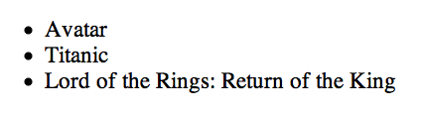
List Elements - Unordered List - <ul>
<ul>
<li>Avatar</li>
<li>Titanic</li>
<li>Lord of the Rings: Return of the King</li>
</ul>
Used to group a collection of items together in a list, but in a way that doesn’t suggest an order of precedence or importance.
Individual items in the list marked with - li

Slide 42
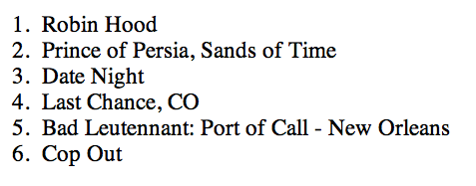
List Elements - Ordered List - <ol>
<ol>
<li>Robin Hood</li>
<li>Prince of Persia, Sands of Time</li>
<li>Date Night</li>
<li>Last Chance, CO</li>
<li>Bad Leutennant: Port of Call - New Orleans</li>
<li>Cop Out</li>
</ol>
Like ul, used to group a collection of items together in a list
However, the bullets in an unordered list are replaced with a series of incrementing numbers

Slide 43
HTML Basics:
Linking pages

Slide 44
Text Formatting Elements - <a>
Usually referred to as a link or hyperlink
Has a 7 possible attributes in total, of which we start with just one: href, which defines the document to which the link leads. This may be
a web page in the same directory,
a page somewhere else on the same server,
a location within the current page,
a web page—or any another kind of document—stored on another server.
In a link to another section within the same page, the destination is identified in the href attribute by a hash symbol combined with the id attribute of the destination
<a href="catalogue/newreleases.html">new releases</a>
<a href="#q1">Q.Does it matter where I live?</a>
<li>
<a id="q1">Q.Does it matter where I live?</a>
</li>
<li>
A.Our service is only available in the republic of Ireland,
we use "An Post" and deliver to all 26 counties.
</li>

Slide 45
HTML Basics:
validation

Slide 46
W3C Validator
The World Wide Web Consortium (W3C) is an international community that develops open standards to ensure the long-term growth of the Web.
The W3C provide online validation tools that you allow to check whether your HTML code complies with the standard they have set.
You will try out this tool in your practical classes this week.

Slide 47
Structure of practical classes

Slide 48
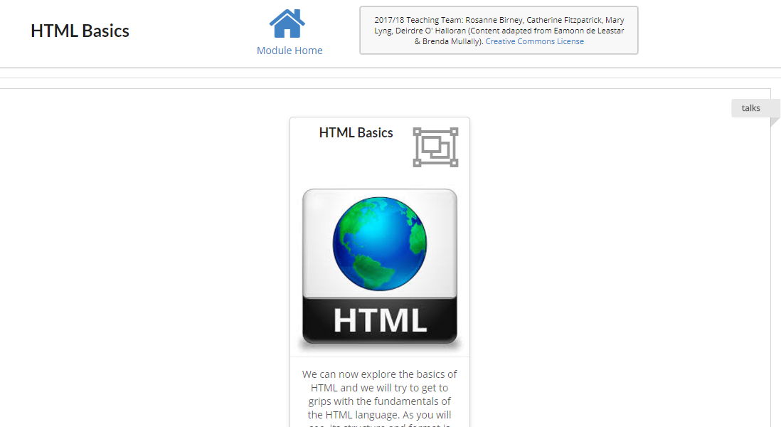
On Moodle: lecture slides
This week’s topic: HTML Basics
Each week there will a new topic; you will find these lecture slides in the ‘card’ at the top

Slide 49
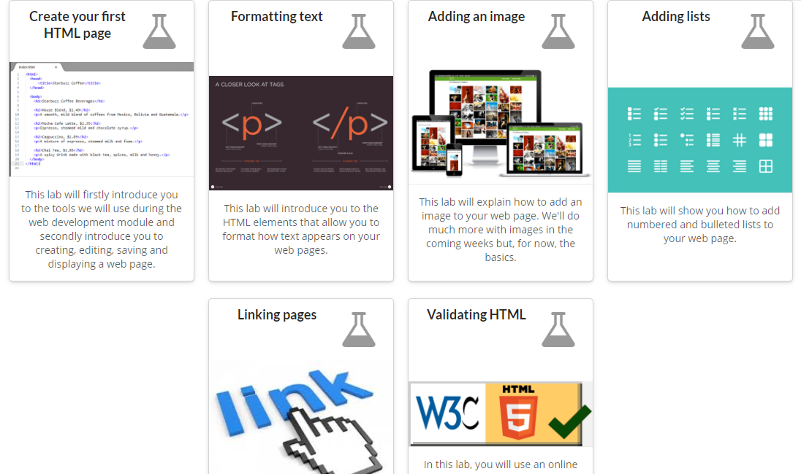
On moodle: labs
Below that, you will see a card for each of the labs in this section
Each topic will be split into a number of sections in this way

Slide 50
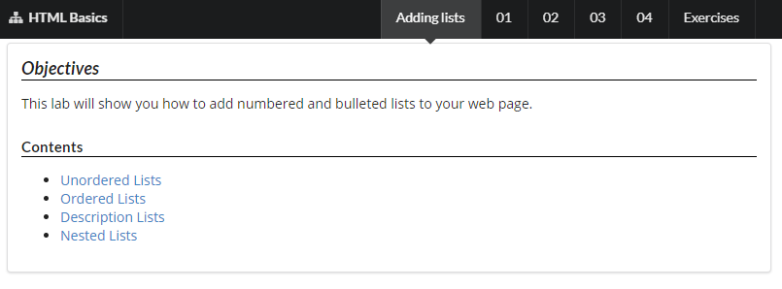
Lab contents
In each lab, you will see a list of the contents
Use the links to jump to a particular piece of information if you wish

Slide 51
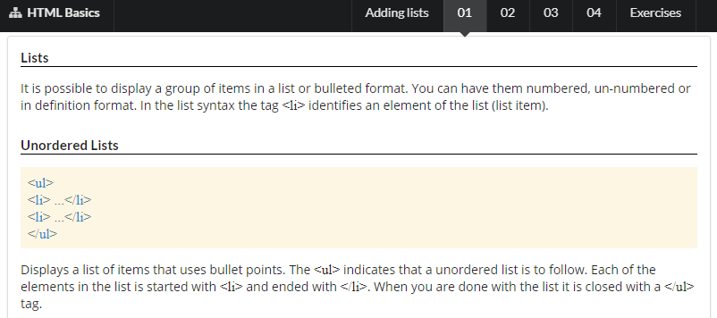
Lab contents
Go through the numbered steps at the top
Read through the information in each step to refresh your memory from the lecture
Try out the examples (if you wish)

Slide 52
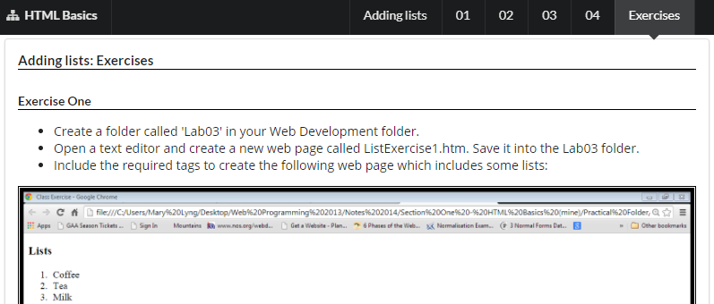
Lab contents
Complete the exercises in the last tab
Each week, you should upload your completed exercises to Moodle

