Slide 1
Html5 Semantic elements

Slide 2
Html5 semantic elements
The need for semantic elements
Structural/layout elements
Figures and captions

Slide 3
The Need for Semantic Elements
Give content on the page meaning and structure
Semantics portray the value of content on a page, and are not just its style
Semantic markup can be interpreted by tools for the visually impaired
Search Engines can use semantic markup to better categorise and classify content
Semantic markup can make site maintenance easier as new developers can quickly grasp the site structure
Updating / restyling may by streamlined by using semantic elements

Slide 4
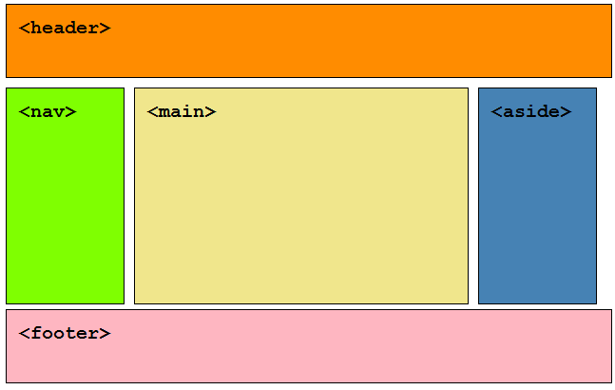
The HTML5 Semantic Elements
<header>
<nav>
<section>
<main>
<article>
<aside>
<figcaption>
<figure>
<footer>

Slide 5
<nav>
<nav>
<h1>Navigation</h1>
<ul>
<li><a href="articles.html">Index of all articles</a></li>
<li><a href="today.html">Things sheeple need to wake up for today</a></li>
<li><a href="successes.html">Sheeple we have managed to wake</a></li>
</ul>
</nav>
"The nav element represents a section of a page that links to other pages or to parts within the page: a section with navigation links.”

Slide 6
<article>
<article itemscope itemtype="http://schema.org/BlogPosting">
<header>
<h1 itemprop="headline">The Very First Rule of Life</h1>
<p><time itemprop="datePublished" datetime="2009-10-09">3 days ago</time></p>
<link itemprop="url" href="?comments=0">
</header>
<p>If there's a microphone anywhere near you, assume it's hot and
sending whatever you're saying to the world. Seriously.</p>
<p>...</p>
<footer>
<a itemprop="discussionUrl" href="?comments=1">Show comments...</a>
</footer>
</article>
"The article element represents a complete, or self-contained, composition in a document, page, application, or site and that is, in principle, independently distributable or reusable, e.g. in syndication. This could be a forum post, a magazine or newspaper article, a blog entry, a user-submitted comment, an interactive widget or gadget, or any other independent item of content.

Slide 7
<section>
"The section element represents a generic section of a document or application. A section, in this context, is a thematic grouping of content. The theme of each section should be identified, typically by including a heading (h1-h6 element) as a child of the section element.”
<article>
<header>
<h2>Apples</h2>
<p>Tasty, delicious fruit!</p>
</header>
<p>The apple is the pomaceous fruit of the apple tree.</p>
<section>
<h3>Red Delicious</h3>
<p>These bright red apples are the most common found in many
supermarkets.</p>
</section>
<section>
<h3>Granny Smith</h3>
<p>These juicy, green apples make a great filling for apple
pies.</p>
</section>
</article>

Slide 8
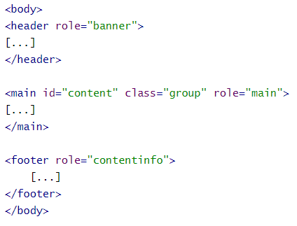
<main>
The main content of the body of a document or application. The main content area consists of content that is directly related to or expands upon the central topic of a document or central functionality of an application.
Can only appear once on each page, and cannot be a descendant of elements such as nav, header, or footer.

Slide 9
<aside>
"The aside element represents a section of a page that consists of content that is tangentially related to the content around the aside element, and which could be considered separate from that content. Such sections are often represented as sidebars in printed typography.”
<aside>
<h1>Switzerland</h1>
<p>Switzerland, a land-locked country in the middle of
geographic Europe, has not joined the geopolitical
European Union, though it is a signatory to a number
of European treaties.</p>
</aside>

Slide 10
<header> & <footer>
"The header element represents introductory content for its nearest ancestor sectioning content or sectioning root element. A header typically contains a group of introductory or navigational aids.”
<header>
<p>Welcome to...</p>
<h1>Voidwars!</h1>
</header>
<footer>
<a href="../">Back to index…</a>
</footer>
"The footer element represents a footer for its nearest ancestor sectioning content or sectioning root element. A footer typically contains information about its section such as who wrote it, links to related documents, copyright data, and the like..”

Slide 11
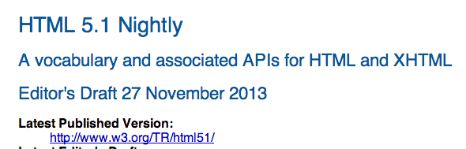
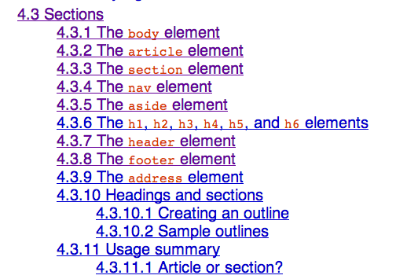
W3C Specifications
Readable and concise
Simple guidance on structuring content

Slide 12
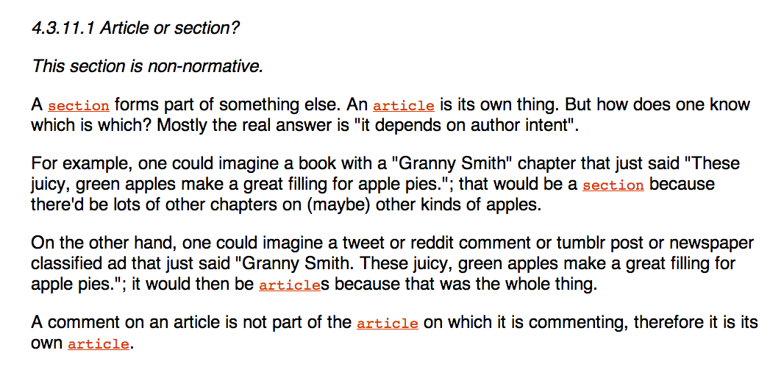
http://www.w3.org/html/wg/drafts/html/master/sections.html#article-or-section

Slide 13
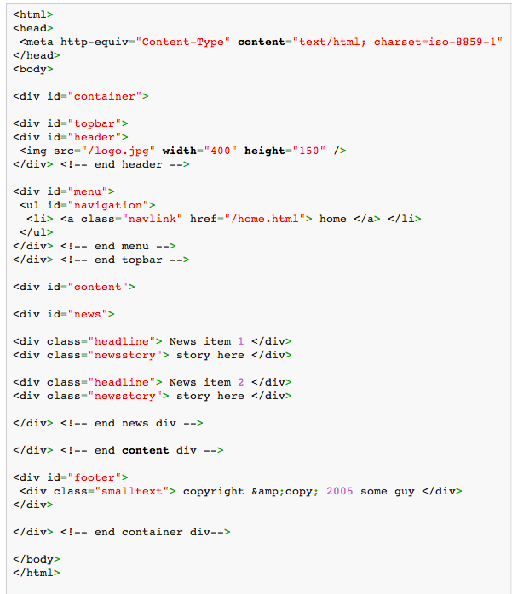
Semantic and Div’itis
Div’itis : the process of using too many nested/unnecessary divs to mark up a page.
Excessive use of DIVs makes page difficult to interpret, both by a human and machine reader

Slide 14
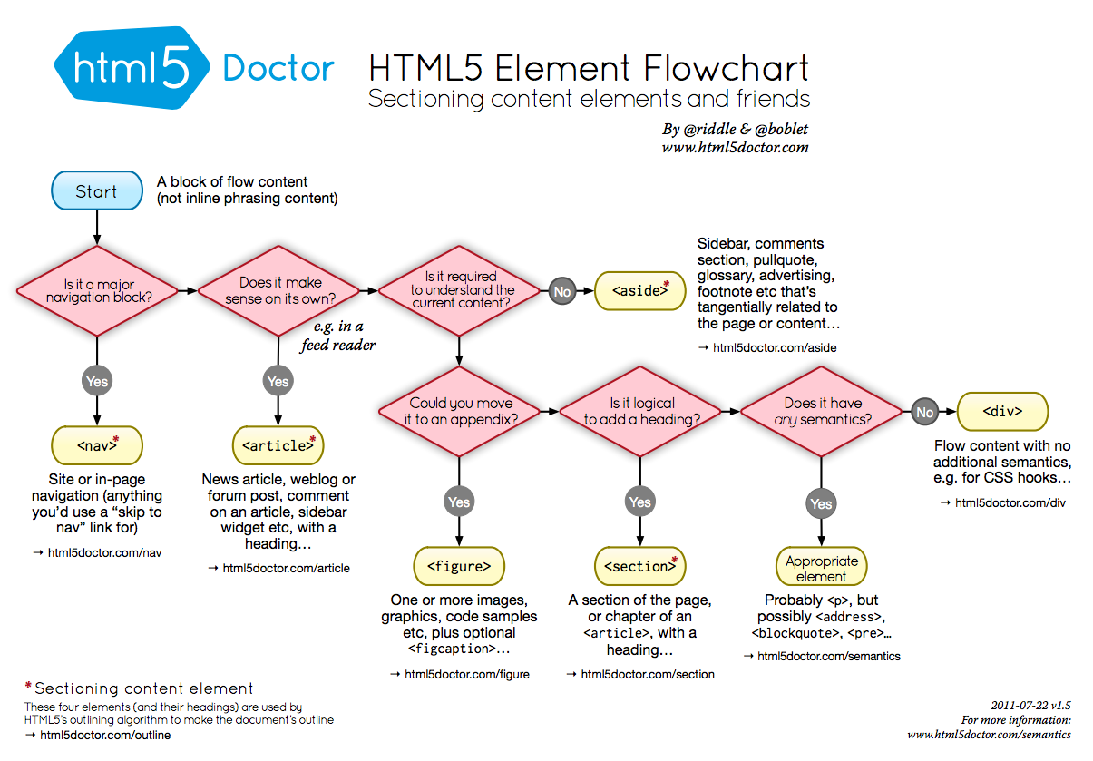

Slide 15
Different Structures and Ordering
<header></header>
<nav></nav>
<main></main>
<aside></aside>
<footer></footer>

Slide 16
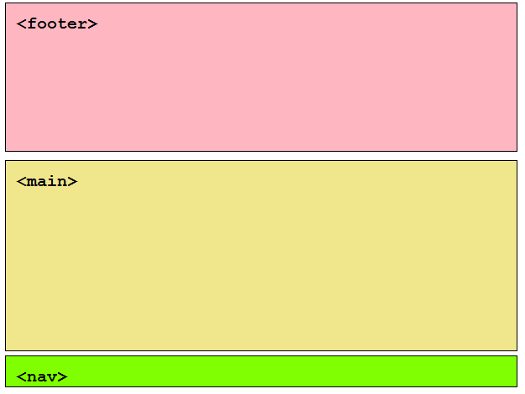
<footer></footer>
<main></main>
<nav></nav>

Slide 17
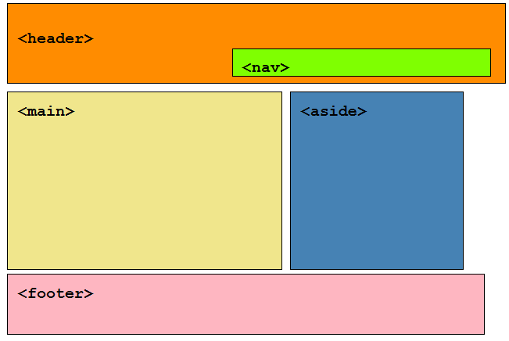
<header>
<nav></nav>
</header>
<main></main>
<aside></aside>
<footer></footer>

Slide 18
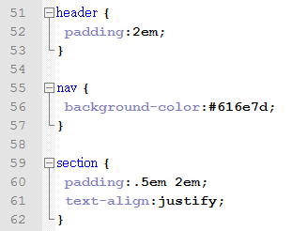
Css example
All of the semantic structural elements mentioned above can have CSS styles applied to them to control their appearance and position

Slide 19
Figure and figcaption
The <figure> element is intended to be used in conjunction with the <figcaption> element to mark up diagrams, illustrations, photos, and code examples (among other things).
“The figure element represents a unit of content, optionally with a caption, that is self-contained, that is typically referenced as a single unit from the main flow of the document, and that can be moved away from the main flow of the document without affecting the document’s meaning”
“The figcaption element represents a caption or legend for a figure.”

Slide 20
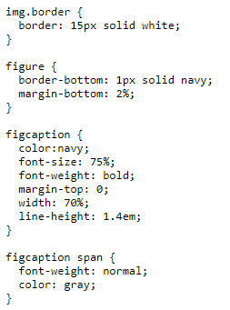
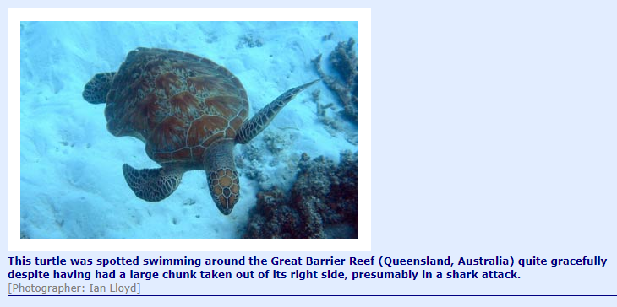
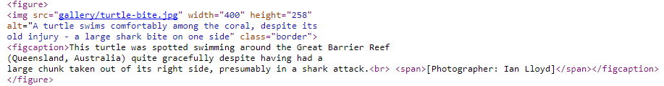
Figure and figcaption

