Slide 1
Forms

Slide 2

Overview of forms
Forms are used all over the Web to
Accept information
Provide interactivity
Types of forms:
Search form, Order form, Newsletter sign-up form, Survey form, Add to Cart form, and so on…

Slide 3
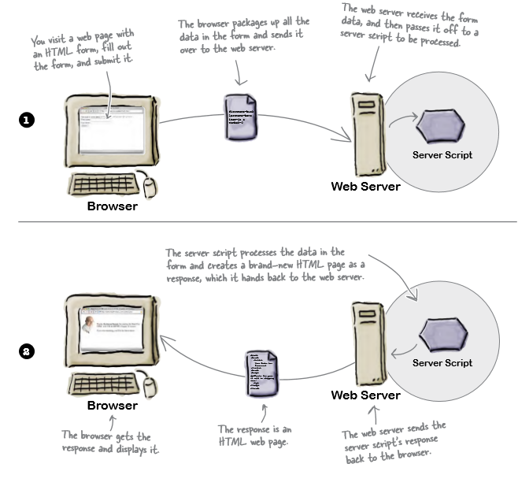
Server side

Slide 4
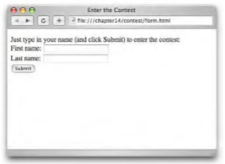
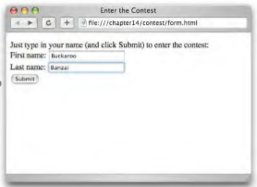
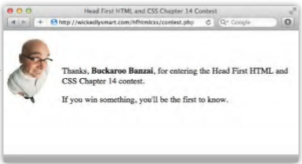
How forms work in the browser
The browser loads the page, it creates controls on the page that allow you to input various kinds of data.
You enter data, type a single line of text, click an option, checkbox control etc.
You submit the form by clicking a submit button.
The server responds by receiving the data and processing it and presenting a new html page.

Slide 5
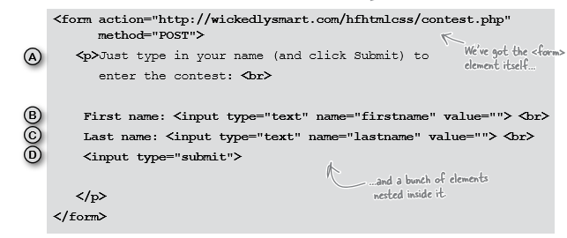
Form elements

Slide 6
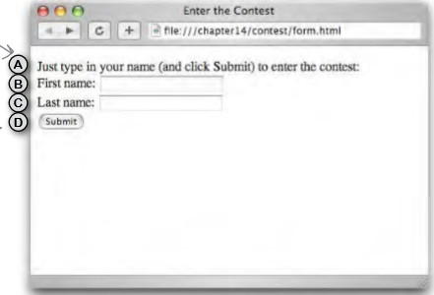
Form elements

Slide 7
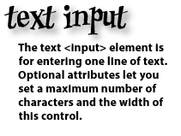
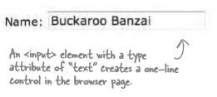

What can go on a form?
The password <input> element works just like the text <input> element except that the text is masked.

Slide 8
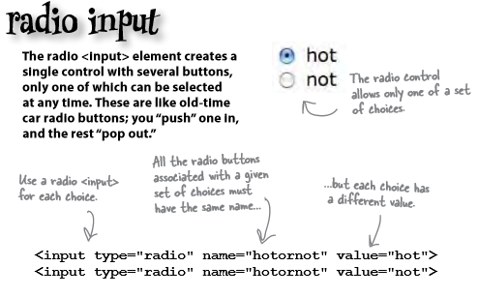
What can go on a form?
Radio buttons create a single control of several buttons of which only one can be chosen.

Slide 9
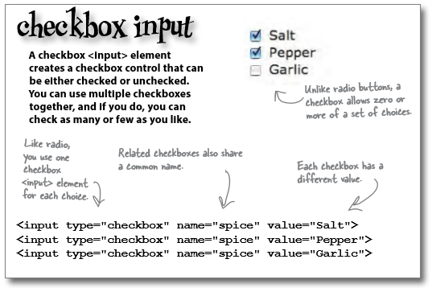
What can go on a form?

Slide 10
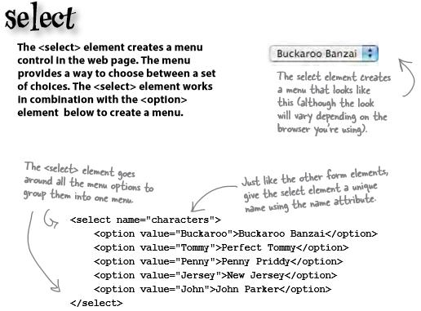
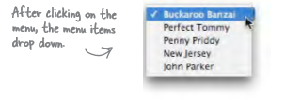
What can go on a form?

Slide 11
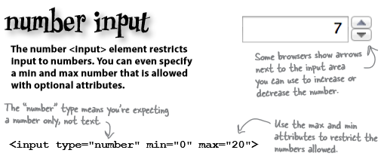
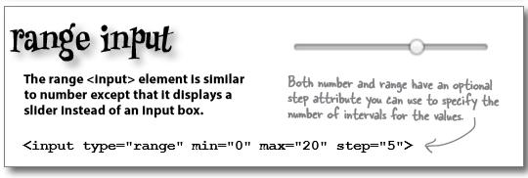
What can go on a form?
HTML5 adds more input types.

Slide 12
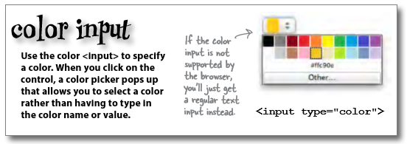
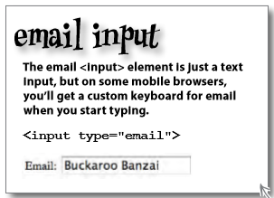
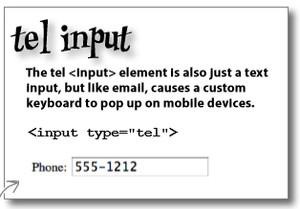
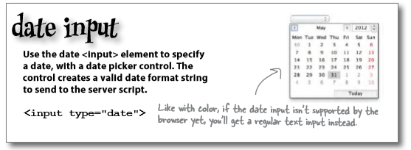
What can go on a form?

Slide 13
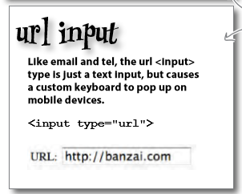
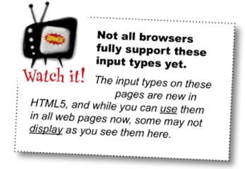
What can go on a form?
Even with these specialised types, it’s up to you to make sure you know what values the server script is expecting and use the right <input> type.

Slide 14
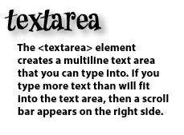
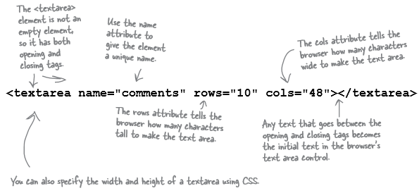
What can go on a form?
Not every form element is an <input> element there are some others for typing more than one line of text:

Slide 15
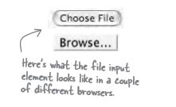
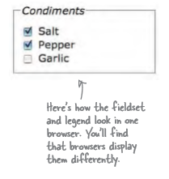
What more could go into a form?
If you need to send an entire file you can set the input type to “file”, this creates a control that allows you to choose a file and the contents when the form is submitted is sent to the server.
A <fieldset> element can be used to group together common elements.
It then can also make use of an element called <legend>.

Slide 16
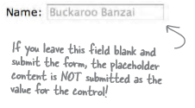

What more could go on a form?
The placeholder attribute can be used with most <input> types in a form, it gives a hint about the kind of content expected.
The required attribute forces the user to enter content. An error will show if the user leaves it blank.
If a form element includes the autofocus attribute then the cursor is in the form element when the form opens.

Slide 17
What more could go on a form?
We can also include a Pattern. This allows us to specify the type of data, and the format required.
pattern="[a-zA-Z0-9]": All alphanumeric characters.
pattern="[A-Za-z]{3}" : Three letter code.
pattern = "[A-Z][a-z]+( [A-Z][a-z]+)*": Name (with optional second name, and more names...).
pattern ="\S{6,}": At least 6 characters (excluding space, tab, newline, carriage return, form feed).
pattern="\d{4,8}": Matches at least 4 digits but no more than 8 digits.
Add a title attribute to add an error message and it is displayed when the cursor moves over the respective form element.

Slide 18
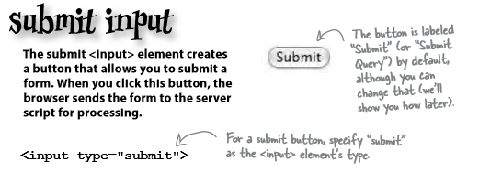

What more could go on a form?
Defines a button on a form that will return all fields to their default values.

Slide 19
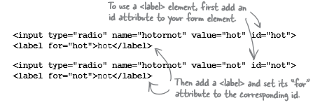
Accessibility
So far we have been labelling our form using text. We should really be using the <label> element to mark up these labels.
The <label> element provides further information about the structure of your page, allows you to style your labels using CSS more easily, and helps screen readers for the visually impaired to correctly identify form elements.
Labels don’t look any different from normal text. But they can make a big difference when it comes to accessibility.

Slide 20
Form layout
Wrap labels and controls inside a <div> (or <fieldset>) with the Bootstrap form-group class applied for optimum spacing.
Use Bootstrap's form-control class against textual <input>, <textarea>, and <select> elements to apply a width of 100% by default.
<div class="form-group">
<label for=“firstname ">First Name</label>
<input type="text" class="form-control" id=“firstname "
name=" firstname ">
</div>

Slide 21
Form layout
Default checkboxes and radio buttons are improved upon with the help of form-check, a single class for both input types that improves the layout and behavior of their HTML elements.
Use the class form-check-label with the label element.
<div class="form-check">
<label class="form-check-label">
<input class="form-check-input" type="checkbox" value="" checked>
Option one is this and that - be sure to include why it's great
</label>
</div>

Slide 22
Form layout
You can use Bootstrap's grid classes to create horizontal forms. Just specify how many columns each element should span.
Specifically, add a row class with the form-group and a col-*- or col-* class for each column.
You should also add Bootstrap's col-form-label class to the label element.
You may use col-form-label-sm or col-form-label-lg to your label elements to correctly follow the size of form-control-lg and form-control-sm.

Slide 23
Form layout
<div class="form-group row">
<label for= “firstname" class="col-sm-2 col-form-label-sm">
First Name</label>
<div class="col-sm-10">
<input type="text" class="form-control" id="firstname"
name="firstname">
</div>
</div>

Slide 24
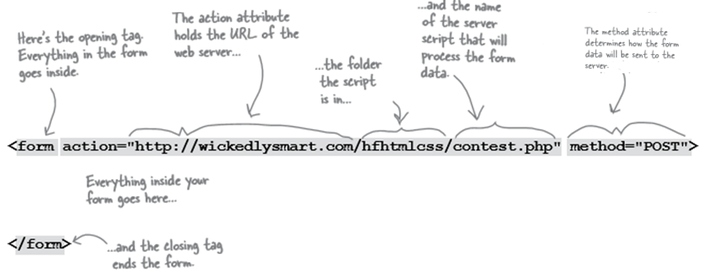
More on how the <form> element works

Slide 25
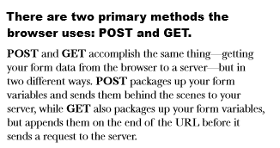
Sending the data to the server

Slide 26
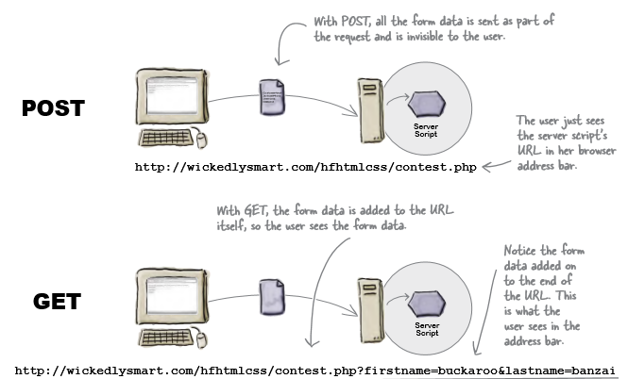
Sending the data to the server

