Slide 1
CSS Part one
Website development 1

Slide 2
overview
Use of CSS for Styling
CSS
Rules, Selectors, Declarations, Properties, Values
Linking CSS to HTML
CSS Properties
Styling Links
Grouping Selectors

Slide 3
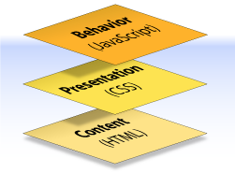
Content, Presentation, Behavior
Content comprises the information the author wishes to convey to his or her audience, and is embedded within HTML markup that defines its structure and semantics.

Slide 4
Content, Presentation, Behavior
Presentation defines how the content will appear to a human being who accesses the document in one way or another, this includes colour, layout, etc..

Slide 5
Content, Presentation, Behavior
Behavior layer involves real-time user interaction with the document.
This task is normally handled by JavaScript.
The interaction can be anything from a trivial validation that ensures a required field is filled in before an order form can be submitted, to sophisticated web applications that work much like ordinary desktop programs.

Slide 6
What is CSS?
Cascading Style Sheets is the recommended way to control the presentation layer in a web document.
CSS is a "style sheet language" that lets you style the elements on your page.
CSS is embedded inside/linked to HTML, but it is not HTML itself.
The main advantage of CSS over presentational HTML markup is that the styling can be kept entirely separate from the content.
e.g. it’s possible to store all the presentational styles for a 10,000-page web site in a single CSS file.
CSS also provides far better control over presentation than do presentational element types in HTML.

Slide 7
Advantages of CSS
All styling is kept in a limited number of style sheets.
Saving on bandwidth: The style sheet is cached (kept on client machine) after the first request and can be reused for every page on the site, it doesn’t have to be downloaded with each web page. Could reduce bandwidth usage—by more than 50% in many documented cases.
The separation of content from presentation makes it easier for site owners to reuse the content for other purposes, such as RSS feeds or text-to-speech conversion.
Separate styling rules can be used for different output media. We no longer need to create a special version of each page for printing—we can simply create a single style sheet that controls how every page on the site will be printed.

Slide 8
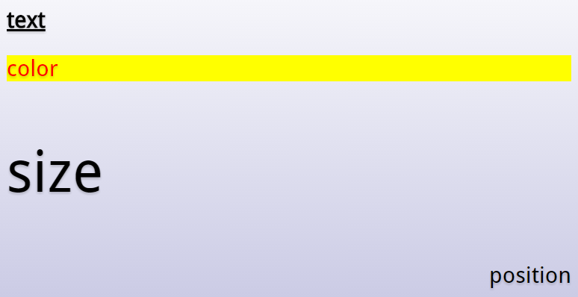
CSS: What can it do?

Slide 9
CSS

Slide 10
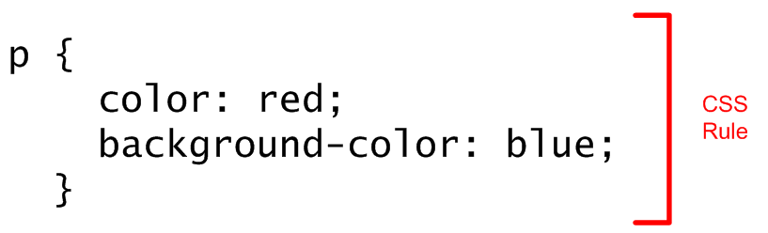
CSS rule
CSS consists of "style rules". Each style rule consists of a "selector" and "declarations" of property-value pairs:
}

Slide 11
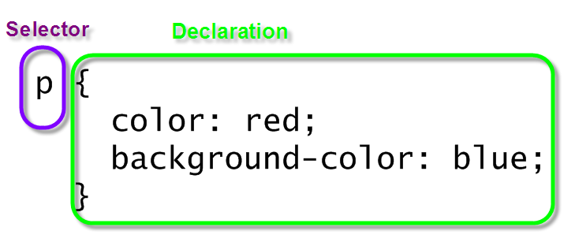
Selector and Declarations

Slide 12
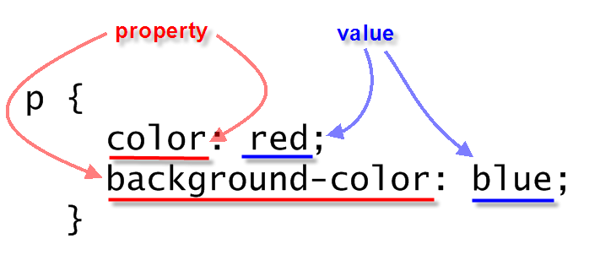
Properties AND Values

Slide 13
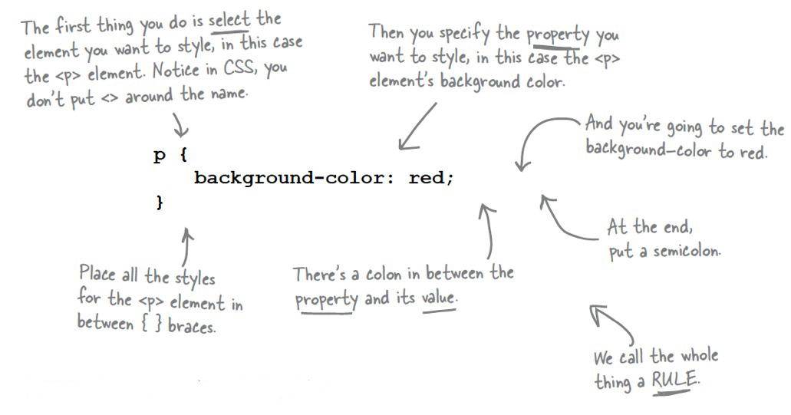
A CSS Rule

Slide 14
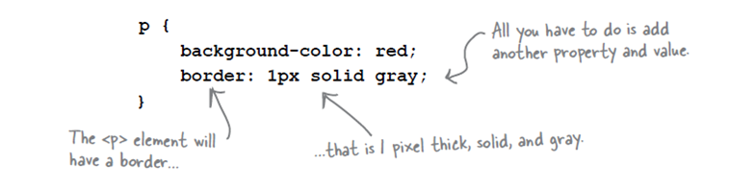
More than 1 Property
You can add as many properties and values as you like in each CSS rule.
To put a border around your paragraphs:

Slide 15
Linking css to html

Slide 16
Linking CSS to HTML
CSS contains information about how your markup (HTML) should be presented to the end user. That means that the two languages have to be linked together - the browser needs to know that you want to combine a piece of HTML markup with a piece of CSS code. This can be done in 3 ways:
Inline CSS through the Style attribute
Document wide CSS through style blocks
Global CSS through external CSS documents

Slide 17
Inline CSS through the Style attribute
Almost every HTML tag includes the Style attribute and using this attribute, you can specify CSS directly for the element. This defeats one of the main advantages of CSS, re-usability, since CSS code applied with this technique only applies to a single element and can't be re-used for other elements.
<p style="color:blue; font-style:italic;">Hello CSS</p>

Slide 18
Document wide CSS through style blocks
The second way to apply CSS to elements in your document is through the use of a style block. HTML includes a tag called style, which can contain CSS code. Here, you can define rules which can then be used all across your document.
<style>
p {
color:blue;
font-style:italic;
}
</style>

Slide 19
Global CSS through external CSS documents
So, by using the style block as described above, you can re-use your CSS code all over the document, but you still have to include it on all of the pages of your website, which requires the browser to download it on each request instead of just downloading an external CSS file once and then cache it. This is a major disadvantage of the style block approach and why you should normally go for the third approach instead: The external CSS file!

Slide 20
Global CSS through external CSS documents
A CSS file is simply a plain text file saved with a .css extension and then referenced in the file(s) where you want to apply the rules. If we re-use our example, we can then move the “p" rule to a new file (without the HTML part) and save it under an appropriate name, e.g. style.css. We will also place it in a CSS sub folder.
We can then reference it in our HTML document, using the link element:
<link rel = "stylesheet" href = "css/style.css">

Slide 21
CSS properties

Slide 22
Properties: color
The "color" property changes the text colour. Colours can be set using RGB colour codes (hex or decimal) or by using the colour names.
red Is the same as rgb(255,0,0) Which is the same as rgb(100%,0%,0%) Which is the same as #FF0000 Which is the same as #F00

Slide 23
Properties: color
The “color" property changes the text color.
body {
color:blue;
}

Slide 24
Properties: background-color
The "background-color" property changes the background color. Besides the BODY element, all elements default to a transparent background.
body {
background-color:lightyellow;
}

Slide 25
Property: font-family
The "font-family" property specifies the font family (or "font face") of the text. You can specify either a specific font name or a generic family name (serif, sans-serif, monospace, cursive, fantasy).
font-family:"Times New Roman", serif;
font-family:Verdana, sans-serif;
font-family:Courier, monospace;
A comma separated list of font families can be specified if you want the browser to prefer one but use the others as backup options.

Slide 26
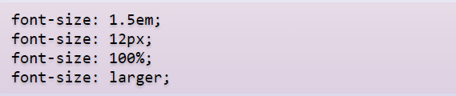
Property: font-size
The "font-size" property specifies the size of a font. It can be specified as a fixed size in various units, a percentage, or as a predefined keyword
.

Slide 27
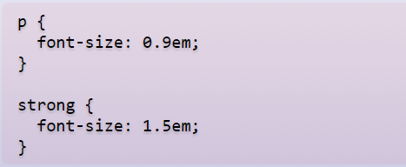
Property: font-size (em)
The "em" unit lets you set the size of the text relative to the text around it. This makes the page resize nicely in proportion if the user changes their default font-size. The default size is "1em".

Slide 28
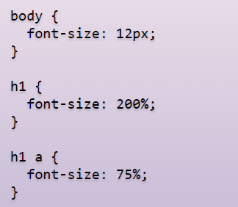
Property: font-size (%)
The size can also be specified as a percentage, which works similar to "ems", and can be used in conjunction with other units.

Slide 29

Property: font-size (px)
The "px" unit lets you size font in terms of pixels, which is the unit also used to size images and other elements. It is easier to understand than em, but doesn't work as well when printing or resizing.

Slide 30
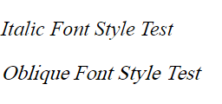
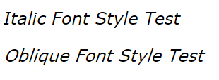
Property: font-style
The "font-style" property specifies the font style of the text. The style can be "normal" by default or italic or oblique.
Italic forms are generally cursive in nature while oblique faces are typically sloped versions of the regular face. However, if the font being used does not have italic or oblique faces available, in most cases there is little, if any, difference between italic and oblique.
In the screenshots above, the fonts used are Times New Roman and Verdana.

Slide 31
Property: font-weight
The "font-weight" property specifies the thickness of the font. The default is "normal" and the typical override is "bold". You can also specify "bolder", "lighter", or a number from 100 to 900.
The keyword value normal maps to numeric value 400 and the value bold maps to 700.
blockquote {
font-weight:bold;
}

Slide 32
Property:text-..
Text decoration: The text-decoration property decorates the text. Values include: underline, overline, line-through, and none.
p {
text-decoration:underline;
}
Text Transform: The text-transform property controls the letters in an element. Values include: uppercase, lowercase, capitalize, and none.
p {
text-transform:uppercase;
}

Slide 33
Property:text-..
Text Align: The text-align property aligns the text in an element. Values include: left, right, center, and justify.
p {
text-align:center;
}

Slide 34
Styling links

Slide 35
Styling links
As we have seen previously, there are different types of links (unvisited, visited, active) that you'll come across on a web page. There's one other state (hover), which occurs when you pass your cursor over the link. In CSS, you can change the styling of all of these link states using pseudo-classes. The different states are addressed within the CSS through the use of the a element selector, and by applying (with the aid of a colon) the pseudo-classes of link, visited, hover, and active.

Slide 36
Styling links
a:link {
color:black;
}
a:visited {
color:slategray;
}
a:hover {
text-decoration:none;
}
a:active {
color:red;
}

Slide 37
Grouping selectors

Slide 38
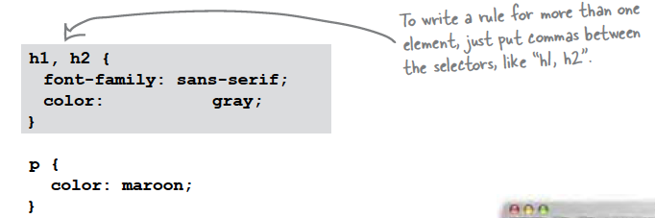
Grouping selectors
You can group selectors to apply the same style to all of the selectors by separating them with commas.

Slide 39
Grouping selectors
In the previous example, if we wish the link and visited states to assume the same styling then we can use the following:
a:link, a:visited {
color:slategray;
}

