Slide 1

Online Shop Data Analysis
Sales Performance and Strategic Insights of a super shop
Prepared by student with ID: 00012938

Slide 2
01
02
03
Data Set Description
Analysis Findings
Recommendations
TABLE OF CONTENTS
04
Conclusion

Slide 3
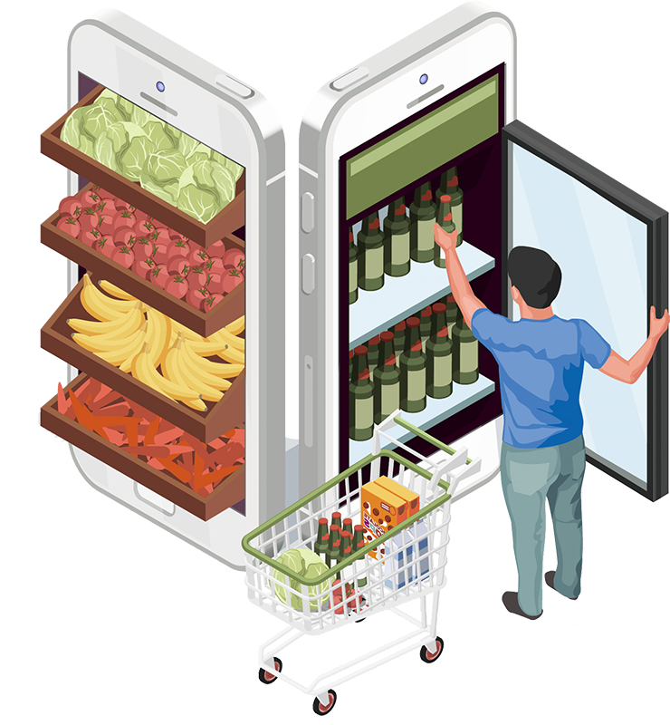
01
Data Set Description

Slide 4
Super Shop
Sales
Geographical Constraint
Orders
Customers
Shipping

Slide 5
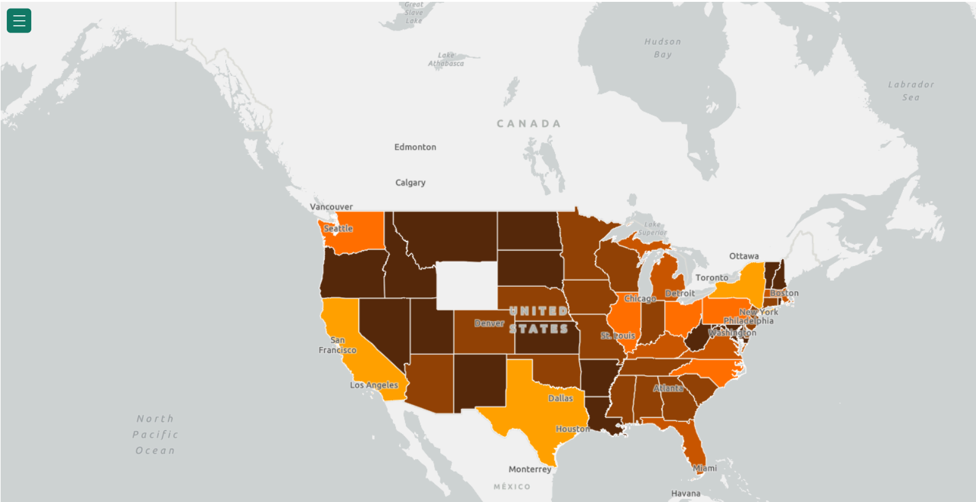
Operating country - USA

Slide 6

Research Findings

Slide 7
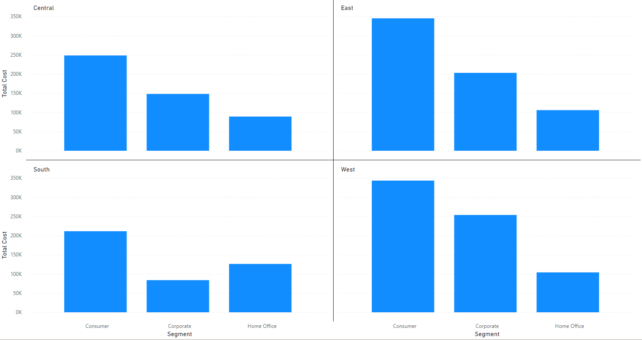
Revenue generated by Costumer Segments | Regions

Slide 8
Regional Differences
Consumer
Segment as the top revenue source
Corporate -> Home Office
Revenue from Corporate Customers is usually higher from Home Office
Home Office
is more popular in the South

Slide 9
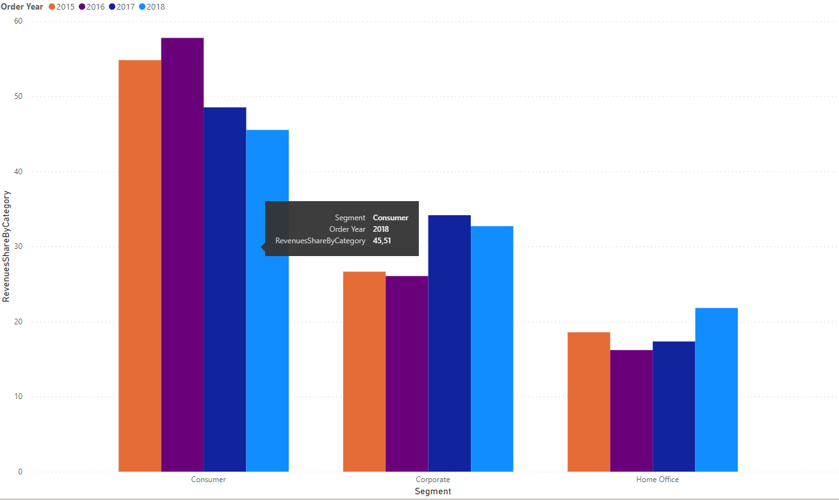
Revenue generated by customer segments in different years

Slide 10
Segment Trends
Consumer
Decreasing revenue share from the ‘Consumer’ segment over time
Rising Revenue
From Corporate and Home Office segments

Slide 11
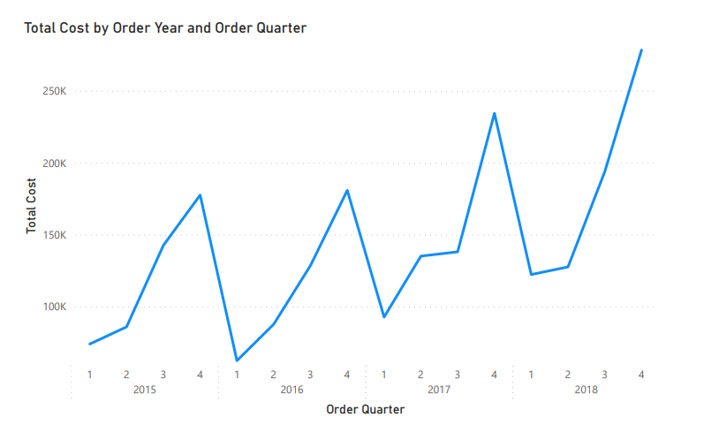
Revenue generated by year and quarter

Slide 12
Sales Fluctuations
Q4
shows highest sales each year, indicating a robust holiday season impact.
Q1
consistently underperforms, suggesting a post-holiday dip in consumer spending

Slide 13
Average cost of Per Item
2015
2016
2017
2018
$245.70
$223.57
$236.85
$221.62

Slide 14
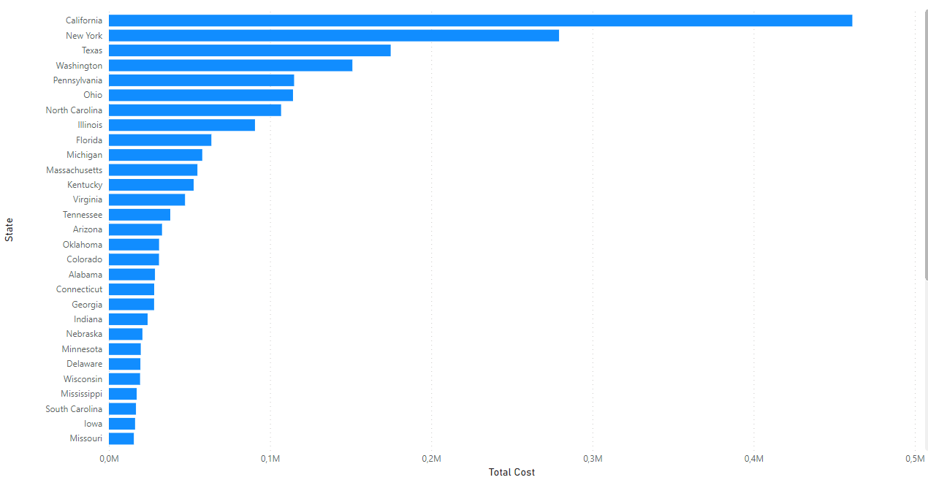
Revenue by State

Slide 15
States Reach issues
CA, NY, TX
Strong sales concentration in California, New York, Texas
Underdeveloped presence
The online shop didn’t manage to reach the customer from other states

Slide 16
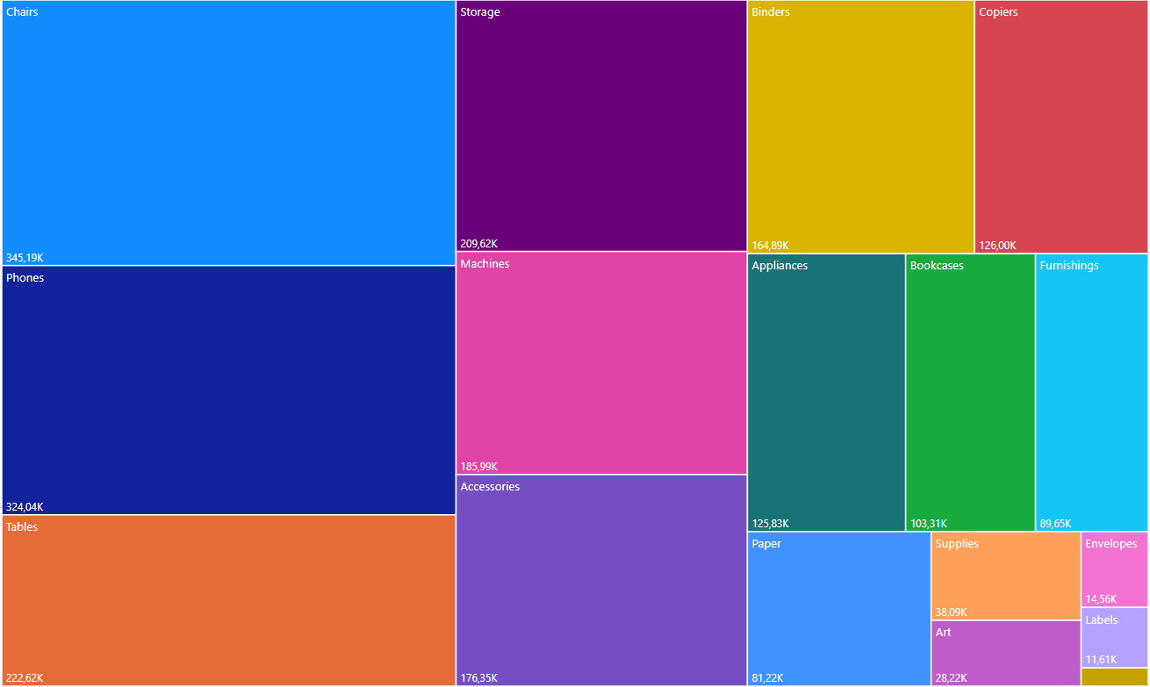
Distribution of sales by subcategories

Slide 17
Subcategories Trends
High Revenue
From Chairs, Phones and Tablets
Low Revenue
In Art, Envelopes, Labels

Slide 18

03
Recommendations

Slide 19
Target ‘Home Office’ with specialized campaigns
Implement off-season promotions to smooth out revenue
Allocate more resources to least reached states with a marketing campaign
Diversify product offerings with higher-margin items

Slide 20

Conclusions

Slide 21
Shift towards lower-cost items | Growth in the Home Office/ Corporate segment
Seasonal sales patterns | need to stabilize the revenues
Uneven state sales distribution | geographic expansion needed
Product diversification

Slide 22

Thank You!

