Slide 1

One hive for scattered holdings
A product and process story, not just a feature list
Final Project Presentation
15-20 min team story
2026-07-28
HoldHive | Final Project Presentation
01
Notes:
Opening beat: set the expectation that this deck tells how the team turned a broad portfolio-management assignment into a focused, explainable MVP. Do not start by listing features.
[Sources]
- README.md
- docs/guideline/project/team_project_guideline_zh.md
- docs/guideline/references/team-project-rules-process.pdf

Slide 2
PRESENTATION CONTRACT
The rules changed what we chose to show
One idea
Story
Git history
Mistakes
per slide
over feature list
as evidence
included
We are being judged on the process as much as the result.
So this deck follows the build story: product decisions -> implementation -> recovery -> learning.
HoldHive | Final Project Presentation
02
Notes:
This slide explicitly ties the deck to the required presentation style: light slides, one key idea, visuals over dense text, and a story that includes mistakes. It also sets up why Git, bugs, and team learning are included.
[Sources]
- docs/guideline/references/team-project-rules-process.pdf
- docs/guideline/references/portfolio_manager.md

Slide 3
CUSTOMER PROBLEM
Alex had prices, but not a portfolio view
Our customer story starts with a beginner investor holding assets across several apps.
Stocks
single prices
ETF
overlap risk
He could see individual prices.
Bank deposit
principal view
Mutual fund
?
He could not answer the whole-portfolio questions.
lagging data
HoldHive became the one-minute snapshot.
Cash
fixed value
Crypto
demo/cache
HoldHive | Final Project Presentation
03
Notes:
Tell Alex's story: scattered apps provide price facts, but not the combined view. The user need becomes: what do I own, what is it worth, and where am I concentrated?
[Sources]
- docs/guideline/project/team_project_guideline_zh.md
- docs/guideline/references/portfolio_manager.md

Slide 4
USER STORY MAP
User stories kept the scope honest
We treated each story as a promise we could demonstrate and explain.
HH-01
Browse holdings
HH-02
Add a holding
As Alex, I want one list of assets so I can stop switching apps.
As Alex, I want a simple form so my first portfolio takes minutes.
HH-04/05
Understand value
HH-06/10
Trust the data
As Alex, I want summary and allocation so I can see the whole picture.
As Alex, I want price status and fund warnings so I know the limits.
Stories set the MVP; stretch ideas waited.
HoldHive | Final Project Presentation
04
Notes:
Make User Stories central. Explain that HH-01 to HH-06 formed the P0 backbone: browse, add, delete, summary, allocation, and data trust. HH-10 made fund warnings visible without forcing full lookthrough into P0.
[Sources]
- docs/guideline/project/team_project_guideline_zh.md
- docs/guideline/project/api_documentation_zh.md
- docs/qa/acceptance-checklist.md

Slide 5
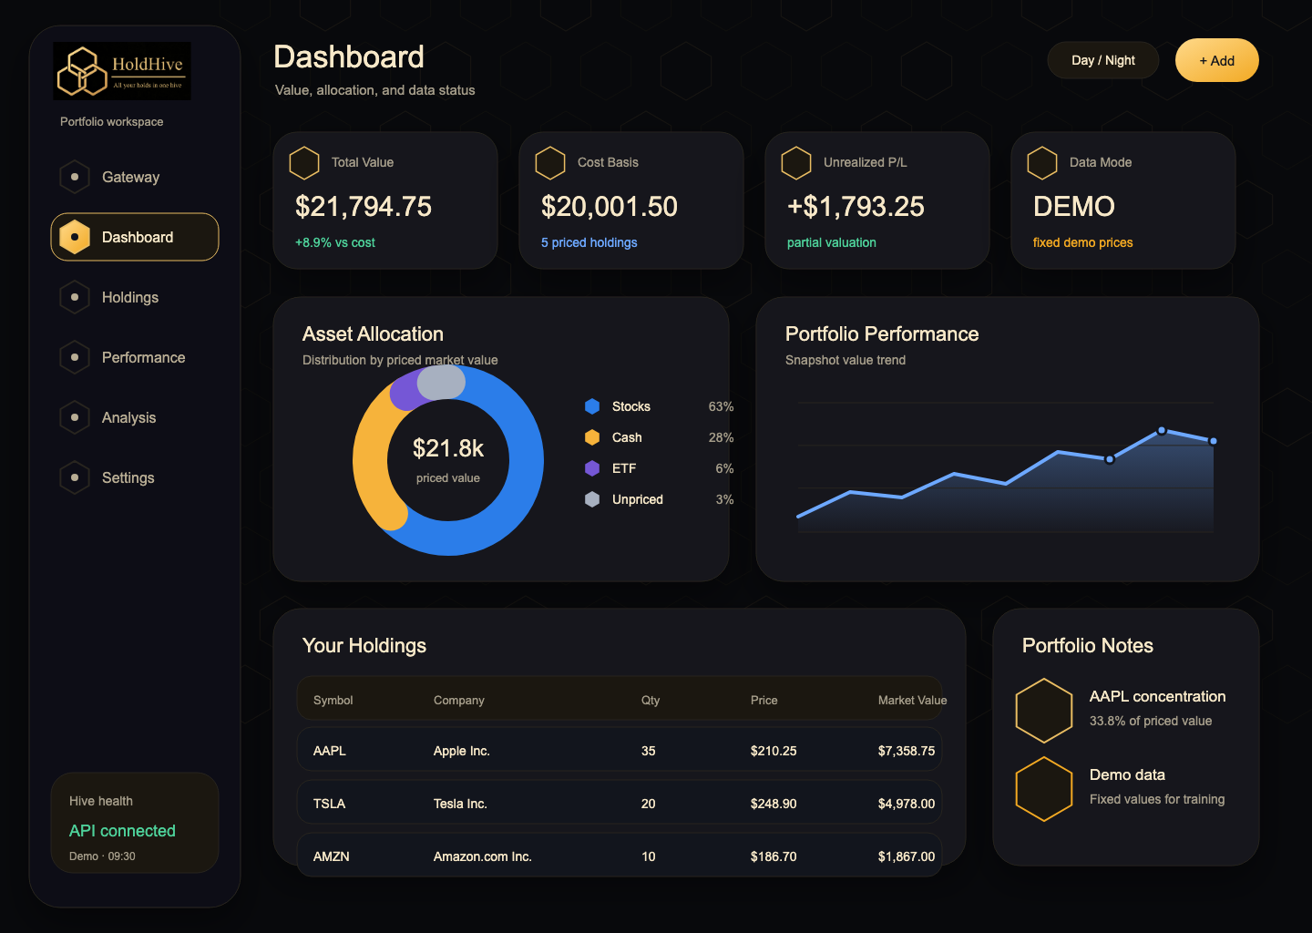
PRODUCT DESIGN
Product design translated stories into screens
Dashboard first
summary before detail
Visible trust
demo / fixed / unavailable
Fund warning
lookthrough stays separate
Recovery states
failure is explainable
The UI made financial trust visible, not hidden in assumptions.
HoldHive | Final Project Presentation
05
Notes:
This slide connects product design to the user stories. The dashboard screenshot should carry most of the page. Explain that the design borrowed mature portfolio-product patterns but intentionally kept the first experience narrow.
[Sources]
- docs/guideline/project/team_project_guideline_zh.md
- docs/design/lanhu/README.md
- docs/design/lanhu/png/02-dashboard-dark.png

Slide 6
TECH SELECTION
We chose tools the team could explain
React + Vite
Spring Boot
MySQL + Flyway
JUnit / Vitest
fast UI loop
clear REST boundary
repeatable data setup
evidence, not hope
The rule was simple: use boring tools, then document why.
HoldHive | Final Project Presentation
06
Notes:
This slide covers technology selection without drowning the audience in details. Explain that the team chose a stack two or more members could learn and explain, and wrote the decision into ADR-001.
[Sources]
- docs/guideline/project/technology_stack_zh.md
- docs/adr/ADR-001-technology-stack.md
- docs/guideline/references/team-project-rules-process.pdf

Slide 7
APPLICATION ARCHITECTURE
Ownership boundaries kept the work explainable
->
->
->
->
React UI
API client
Spring REST
Domain
Adapters
display only
typed contract
HTTP boundary
valuation logic
MySQL + pricing
Frontend never owns valuation formulas
Domain has no Spring or database dependency
Pricing failures do not corrupt holdings
HoldHive | Final Project Presentation
07
Notes:
This is the high-level architecture required by the project presentation. Keep it simple: user interface, REST contract, domain calculation, persistence, and pricing adapter. Mention that this is a modular monolith, not microservices.
[Sources]
- docs/architecture/c4-context.md
- docs/guideline/project/technology_stack_zh.md
- frontend/src/api/README.md
- backend/src/main/java/com/holdhive/portfolio/domain/PortfolioCalculator.java

Slide 8
ITERATIVE DEVELOPMENT
We iterated in four distinct beats
Day 1
Day 2
Day 3
Day 4
Scope
Design
Build
Stabilise
stories, ADR, skeleton
API, data, screens
summary, quotes, UI
tests, docs, rehearsal
The point was not to finish first; it was to make progress visible and explainable.
HoldHive | Final Project Presentation
08
Notes:
This slide tells the planning-to-delivery story. Tie it back to the course guidance: do not jump into code on day one, surface blockers early, and leave time for rehearsal.
[Sources]
- docs/guideline/project/team_project_guideline_zh.md
- docs/guideline/references/team-project-rules-process.pdf
- docs/guideline/project/git_branching_ci_zh.md

Slide 9
GIT COLLABORATION
The Git graph shows the real teamwork
main
c36d917
8e4126d
d1190d4
36a3d68
bbc6cd7
baseline
backend
frontend
CI
docs
qa
104802f
ba2f5f6
3d79a2a
1f8b727
e024ae8
6cb6d8c
pricing base
summary API
merge fix
revert
reapply
CRUD
2a1d243
feature work
QA docs
4ec90f4
da61953
bf1fec4
quotes API
multi-asset
Flyway test
History matters: conflict, reapply, CRUD, and QA hardening are visible.
HoldHive | Final Project Presentation
09
Notes:
This is a visual Git graph based on the actual repository history. Explain the main and qa branches, feature work, the conflict-resolution merge, the revert, and the reapply. This directly follows the course PDF's instruction to bring process visuals such as a git graph.
[Sources]
- git log --oneline --decorate --graph --all --max-count=24
- docs/guideline/references/team-project-rules-process.pdf
- docs/guideline/project/git_branching_ci_zh.md

Slide 10
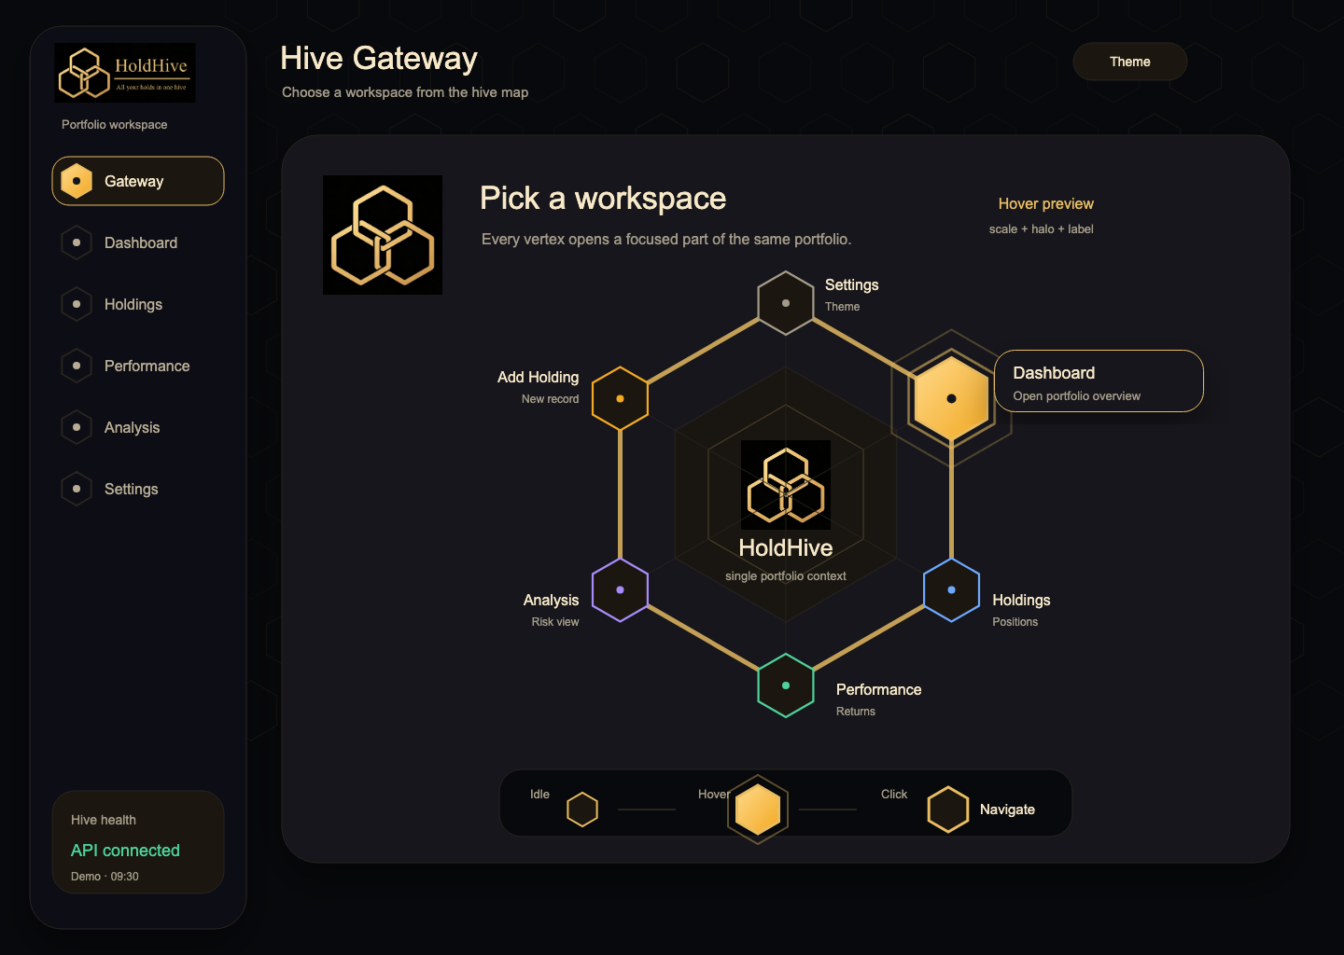
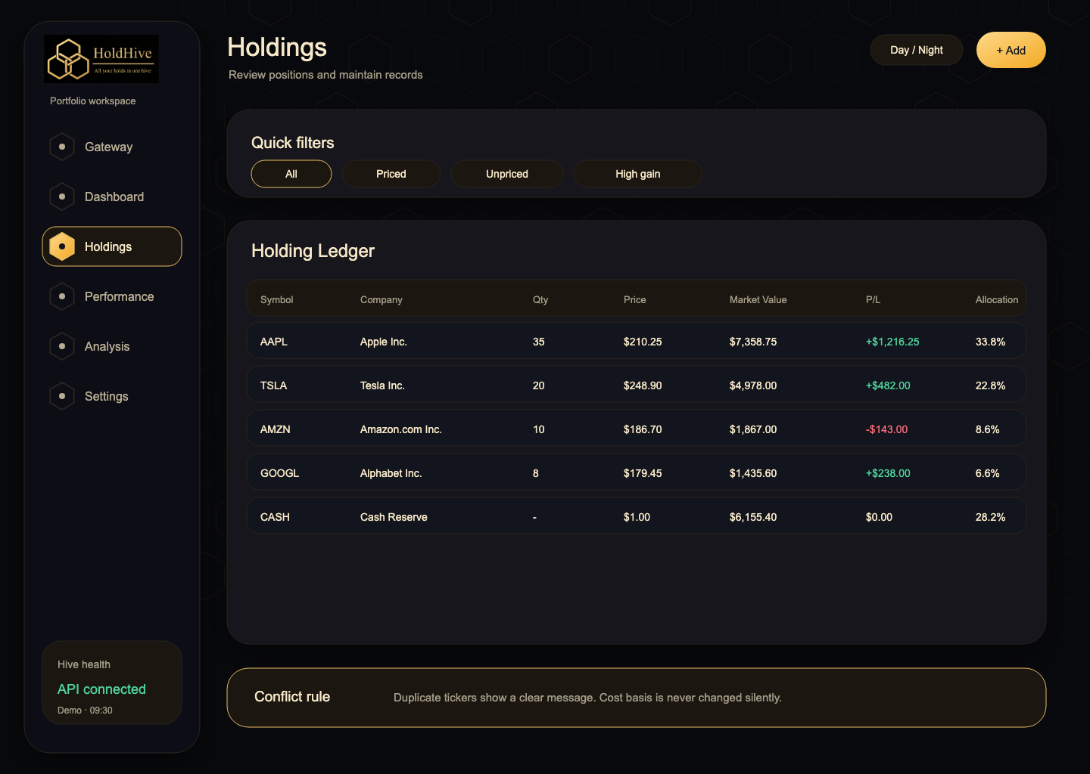
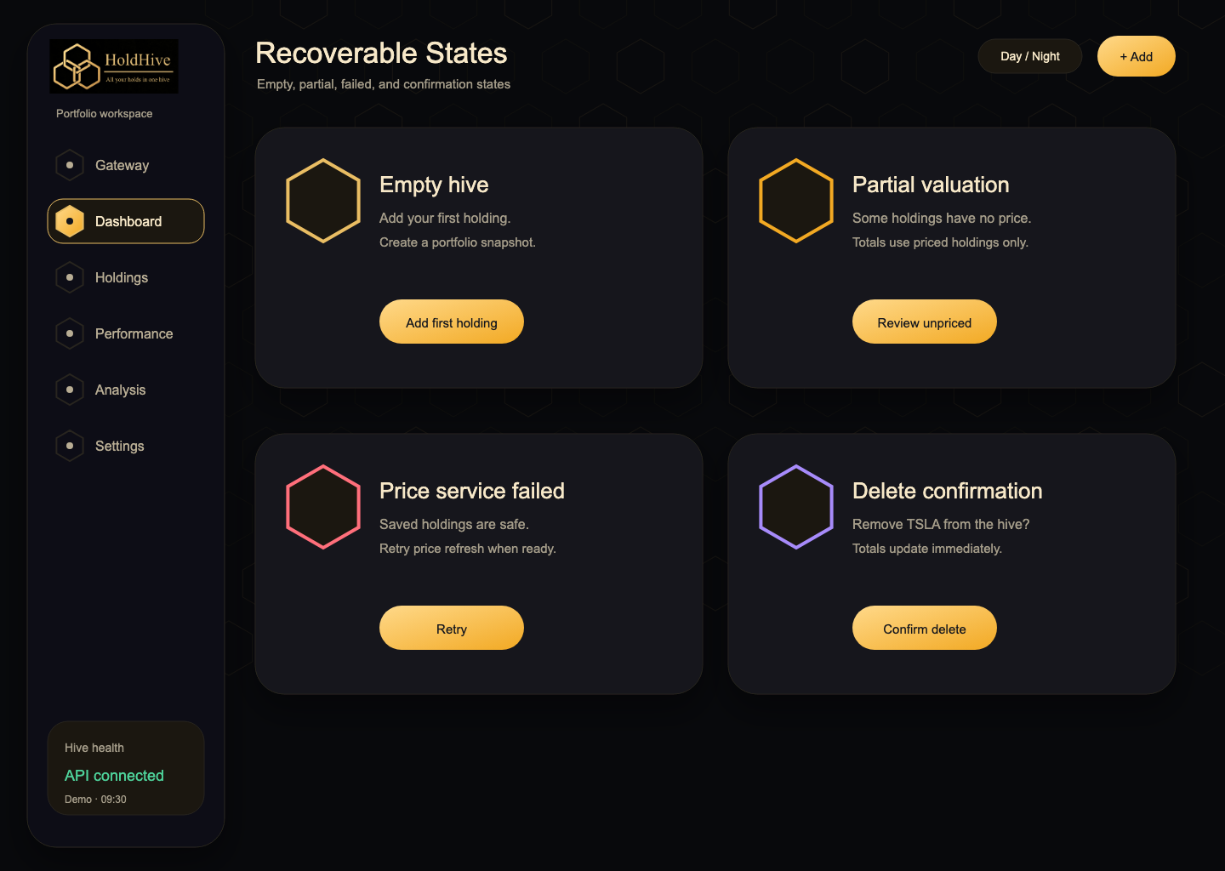
WHAT WE BUILT
The demo follows the customer journey
Enter
Understand
Maintain
Recover
Live route: Gateway -> Dashboard -> add/list/delete holdings -> recoverable states.
HoldHive | Final Project Presentation
10
Notes:
Use this slide as the bridge into live demo. It keeps the screen uncluttered and product-styled. The current qa branch includes holdings list, create, and delete endpoints; the UI/demo route should show the journey rather than API details.
[Sources]
- docs/demo/demo-script.md
- docs/design/lanhu/README.md
- frontend/src/App.tsx
- frontend/src/components/DashboardPage.tsx

Slide 11
VALUATION SLICE
Small formulas made the product trustworthy
Cost
Value
P/L
Allocation
quantity x average price
quantity x current price
value - cost
value / priced value
Price statuses are product language.
LIVE | CACHED | DEMO | FIXED | UNAVAILABLE
Unknown price is never treated as zero.
HoldHive | Final Project Presentation
11
Notes:
Keep this technical slide short. Explain why BigDecimal, price statuses, and partial valuation matter to the product. This is the point where technical implementation reinforces customer trust.
[Sources]
- docs/guideline/project/api_documentation_zh.md
- backend/src/main/java/com/holdhive/portfolio/domain/PortfolioCalculator.java
- backend/src/test/java/com/holdhive/portfolio/domain/PortfolioCalculatorTest.java

Slide 12
BUGS AND RECOVERY
We made mistakes, then made them visible
Merge conflict
Contract drift
resolved -> reverted -> reapplied
DTOs and docs moved together
Price failure
Demo risk
partial valuation, not fake zero
screenshots and script as backup
The recovery is the project story, not an embarrassment.
HoldHive | Final Project Presentation
12
Notes:
This slide follows the rule PDF: mistakes included. Use the actual git history as evidence for merge conflict recovery. Then explain bugs as learning moments: unknown prices, API contract drift, and live-demo risk were handled through clearer states and documentation.
[Sources]
- git log --oneline --decorate --graph --all --max-count=24
- docs/guideline/references/team-project-rules-process.pdf
- docs/guideline/project/technology_stack_zh.md
- docs/demo/demo-script.md

Slide 13
QUALITY GATES
Done meant checked, not just compiled
Backend gate
PR rule
Acceptance
70%+
Human
Manual
line coverage target
review before merge
checklist-driven
Tests cover edge cases, not only happy path
API cases and defect log keep QA visible
Every member can explain their code
HoldHive | Final Project Presentation
13
Notes:
This slide links the project to the rules PDF and GenAI guidance. Verification mattered more than simply generating code. Mention backend unit tests, frontend build/test, acceptance checklist, PR review, and human explainability.
[Sources]
- docs/guideline/references/team-project-rules-process.pdf
- docs/guideline/references/use-of-genai.md
- docs/qa/acceptance-checklist.md
- docs/qa/api-test-cases.md
- docs/qa/defect-log.md
- backend/pom.xml

Slide 14
NEW KNOWLEDGE
The main output was what the team learned
Product
Backend
Frontend
Git
AI
scope is a design choice
BigDecimal + adapter boundaries
stateful dashboards and charts
conflict recovery is a skill
assistant output must be explainable
We can defend the choices because we documented them.
HoldHive | Final Project Presentation
14
Notes:
This slide answers the user's request to include the learning process. Keep it reflective: what the team learned about product design, technical boundaries, Git collaboration, debugging, and disciplined AI use.
[Sources]
- docs/guideline/references/use-of-genai.md
- docs/guideline/project/technology_stack_zh.md
- docs/guideline/project/git_branching_ci_zh.md
- docs/adr/ADR-001-technology-stack.md

Slide 15
NEXT STEPS
Next step: prove P0 before adding ambition
Prove P0
Harden demo
Sync QA
Expand insight
run CRUD demo end to end
full rehearsal + backup
test cases + defect log
fund exposure, then AI brief
Questions?
HoldHive | Final Project Presentation
15
Notes:
Close by returning to the core discipline: prove P0 before adding P1/P2. Current qa has holdings CRUD endpoints, so the next work is end-to-end demo rehearsal, QA documentation sync, then fund exposure and AI brief expansion.
[Sources]
- docs/guideline/project/team_project_guideline_zh.md
- docs/guideline/project/api_documentation_zh.md
- docs/qa/acceptance-checklist.md
- docs/qa/api-test-cases.md
- backend/src/main/java/com/holdhive/portfolio/api/HoldingController.java

