Slide 1
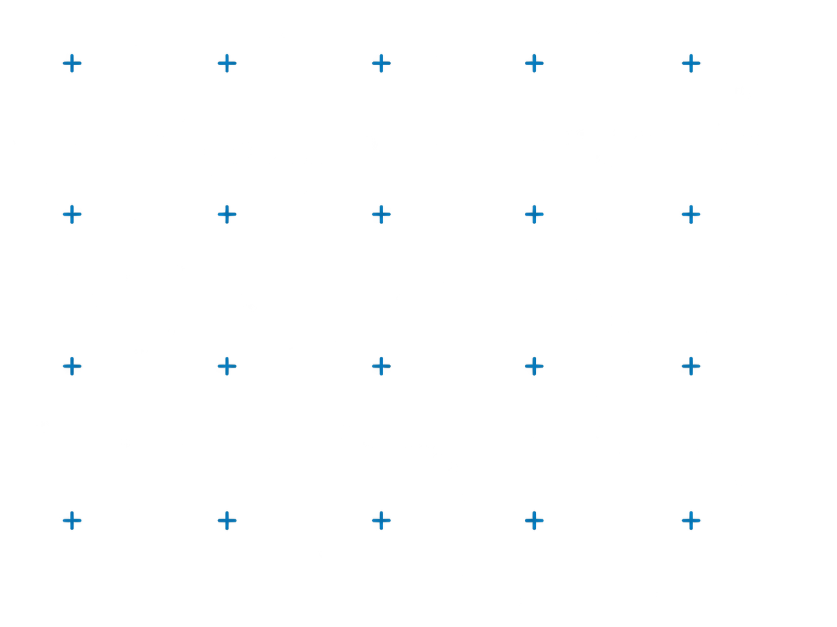
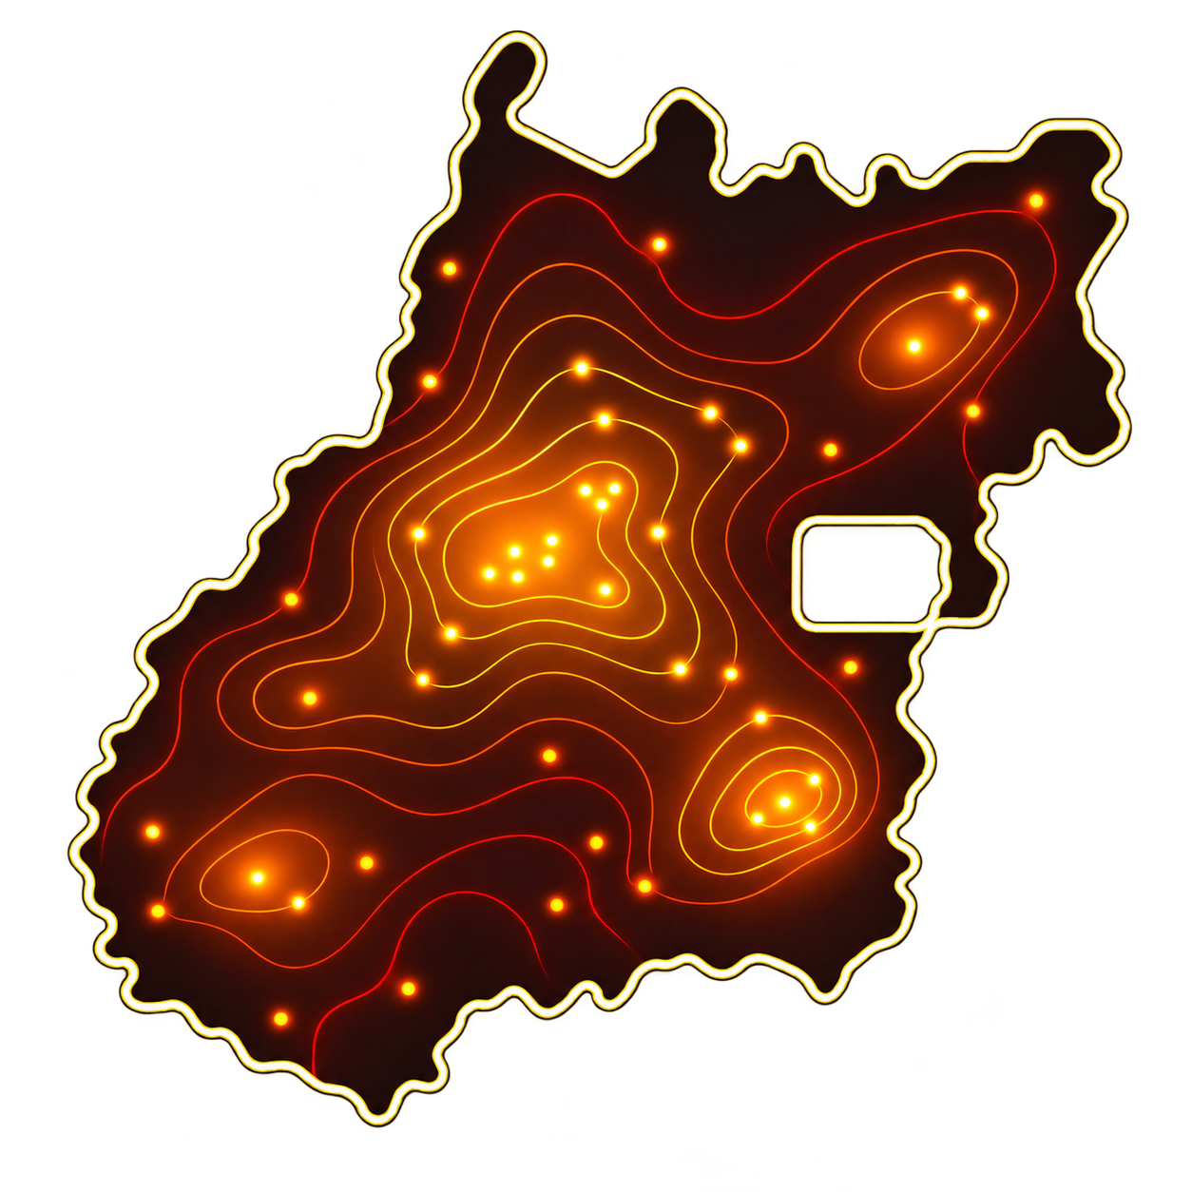
WILDFIRE PREVENTION · CBMGO
Does a 3-year
fire rule hold
in the Cerrado?
Testing a field assumption against ten years of satellite heat hotspots in Goiás state parks
22.9%
of burned areas burned again within 3 years
Executive presentation
INPE heat hotspots 2016–2025
2,774 hotspots
9 state parks
Heat hotspot
Re-burn
ILLUSTRATIVE

Slide 2



01 | EXECUTIVE SUMMARY
Fire protects an area for about one year, not three
CBMGO weighed dropping burned areas from inspection rounds for three years, on the assumption that fuel needs that long to recover.
PROTECTION AFTER FIRE
TIME TO RE-BURN
WHERE AND WHEN
6.5% → 12.7%
22.9%
71% / 91%
Annual chance of a new fire doubles from year 1 to year 2 after a fire.
More than 1 in 5 burned areas burned again within 3 years — inside the window the rule would leave unchecked.
Fire concentrates in 2 of 9 parks (Terra Ronca, Serra Dourada) and in August–October.
Year 1
6.5%
Within 2 yrs
12.6%
2 of 9 parks
71%
Year 2
12.7%
Within 3 yrs
22.9%
Aug–Oct
91%
RECOMMENDATION
NEXT STEP
Do not adopt the 3-year skip. Keep burned areas on the inspection list from the second year on and prioritize sectors by fire history, season and drought.
Pilot a risk-based ranking of park sectors for one fire season and compare it with where new hotspots occur.
Heat hotspots are an indirect fire indicator. Results show association, not causation.

Slide 3


02 | CONTEXT
Can recently burned areas leave the inspection rounds?
01 · LIMITED STAFF
02 · FIELD ASSUMPTION
94%
~3 years
of surveyed commanders cite lack of personnel; CBMGO runs inspection rounds in 9 state parks with limited staff.
assumed for Cerrado fuel to recover after a fire, so burned areas could be skipped in the rounds.
03 · THE CENTRAL QUESTION
Does that three-year interval hold in Goiás state parks, and how should prevention be prioritized instead?
?
2,774
9
10 years
heat hotspots
state parks
analyzed, 2016–2025
Source: INPE BDQueimadas, NPP-375/VIIRS satellite · 9 Goiás state parks · 2016–2025.

Slide 4




03 | PROBLEM & OBJECTIVE
Ten years of satellite data to test a field assumption
SATELLITE HOTSPOTS
BURNED AREAS
RECURRENCES
2,774
717
500
detected inside the 9 parks, 2016–2025
~1 km grid cells that burned
times the same area burned again
OBJECTIVE
Test whether burned areas stay safe for three years, and define where and when to focus prevention.
APPROACH
1
2
3
Structure hypotheses
Test them with satellite data and statistics
Turn findings into recommendations
SCOPE & LIMITATION Satellite hotspots are an indirect indicator; no field data on vegetation was available.
Hotspots in the same 0.01° (~1.1 km) cell less than 180 days apart count as one fire event. Source: INPE BDQueimadas · NPP-375/VIIRS · 2016–2025.

Slide 5


04 | HYPOTHESIS TREE
Three conditions must all hold for the 3-year rule to work
HYPOTHESIS UNDER TEST
Burned areas stay safe from new fires for about three years while fuel recovers.
AND
C1 · DATA
C2 · FUEL
C3 · MEASUREMENT
The data show 3 years of protection
Fuel takes 3 years to recover
Hotspots measure re-burns
Few areas re-burn within 3 years
Risk stays low in years 2 and 3
Most common interval is 3+ years
The pattern holds in every park
Cerrado grass fuel needs about 3 years to come back
A recurrent hotspot means the same area burned again
EVIDENCE · SATELLITE DATA
EVIDENCE · LITERATURE
EVIDENCE · SATELLITE DATA
LOGIC
One false condition rejects the hypothesis. Evidence: satellite data (C1, C3) and literature (C2).

Slide 6
05 | ANALYSIS · PROTECTION AFTER FIRE
The risk of a new fire doubles in the second year
Chance of a new fire that year, by years since the last fire
OR = 0.54
Goiás state parks · 2016–2025
Burning one year halves the odds of burning the next (p < 0.001).
2× the risk
The chance doubles from year 1 to year 2.
No safe window
No 3-year safe period appears in the data.
CONCLUSION
Fire buys about one year of protection, not three.
Logistic regression on 4,904 cell-years, cluster-robust errors by cell. Association, not causation.

Slide 7
06 | ANALYSIS · TIME TO RE-BURN
More than 1 in 5 burned areas burns again within 3 years
Share of burned areas that burned again, by time since the fire
22.9%
Kaplan-Meier · 717 areas · 2016–2025
burned again inside the 3-year window (95% CI 19.8–26.0%).
12.6%
burned again within only 2 years.
717 areas
followed, including those that never burned again.
CONCLUSION
A 3-year skip would leave these areas off the inspection list.
Kaplan-Meier survival analysis; areas not burned again by December 2025 treated as censored.

Slide 8
07 | ANALYSIS · RECURRENCE INTERVAL
Three years is the typical gap, not a safe period
Recurrences by interval between fires, in whole years
Mode = 2 years
Count of recurrences · n = 500
The most common interval between fires.
Median ≈ 3 years
This is why the assumption seemed right (Wilcoxon p = 0.28).
Average ≠ minimum
Protection ends long before the typical gap.
CONCLUSION
The 3 years describe how often fire returns, not how long an area is safe.
Intervals measured in whole years between consecutive fires in the same ~1 km cell. Cumulative share reaches 64% by year 3.

Slide 9
08 | ANALYSIS · WHY SO FAST?
Grasses explain why protection ends so early
70–80% of biomass
~100%
Cerrado grass layer
literature
Goiás state parks
Risk of a new fire doubles
project data
Field assumption
Assumed fuel recovery
current practice
Years after a fire
0
1 yr
2 yrs
3 yrs
4 yrs
~2 years
Up to 2× taller flames
Literature only
for the native grass layer to fully recover after a fire.
Invasive grasses (capim-gordura, braquiária) add biomass to the fuel load.
This explanation comes from published studies, not from project data.
CONCLUSION The next step is to test grass cover with land-cover data.
Sources: Gorgone-Barbosa et al. (2016); Onigemo, Miranda & Haridasan (2003); Pivello et al. (2021).

Slide 10
09 | ANALYSIS · WHERE AND WHEN
Fire is predictable in space and time
Heat hotspots by park
Heat hotspots by month
count · 2016–2025
count · all years combined
71.3%
90.8%
ρ = 0.83
of hotspots in 2 of 9 parks
between August and October
days without rain vs. hotspots
CONCLUSION Concentrate prevention in the right parks, before August.
Source: INPE BDQueimadas, NPP-375/VIIRS · 2,774 hotspots in 9 Goiás state parks. ρ = Spearman correlation, monthly.

Slide 11
10 | SYNTHESIS
Not every finding is relevant enough to guide action
PRIORITIZE FOR ACTION
NO SPECIFIC ACTION FOR NOW
Protection lasts ~1 year: the risk doubles in year 2
Fire intensity barely differs between frequent and infrequent fire (8.4 vs 9.1 MW)
22.9% of burned areas re-burn within 3 years
2 parks concentrate 71% of hotspots
Precipitation is not significantly associated with hotspots
91% of hotspots fall in August–October
Drought is strongly associated with hotspots
The 2016–2025 hotspot trend is not significant
Araguaia re-burns faster (median 2.1 years) than Serra Dourada (4.0)
DECISION
Replace the time-based rule with a risk-based ranking.

Slide 12
11 | PRIORITIZATION
Keep burned areas on the list and prioritize by risk
1
PRIORITY 1
2
PRIORITY 2
3
PRIORITY 3
Decide now
Pilot next season
June–July
Drop the 3-year skip
Risk-based sector ranking
Pre-season prevention
Keep burned areas on the inspection list from year 2. Decide before the next fire season.
Rank sectors by fire history, month and days without rain. Start with Terra Ronca and Serra Dourada.
Firebreaks and patrol schedules in June–July, ahead of the August–October peak.
INVESTIGATION TRACK
Test the grass hypothesis with MapBiomas land-cover and burned-area maps.
RECOMMENDATION
Start by dropping the 3-year skip; pilot the ranking in parallel.

Slide 13
12 | NEXT STEPS
Validate the ranking over one fire season
01
02
03
Validate
Test
Decide
By June
August–October season
After the season
Rank park sectors using hotspot history, season and drought.
Apply the ranking in the fire season, keeping burned areas in the rounds.
Compare the ranking with where new hotspots fell (hit rate and miss rate); keep, adjust or revert.
EXPECTED DECISION
Adopt the risk-based ranking if it captures more new hotspots than the 3-year rule.
Hit rate: share of new hotspots inside top-ranked sectors. Miss rate: share outside them.

Slide 14
CLOSING
Turning satellite data into safer inspection rounds
~1 year
22.9%
71% | 91%
of protection after a fire, not three
of burned areas burned again within 3 years
of hotspots in 2 parks | in August–October
EXECUTIVE RECOMMENDATION
Do not adopt the 3-year skip. Prioritize park sectors by risk and validate the ranking over one fire season.
Fire returns faster than assumed; prevention should follow risk, not the calendar.
CBMGO · INPE heat hotspots 2016–2025 · 2,774 hotspots · 9 state parks

Slide 15
APPENDIX
Supporting analysis and data
A1 Methods: why each statistical test was used
A2 Limitations
A3 Data sources and tools (GitHub · Excel · Power BI)

Slide 16
APPENDIX | A1
Methods: why each statistical test was used
Question | Test | Result
Are the data normal? | Shapiro-Wilk, Kolmogorov-Smirnov (Lilliefors) | No (p < 0.001) → non-parametric tests
Is the median interval 3 years? | Wilcoxon | Median 2.98, p = 0.28
What share re-burns in 1–3 years? | Kaplan-Meier | 3.4% / 12.6% / 22.9%
Does fire lower next-year risk? | Logistic regression | OR 0.54, p < 0.001
Is drought associated with hotspots? | Spearman | ρ = 0.83, p < 0.001
Do parks differ? | Kruskal-Wallis + Dunn (Holm) | p < 0.001
Is there seasonality? | Chi-square | 90.8% Aug–Oct, p < 0.001
Is there a trend? | Mann-Kendall + Sen | Fire events −9/year, p = 0.049
Does fire cluster in space? | Moran's I | I = 0.33, p = 0.001
Significance level α = 0.05. Non-parametric tests used because the data are not normally distributed.

Slide 17
APPENDIX | A2
Limitations
Indirect indicator
Spatial dependence
Heat hotspots are an indirect fire indicator; small or short fires may be missed.
Neighboring cells hit by the same large fire are not independent.
No vegetation data
Missing context
No local vegetation data: the grass explanation relies on the literature.
No data on ignition causes; hotspots not normalized by park area.

Slide 18
APPENDIX | A3
Data sources and tools
GitHub
Excel
Power BI
Analysis code and statistical tests
Hotspot base and data treatment
Commanders' fire-risk dashboard
Methods and tests: see A1
Records: 2,774 hotspots
Audience: CBMGO commanders

