Slide 1
EMP
Exploit mach-o project
조성준
정재영
김명수

Slide 2
정재영
김명수
한양대 보안 동아리 icewall
BOB8기 취약점 트랙
성균관대학교 정보보안 동아리 HIT

Slide 3


Linux vs macOS
디버거
2. ASLR
3. Canary 형식
4. Library
둘 다 Unix 계열이지만….

Slide 4
There are too many starter edition document for
linux and window, but mac?

Slide 5
Let’s start EMP
Exploit mach-o project

Slide 6
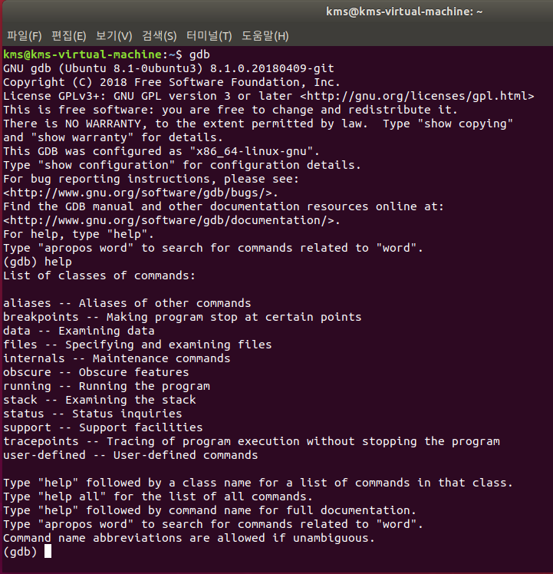
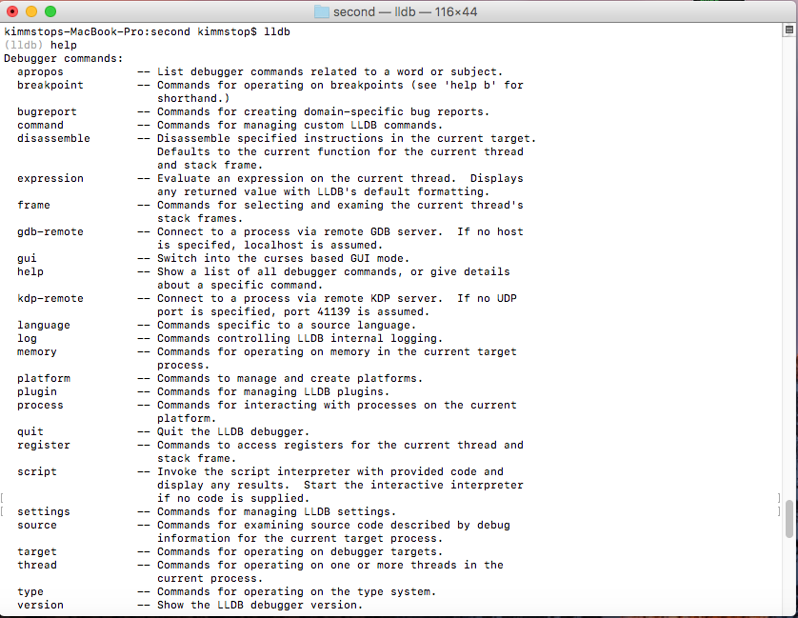
1. 디버거
리눅스 : gdb
macOS : lldb

Slide 7
1. 디버거
레지스터 상태 출력 : register read
메모리 읽기 : memory read
disassemble, attach, run,
si(step in), ni(step over)…

Slide 8
2. ASLR
Address Space Layout Randomization
Address Mapping
0x????????
0x????????
0x????????
0x????????

Slide 9
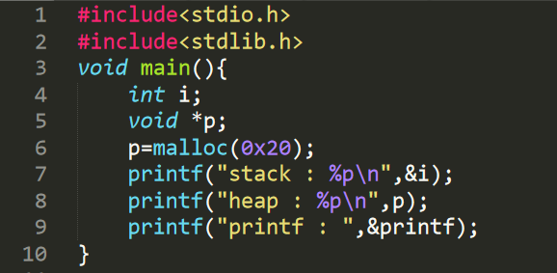
2. ASLR
ASLR.c

Slide 10




2. ASLR
•

Slide 11
2. ASLR
•
Library 영역에 대해서 ASLR이 적용되지 않는 것처럼 보임

Slide 12

2. ASLR
Before reboot
After reboot

Slide 13
2. ASLR
Stack : Randomized per execution
Heap: Randomized per execution
Library : Randomized per device boot

Slide 14
2. ASLR
Stack : Randomized per execution
Heap: Randomized per execution
Library : Randomized per device boot
-> lpe의 경우 ASLR이 무의미함

Slide 15
3. Canary 형식
a | a | a | a
a | a | a | a
 | ? | ? | ?
? | ? | ? | ?
메모리 보호 기법
버퍼
카나리
->랜덤 값
a
?
Seg fault

Slide 16
3. Canary 형식
리눅스
macOS
00
 | 00

Slide 17
5. library
4. library
Linux : 우리가 자주 사용하는 함수들이
libc에 존재
Mac : 우리가 자주 사용하는 함수들이
libsystem_c.dylib에 존재

Slide 18
What is stack buffer overflow
buffer | buffer
buffer | buffer
buffer | buffer
sfp | return address

Slide 19
What is stack buffer overflow
aaaaaaaa | aaaaaaaa
aaaaaaaa | aaaaaaaa
aaaaaaaa | aaaaaaaa
aaaaaaaa | aaaaaa

Slide 20
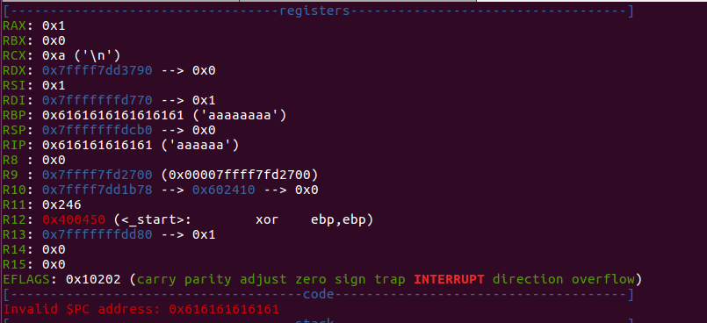
What is stack buffer overflow

Slide 21
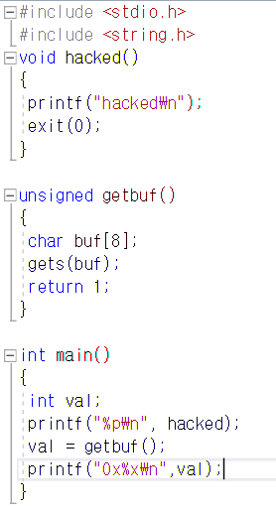
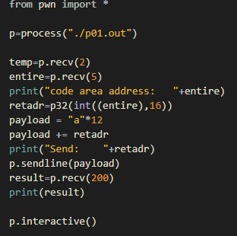
P01
Return address
조작
gcc –fno-stack-protector

Slide 22
Getbuf의 return address 를 조작하여 hacked 함수가 호출되도록
Gets 함수는 입력 문자의 수를 검사하지 않음
-> 버퍼의 크기보다 큰 입력을 받기가 가능
-> return address가 바뀔 수 있다
hacked 함수의 주소 출력

Slide 23

temp : 0x
entire : 4bec0

Slide 24
temp : ”0x”
entire : “4bec0”
retadr : “a”*12 +” xc0 xbe x04 x00”

Slide 25
a | a | a | a
a | a | a | a
a | a | a | a
c0 | be | 04 | 00
gets 함수로 받은
데이터가 저장되는 곳
rbp(return address)
return address

Slide 26
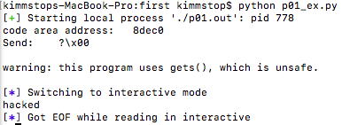

Slide 27
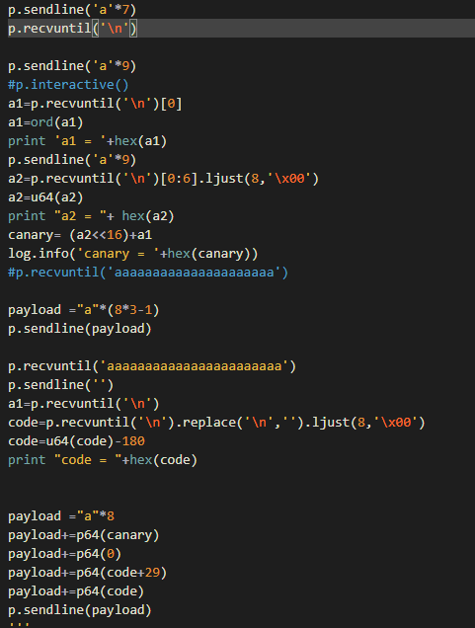
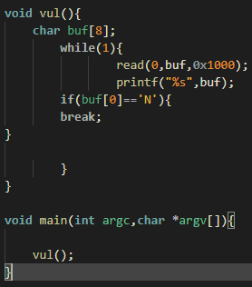
P02
canary leak
2. 코드 영역 leak

Slide 28
1.Canary leak
Read 함수로 받은
데이터가 저장되는 곳
 | 00
canary
rbp(return address)

Slide 29
1.Canary leak
a | a | a | a
a | a | a | \n
xx | 00 | xx | xx
xx | xx | xx | xx
aaaaaaa n
카나리 첫 바이트

Slide 30
1.Canary leak
a | a | a | a
a | a | a | a
a | \n | xx | xx
xx | xx | xx | xx
a1 : xx(카나리 첫 바이트)
xx+a*9+n~~

Slide 31
1.Canary leak
a | a | a | a
a | a | a | a
a | \n | xx | xx
xx | xx | xx | xx
xx+a*9+n~~
6바이트 카나리

Slide 32
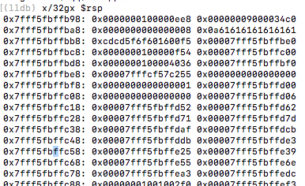
2.코드 영역 leak

Slide 33
2.코드 영역 leak
a | a | a | a
a | a | a | a
a | a | a | a
a | a | a | a
a | a | a | a
a | a | a | n

Slide 34
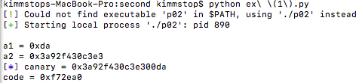

Slide 35
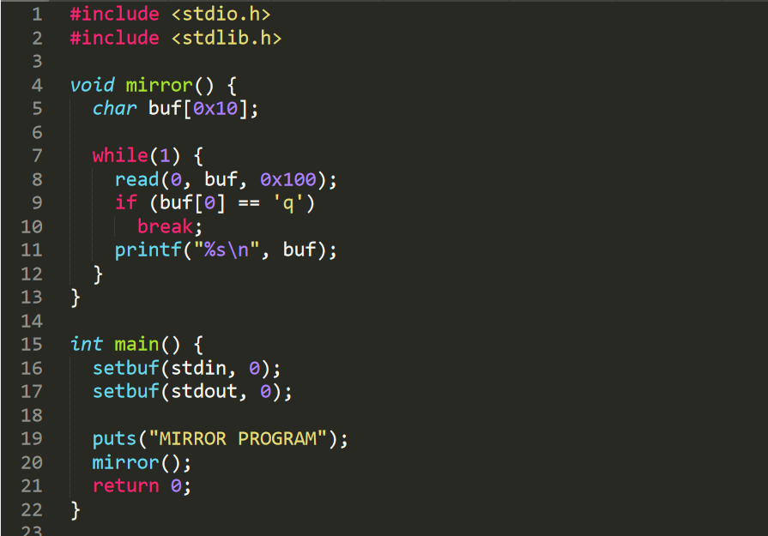
P03
•
Canary
No win fuction
Pie

Slide 36
without win fuction
how2exploit?
The anwser is ROP!

Slide 37
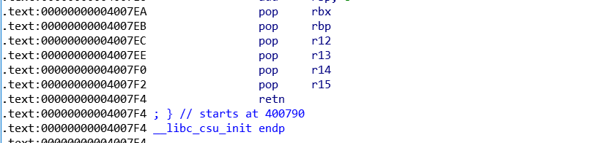
Diff elf mach-o
“pop rdi” & “pop rsi” gadget exist in elf binary
Because of _libc_csu_init
pop r15 (41 5F) --> pop rdi (5F)

Slide 38
Diff elf mach-o
However, “pop rdi” gadgets may not exist in mach-o files.
So rop became a bit harder.

Slide 39
Diff elf mach-o
If usefull gadget doesn’t exist in mach-o binary
leak lib -> find usefull gadget in lib

Slide 40
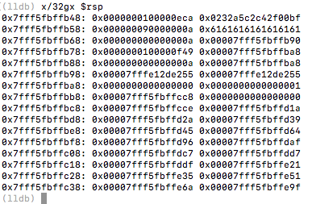
What can we leak

Slide 41
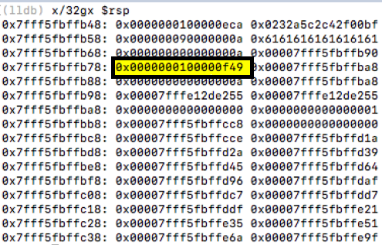
What can we leak
code

Slide 42
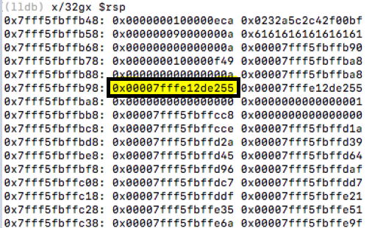
It looks like lib

Slide 43
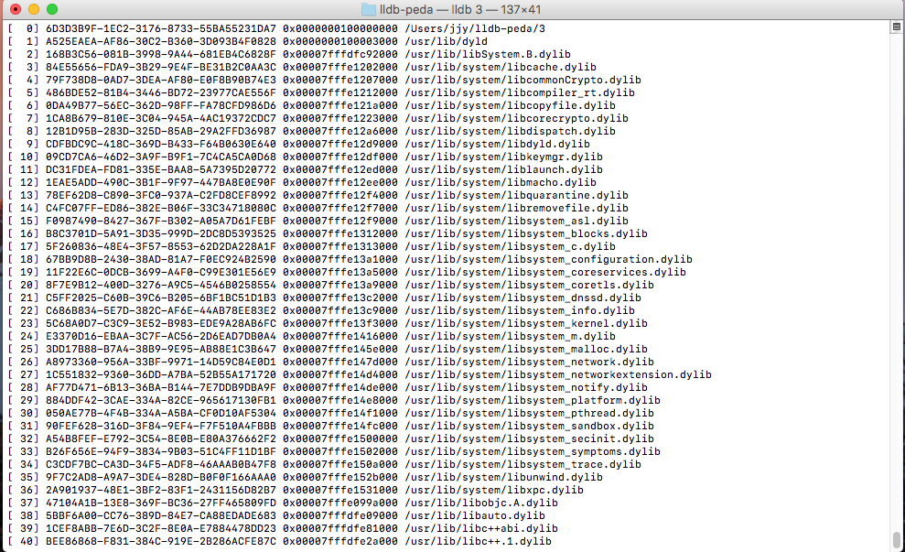
Mach-o image list

Slide 44
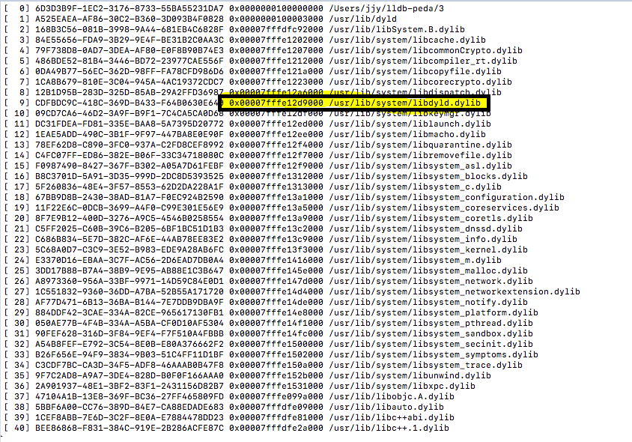
We can leak libdy.ld.dylib!
0x7fffe12de255-0x7fffe12d9000
=0x5255

Slide 45

Find gadget in libdy.ld.dylib
We found “pop r15; pop rbp; retn” gadget in libdy.ld.dylib As we said earlier, “pop r15” can transfer “pop rdi”
We found “pop rdi; pop rbp; retn” gadget

Slide 46
Leak system fuction address
System fuction exists in libsystem_c.dylib
So let’s leak libsystem_c.dylib’s address

Slide 47
Leak system fuction address
Like system fuction, puts fuction exists in libsystem_c.dylib
We have “pop rdi” and puts.plt (in mach-o binary)
So if we execute puts using ROP

Slide 48
Exploit sequence
Leak code address
Leak libdy.ld.dylib
Leak libsystem_c.dylib
Execute system fuction

Slide 49
Let’s start exploit!

Slide 50
Leak code address
code
Offset = 0x18

Slide 51
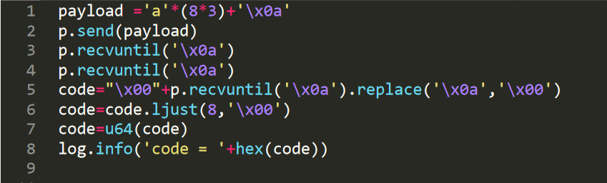

Leak code address

Slide 52
Leak libdy.ld.dylib address
libdy.ld.dylib
Offset = 0x38

Slide 53
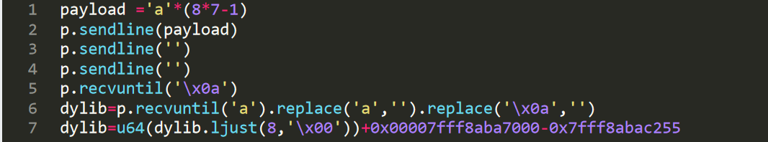

Leak libdy.ld.dylib address

Slide 54

Leak libsystem_c.dylib
Put’s plt address
Put’s got address

Slide 55
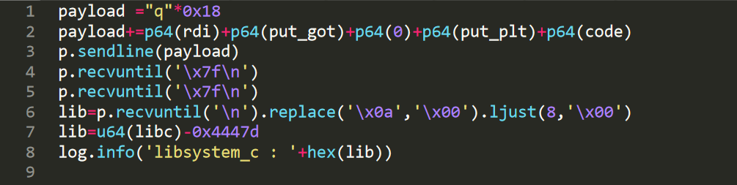
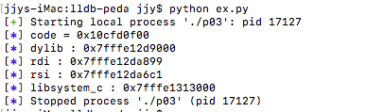
Execute puts with rop

Slide 56


Description of ROP
Execute pop_rdi_rbp -> arg1= “put_got”
Execute put -> print “put_got”
Return to main -> we know all needed address, so exploit!

Slide 57

Execute system fuction
This payload is almost like Former.

Slide 58
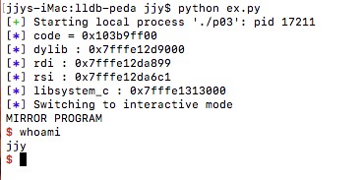
Execute system fuction
Get shell!

Slide 59
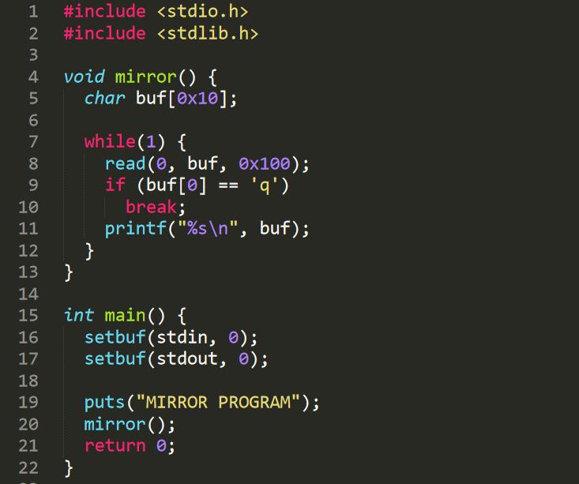
Pb4
Canary
No win fuction
Pie

Slide 60
P04
Pb2에서 사용한 방법으로 카나리를 leak한다.
Pb3에서 사용한 방법으로 libsystem_c.dylib의
주소를 알아내고 system 함수를 실행한다.
->이전에 한 것들의 조합

Slide 61
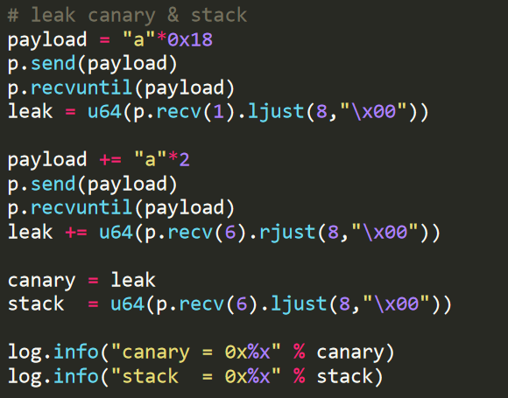
Leak canary

Slide 62
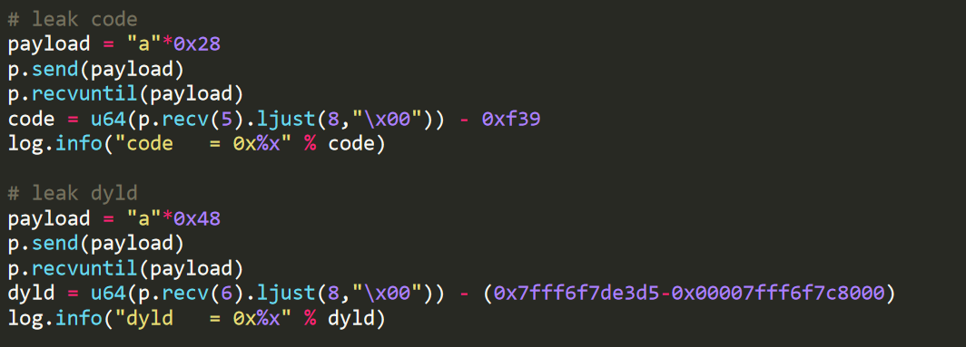
Leak code and dyld

Slide 63
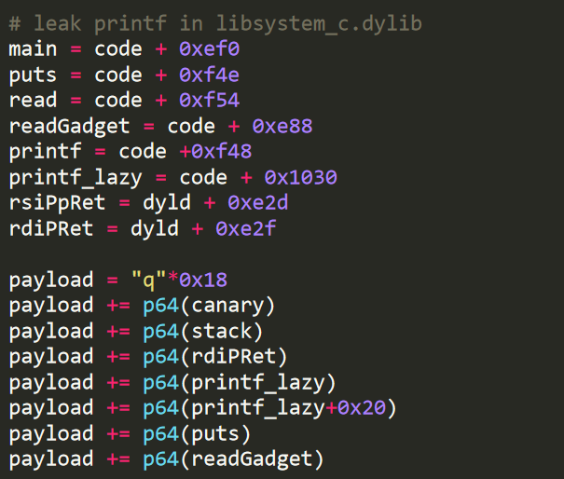
Calculate offset and ROP

Slide 64
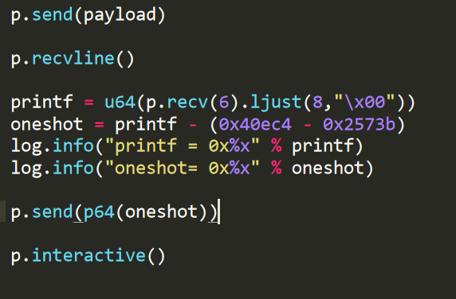
Jump oneshot gadget

Slide 65

We found oneshot gadget in system_c

