Slide 1

Name - Nitesh
Software - Free dos

Slide 2

Jim hall
He is developer of software

Slide 3
What is free dos
Free DOS (formerly Free-DOS and PD-DOS) is a free operating system for IBM PC compatible computers.
It intends to provide a complete DOS-compatible environment for running legacy software and supporting embedded systems.
Free DOS can be booted from a floppy disk or USB flash drive.

Slide 4
Ideas behind making free dos
classic DOS games
Run legacy business applications
develop embedded systems
In this software we can run ms - dos file also

Slide 5
What problem does it solve
Free dos make easy to Playing classic dos games
Solve legacy software problem
It makes to Develop embedded system

Slide 6
Licensing model of free dos
Developer :- jim hall
Os family :- dos
Source model :- open source
Available :- English , German, Dutuch
Platforms :- 32 bit or 64 bit
Kernal type :- monolithic Kernal
License :- Gpl with various different licenses for utilities

Slide 7
Intended behind making it open source
People who play classic DOS games. Sure, you can play DOS games in something like DOS Box, and some classic games have been ported to Linux (for example, DOOM) but there are a large number of us who still like to play DOS games on a DOS system. That's often how I play some of the old DOS games I loved.
People who develop embedded systems. DOS used to be a very popular platform to run embedded systems. So if you support an older embedded system, you might be running DOS. And FreeDOS can fit in very well. At least one developer contacted me a few years ago to say the embedded system he writes for is running on Free DOS. I thought that was great!
People who run legacy business applications. There may not be as many of these people in 2016, but they're still there! We don't know if these are Free DOS or some other DOS, but there's the car company that uses an old Compaq laptop running DOS software to service luxury McLaren F1 cars and the South Australian Government is still running their electronic health records on a DOS-based system. Probably my favorite example is author George R.R. Martin (author of the 'Game of Thrones' series) writes all his books and manuscripts on a DOS computer,

Slide 8
Monetization model of free dos
Advertising costs money
Viewing and download

Slide 9
popularity of free dos
It get popular in 1955
Then it get less use because linux take place of it.
Now day this software is not using that much because of modern system
But in south australia is very much used

Slide 10
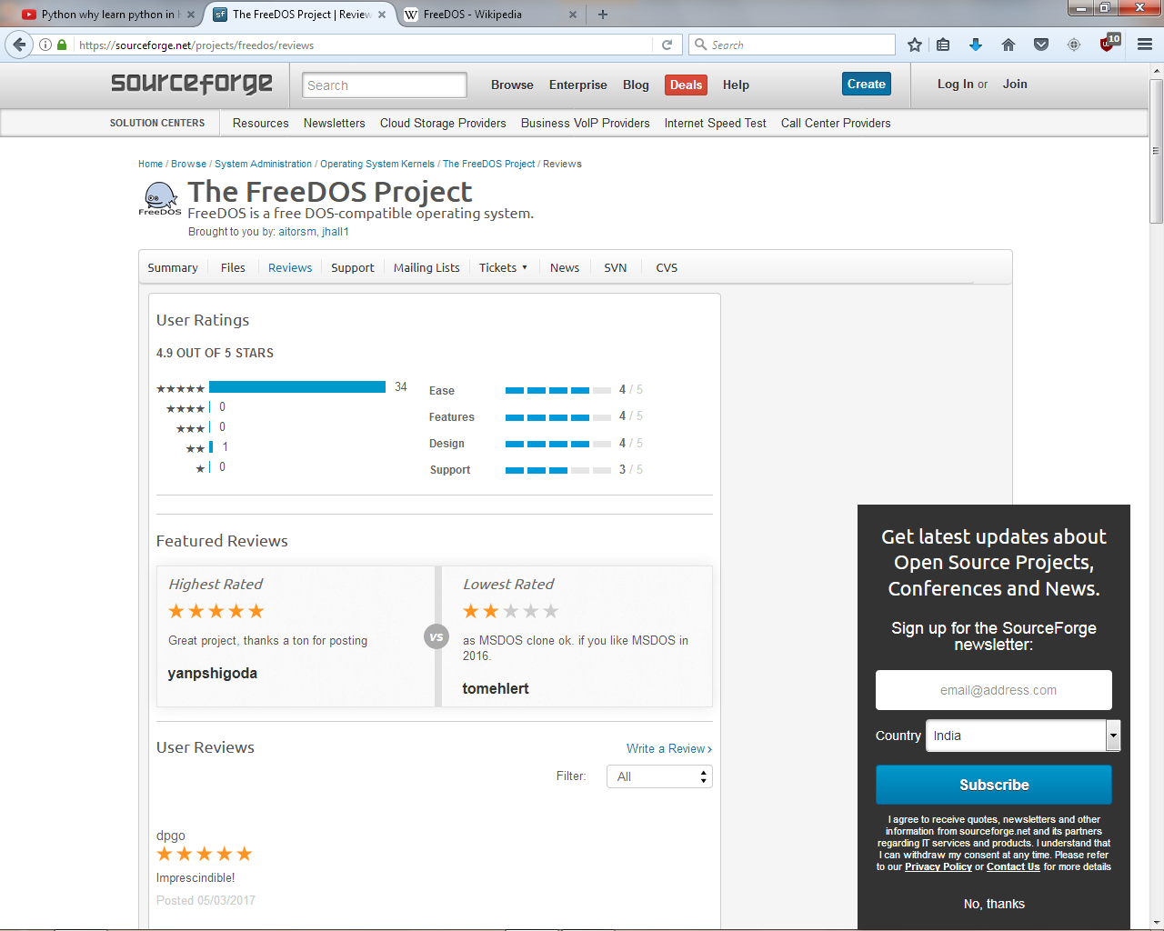
popularity of free dos

Slide 11
Impact of free dos
free-DOS (shorthand for Microsoft Disk Operating System) is a single tasking, single user, non-graphical command line operating system.
Originally developed for use with IBM's earliest line of personal home computers, free-DOS is one of the most successful operating systems of its kind.
As an operating system, DOS is simple, compact, and remarkably robust; especially considering its age.
While it may have been surpassed by the newer, and more user friendly, graphical user interface (GUI) operating systems, free -DOS remains in widespread use by businesses and independent programmers throughout the world.

Slide 12


Thank y u f r
watching

