Slide 1
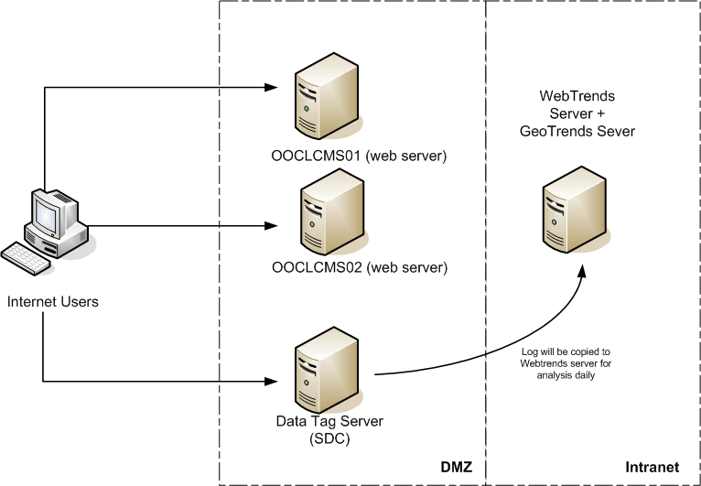
OOCL Webtrffends Servers Infrastructures

Slide 2
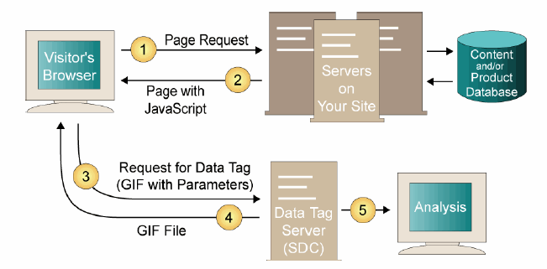
WebTrends SDC Server and Data Tagging

Slide 3
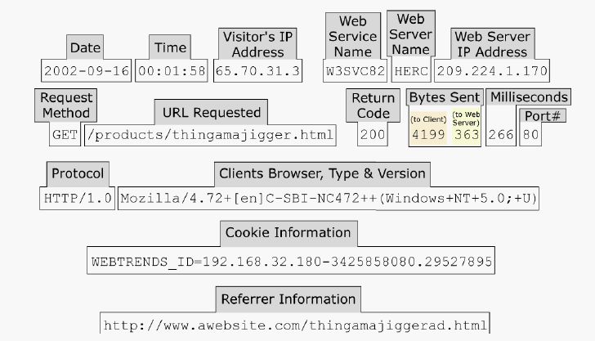
Standard Web server log

Slide 4
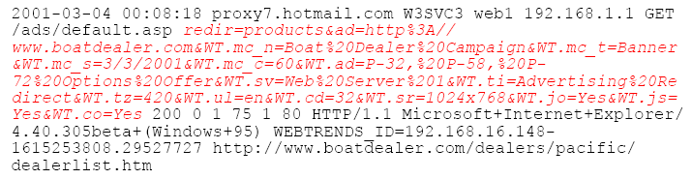
Webtrends SDC log

Slide 5
General Web Server Logs infromation
Date and time
Client IP address and port number
Web Server Name & IP address
Method used in the request, GET, POST, and HEAD
URL of the request
Return code
The number of bytes sent by the web server
The number of bytes sent by the client
Client machine’s browser type and version number
Cookie information
Referrer information

Slide 6
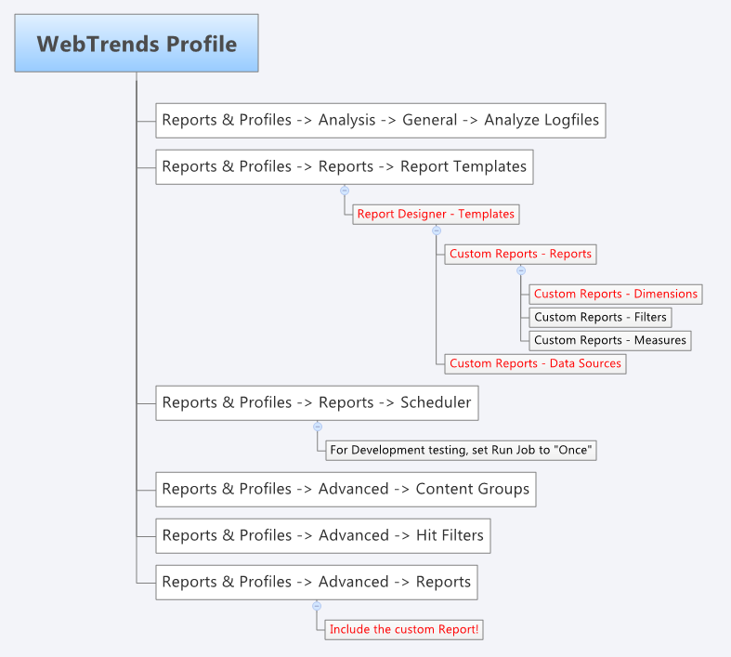
Webtrends Profile Setup

Slide 7
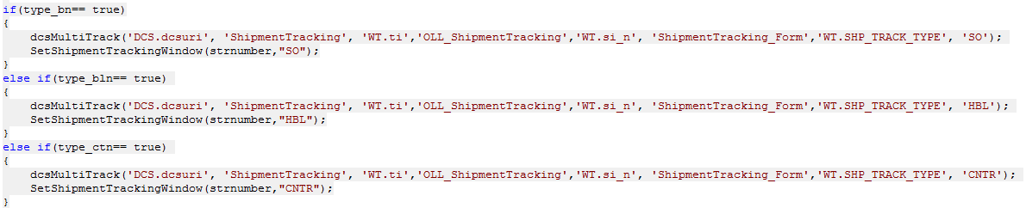
OLL.com Java Script Sample

Slide 8
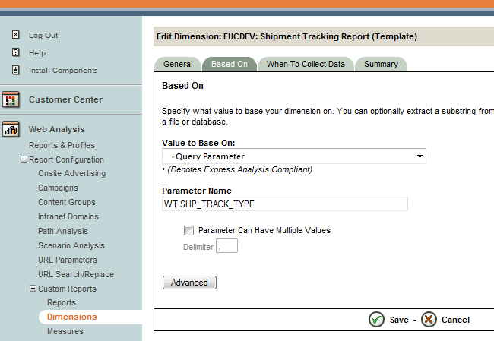
Webtrends Custom Measures

