Slide 1
CITS4404 · Team 20
Optimising AI Bitcoin
Trading Bots
PSO · GWO · HHO · Random Search
Qiurong Chen (24558583) · Yanchen Yu (24256987)
Deliverable 2 · CITS4404 2026
Notes:
Good afternoon. We are Team 20 — Qiurong Chen and Yanchen Yu. This presentation reports our work for CITS4404 Deliverable 2: optimising a Bitcoin trading bot with four algorithms.

Slide 2
INTRODUCTION
Why Nature-Inspired Algorithms for Trading?
70–80%
Research question: Can a nature-inspired optimiser find WMA parameters that yield a profitable BTC bot — and do optimisers differ in any meaningful way?
of digital-asset
trading is algorithmic
Part 1 (D1)
Part 2 (D2)
Added for D2
PSO (1995) vs HHO (2019)
Literature review & synopses
Empirical test on real BTC
price data (2014–2022)
GWO + Random Search
for full structural spectrum

Slide 3
PART 1 REVIEW
Particle Swarm Optimization (PSO, 1995)
Design motivation
Velocity update (Shi & Eberhart, 1998)
Genetic Algorithms: discarded weak individuals — lost knowledge Gradient methods: single solution — trapped in local optima PSO solution: Keep all particles; pull each toward pBest AND gBest
v ← w·v + c₁·r₁·(pBest − x)
+ c₂·r₂·(gBest − x)
w = 0.7 c₁ = c₂ = 2.0 population = 30
Key properties
Attractors: 1 global best Memory: velocity (momentum) Heavy-tail: none

Slide 4
PART 1 REVIEW
Harris Hawks Optimization (HHO, 2019)
Problem with single-rule swarms
6 Update Modes
Contract once global best stabilises — cannot escape local optima.
|E| ≥ 1 EXPLORE
|E| < 1 EXPLOIT
1. Perch near random family member
1. Soft besiege
2. Perch near swarm mean
2. Hard besiege
Escape energy gate
E = 2·E₀·(1 − t/T)
E₀ ~ U(−1, 1)
|E| ≥ 1 → explore (2 modes)
|E| < 1 → exploit (4 modes)
3. Soft besiege + Lévy dive ⚡
4. Hard besiege + Lévy dive ⚡

Slide 5
PART 1 REVIEW
D1 Summary: PSO vs HHO
Property | PSO (1995) | HHO (2019)
Update rules | 1 — velocity update | 6 — energy-gated modes
Attractors | 1 (global best) | 1 (rabbit / best-so-far)
Memory | Velocity (momentum) | None
Heavy-tail | None | Lévy flight dives
Annealing | Fixed inertia weight w | Linearly decaying |E|
D1 prediction | Fast convergence; may overfit | Slower, broader exploration
D1 conclusion: genuinely different structural choices — the comparison is worth running empirically.

Slide 6
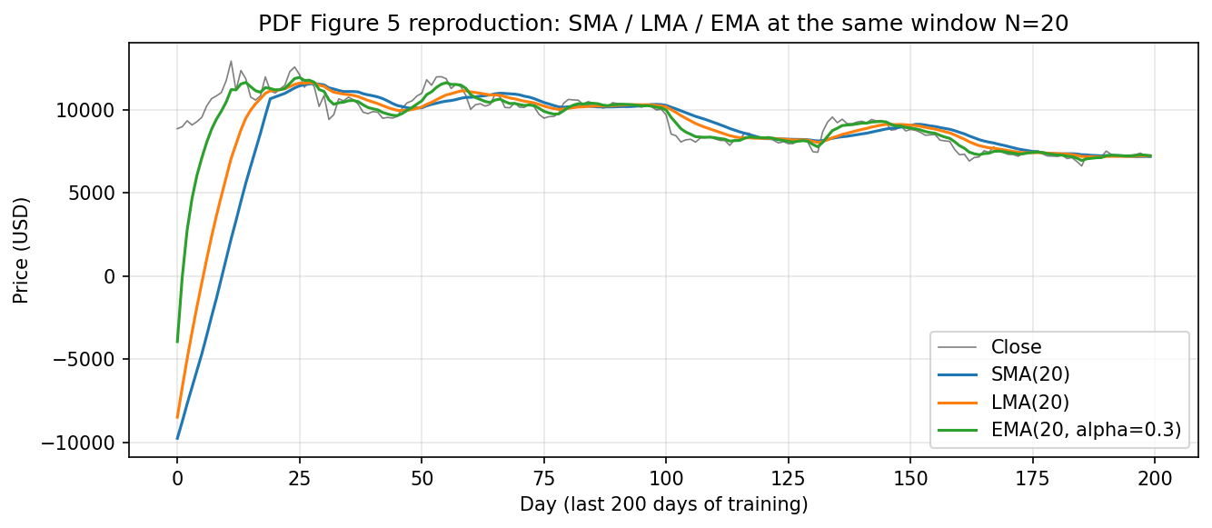
BOT DESIGN
WMA Building Blocks: SMA, LMA, EMA
SMA
Flat kernel — equal weights.
Slowest to react, most smoothing.
LMA
Triangular kernel — linear decay.
Medium responsiveness.
EMA
Geometric decay with factor α.
Fastest response to recent prices.
signal = P * K (convolution, Eq. 3)
Flip-pad handles edge at t = 0

Slide 7
BOT DESIGN
Two Hypothesis Spaces: B1 and B2
B1 — Dual-SMA Crossover
B2 — Compound Mixture (Eq. 7)
2-dimensional
14-dimensional
[ N₁ , N₂ ] ∈ [2, 300]²
HIGH = (w₁·SMA(d₁) + w₂·LMA(d₂)
+ w₃·EMA(d₃,α)) / Σwᵢ
Two SMA windows.
Crossover → buy/sell signal.
Purpose:
"Is optimisation even worth it?"
Baseline reference point.
Same structure for LOW indicator.
7 params × 2 blocks = 14-D.
Optimiser freely blends SMA/LMA/EMA.
No hard-coded WMA type or window.

Slide 8
ALGORITHM SELECTION
Four Algorithms — A Structural Spectrum
Algorithm | Attractors | Update rule | Memory | Heavy-tail | Role
Random Search | — | Uniform draw | None | — | Single-state baseline
PSO | 1 (g-best) | Velocity update | Velocity | — | D1 algorithm
GWO | 3 (α/β/δ) | Averaged candidate | None | — | Test Camacho claim
HHO | 1 (rabbit) | 6 modes, gated | None | Lévy dives | D1 algorithm
Fixed budget: exactly 5,000 fitness evaluations per run — every comparison is apples-to-apples

Slide 9
ALGORITHM SELECTION
Why Add GWO? The Camacho-Villalon Claim
Grey Wolf Optimizer (2014)
⚠ Camacho-Villalon et al. (2023)
Ranks population each iteration Top 3 = α, β, δ (leaders) Each non-leader: 1. Compute 3 candidate positions (one per leader) 2. Move to their average No velocity · No Lévy · No gating
Only annealing: a → 2 to 0
Int. Trans. Oper. Res., vol. 30, no. 6, pp. 2945–2971
Claim: GWO can be algebraically reduced to an inertia-weight PSO variant. The wolf-hierarchy metaphor is misleading.
Credibility: Dorigo = inventor of Ant Colony Optimization (ACO).
Our D2: empirical test of this theoretical claim

Slide 10
IMPLEMENTATION
Algorithms — All Hand-Written from Scratch
Random Search
PSO
for each evaluation:
x = uniform(bounds)
evaluate(x)
track best-so-far
for each iteration:
v ← w·v + c₁r₁(pBest−x)
+ c₂r₂(gBest−x)
x ← clip(x+v, bounds)
GWO
HHO
for each iteration:
rank → α, β, δ; a: 2→0
for each wolf:
x ← avg(Xα_c, Xβ_c, Xδ_c)
for each hawk:
E = 2·E₀·(1−t/T)
if |E|≥1: explore (2 modes)
else: exploit (4 modes)
incl. Lévy if strict improve
No scipy.optimize · No mealpy · No pyswarm — all code from scratch (PDF §3 Rules of Engagement)

Slide 11
EXPERIMENT SETUP
Experiment Matrix & Data Split
Experiment Matrix
Data Split (Kaggle BTC Daily)
4
TRAIN
algorithms
Nov 2014 → Dec 2019 (1,860 days)
× 2
bot configurations
TEST (HELD-OUT)
Jan 2020 → Mar 2022 (791 days)
× 5
random seeds
Train: bull run 18×
Test: COVID crash, 2021 peaks,
2022 retracement
= 40
total runs
5,000 FE per run · 200,000 backtests total · ~90 sec wall time

Slide 12
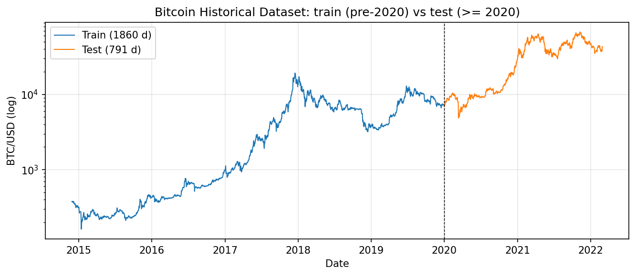
EXPERIMENT SETUP
Bitcoin Price: Train / Test Split (Log Scale)
Training: 18× price appreciation (bull run) · Test: crash, dual peaks, retracement

Slide 13
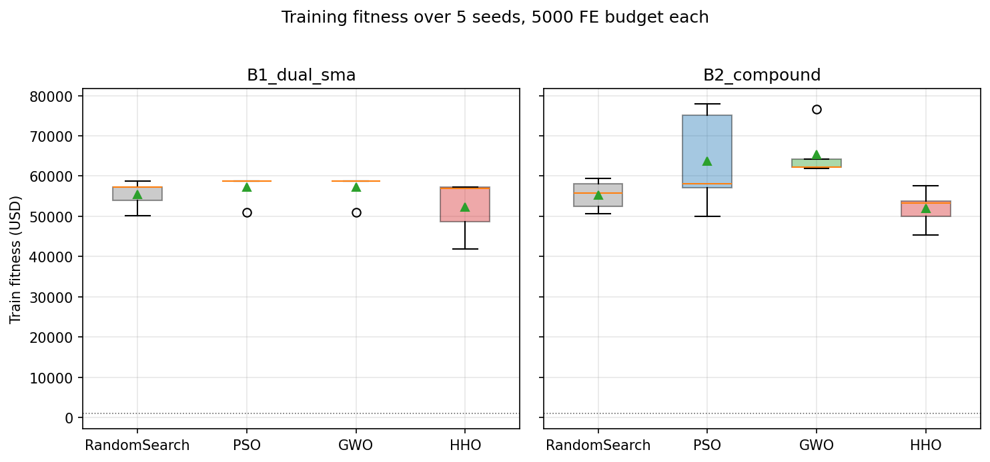
TRAINING RESULTS
Training Fitness: All Bots Beat Buy-and-Hold
Buy-and-hold (train)
$17,925
Best training run
$77,897
All 40 runs beat buy-and-hold
by 2.3–4.4×
Starting capital: $1,000

Slide 14
TRAINING RESULTS
Key Finding: GWO ≡ PSO on B1 (p = 1.0)
Bot / Algorithm | Mean ($) | Std ($) | Min | Max
B1 · Random Search | 55,484 | 3,414 | 50,232 | 58,776
B1 · PSO | 57,219 | 3,482 | 50,990 | 58,776
B1 · GWO | 57,219 | 3,482 | 50,990 | 58,776
B1 · HHO | 52,383 | 6,958 | 41,802 | 57,212
B2 · Random Search | 55,323 | 3,683 | 50,714 | 59,480
B2 · PSO | 63,651 | 12,207 | 50,046 | 77,897
B2 · GWO | 65,424 | 6,318 | 61,840 | 76,594
B2 · HHO | 52,001 | 4,557 | 45,418 | 57,522
★ B1: PSO = GWO (identical, p=1.0) · B2: GWO > RS and HHO (p=0.009) · HHO lowest on both

Slide 15
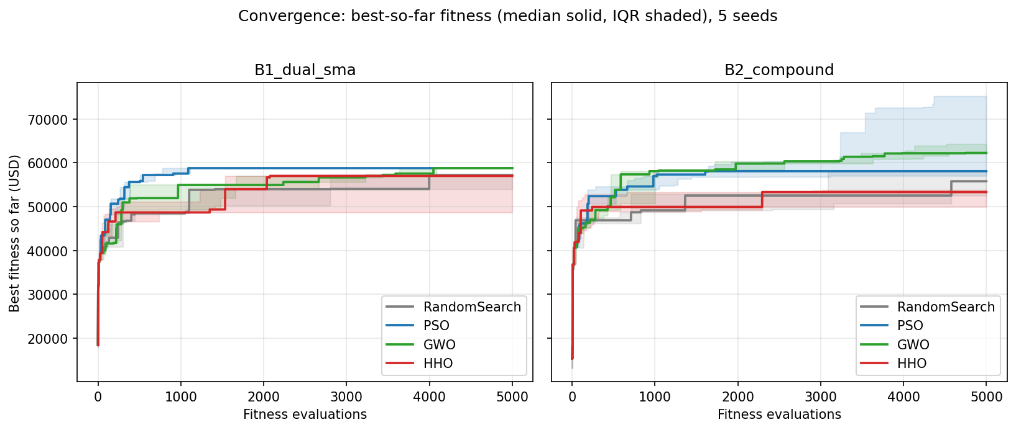
TRAINING RESULTS
Convergence: GWO Tracks PSO on B1, Edges Ahead on B2
HHO explores broadly through ~2,000 FEs → less budget for exploitation (explains lower training fitness)

Slide 16
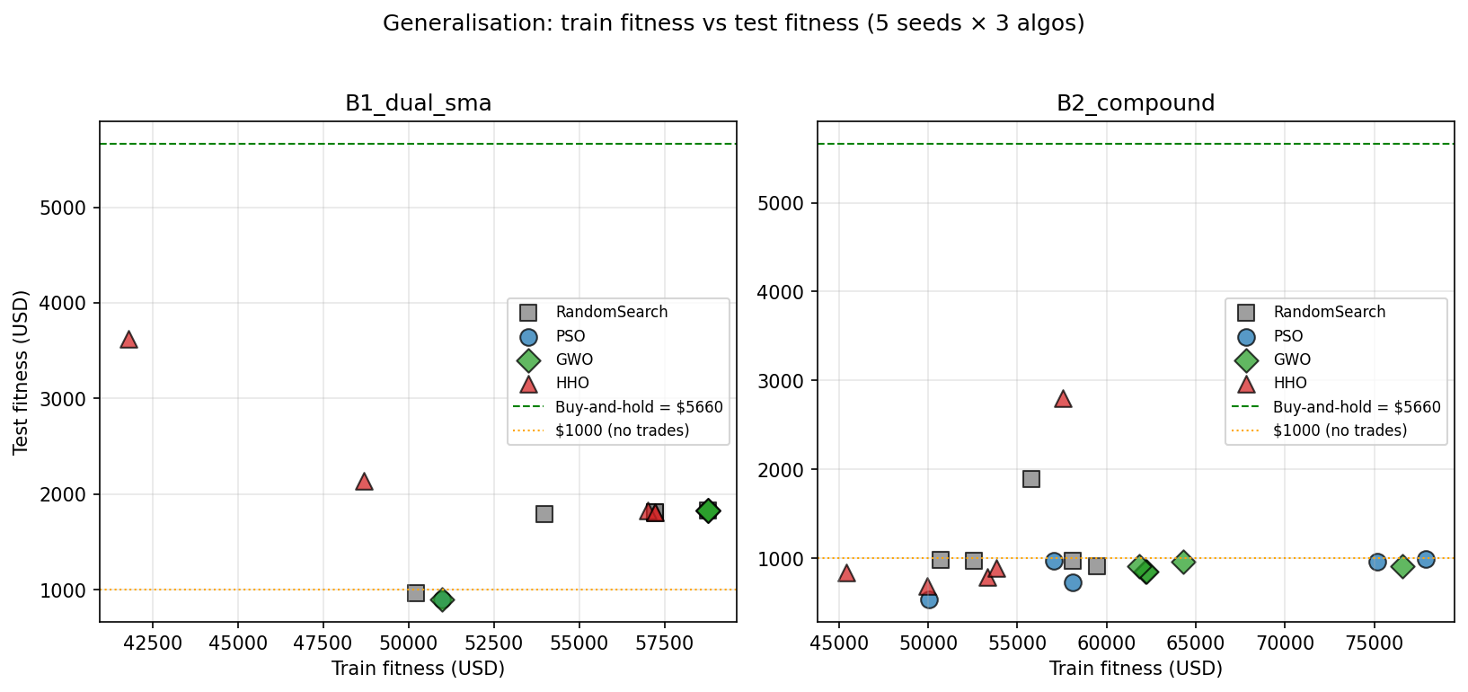
GENERALISATION
All 40 Bots Underperform Buy-and-Hold on Test
Buy-and-hold (test)
$5,660
Best test run (HHO/B1)
$3,623
Worst test run (PSO/B2)
$537
Training champion
= Test loser

Slide 17
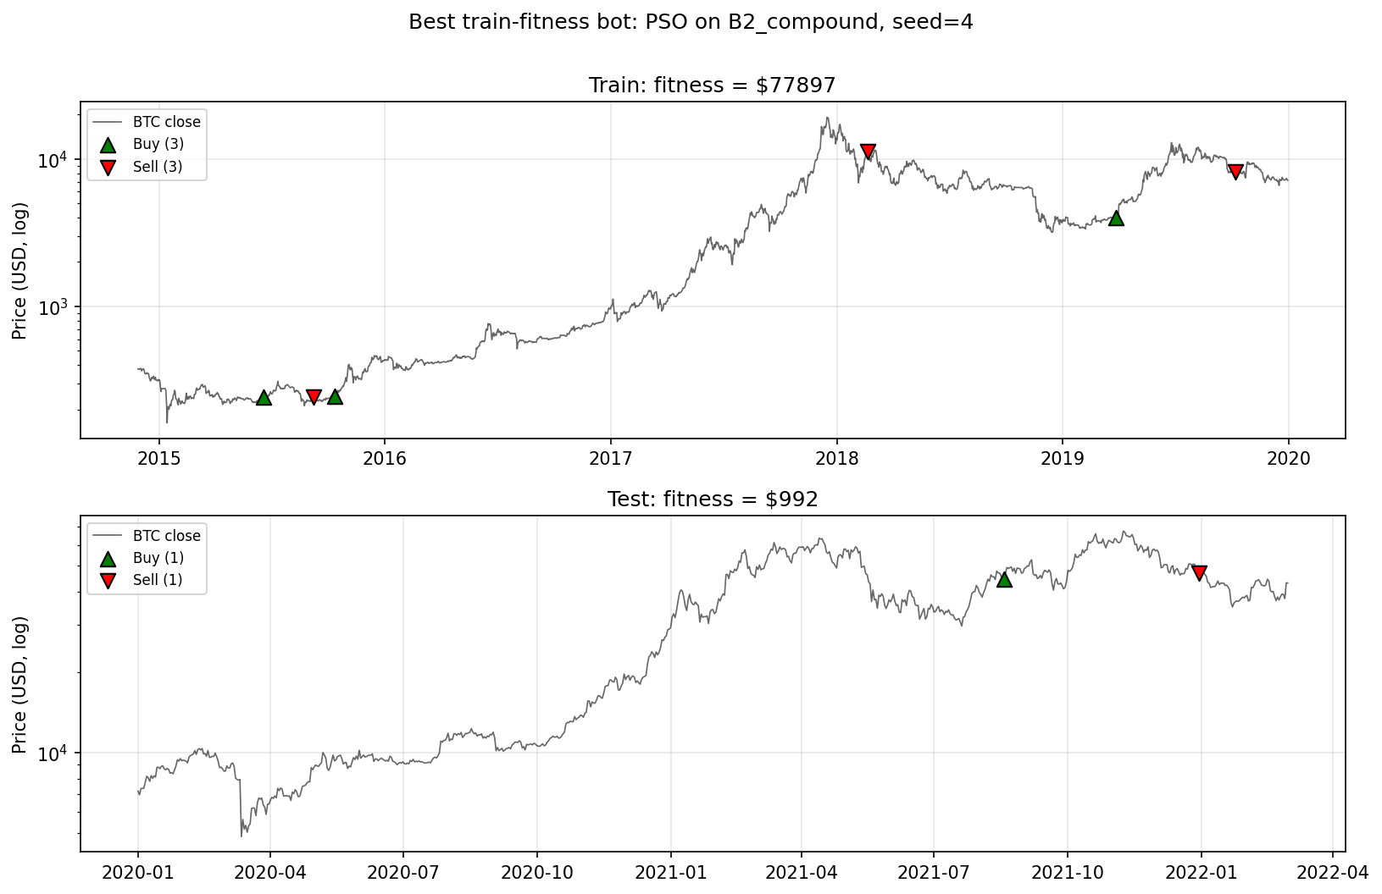
GENERALISATION
Training Champion → Test Failure
PSO / B2 / seed 4: $1,000 → $77,897 on train · same parameters → $992 on test

Slide 18
GENERALISATION
HHO's 'Weakness' Becomes Implicit Regularisation
Bot / Algorithm | Train mean ($) | Test mean ($) | Gen. gap ($)
B1 · Random Search | 55,484 | 1,637 | 53,846
B1 · PSO | 57,219 | 1,642 | 55,576
B1 · GWO | 57,219 | 1,642 | 55,576
B1 · HHO | 52,383 | 2,240 | 50,143
B2 · Random Search | 55,323 | 1,144 | 54,180
B2 · PSO | 63,651 | 836 | 62,815
B2 · GWO | 65,424 | 895 | 64,528
B2 · HHO | 52,001 | 1,199 | 50,802
HHO's late-budget re-exploration (D1 'weakness') = implicit regularisation on non-stationary data

Slide 19
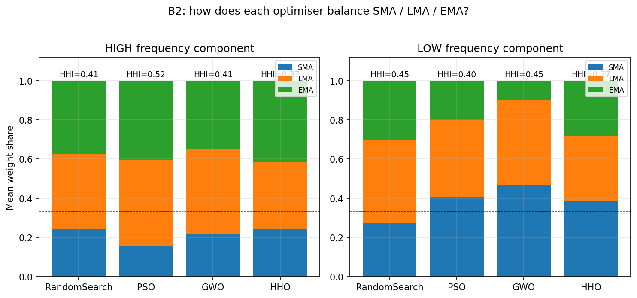
BEHAVIOURAL ANALYSIS
Do Optimisers Favour One WMA Filter?
Answer: All three used
(HHI = 0.37 – 0.52)
Fast band: LMA+EMA dominate (60–84%) SMA: only 16–24% → recency bias rediscovered Slow band: SMA preferred (28–46%)
GWO: EMA collapses to ~10%
"...favour one or draw from all three?" — spec §3 (Answer: all three)

Slide 20
CONCLUSIONS
Four Take-Aways
1
Engineering fairness is non-trivial
2
Camacho-Villalon claim survives
A counted-objective framework was the technical lever that made every comparison apples-to-apples under a fixed 5,000 FE budget.
GWO and PSO are statistically indistinguishable (p=1.0 on B1, p=0.46 on B2). GWO is an inertia-weight PSO variant — empirically.
3
Higher dimensionality amplifies gaps
4
Over-fitting; exploration = regularisation
On 2-D B1 all four clustered at the same plateau; on 14-D B2 the gap opened and HHO underperformed the other three.
Most concentrated training search (GWO, PSO) → worst out-of-sample. Algorithm choice changes how you over-fit, not whether.

Slide 21
Thank You
Submission Contents
Code: notebooks/final_report.ipynb (pre-executed, all figures embedded) Report: CITS4404_Team20_Report.pdf (≤3,000 words, IEEE citations) Video: [link to be added before submission]
Key References
[1] Kennedy & Eberhart, IEEE ICNN, 1995 · [2] Shi & Eberhart, IEEE ICEC, 1998
[3] Heidari et al., Future Gener. Comput. Syst., vol. 97, 2019 · [4] Mirjalili et al., Adv. Eng. Softw., vol. 69, 2014
[5] Camacho-Villalon et al., Int. Trans. Oper. Res., vol. 30, 2023 · [6] Kottarathil, Kaggle BTC Dataset, 2020
Narration assisted by text-to-speech; all data, code, and analysis produced by Team 20.
Team 20 · Qiurong Chen (24558583) · Yanchen Yu (24256987) · CITS4404 2026

