Slide 1
  Wizbit, a distributed revisioning file system
  Rob Taylor and Mark Doffman
  Codethink Ltd

Slide 2
Contents
Background
  File system problems & solutions
Goals
  What we intend to solve
Design
  Git internals & implementation
  Wizbit design
Blinding future
  How Wizbit may be (mis)used in the future

Slide 3
Background

Slide 4
What's the problem?
We all now have lots of devices
  Computers
  Web services
  Phones
  Tivos
  Tablets
  ....

Slide 5
What's the problem??
All of these have their own file/data stores
  You need to regularly make decisions about what should be on what.
  You need to transfer data between the devices
  Things get out of sync, especially when it's something you're working on. Especially if you're working on it with other people.

Slide 6
What's the problem???
Sync – FAIL!
Collaboration – FAIL!
Backup – FAIL! (ish..)

Slide 7
Doing data sharing now
Flickr
E-mailing file versions
Shared drives
Google docs
Google file system (Wuala)
SVN
Git / DVCS (Distributed Revision Control Systems)

Slide 8
Problems
Flickr / Google Docs and DVCS are application specific.
E-Mailing revisions about is incredibly frustrating.
Google file system / Shared drives do not allow off-line collaboration.

Slide 9
Device data syncronisation
OpenSync
Conduit
Multiple commercial software packages, allwaysync, GoodSync.
iTunes

Slide 10
Problems
Limited data formats, proprietary or lots of failure cases
Two-way sync is hard.

Slide 11
Backup
Files are not automatically backed up leading to data loss.
Many enterprise solutions.
rsync and dirvish may provide complete solution.
Lack of open-source GUI.

Slide 12
Where is my data?
User experience should be that you have the same file store on all devices
Perhaps different views onto the same file store
Media player gets to see your media files
Desktop sees all
Flickr sees pictures
BUT it should be the same file store!

Slide 13
So?
We need a distributed file system
Must still be fully usable when disconnected
Must cope with conflicting changes

Slide 14
Conflicts
Most existing distributed file systems don't allow conflicts – no disconnected operation possible
Those that do resolve conflicts by a complicated (and error prone) system of rules when the file system syncs (e.g. Coda)

Slide 15
Conflicts, fixed..
We need conflict resolution to involve the user and the application.
  Only the applications fully understand their data formats
  Some merge cases can only be resolved by the user telling the application what is right.
When to resolve a conflict should be the choice of the user.
  Don't force users to make decisions when they don't need to.
  Don't get in the way of the workflow

Slide 16
Collaboration
If we can solve this, we get free collaboration tools.

Slide 17
What does the solution look like?
Looks a bit like a DVCS (Distributed Revision Control System)
  Branching history
  Merges on request
  Store synchronization without changing working tree or even necessarily the working branch

Slide 18
What doesn't fit?
DVCSs have the luxury of understanding what kind of data they are storing
  Text files where unit of merge is a line
In a DVCS you merge a whole tree
  For a user file system the user has to be able to merge individual files and leave other conflicts unresolved.
User interface is not suitable, not even for DVCS ;-)
  (ok, maybe with Bazaar..)

Slide 19
Wizbit Design

Slide 20
Attempt 1: Git wrapper design
Each file referenced by UUID
Each file stored in separate git repository
XML storage of the directory structure
Python implementation using Popen and git commands

Slide 21
Attempt 1: FAIL
Git issues
  Whole tree merge was unsuitable – Separate repository per file.
  Git repository per file was heavy
  Directory structure is not versioned
Implementation issues
  XML storage of file information was heavy and error prone
  Python and Popen were error prone
  Language bindings and library impossible
  Directory file system is the only application

Slide 22
Attempt 2
Move core Git functionality to reusable library
  All of Git UI not wanted.
Create new directory structure
  Uses git object and pack format, but rewrite the storage of references.
Build file system on-top of this
  File system is a particular application of a versioned collection of files.
Git chosen for speed and language choice
  'C' library would make for easier language bindings

Slide 23
Git Overview

Slide 24
Git design
Git objects are files referenced by their own hash
They are stored compressed
They may contain data or meta-data
  Meta-data in this case is version history.

Slide 25
Git object types
Blob
  File data objects
Tree
  Store directory data a list of references to blob or tree objects.
Commit
  Represent a commit including a commit message, time, references to parent commits, and a single tree object.
Tag
  Used to implement Git tags, we won't worry about these.

Slide 26
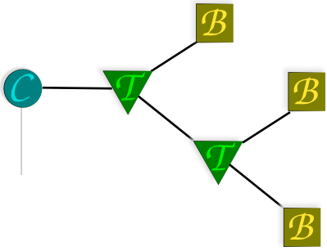
Git tree – Single commit

Slide 27
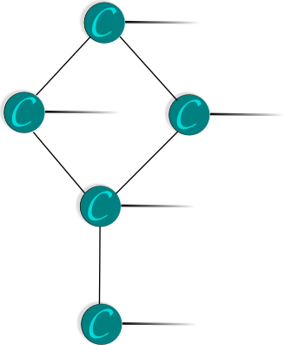
Git commit tree

Slide 28
Git refs
“Entry point” required for commit tree
Hash reference used as this entry point – The most recent commit

Slide 29
Git design overview
All objects referenced by their hash.
A commit object uniquely references and entire directory tree.
Commit tree used for revision history.
Files store branch references
Special file stores merge reference

Slide 30
Git implementation
Written in 'C' with some bash scripts.
Optimized to execute in short live process as a command line application.
An 'evolved' code base that is not obviously modular.
Mostly not reentrant

Slide 31
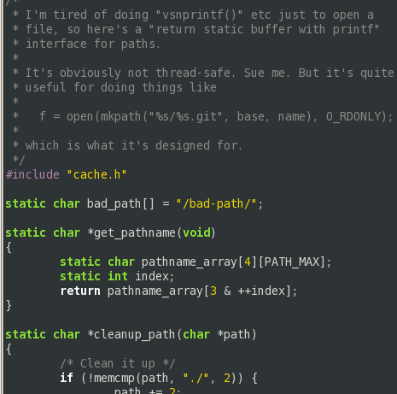
Git thread safety
Thread safety not considered in Git.
Good decision for a command line application.
Concurrency provided by larger git design and file locking.

Slide 32
Git memory management
Memory cleared by OS – process exits!
Frequent memory allocations (Objects) stored in ever-growing cache
Code-base does not consider long-lived processes

Slide 33
libgit.a suitability
None
(oops!)

Slide 34
So.... libgitcore
Reentrant, object-like rewrite of git code functionality (objects, blobs, trees, commits, tags
Using git code but heavy reworking needed
Usage is one git object-loader and writer per thread.
Git code is horrible..

Slide 35
Wizbit design overview
Files referenced by UUID
  Common feature of distributed file systems
  Ensures that files created on different computers do not have the same reference
Commit tree per file
  Each file can be merged separately from the rest of the repository

Slide 36
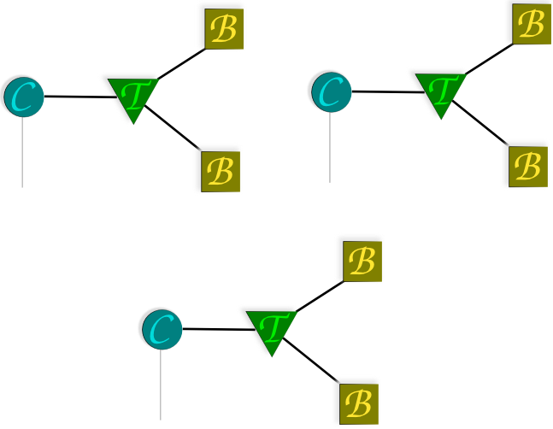
Wizbit data structures
File tree is a standard format
Reduced to two blobs
  /data
  /meta-data

Slide 37
Wizbit directory structure
Commit refs no longer stored in files
Git configuration no longer exists
Object store is the same as git

Slide 38
Refs in Wizbit - Requirements
A single head reference per file
  The 'work branch'
Multiple other references
  Usually unmerged tips from other Wizbit instances
Multiple references need to be updated within a single transaction
  To provide posix semantics, we'll need to update multiple refs atomically.

Slide 39
Wizbit references - Solution!
Use SQLite for the win, avoiding lots of clever file system locking code.

Slide 40
Difference of two repositories
Calculating the differences between repositories is vital for syncing
Checking the head reference of every file is not optimal in the common case of similar repositories
Git / SVN / Everything else do not have this problem as a reference applies to an entire tree

Slide 41
Difference of two repositories
Use a branching tree of UUIDs.
Compare SHA1s at each tree depth
Quickly find out which refs have changed

Slide 42
Building a file system
Options include
  Fuse
  GVFS
Choice not important to us – probably do both
Didn't think GVFS had any advantages

Slide 43
File system structure
How do we build a file system on-top of the UUID structure?
  Store directories as versioned files in the Wizbit repository
  Store symlinks as versioned files in the Wizbit repository
  Store files as versioned files in the Wizbit repository
Extremely similar to local file system
UUID could be considered as the inode

Slide 44
Wizbit design implications
Destructively deleting is difficult
  Real deleting would require removing commit history.
  Commit tree modification is nearly impossible on published or shared repositories.
  For the moment freeing up space will not be supported.
  Don't use wizbit for your “sensitive data”
Checkout of directory revisions is difficult
  In the versioned file system directories only point to file uuid rather than file versions, making checking out a directory out at a certain revision non-trivial.

Slide 45
Related Tech
Versioned file systems
  Andrew FS, CODA, Elephant FS
  User space, slower but perhaps more flexible
  Synchronization between repositories built in
Log based file systems
  User space implementation and commit on close make wizbit unsuitable for the forensics applications of Log based file systems
  Possibly faster file writing.
  Possibly better ratio of data to commit data.

Slide 46
Usefulness
Not a whole-file system solution
  Lack of delete
  Temporary files to be generally avoided
Not a revision control solution
  Git / Mercurial / Bazarr much better choices as they are designed to version whole directories + Years of UI development.
Intended for personal files, accessed and modified on multiple devices by many people

Slide 47
Usefulness
Intended for creating a single file system across multiple devices

Slide 48
User interface – Local repository
File access
  Handled by user space file system
Committing
  When to commit is difficult. Best bet – Commit on close.
Version history
  Reuse ideas from graphical VCS.
Revision checkout
File merging
  Application specific and hard. Provide some basics such as “Use most recent file”.

Slide 49
User interface - Syncing
Relating devices
  Where are we syncing from / to?
Sync schedules
  When do we sync between devices?
Authorization
  How do we obtain permission to sync to a device?

Slide 50
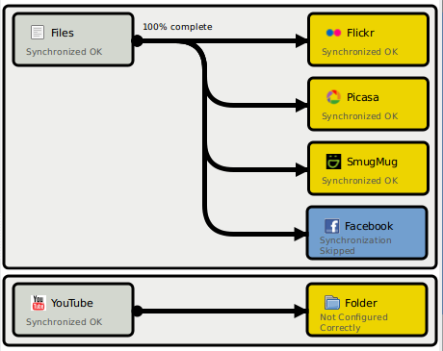
Syncing - Conduit
Aims to integrate into desktop
Plug and play for your device syncing
Automatically syncs when something changes
Already has code to handle authorization against web services

Slide 51

The blinding future!

Slide 52
Meta-data formats
In the core design, every file has both data and meta-data.
Not yet decided what form meta-data should take: RDF/XML? Tuples?
Common meta-data:
  User visible file name
  mtime/ctime (atime??!)
  Document info

Slide 53
Tracker / XESAM
Initially can use Tracker to create the meta-data
If Wizbit successfully adopted, applications can create the meta-data themselves and commit along with the data.

Slide 54
Contextual browsing
Given all this and a suitably rich ontology, we can start imagining new ways of reaching our data:
  Time line: “The work I was doing last week”
  Context: “Documents on RDF”
  Virtual folders with complex stored search terms
  “Related files”

Slide 55
Metadata
Metadata should move with the file system
  Shouldn't need to be regenerated for each store
  What to do about inter-file relations?

Slide 56
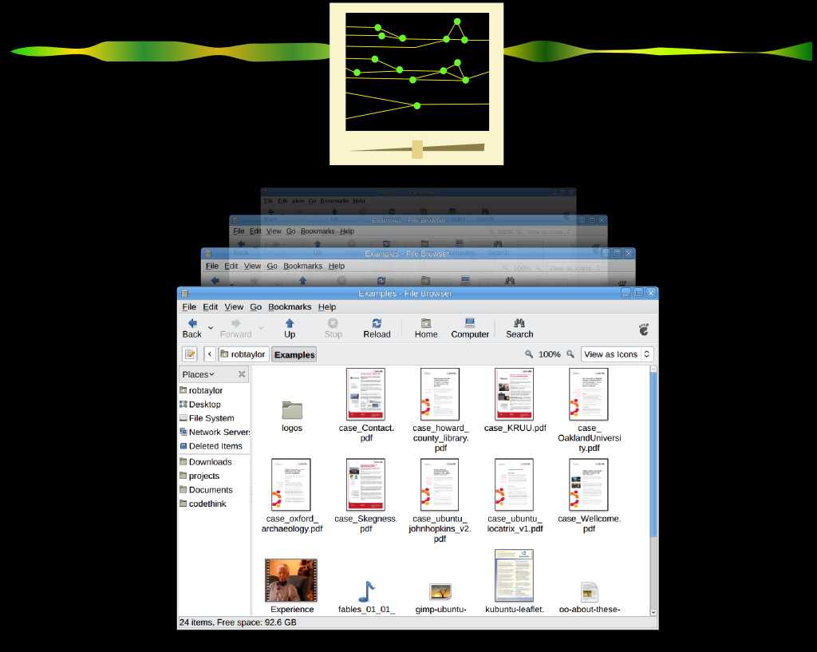

Slide 57
Timeline view
UI Mockup by Karl Lattimer
  Top line shows activity over time – thicker/hotter means more activity
  Dragging magnifier scrolls time line forwards/backwards
  Magnifier scale gives detail level
    Files changing
    How files changed

Slide 58
More ideas welcome!

Slide 59
Thanks!
http://wizbit.org
  (not much there yet)
http://git.codethink.co.uk
  libgitcore
  wizbit

