Slide 1
SALES PERFORMANCE
DASHBOARD
An in-depth analysis of sales trends, regional performance,
customer segments, and category breakdowns
$2.26M
4 Regions
3 Segments
3 Categories
Total Revenue
Coverage
Customer Types
Product Lines
FY 2014–2018 | CleanedData Dataset | Power BI Report

Slide 2
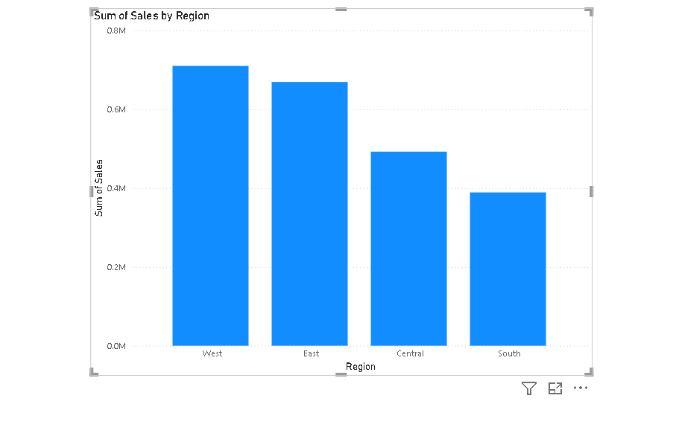
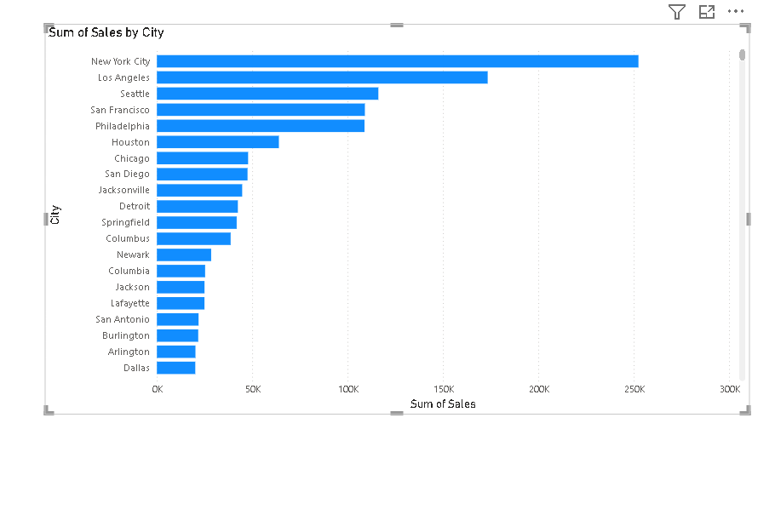
REGIONAL & CITY PERFORMANCE
Slide 2 of 6
Key Insight: West leads all regions at ~$0.73M. New York City dominates city-level sales with $250K+, nearly double Los Angeles.
Sum of Sales by Region
Sum of Sales by City (Top 20)

Slide 3
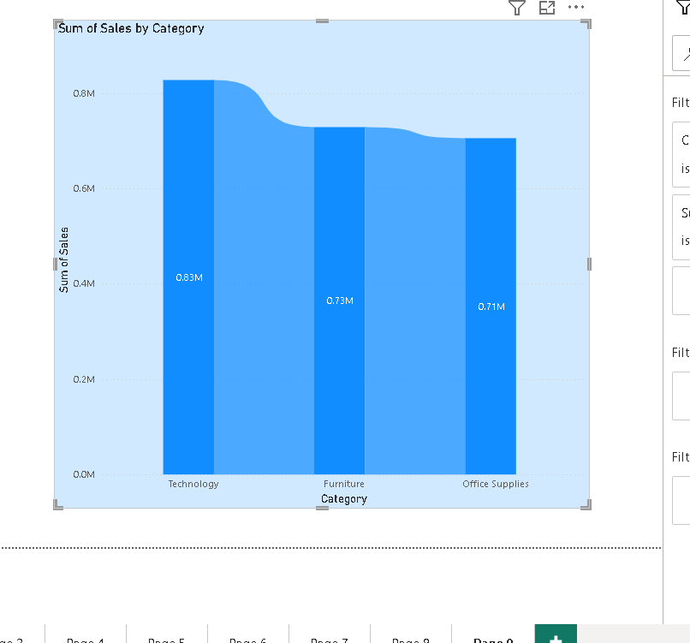
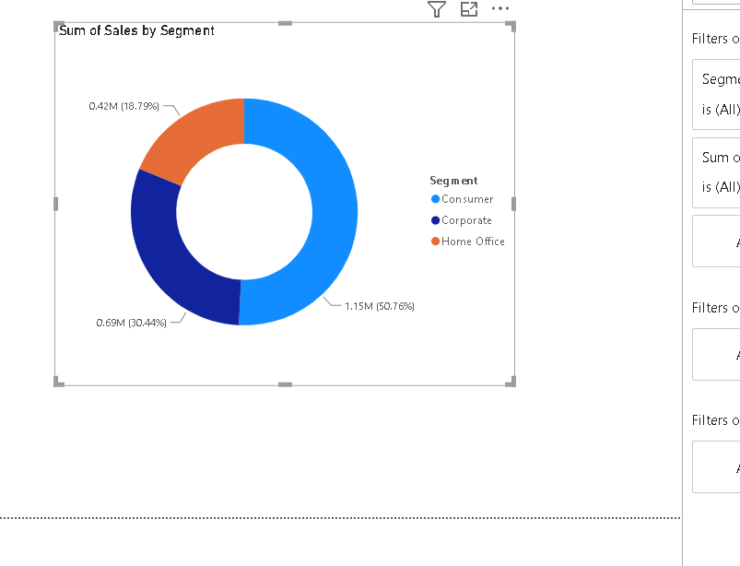
CATEGORY & SEGMENT ANALYSIS
Slide 3 of 6
Key Insight: Technology leads at $0.83M (37%), marginally ahead of Furniture ($0.73M). Consumer segment drives 51% of total sales.
Sum of Sales by Category
Sales by Segment
Consumer: 50.76%
Corporate: 30.44%
Home Office: 18.79%

Slide 4
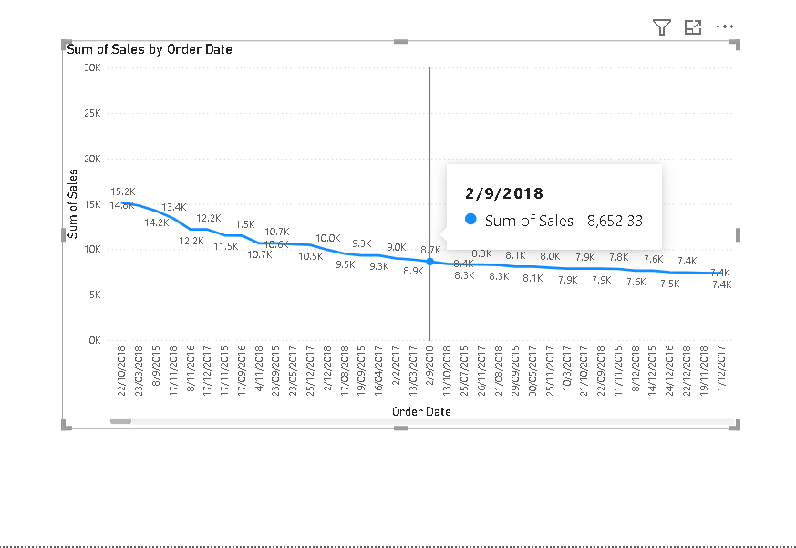
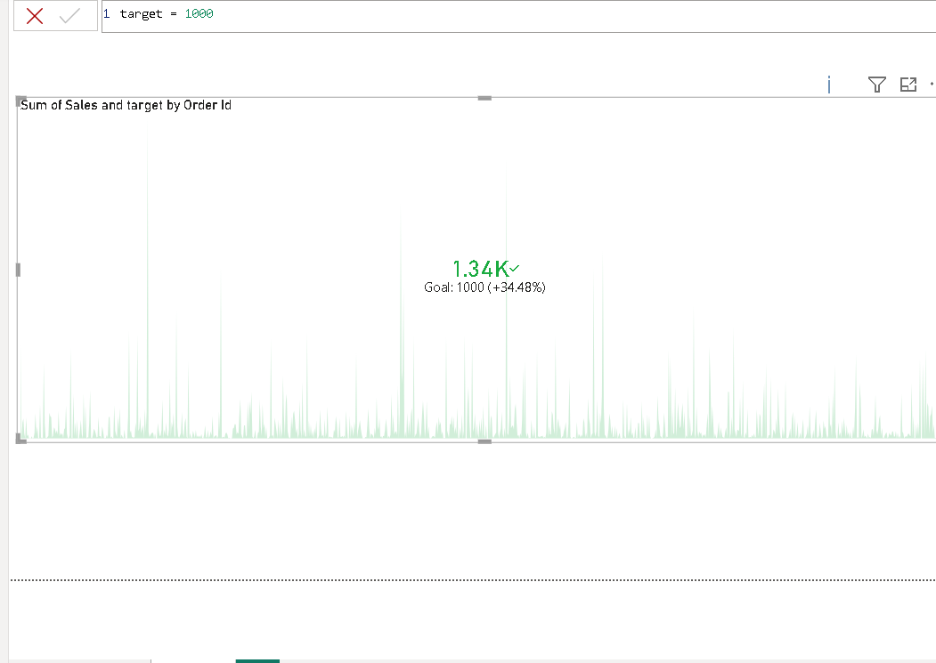
SALES TRENDS & TARGET TRACKING
Slide 4 of 6
Key Insight: Peak daily sales reached ~$30K. The sparkline KPI shows average order sales at 1.34K — 34.48% above the $1,000 target.
Sum of Sales by Order Date
Sales vs. Target KPI
Avg Sales / Order
$1,340
Target
$1,000
vs. Target
+34.48%

Slide 5
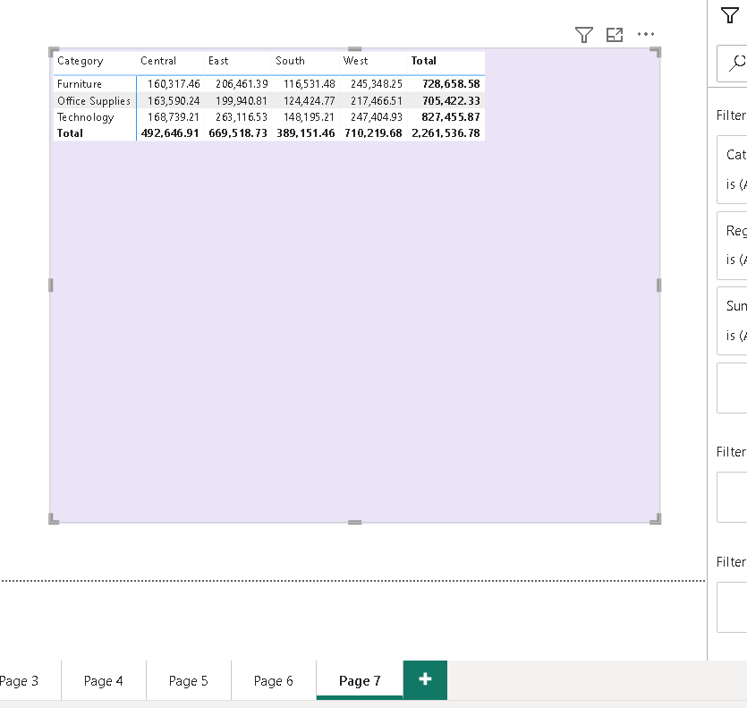
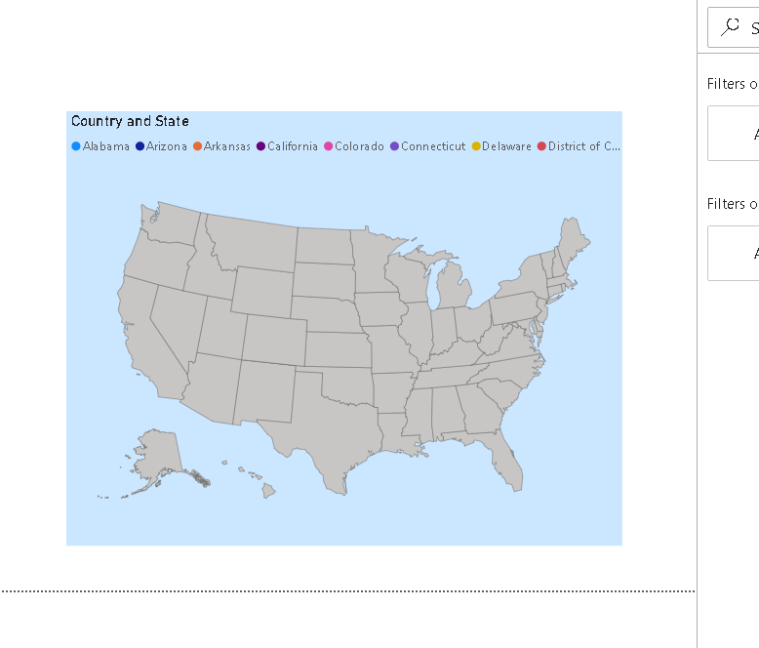
REGIONAL MATRIX & GEOGRAPHIC VIEW
Slide 5 of 6
Key Insight: West region tops all three categories. Technology in West ($247K) and Office Supplies in East ($200K) are standout performers.
Category × Region Sales Matrix
Geographic Distribution (USA)

Slide 6
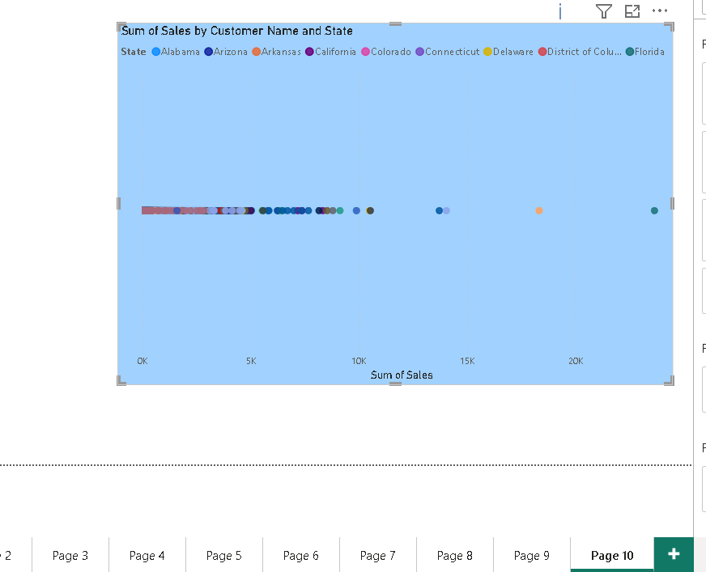
CUSTOMER-LEVEL ANALYSIS & SUMMARY
Slide 6 of 6
Sales by Customer Name & State
Top Region
West
$710K revenue
Top Category
Technology
$827K revenue
Top Segment
Consumer
50.76% of sales
Top City
New York City
$250K+
KPI Status
+34.48%
Above $1K target

