Slide 1


Group 2
Project Submission
Due Friday, May 28th at 1:00pm

Slide 2

PLAN
Problem
Methodology
Results
Proposed solution
References and appendices
Team members

Slide 3


Problem
The main problem is that Michel, the owner of a boutique is unable to sell tomato paste orders on time before their expiration date. This problem has been lasting for the past three months and still…
The client, Michel’s son wants to know what are the causes of the problem and if he should continue to sell tomato paste or not.

Slide 4
Stakeholders
The owner and his son
Michel, as the owner is the first one impacted by this problem of losses. Business is made to generate profit to the owner so losses is not what is he was attended to.
If the father is affected this included that his son is also affected by the problem. The profit will be benefit for him too.
The customers
If Michel chose to not sell tomato paste anymore it would affect them especially those who buy it. And if they are not buying the product it's because there's a problem somewhere.
The providers and all those who have participated in the supply chain (Bus driver…)
If Michel decided to stop purchasing the products, it would be non benefits for the provider.

Slide 5


Methodology
Firstly, we will collect data for the analysis. We will use the data related to the purchases and sales of the company.

Slide 6

Methodology
Secondly, we will use Excel to manipulate the data. We will start by treating the data and then we will look for the quantity sold each week and also for the quantity of items purchased. We will evaluate losses and profits and we will proceed in this way for each brand.

Slide 7


Methodology
And then, we will use mathematics and statistics tools such as average, sum, trends to make calculations based on the information on the daily sales. To determine if the owner was making profit or loss. Then assuming that a can of tomato paste can only last a month we determine the quantity of boxes he loses per month. And then based on the average he sells every two weeks we set an average of the quantity of boxes he should buy in case the owner chose to still sell tomato paste.

Slide 8
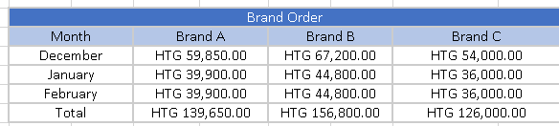
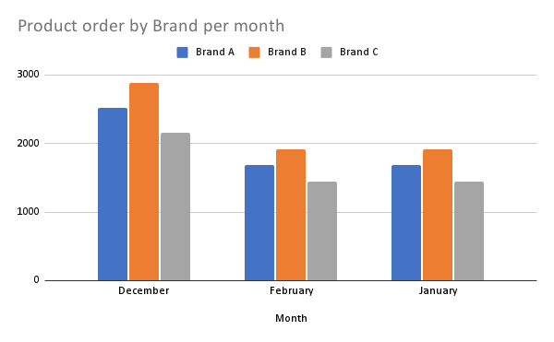
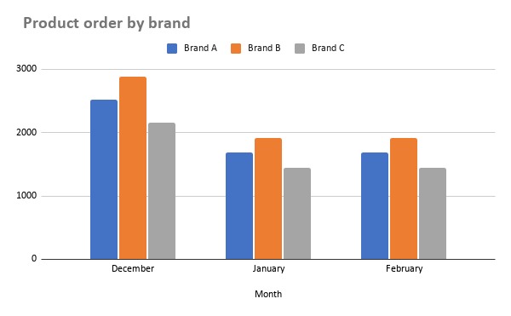

Information about the tomatoes purchased
The 1st graph, we have the money invested on tomatoes during the last 3 months, as we can see the brand B is the highest
The 2nd graph, we have the number of tomatoes can purchased. Still the brand B is the highest

Slide 9
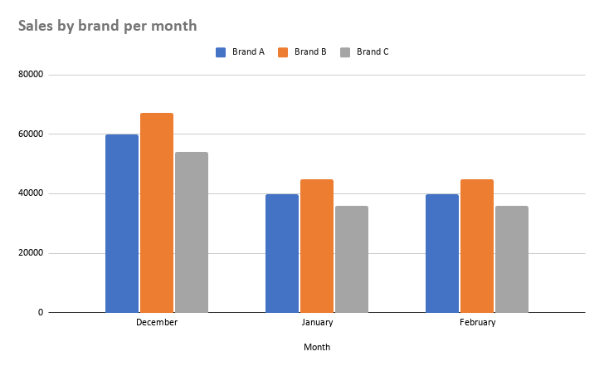

Information about the sale of tomatoes
We can see the brand B have the lowest score while the brand C has the highest score.
PS : the brand B have been ordered the most

Slide 10
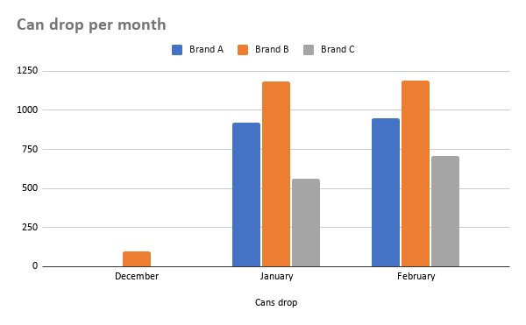

As we know each can of tomatoes have one month to be expired. Here are the number of can drop during the 3 months
Actually the number of every brand drop is really high but the brand B still have the highest score.
and if we look closer, the 1st month was not totally bad for the brand A and C, in the next months everything is out of control.

Slide 11

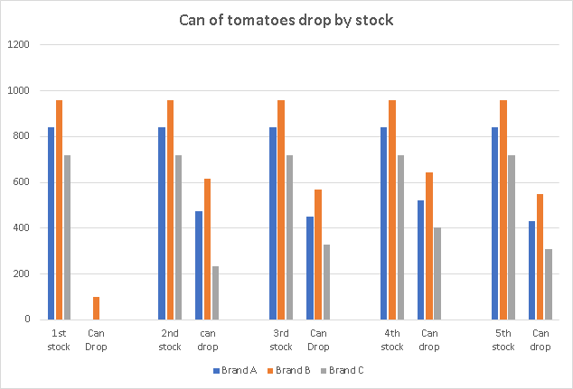
Michel actually purchased tomatoes 7 times in 3 months. the first 5th stock purchased have tomatoes that are expired. the 1st graph tell how many can that are dropped on the 5 stocks
The first stock actually have only the brand B with low amount expired.
after everything is out of control

Slide 12
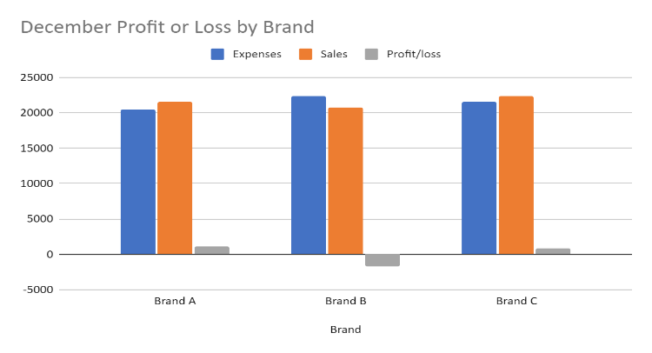
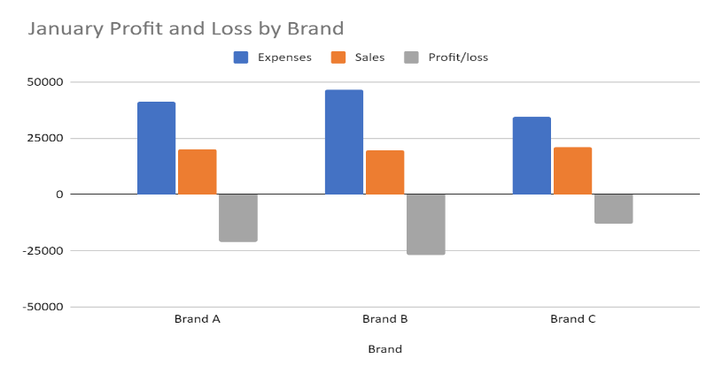
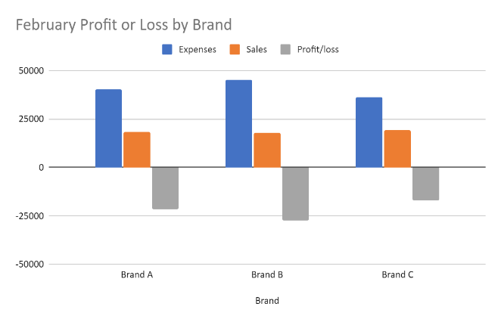

Informations about the loss and the profit
Let’s look closer on the profit or loss of Mr Michel.
On the 1st month he only make losses on the brand B. After that everything is out of control

Slide 13
SWOT
Opportunities | Threats
Organize a market research based on a survey They can use the result of the business analysis to adjust their stock Adjust their business to the market trends | The waste of so many products A considerable loss The lack of business analysis Bankruptcy
Strengths | Weaknesses
Multiple brands Record of each transaction Stock on time | Problem of management The brands don’t really affect the customers Lack of information on the market

Slide 14
Discussion
The different graphics above shown the business situation of the store boutique. The amount spent by the owner is above the profits he made for the three months of record we studied. Which is very alarming. The boutique can’t make any real profit concerning the selling of tomato paste. To find a solution, the team questioned:
The frequency of orders
The quantity of boxes ordered
The policy regarding the offer

Slide 15
Proposed solution
The owner has to put in place some stock management processes.
1.1 They have to change the order’s composition.
1.2 Recommend the owner to reduce the order of brand B and increase the order of brand C.
2. We are proposing that they do a market research.
3. Another solution we are proposing the client is to change the schedule of tomato paste boxes he buys.

Slide 16
References & Appendices
www.marketsandmarketsblog.com
What is Business Analysis? | Global Standard for Business Analysis Certification | IIBA®
Strength, Weakness, Opportunity, and Threat (SWOT) Analysis Definition (investopedia.com)

Slide 17


Present Team Members
Jeffking STERILE
Linxsly ALEXIS
Yvesna MARCELIN
David LOUIS

