Slide 2


Age regression for Brain MRI
Ioannis Valasakis
ioannis.valasakis@kcl.ac.uk

Slide 3
Aim
Predict the age from a brain MRI
Explore a volume-based regression approach
Alternatively implement an image-based regression
Comparison between those two

Slide 4
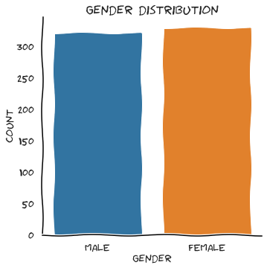
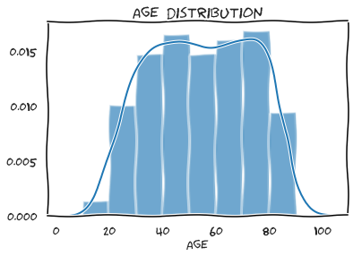
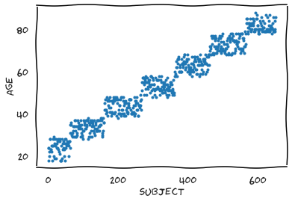
Population statistics

Slide 5
Volume-based approach
Workflow and results

Slide 6


Preprocessing
Steps
Resampling to a size of 128x128
Isotropic resolution 8x8x8 mm
Intensity normalisation using z-score
https://intensity-normalization.readthedocs.io/en/latest/algorithm.html
Notes:
Z-score normalization uses the brain mask B for the image I to determine the mean and standard deviation of the intensities inside the brain mask

Slide 7
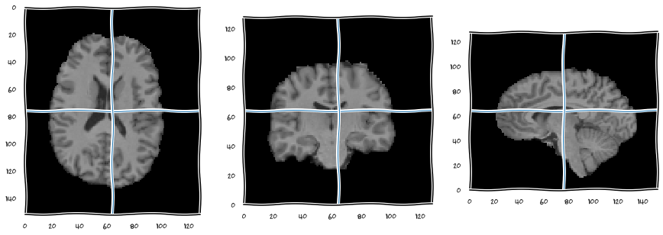
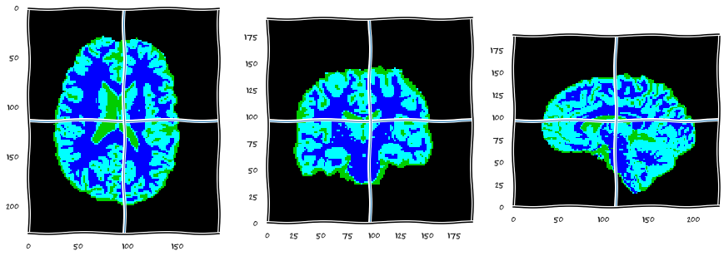
Segmentation
Approach
Gaussian Mixture Model (GMM)
WM, GM
WM
CSF, WM, GM
Notes:
Features form patterns which are classified to their probability belonging to a pixel
Segmentation on 3 different classes (White Matter, Gray Matter and Cerebrospinal Fluid)

Slide 8
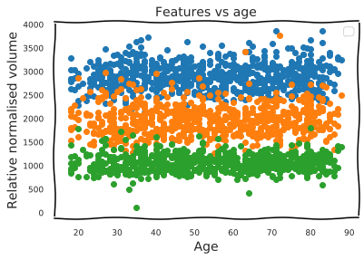
Features
The selected features were based on the volume (mm^3) of the brain voxels
Equally distributed
Green: CSF
Orange: GM
Blue: WM

Slide 9
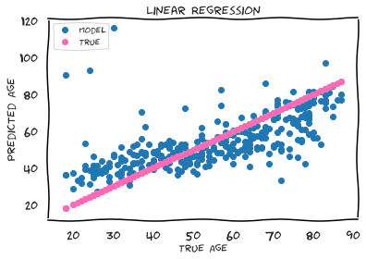
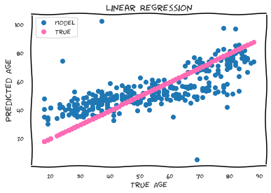
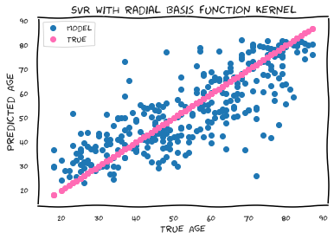
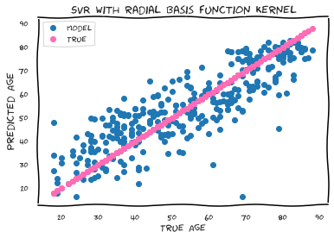
Regression (1/2)
Linear Regression
Bayesian Ridge Regression
Support Vector Regression with radial basis function kernel
Gradient Boosting
Decision Tree
Notes:
Linear Regression: modeling the relationship between a dependent variable and one or more explanatory variables
Bayessian Regression: predictor variables are corellated, small bias is introduced for regularisation. Mean Square Error minimised using bias (mean(ND)=0, least square matrix has prior ND with known mean, posterior probability able to infer using Bayes theorem)
SVR: Hyperplane in multidimensional space to separate various classes; a decision boundary between classes. Iteratively constructed to minimise the error. // Radial Basis Function (RBF) kernel is used in support vector machine classification and it can map an input space in infinite dimensional space.
Decision Trees: segment predictor space into regions; for each node a test is performed on the input and if reaches a node a prediction is made => using the mean of the data in the branch
Gradient boosting is a machine learning technique for regression and classification problems, which produces a prediction model in the form of an ensemble of weak prediction models, typically decision trees ; each new tree is a fit on a modified version of the original data set.

Slide 10
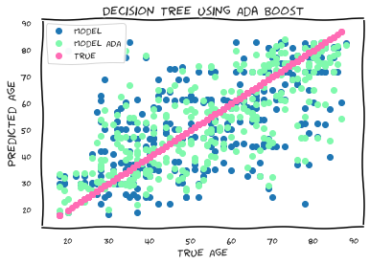
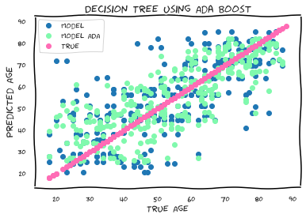
AdaBoost
53.28% => 62.99%
Notes:
Adaptive Boost -> Combine multiple “weak classifiers” into a single “strong classifier”.
→ The weak learners in AdaBoost are decision trees with a single split, called decision stumps.

Slide 11
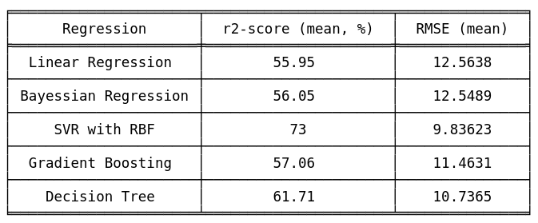
Cross Validation

Slide 12
Image-based regression
Using Gray Matter maps

Slide 13
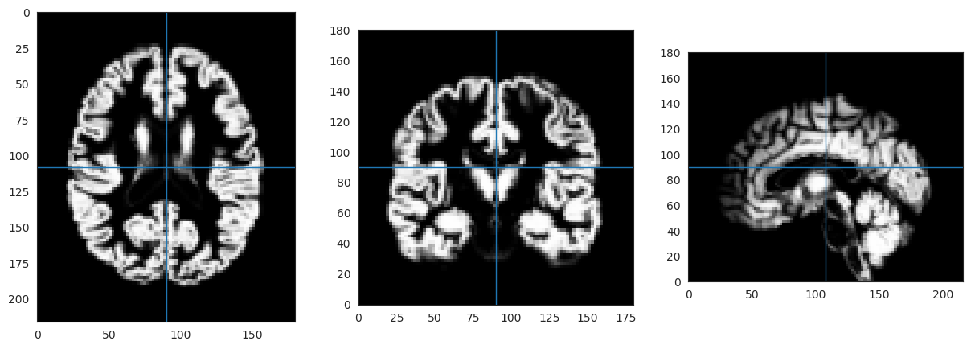
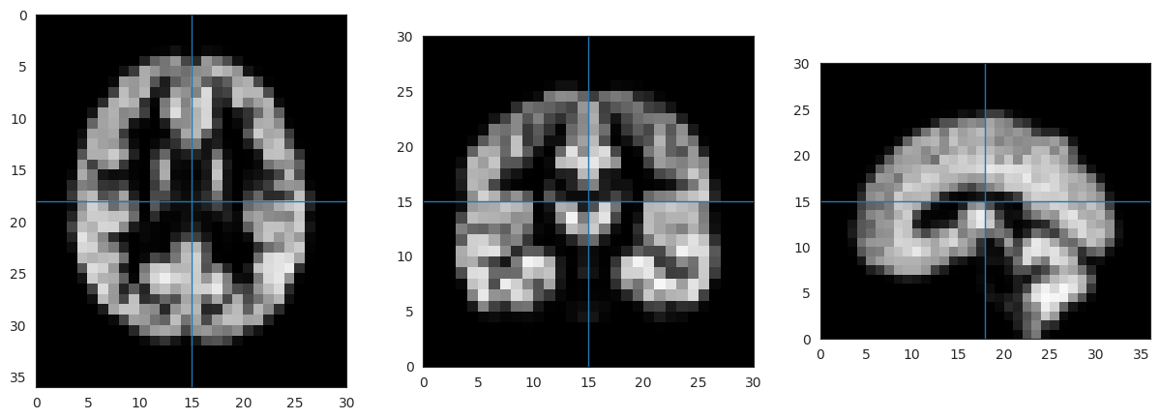
Preprocessing
Steps
Downsampling the GM image
Gaussian filter / smoothing using a σ=0.65

Slide 14
Dimensionality reduction
Approach
PCA
Directions of the minimum variance into a new subspace
Preserve 95% of the variance
Notes:
It performs a linear mapping of the data to a lower-dimensional space in such a way that the variance of the data in the low-dimensional representation is maximized.
DISTANCE MINIMISATION
minimise the distance of xi points to u1 (maximum variance axis)
PCA aims to find the directions of maximum variance in high-dimensional data and projects it onto a new subspace with equal or fewer dimensions than the original one.
The orthogonal axes (principal components) of the new subspace can be interpreted as the directions of maximum variance given the constraint that the new feature axes are orthogonal to each other

Slide 15
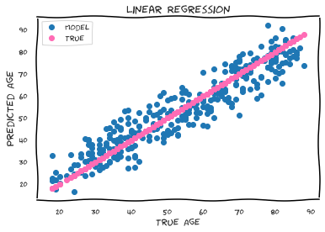
Age Regression
Linear Regression
Support Vector Regression with RBF
Decision Tree (AdaBoost)
Notes:
Linear Regression: modeling the relationship between a dependent variable and one or more explanatory variables
SVR: Hyperplane in multidimensional space to separate various classes; a decision boundary between classes. Iteratively constructed to minimise the error. // Radial Basis Function (RBF) kernel is used in support vector machine classification and it can map an input space in infinite dimensional space.
Decision Trees: segment predictor space into regions; for each node a test is performed on the input and if reaches a node a prediction is made => using the mean of the data in the branch

Slide 16
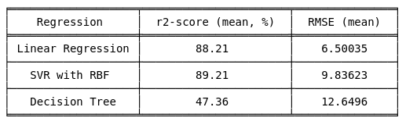
Cross Validation
Best case 32% r2-score increase
Overall much better prediction accuracy
Optimise the model further and find the best feature combinations

Slide 17
Contact details/for more information Ioannis Valasakis ioannis.valasakis@kcl.ac.uk www.github.com/wizofe
Thank you
© 2019 King’s College London. All rights reserved

