Slide 1
Would you survive?
A python introduction using the titanic dataset
Notes:
Hello everyone! How are you doing today?

Slide 2
Ioannis
[Ee-o-a-nn-e-s]
Notes:
My name is Ioannis (yes that is a tricky one) and I am currently doing research at King’s College London // in Medical Imaging using Deep Learning. Today I am going to explore / and assist you / writing your first Python program.

Slide 3
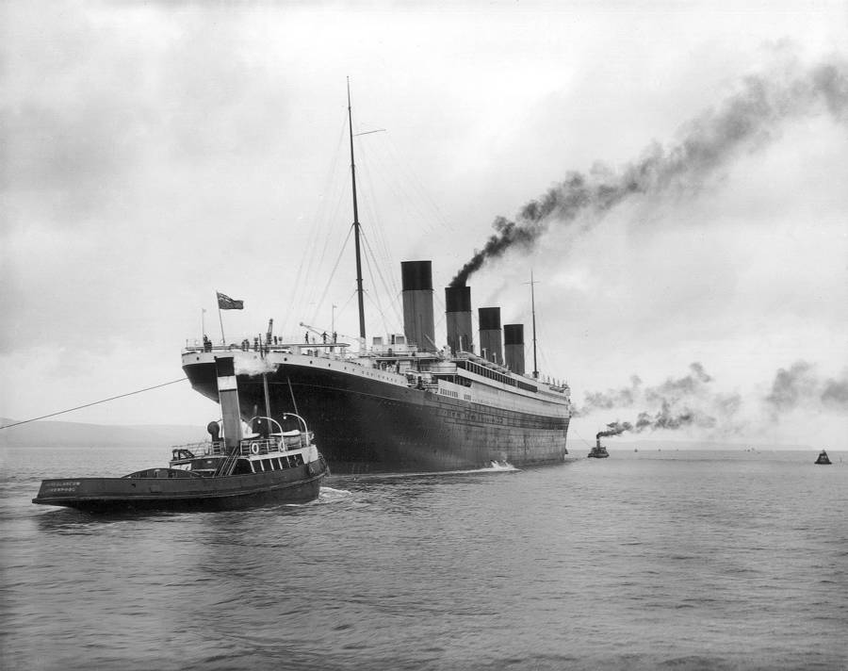
Notes:
It’s 1912 and Titanic is leaving Southampton. Unfortunately, not everyone survived this trip. Today we are going to discover, by programming, what are the chances of passenger survival, depending on their travel seating.

Slide 4
What is a computer program?
Notes:
Does anyone know what a computer program is? ///////// A computer program is a series of instructions, written in words, numbers and symbols, that performs a specific task when executed by a computer.

Slide 5
What is python?
Notes:
That’s great! …and what is Python?

Slide 6
Characteristics
WHAT IS python?
High-level interpreted language
Portable
Readable

Slide 7
Where is it used?
uses
Machine Learning
Computer Vision
Web Development
Data Analysis
Internet of Things

Slide 8




Who is using it?
uses
Notes:
Many big companies are using Python either to prototype or for production.

Slide 9
output/functions
THE BASICS
VARIABLES
print(‘Hello Python!’)
draw(x)
a = 3
b = ‘3’
Data types
ARITHMETIC OPERATIONS
Integer
Float
String
Boolean
+
/
*
-
>, >=
<, <=
and, or, not
Notes:
FUNCTION is a block of organized, reusable code that is used to perform a single, related action.

Slide 10
ANACONDA
Workflow
The world’s most popular Python data science platform
Spyder
Scientific Python Development Environment

Slide 11
Demo time!

Slide 12
https://tiny.cc/lse-titanic

Slide 13
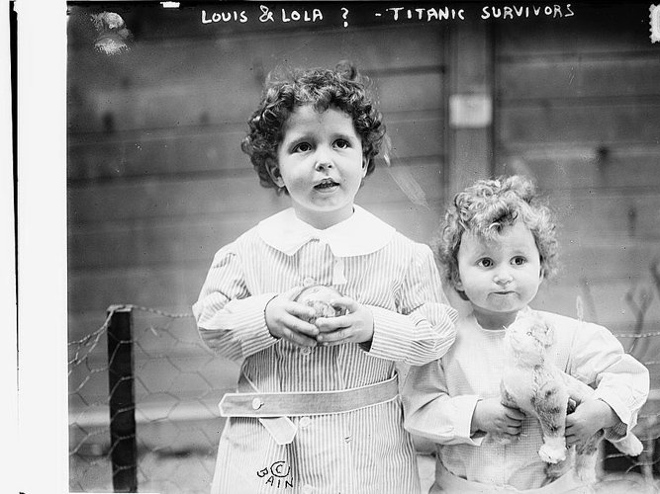

Slide 14
Thank yoU!

