Slide 1
TITANIC
VISUALISATION AND PYTHON INTRODUCTION
Notes:
Hello everyone! How are you doing today?

Slide 2
Ioannis VALASAKIS
King’s college London
[Ee-o-a-nn-e-s]
Notes:
My name is Ioannis (yes that is a tricky one) and I am currently doing research at King’s College London // in Medical Imaging using Deep Learning. Today I am going to explore / and assist you / writing your first Python program.

Slide 3
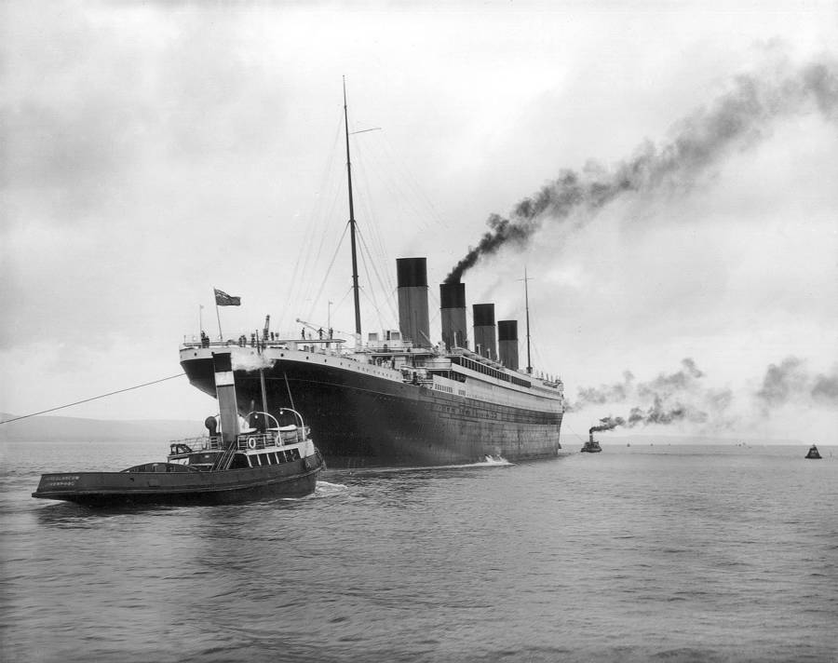
Notes:
It’s 1912 and Titanic is leaving Southampton. Unfortunately, as you know, not everyone survived this trip. Today we are going to discover, by programming, what are the chances of passenger survival, depending on their travel seating.

Slide 4
What is a computer program?
Notes:
What do you think a computer program is? Would anyone like to tell me? ///////// A computer program is a series of instructions, written in words, numbers and symbols, that performs a specific task when executed by a computer.

Slide 5
What is python?
Notes:
That’s great! …and what is Python?

Slide 6
Characteristics
WHAT IS python?
High-level interpreted language
Portable
Readable
Notes:
Python is a programming language, created by Guido Van Rossum in 1991, in an effort to create a simple, modern, readable language. Its usage skyrocketed the last 10 years, as computers become faster and because of its extreme user friendliness. In comparison, with a language like C++ the development time can be 3-4x times slower!

Slide 7
Where is it used?
uses
Machine Learning
Computer Vision
Web Development
Data Analysis
Internet of Things
Notes:
Python is found very frequently in Machine Learning and Computer Vision applications, typically dominated by other languages like C++. Especially for prototyping though, Python has the edge. It can also be used to create a webserver, host it and let it serve more complex websites, using different frameworks (that is collections of software functions).
Many commercial websites and servers are based on Python and in some places like Instagram, that is the main language used, including production. Data analysis is another very strong field.

Slide 8




Who is using it?
uses
Notes:
Many big companies are using Python either to prototype or for production. Companies like….. and Netflix, is using Python to analyse the massive incoming data from people around the world / who stream their online movies, and take better business decisions, increase the performance of their systems, monitor for errors, etc.

Slide 9
output/functions
THE BASICS
VARIABLES
print(‘Hello Python!’)
draw(x)
a = 3
b = ‘3’
Data types
ARITHMETIC OPERATIONS
Integer
Float
String
Boolean
+
/
*
-
>, >=
<, <=
and, or, not
Notes:
Now let’s talk about the language basics. VARIABLES, are reserved memory locations that store values. Now, we can perform ARITHMETIC OPERATIONS in those values. Those are what you expect from mathematics, including addition, division, multiplication, subtraction. Those values can be referred (used) much later in the program. Now the variables can have different data types. BOOLEAN values are used to denote one of two values TRUE or FALSE. Like the 1/0 and the on/off of an electric switch. FUNCTION is a block of organized, reusable code that is used to perform a single, related action.

Slide 10
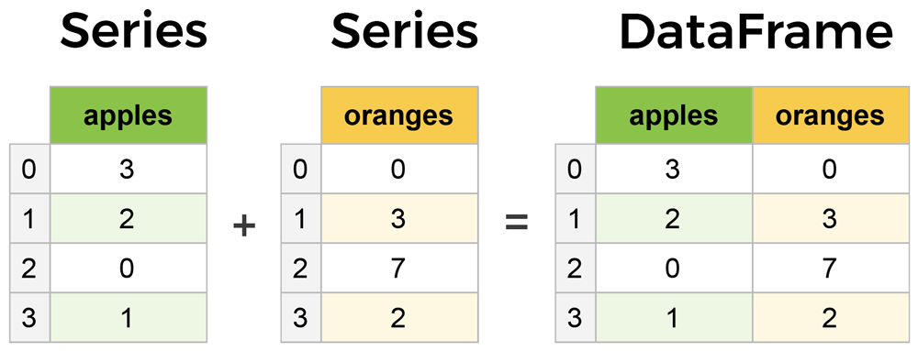
(VERY QUICK) INTRO TO PANDAS
THE BASICS
data = {
'apples': [3, 2, 0, 1],
'oranges': [0, 3, 7, 2]
}
shopping = pd.DataFrame(data)
shopping.[‘apples’]
Notes:
Pandas is a fundamental high-level building block (library) for doing practical, real world data analysis in Python.
Its two primary components are the Series and DataFrame. A Series is essentially a column, and a DataFrame is a multi-dimensional table made up of a collection of Series. To create a new dataframe, you can use the format on the left. To reference a specific column, you can use the notation on the right, by giving the label as an index input.

Slide 11
ANACONDA
Workflow
The world’s most popular Python data science platform
Spyder
Scientific Python Development Environment
Notes:
Anaconda Is a very popular data science framework, which allows different Python libraries to co-operate smoothly. Spyder is a Development Environment, which is user friendly and can be used to test, run and correct your programs!

Slide 12
Demo time!
Notes:
You will find Anaconda in your Start Menu (or Program Files). Just open the Navigator and through this, choose the Spyder option.
If anyone needs help, just let me know!

Slide 13
https://tiny.cc/lse-titanic

Slide 14
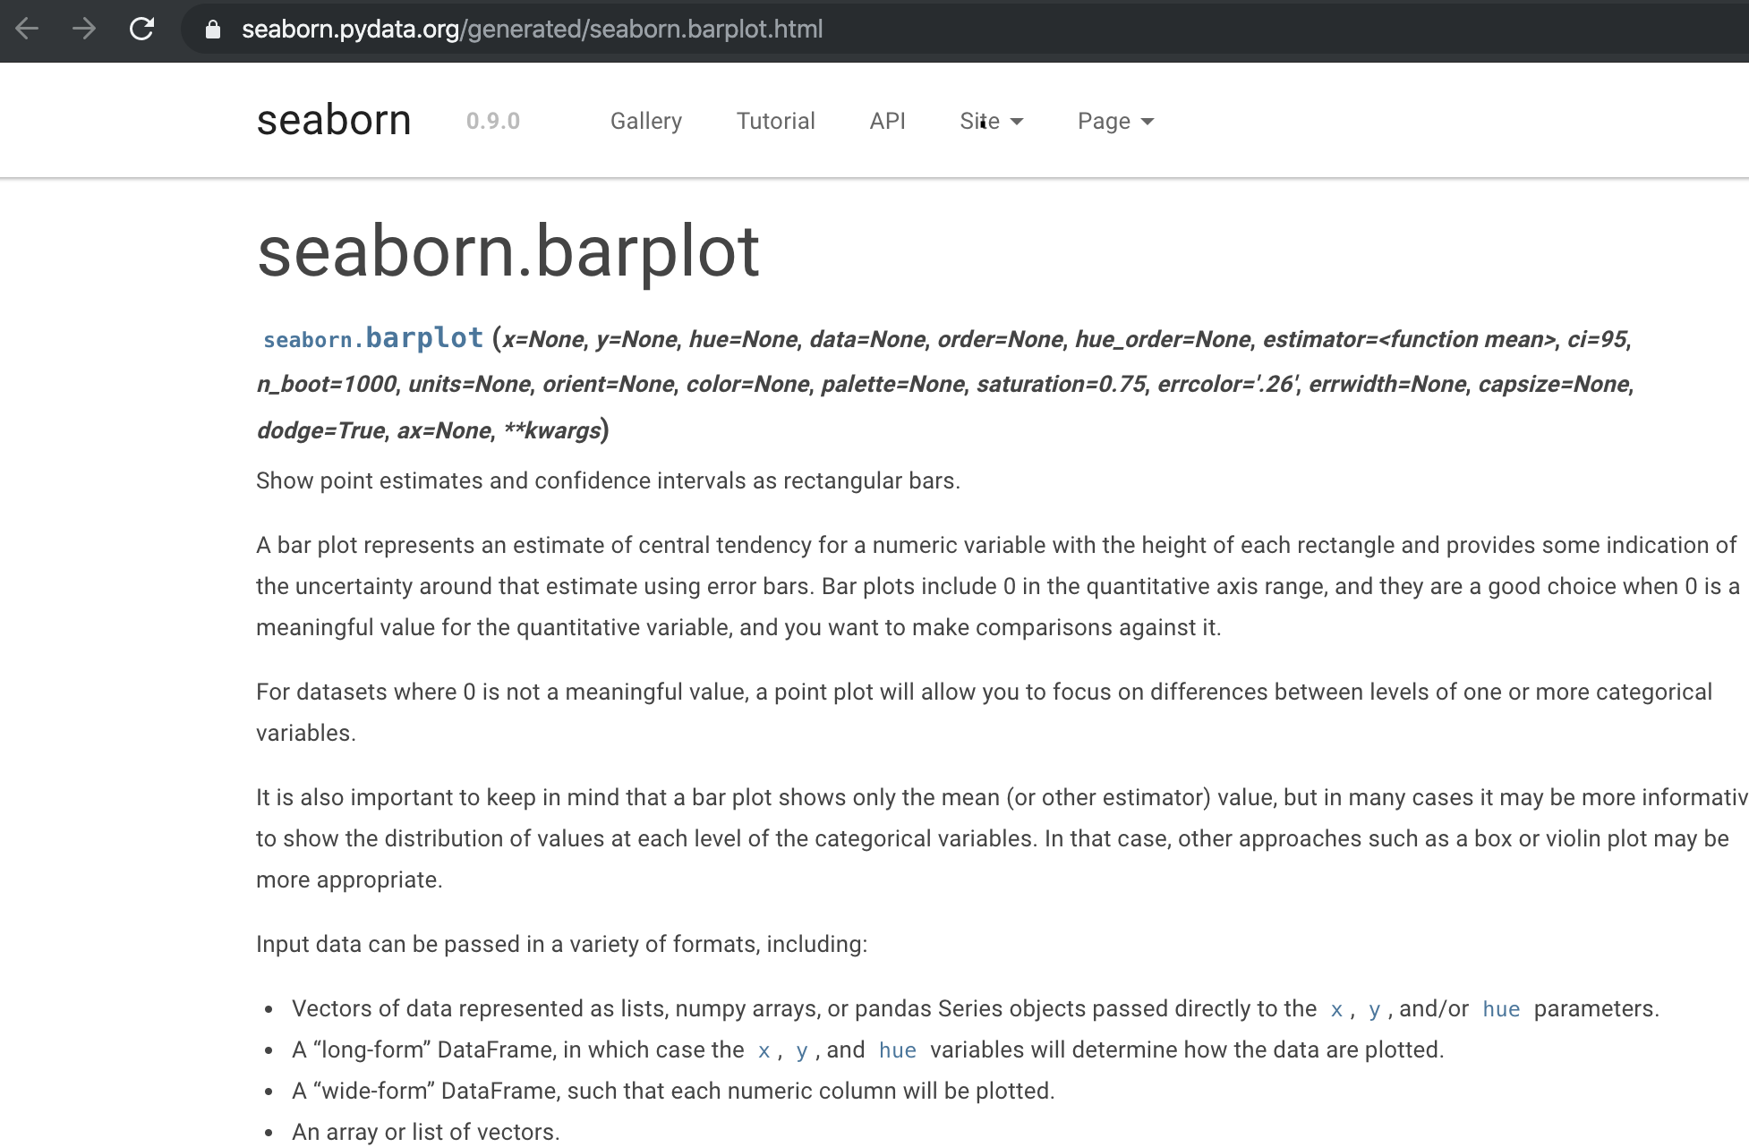
Notes:
Now if you want to know more details on the functions used, you can have a look at the libraries documentation. For example, you can see here, the marplot function from seaborn, its syntax and a detailed description.

Slide 15
SUMMARY
Python is a high-level interpreted language commonly used in many fields
Built-in data structures
Many libraries made for and working smoothly with Python
Libraries like seaborn and pandas can be used to extend its functionality for handling data and adding visualisation
Notes:
A quick summary of today’s lesson!

Slide 16

Notes:
and I will close with a positive photo, of two of the survivors of Titanic, Louis and Lola! I hope you enjoyed it.

Slide 17
Questions?
code@wizofe.uk
https://github.com/wizofe/lse-titanic
Notes:
If you have any questions, feel free to email me. All the source code, the solutions and the presentation from today can also be found on my GitHub page.

Slide 18
Thank yoU!
Notes:
Thank you for your time :)

