Slide 1
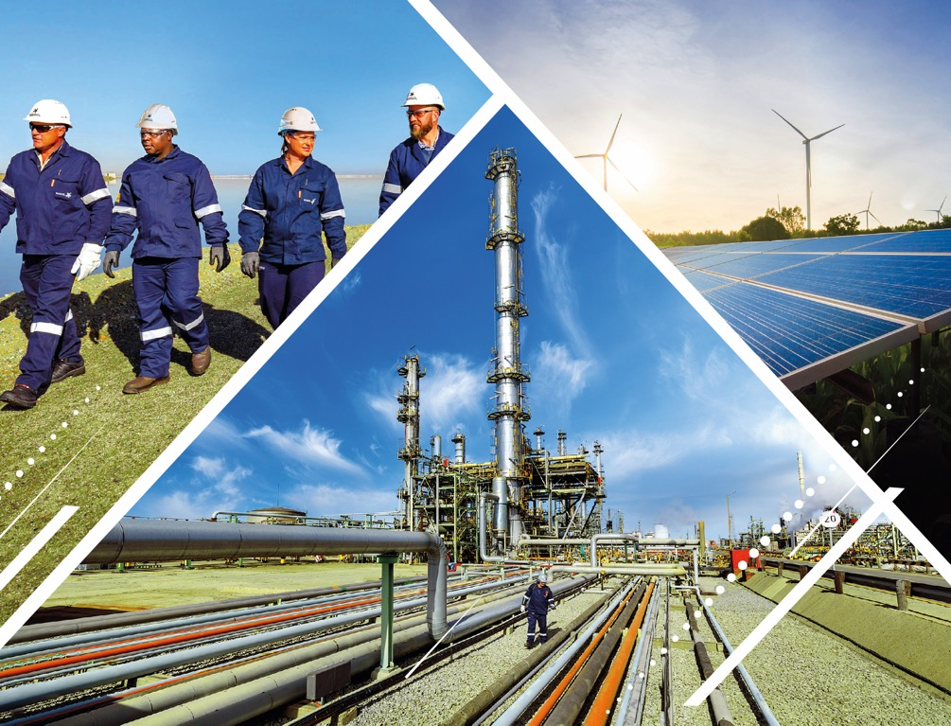
Lube Oil Systems
Tlotliso Branden Nkhahle
Gas Circuit
08/01/2025

Slide 2
Background
From December 2024 to January 2025, with the guidance of coaches Karabo and James, I focused on several key objectives which include:
Understanding the basic principle of lube oil systems
Study compressor PFDs and instrumentation loop diagrams
Learn the control and operating philosophy for LOSs in GC.
Additionally, I investigated transfer systems during normal and unusual conditions, such as power outages, and reviewed the pumps' protection settings.
And finally understanding what caused the trip of the compressors on April 19th
Notes:
My objectives included understanding the basic principles of lube systems in compressors and motors, studying compressor Process Flow Diagrams and Instrumentation loop diagrams, and learning the control and operating philosophy for lube oil control systems in GCC. I researched different types of lubrication systems for large MV motors, investigated the effects of loss of lube oil pressure, and explored methods to maintain oil pressure during normal and unusual conditions like power outages. Additionally, I investigated transfer systems for compressor lube oil, reviewed protection settings, and understood Sasol specifications and SABS standards. I also gathered information on oil accumulators, rundown tanks, and various lube oil system failures, ensuring a well-rounded learning experience.

Slide 3
Working Principle of the compressors
Compressors
023KC-203 and 023KC-204
1. Ethylene (C2H4):
2. Propylene (C3H6):
Why They Are Compressed:
1. Cooling
2. Facilitating Chemical Reactions
Notes:
Compressors are machines that increase the pressure of gases by reducing their volume. They are used in various applications, including refrigeration, air conditioning, and chemical processing.
KC203 and 204 compressors are designed to compress ethylene and propylene, respectively. Here’s a brief overview of what these substances are and why they are compressed:
Ethylene is a colourless gas that is a key raw material in producing various chemicals and plastics, including polyethylene, which is widely used in packaging, containers, and other products.
Propylene is also a colourless gas and is used as a building block for the production of polypropylene, another important plastic used in a variety of applications, including automotive parts, textiles, and packaging.
Reasons for compression - Cooling and facilitating chemical reactions: propylene is first used to cool the feeder gas down to -35 degrees then the ethylene cools the gas further down to -100 degrees which is the optimum temperature for breaking down hydrocarbons

Slide 4
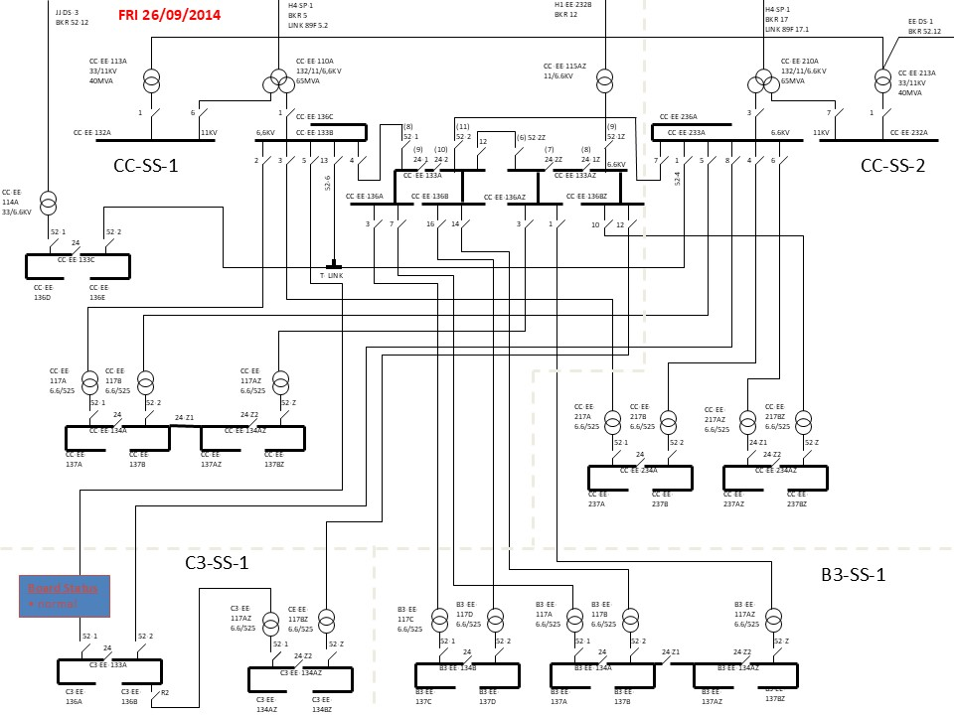
Distribution
Notes:
The Lube oil system for the compressors in question consists of 2 motors, P1A(primary) and P1B(standby) which are fed from 2 incomers. Incomer 1, our critical board H1 from our generators is primarily used as the lube oil system is a critical system and incomer 2 the H4 board from Eskom.

Slide 5
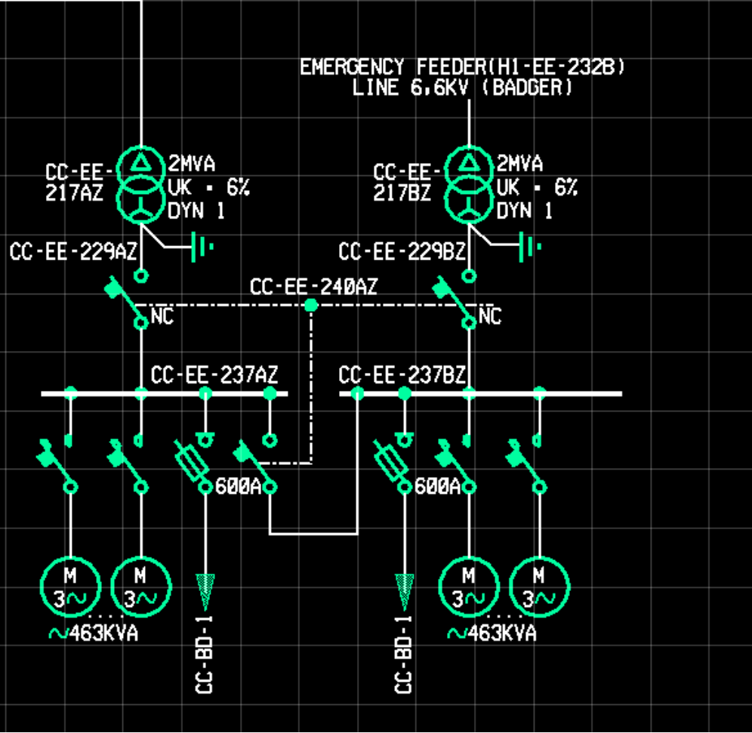
Lube Oil System (Slow transfer)
Notes:
Here I will show how the slow transfer works and why it is good idea to have a reacceleration scheme witch staggered timers in place. This slow transfer system uses the universal relay F35-60 which has the capability of detecting under voltages on either incomer. This circuit has the breaker normally closed from the emergency feeder along with the tie-breaker while the incomer from the H4 board is left normally open. In the case of under voltages, the UR executes the slow transfer which is BM, i.e. to open the breaker on incomer 1 and then close the breaker on incomer 2. The slow transfer system is good as it takes 2,5 seconds to switch the sources which allows time for the fast transfer system to take place upstream if there is a problem upstream. However without staggered timers in place, as power was down for 2,5 seconds the lube oil pressure drops and triggers the pressure switch low which triggers the standby pump to start. Then both motors will start simultaneously causing a huge inrush current which can blow the board and damage a lot of equipment.

Slide 6
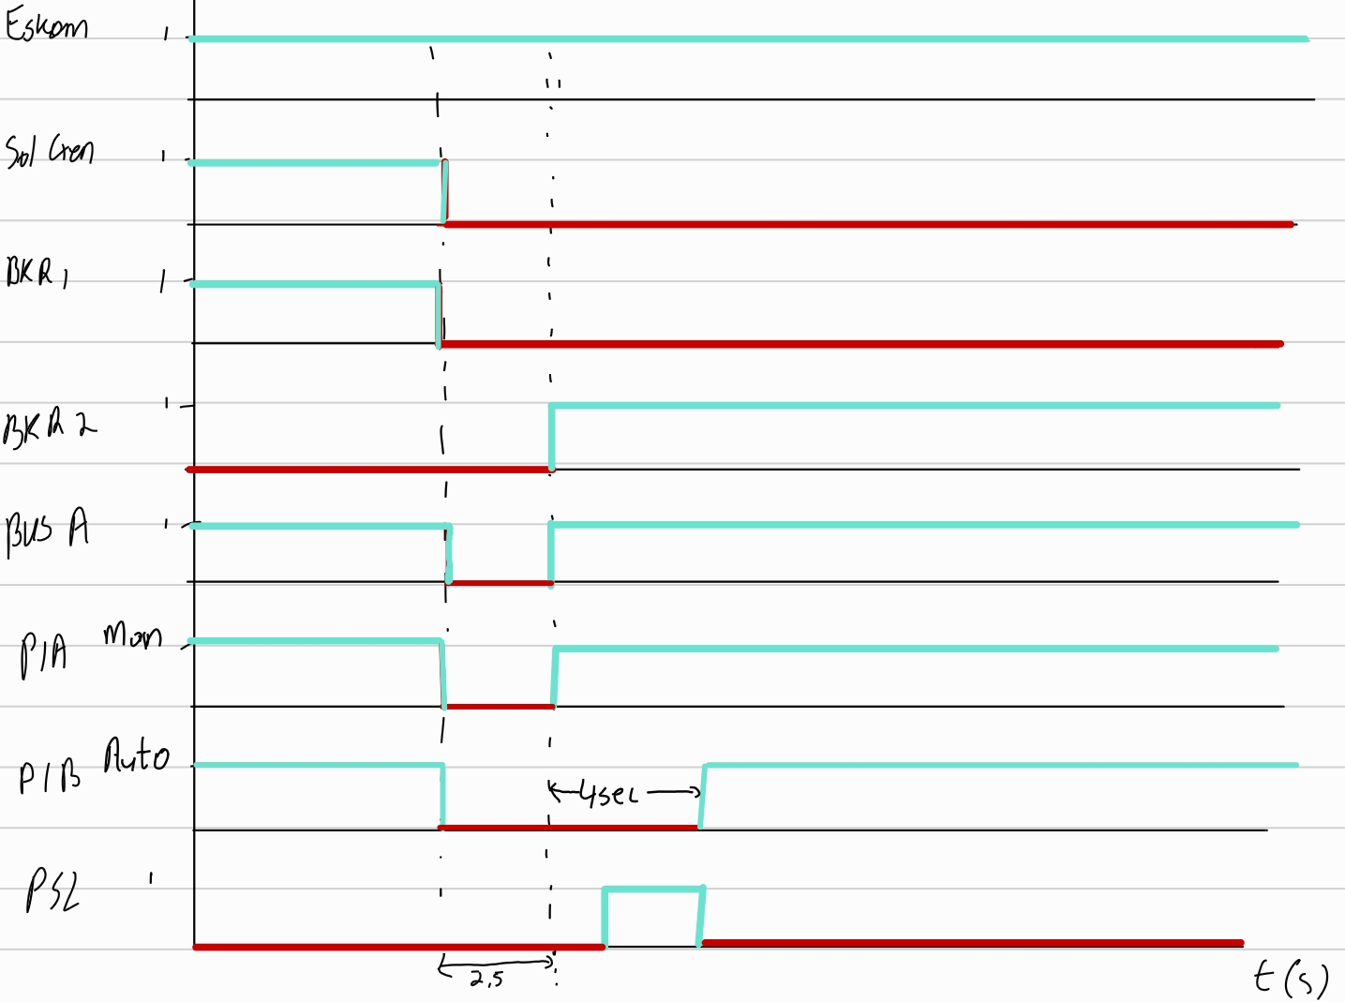
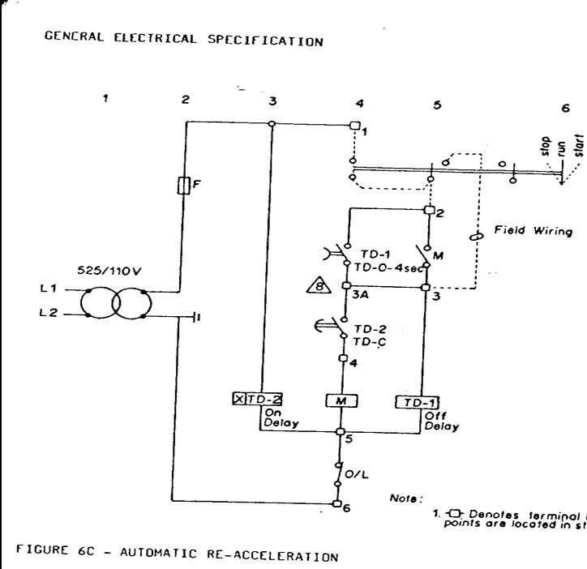
Reacceleration Scheme schematic and staggered timers

Slide 7
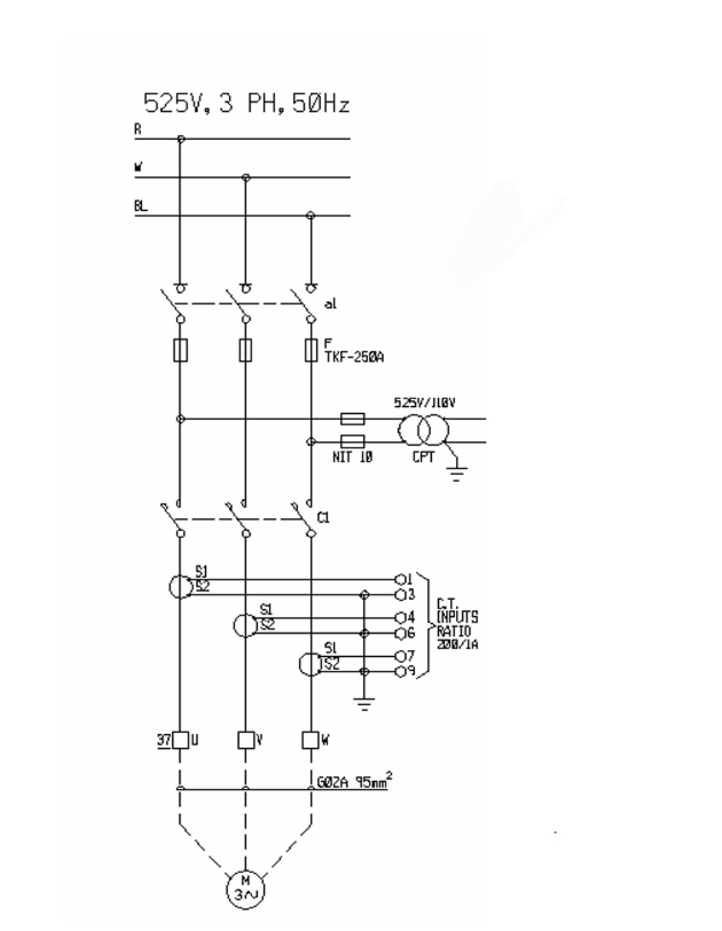
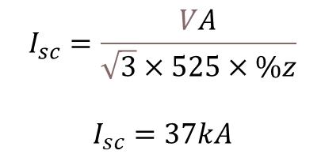
Protective measures
$$I_{sc}=\frac{VA}{\sqrt{3}×525×\%z}$$
$$I_{sc}=37kA$$
These are some of the devices used to protect the motor from the short circuit current
Fuse TKF-250A
CTs and VTs
Relays and cabling
Notes:
To protect the motor from short circuit currents I have the TKF-250A fuse that is rated 80kA which can handle the short circuit current. I also have a PVC insulated cable with a cross section area of 95 mm^2

Slide 8
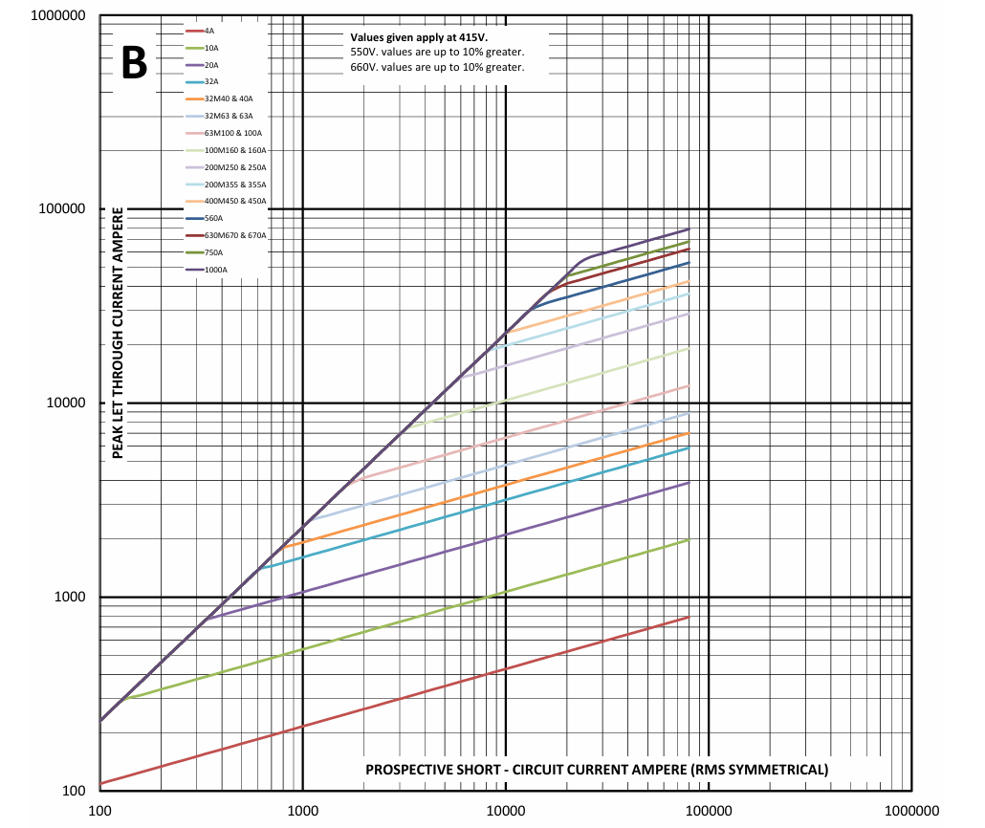
Let through current by the fuse
Notes:
From the graph I can see that the fuse TKF250A has a peak let through current of just above 20kA and a 5kA let through current

Slide 9
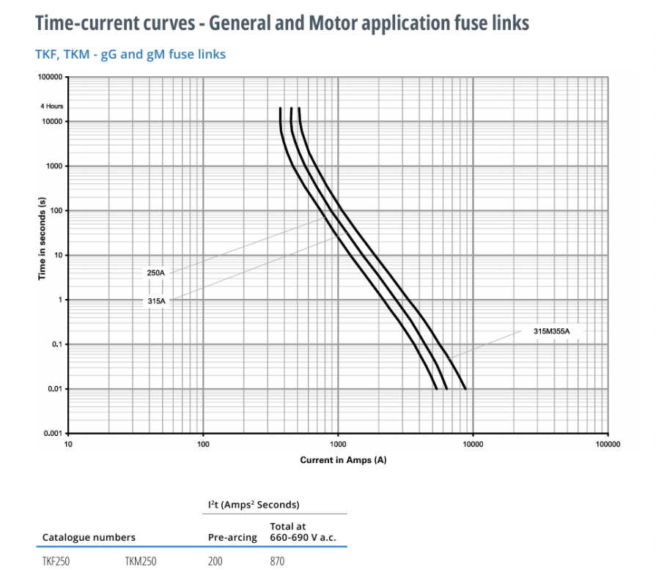
Time current curves
Notes:
From the time current curve of the 250A fuse it takes 0,01 seconds for it to fuse when letting through the 5kA current.

Slide 10

Useful Calculations
The short circuit current rating of the cable is as follows:
$$I_{sc}=k\text{×}A\text{×}\sqrt{\frac{1}{t}}$$
$$I_{SC}=115×95×\sqrt{\frac{1}{0,01}}=109,25kA$$
Therefore the chosen cables can handle the let through current from the fuse.
Notes:
where k, the material constant of PVC insulated is 115, A which is the cross-sectional area of the cable with a value of 95 mm^2 and t is time is seconds.

Slide 11
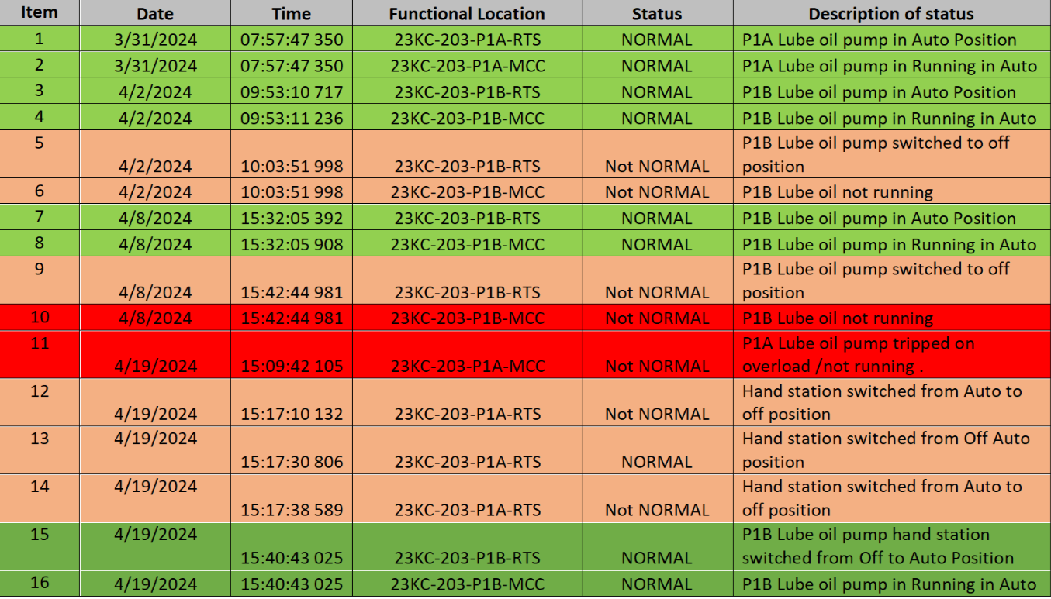
Sequence of events
Notes:
Now look at the sequence of events that led to the trip of compressor Kc-203 and 204. On the 2nd of April, the standby pump was switched off at 10 am, and it was put back to auto at 15h32 but was set to off again just 10 minutes later and was left in that state until the day of the trip. Fast forward, to the 19th at 15h09, the main pump tripped on overload and the handstation was put off about 30 minutes later the stand-by pump hand station switched from off to auto Position and the system was normal again.

Slide 12
Effects of the compressor trip on production and value chain
Production Loss of R 5,834,407,68
Maintenance Costs
Supply Chain Disruptions
Notes:
The incident involving the compressor trip and the associated lube oil pump failures can significantly impact the value chain in several ways. Here’s an explanation of how such incidents can affect various aspects of the value chain:
1. Production Loss:
o The immediate effect of the compressor trip was a production loss amounting to R 5,834,407.68. This loss directly affects the output of the facility, leading to reduced availability of products for customers and potential delays in fulfilling orders.
2. Maintenance Costs:
o The incident necessitates additional maintenance activities, including inspections, repairs, and potential upgrades to the systems involved. Increased maintenance costs can strain budgets and divert resources from other critical areas, impacting overall financial performance.
3. Supply Chain Disruptions:
o Production delays can lead to disruptions in the supply chain, affecting the availability of products for customers. This can result in missed delivery deadlines, which may damage relationships with suppliers and customers, leading to potential loss of future business

Slide 13
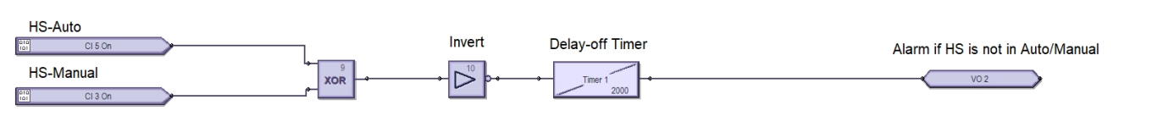
Recommendations
Set up an alarm system that warns Control of the Standby pump not being on auto for longer than 10 minutes.
Notes:
. Control already has a system that updates them of the status of the pumps so it should be easy to set a timer for when the status of the standby pump is not normal that will trigger an alarm so that the standby pump is not off for a long time.

Slide 14

Questions

