Slide 1
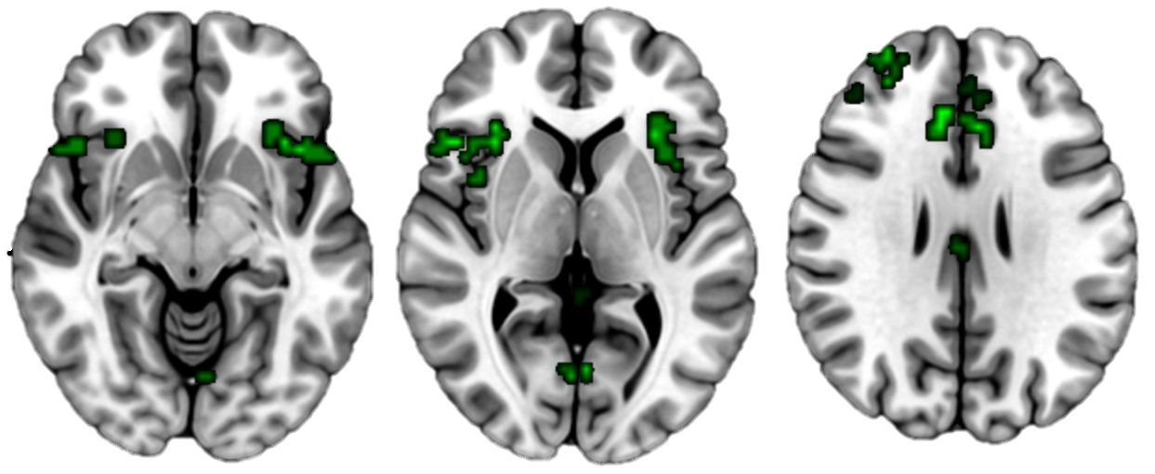
OFC
vlPFC
AI
dlPFC
dACC
IFG
Slice Z-Coordinates:
-08
04
28

