Slide 1





 | F99 Phase |  |  |  | K00 Phase
 | Fall 2023 / Spring 2024 |  | Fall 2024 / Spring 2025 |  | Fall 2025 - 2029
Career Milestones | Contact Potential Post-Doc Mentors |  | Graduate |  | Begin Post-Doc Position | Apply for R01 Jobs
Research & Writing | Start Specific Aim 1 |  | Complete Specific Aim 1 and Follow-Up Analyses |  | Start Specific Aim 2
 |  |  |  |  | Publish Dissertation | Write and Submit Papers
 | Draft Dissertation |  | Complete Dissertation
 |  |  |  |  | Review Papers | Apply for K99/R00
Conferences & Workshops | Flux CCN SANS | MiNDs, Kavli, Neurohackademy | Flux CCN SANS | MiNDs, Kavli, Neurohackademy | Flux, CCN, SANS (yearly), CN Workshops
Teaching & Mentoring | COG Introductory Coding Bootcamp & Summer Workshop Series |  | COG Introductory Coding Bootcamp & Summer Workshop Series |  | Recruit mentees for research experience
 |  |  |  |  | Train mentees in computational methods
 | COG NIH Meter Grant Application |  | COG Hackathon Series
 |  |  |  |  | Host workshops at Post-Doc Institution; Share resources publicly
Professional Development | Ethics Course at CHOP |  | Organize SANS Symposium |  | Organize Flux Symposium

Slide 2
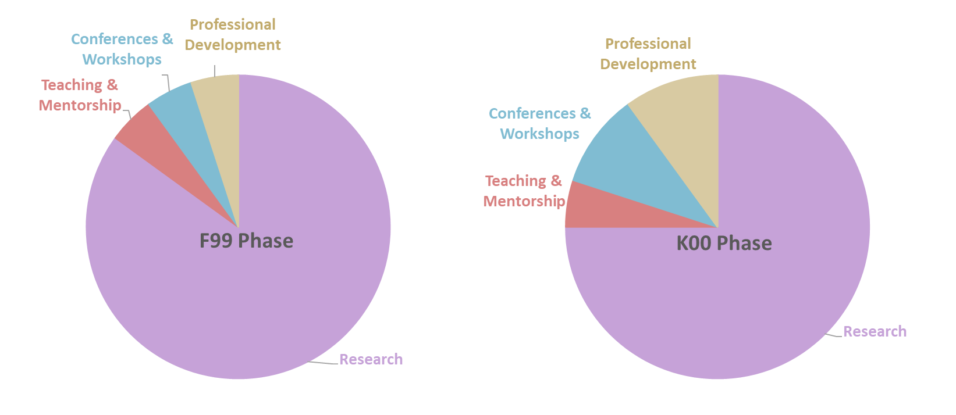
05%
05%
10%
05%
10%
05%
75%
85%

