Slide 1
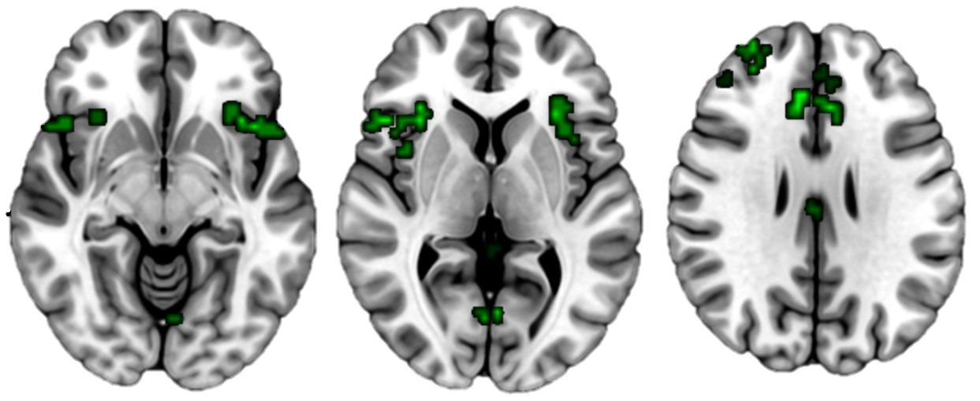
IFG
AI
dlPFC
dACC
PCun
Slice Z-Coordinates:
-08
04
28

