Slide 1
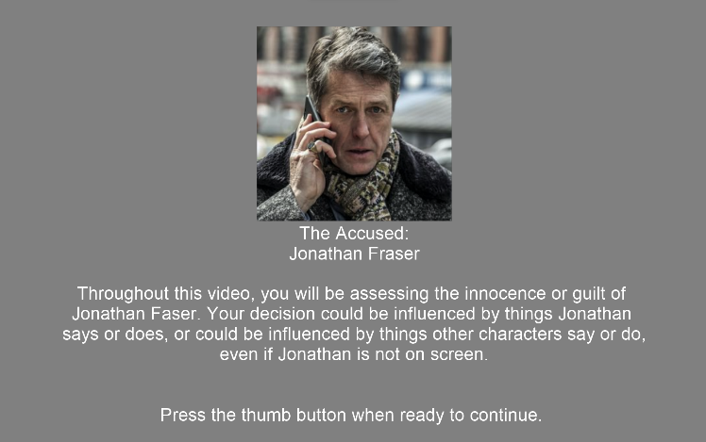
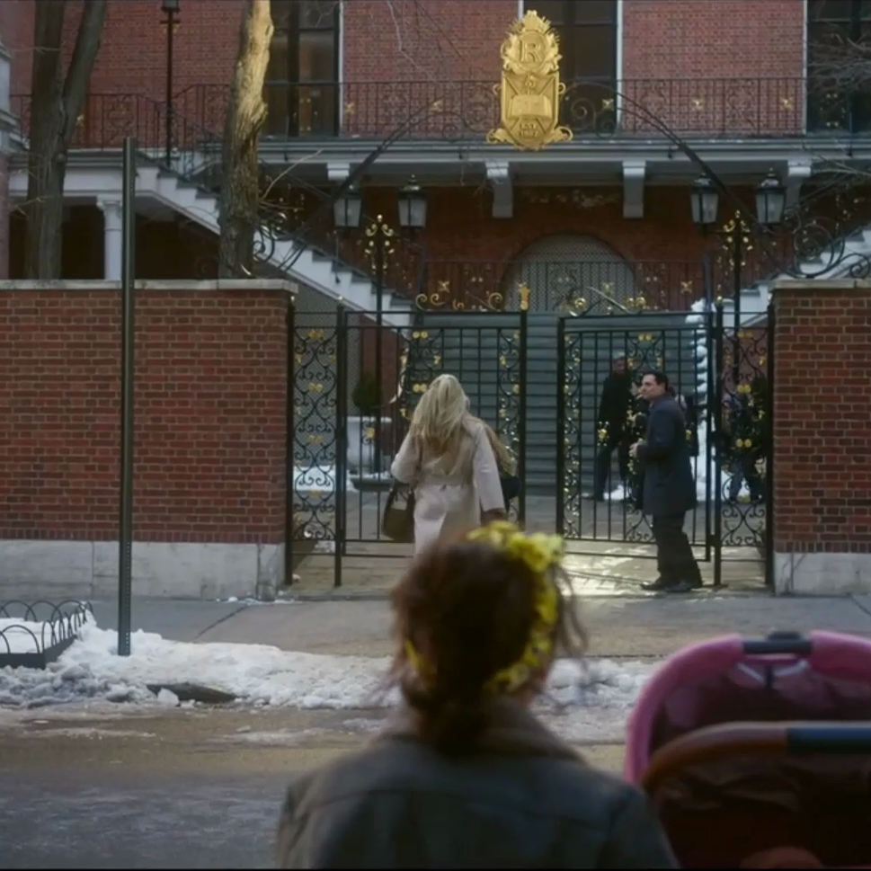
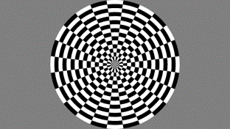
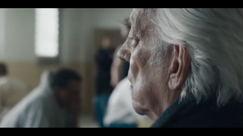
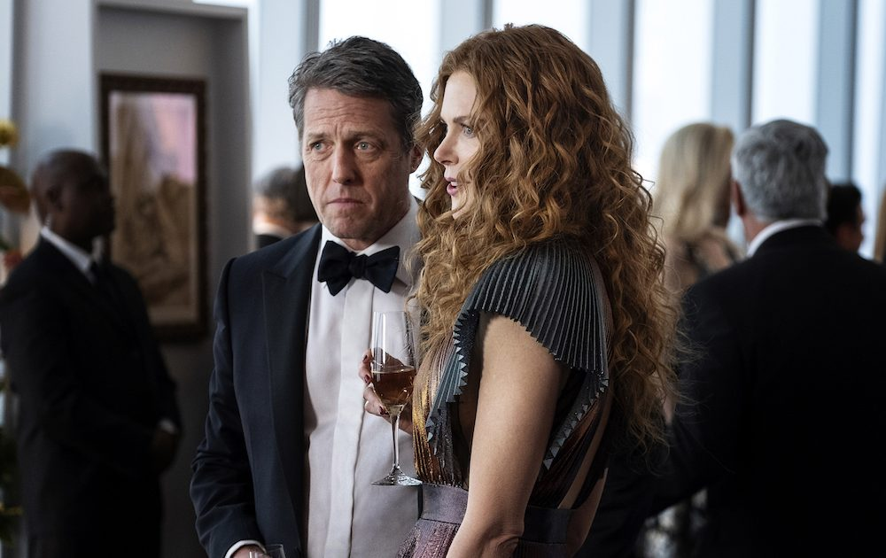
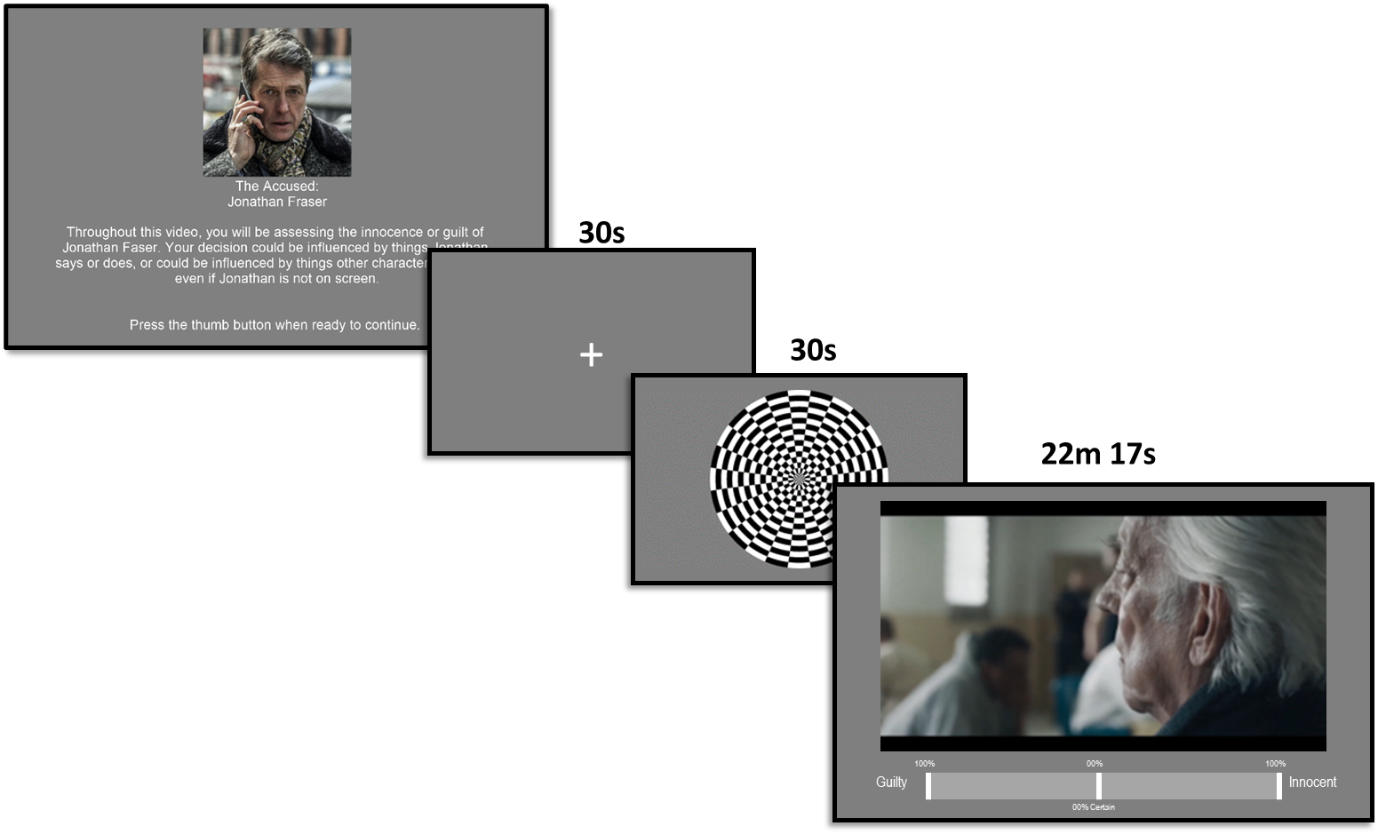




_{The Target Image}
Using the same buttons and scale that you had used in the previous task, please indicate from moment to moment how certain you are that what you see on screen is either brighter or darker than our target image
30s
+
30s
5m
UNCERTAINTY TASK
Darker
100%
00%
100%
Brighter
00% Certain
2 RUNS
~10 min
~20 min

Slide 2
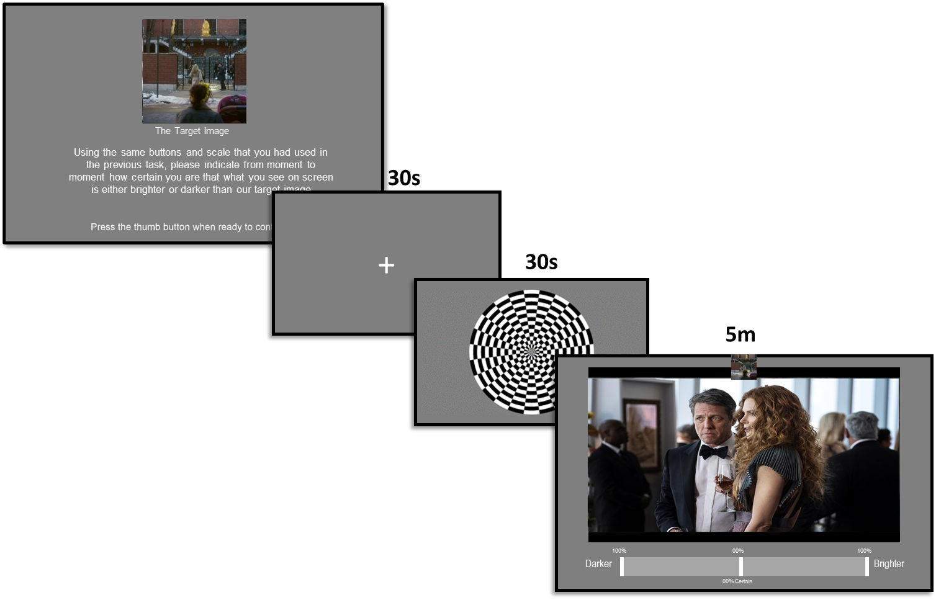
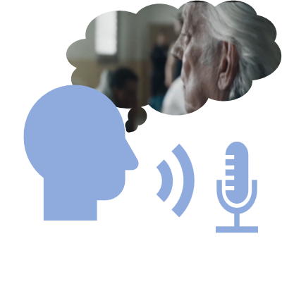


SOCIAL AMBIGUITY TASK
2 RUNS
PERCEPTUAL AMBIGUITY TASK
FREE
RECALL TASK
INDIVIDUAL
DIFFERENCE MEASURES

