Slide 1
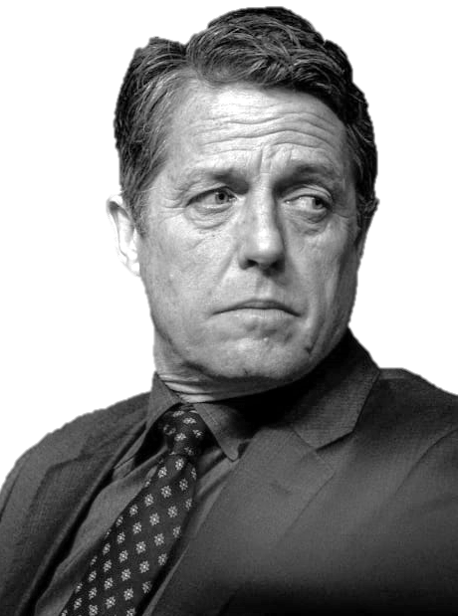


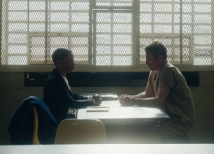
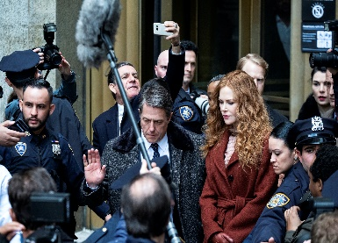
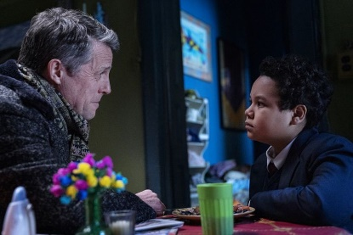
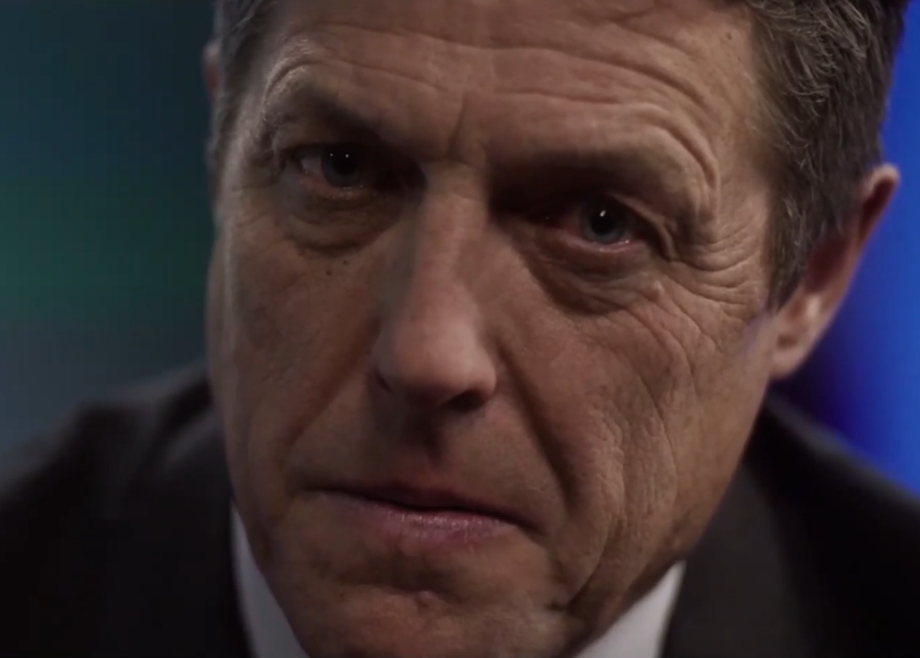


Social Uncertainty
Is Jonathan guilty?
100% Certain
100% Certain
Guilty
Innocent
Notes:
I’d already covered our primary task exploring social uncertainty,

Slide 2
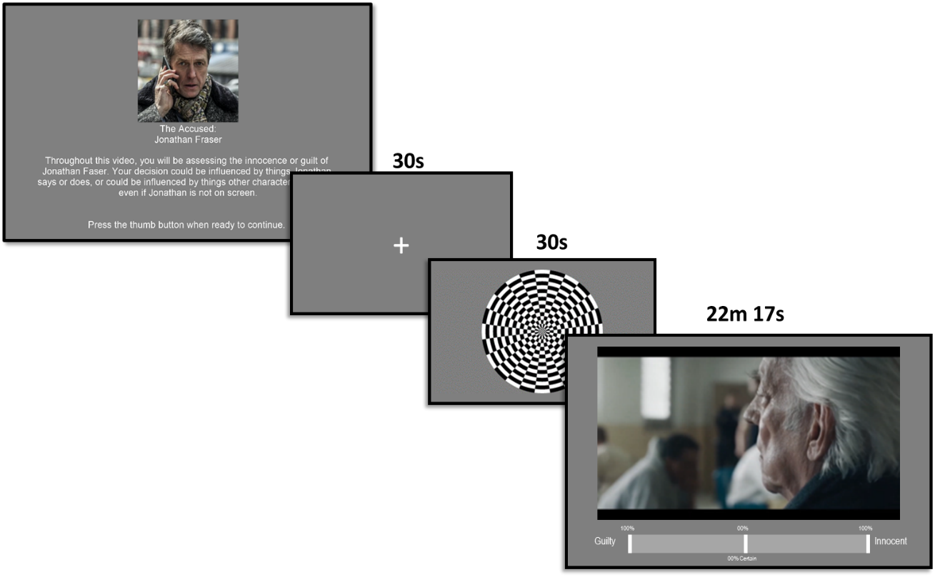
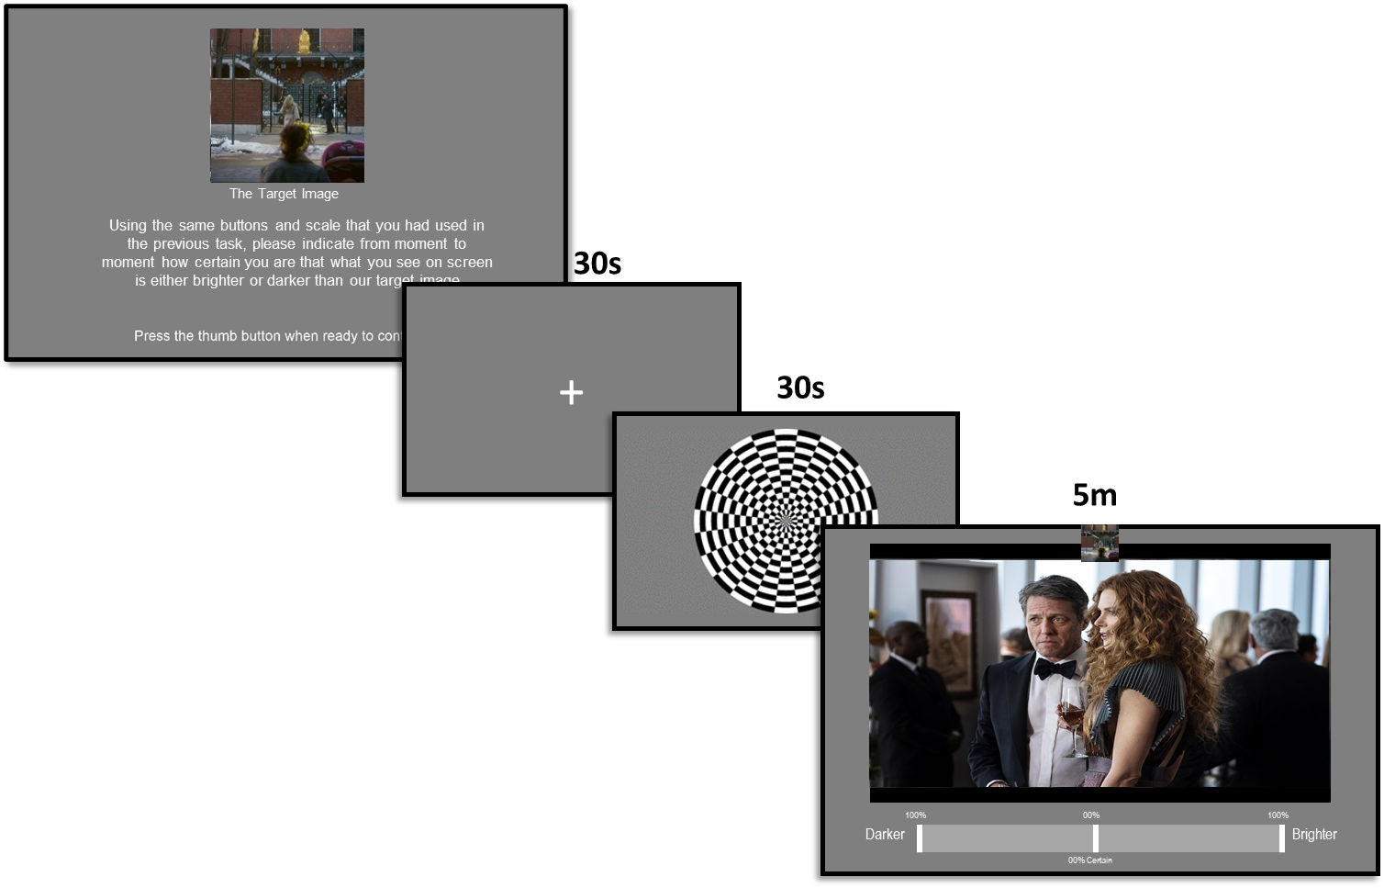










SOCIAL UNCERTAINTY
2 RUNS
PERCEPTUAL UNCERTAINTY
X 1
SURPRISE
FREE RECALL
INDIVIDUAL
DIFFERENCE MEASURES
Social Uncertainty
Is Jonathan guilty?
100% Certain
100% Certain
Guilty
Innocent
Notes:
I’d already covered our primary task exploring social uncertainty,

Slide 3
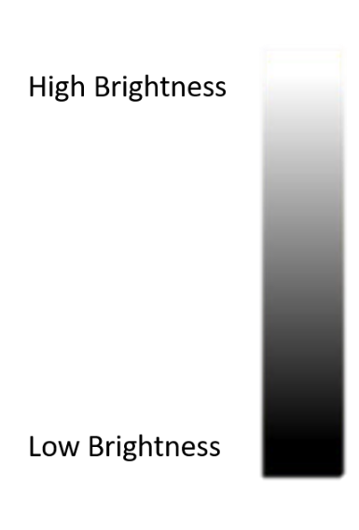
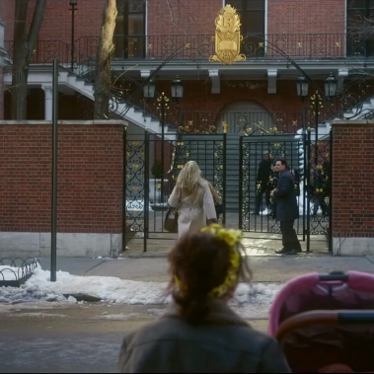
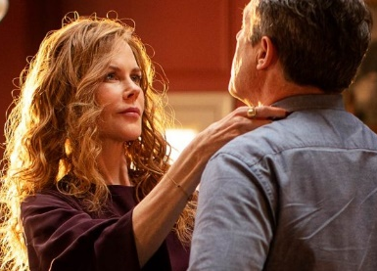
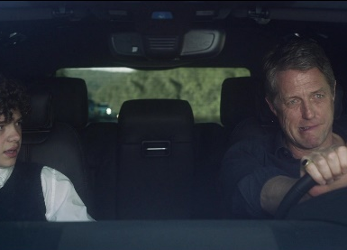
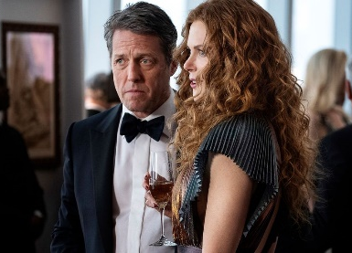
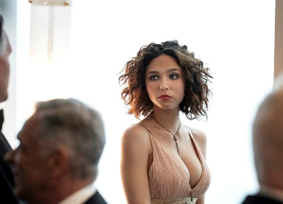
Perceptual Uncertainty
Is the current frame brighter than this image?
100% Certain
100% Certain
Darker
Brighter
Notes:
But we also had participants complete a run of our control task.
Rather than tracking certainty of guilty or innocence
we ask them to track the luminance of the video, frame by frame,
and indicate how certain they are the current frame is brighter or darker than a target image,

