Slide 1
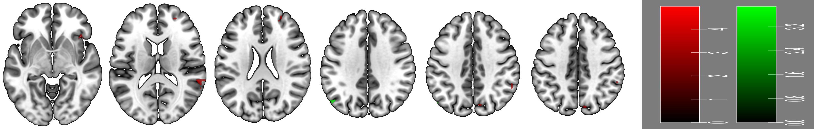
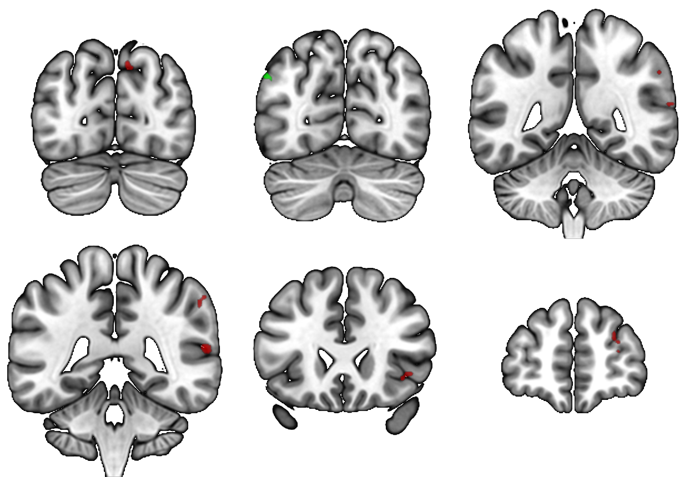
-78
-71
-48
5.0
3.9
SMG
pCUN
AG
L
R
Reflective Non-Rating > Expressive Non-Rating
Expressive Non-Rating > Reflective Non-Rating
IPL
dPFC
TPJ
AI
-42
+24
+54
0.0
0.0

