Slide 1
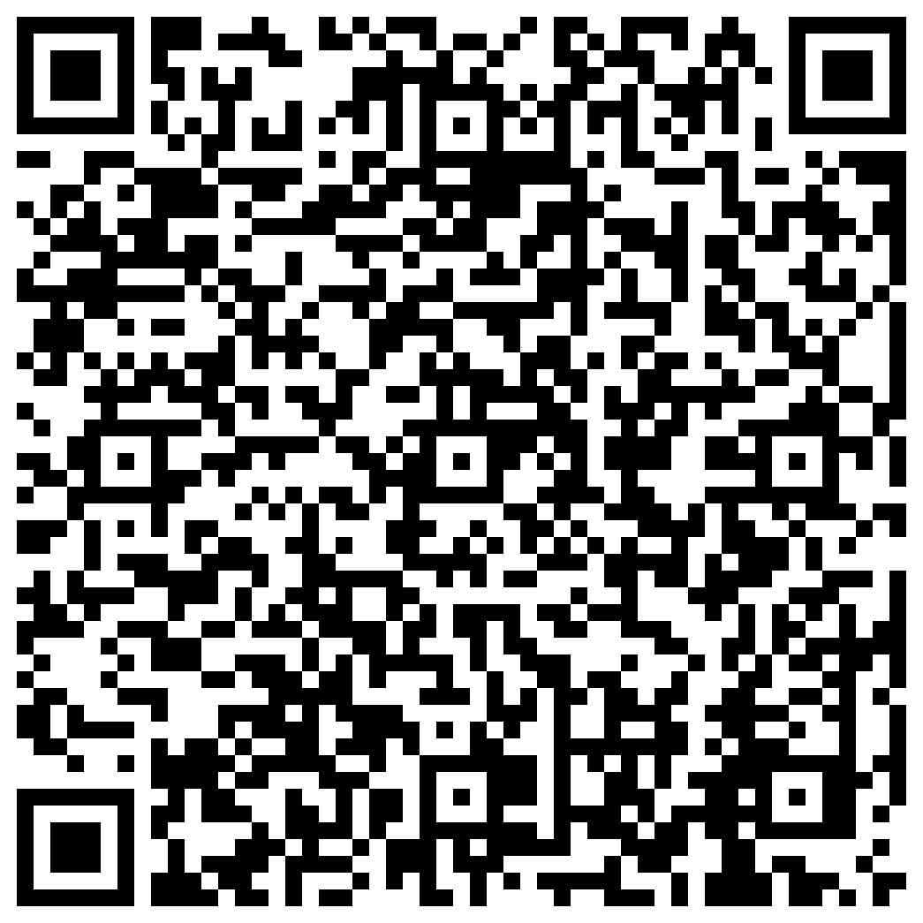

Participate in psychology research!
Please use the QR code to sign up!
How do we form judgements of people
and things around us?
To answer this question, our research study asks participants to make judgments of characters within popular television shows while undergoing functional magnetic resonance imaging (fMRI).
Eligible participants must be fluent- or native-English speakers between the ages of 18 and 85 without magnetic metals in their body.
Participation may take up to 2.5 hours
Receive up to $65.00 in gift cards with a chance to earn a cash bonus payment based upon performance!
Or email us at sanlab@temple.edu
Social and Affective Neuroscience Lab: Chelsea Helion, PhD.

