Slide 1
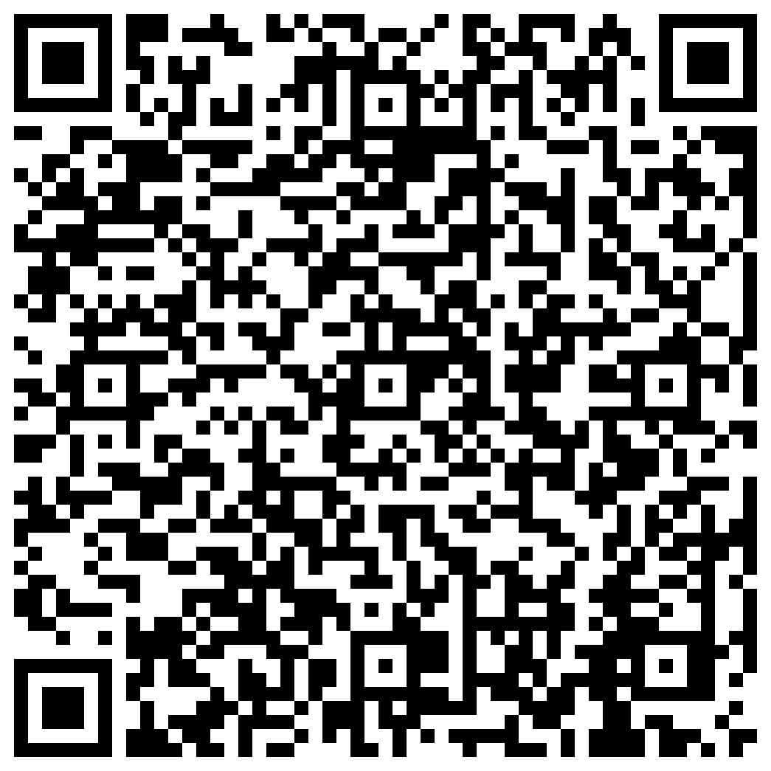

Participate in psychology research!
Please use the QR code to sign up!
How do we form judgements of people
and things around us?
To answer this question, our research study asks participants to make judgments of characters while watching episodes of popular television shows.
Eligible participants must be fluent- or native-English speakers between the ages of 18 and 85.
Participation may take up to 1 hour
Receive up to $10.00 in gift cards!
Or email us at sanlab@temple.edu
Social and Affective Neuroscience Lab: Chelsea Helion, PhD.

