Slide 1
Method Area
Stack
Heap
static
ob2
c
d
ob1
ob2
c
Exam
ob1
d
y
20
sum
args
x
10
0
10
multi
args
1
20

Slide 2
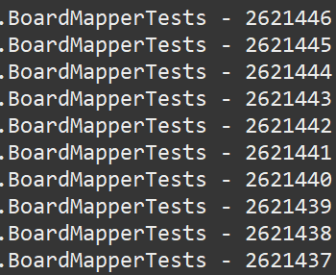
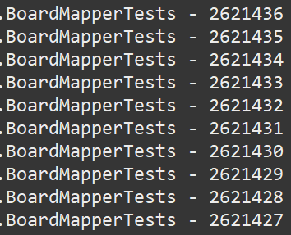
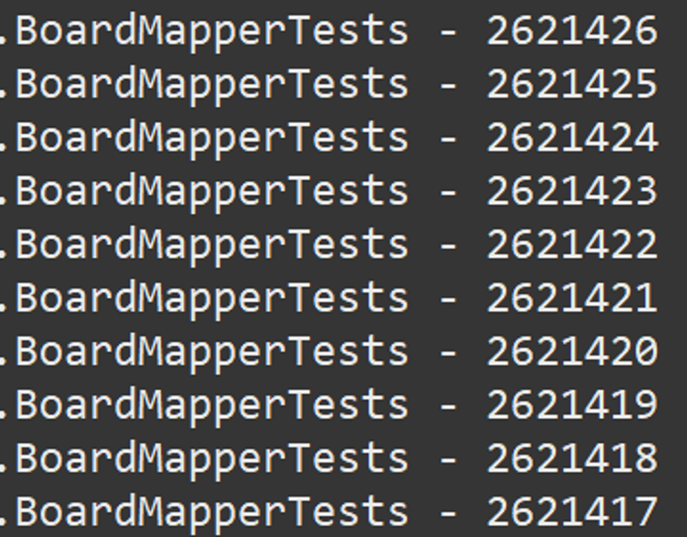
dataSourceConfig
dataSource
sqlSessionFactory
TimeMapper
cri.setPageNum(1);
cri.setAmount(10);
cri.setPageNum(2);
cri.setAmount(10);
cri.setPageNum(3);
cri.setAmount(10);

Slide 3
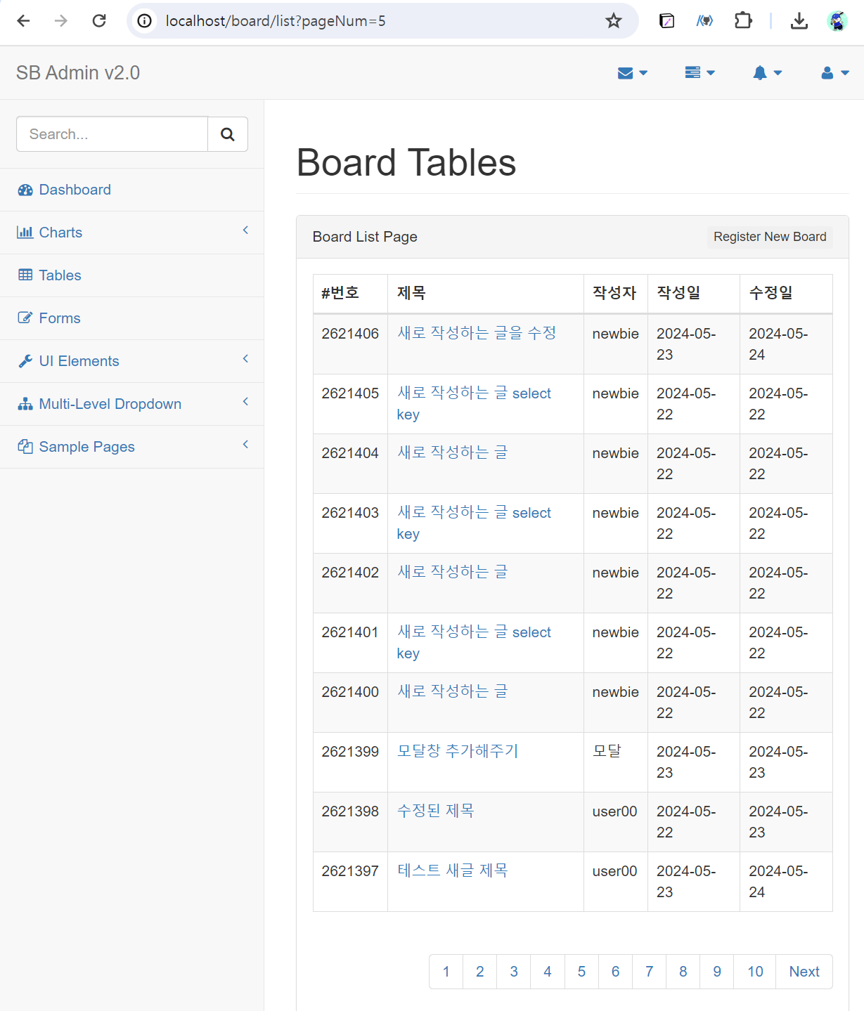
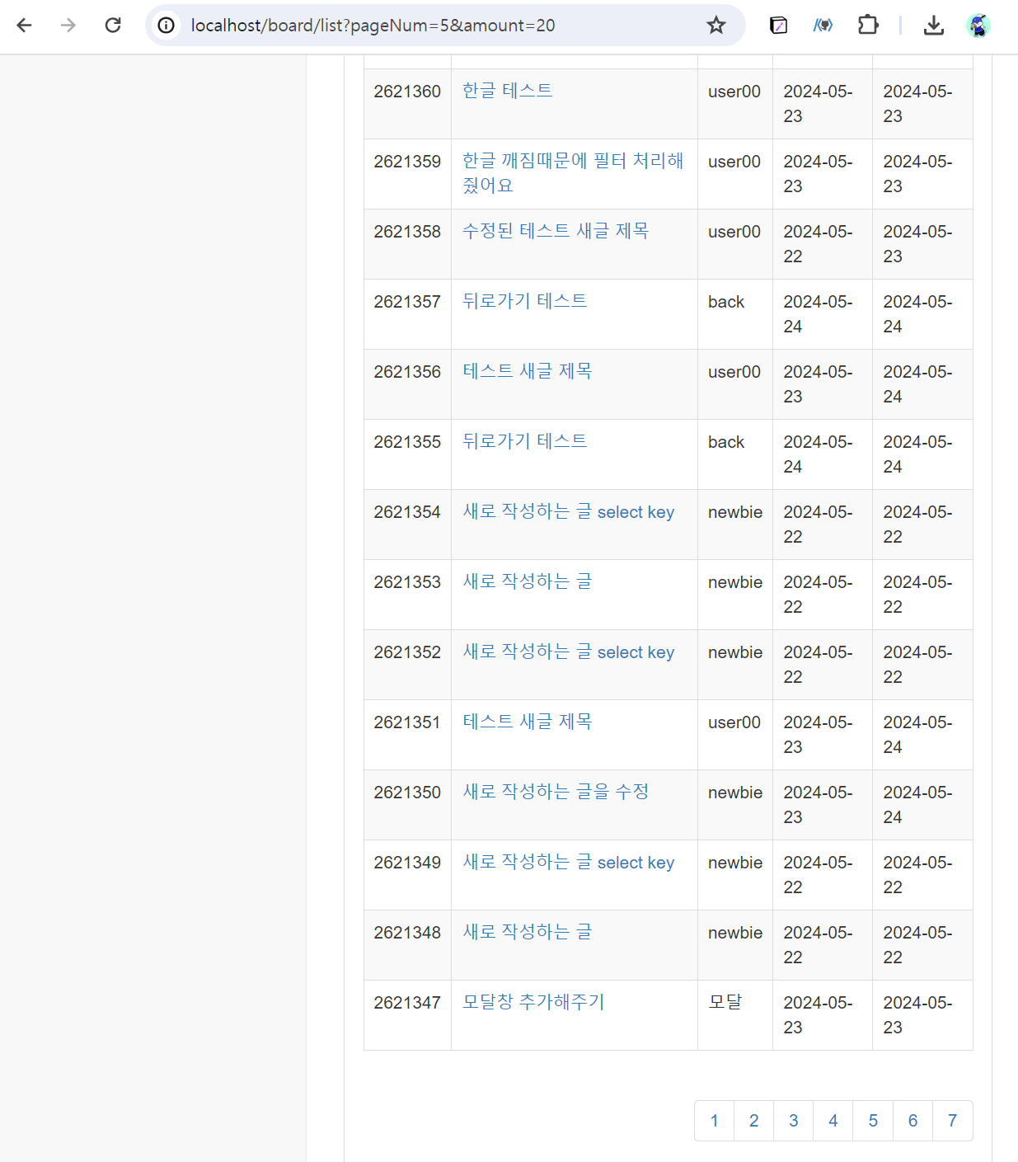
http://localhost/board/list?pageNum=5
http://localhost/board/list?pageNum=5&amount=20

Slide 4
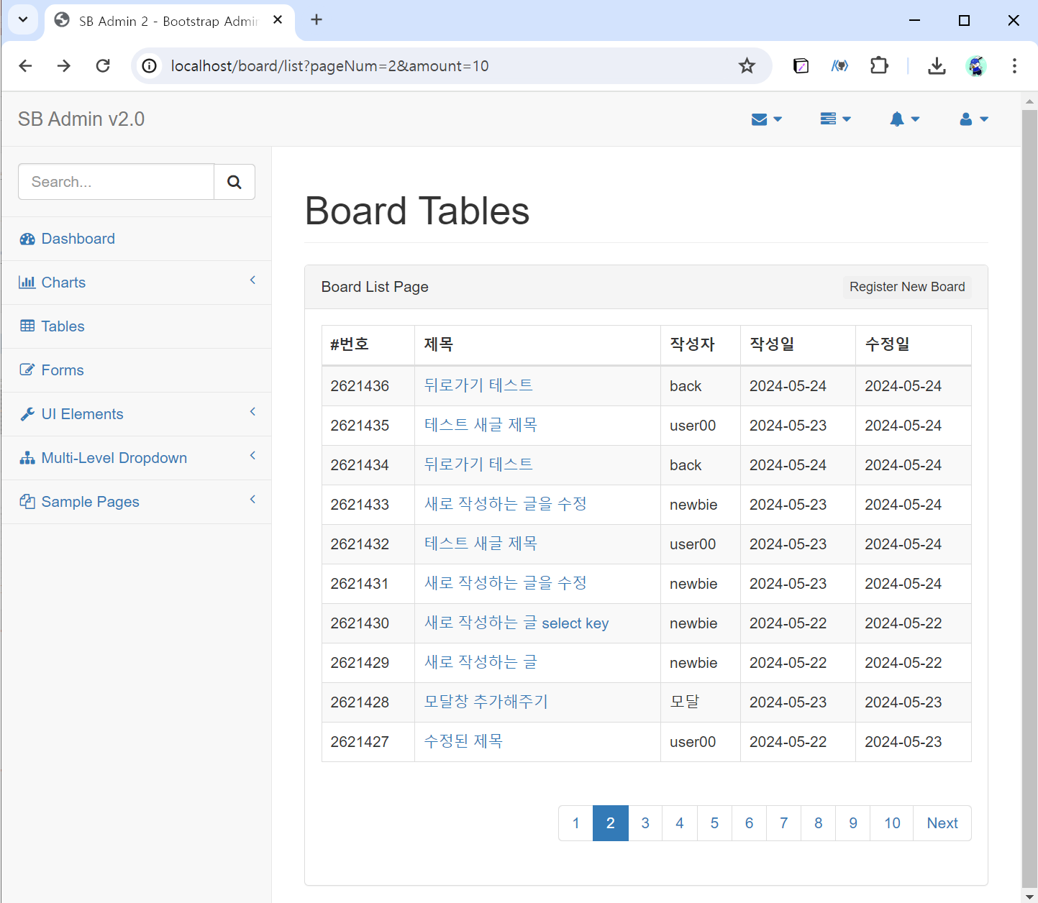
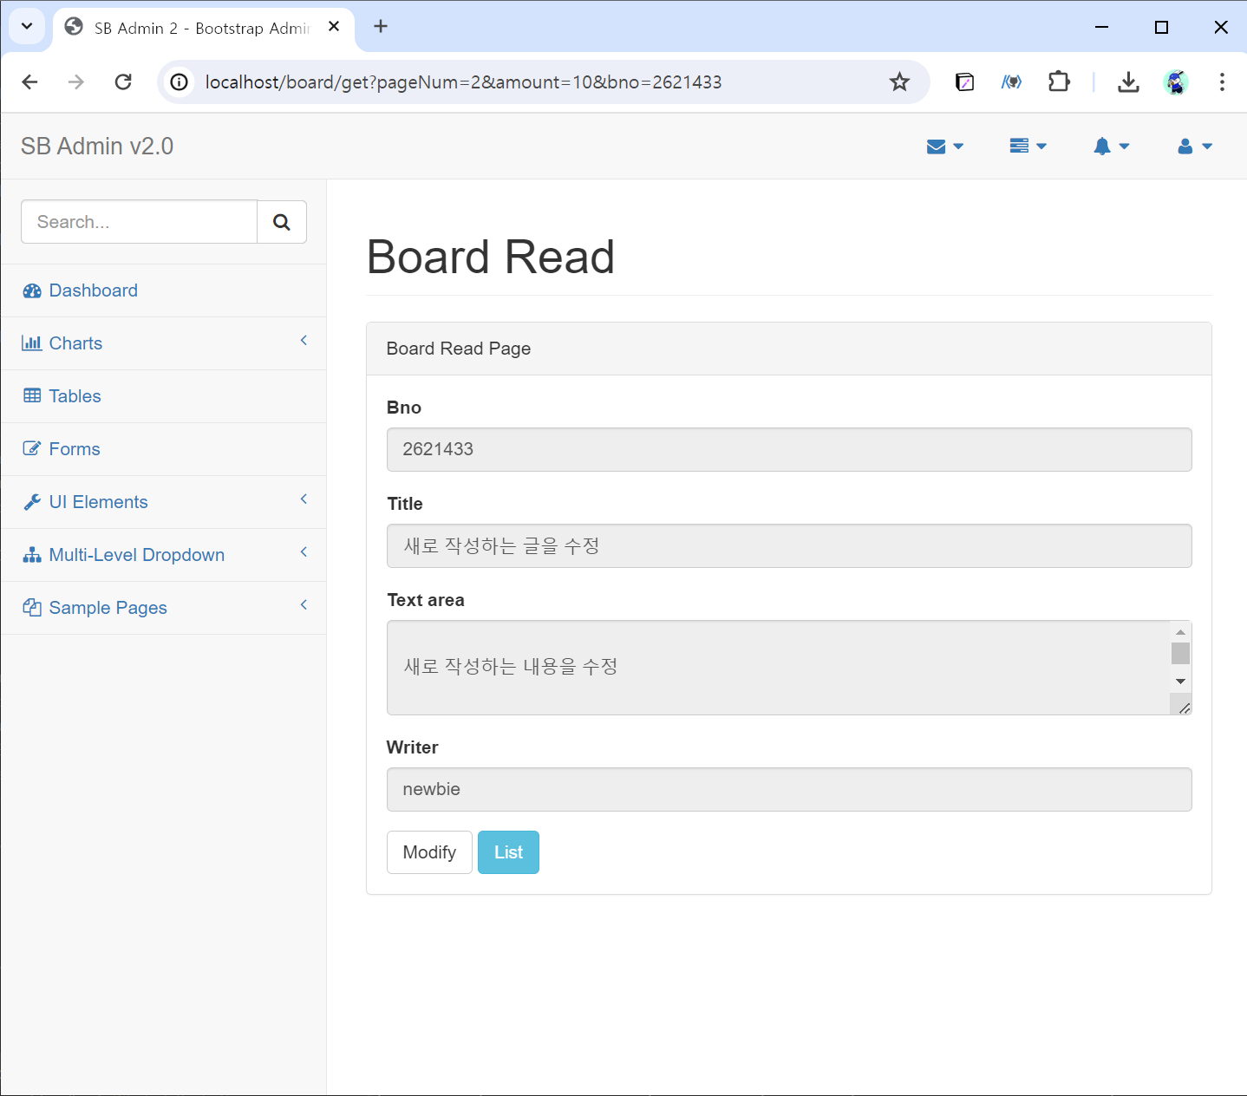
http://localhost/board/list?pageNum=2&amount=10
http://localhost/board/get?pageNum=2&amount=10&bno=2621433

Slide 5
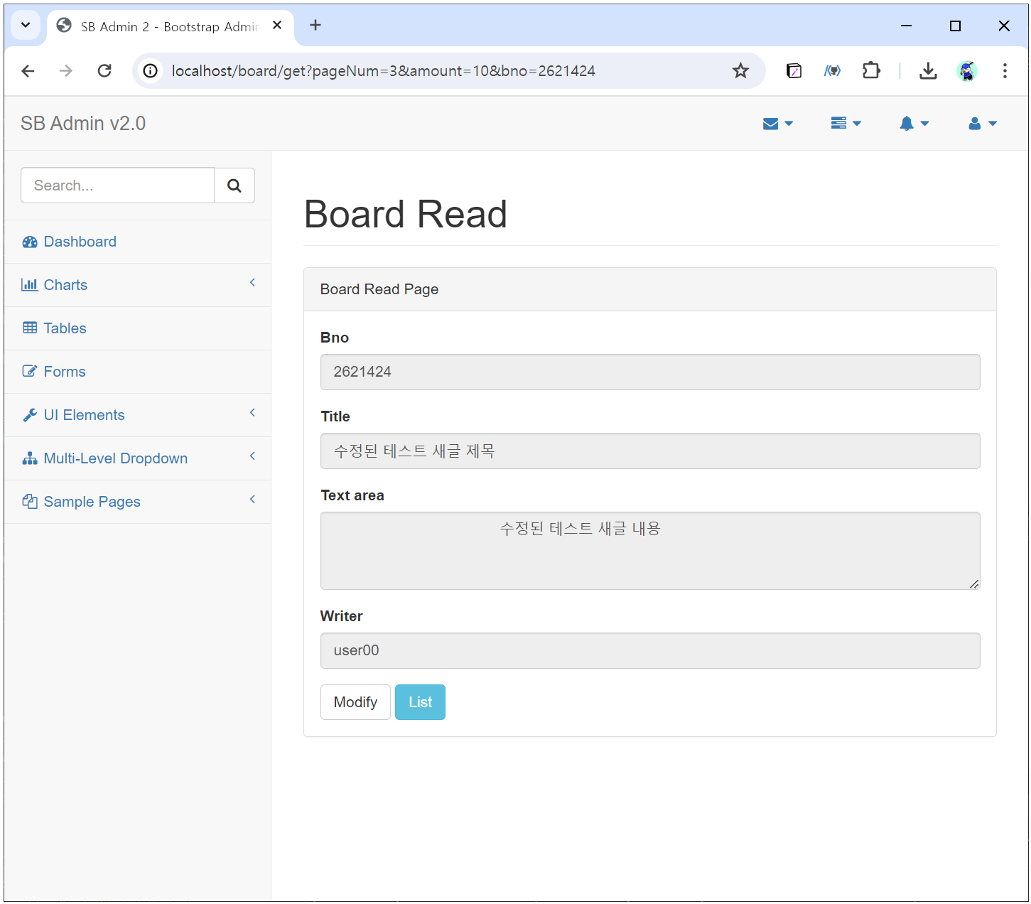
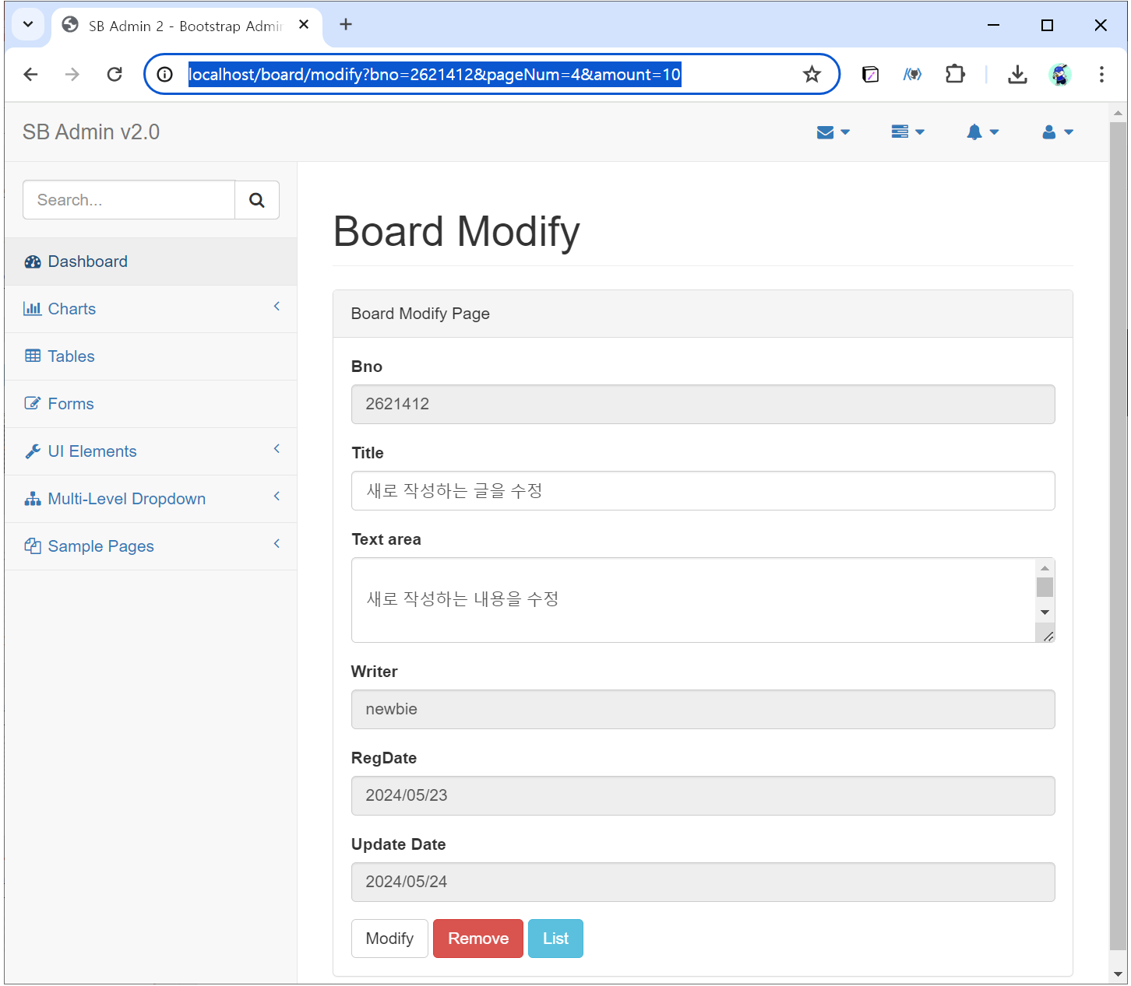
http://localhost/board/get?pageNum=4&amount=10&bno=2621412
http://localhost/board/modify?bno=2621412&pageNum=4&amount=10

Slide 6
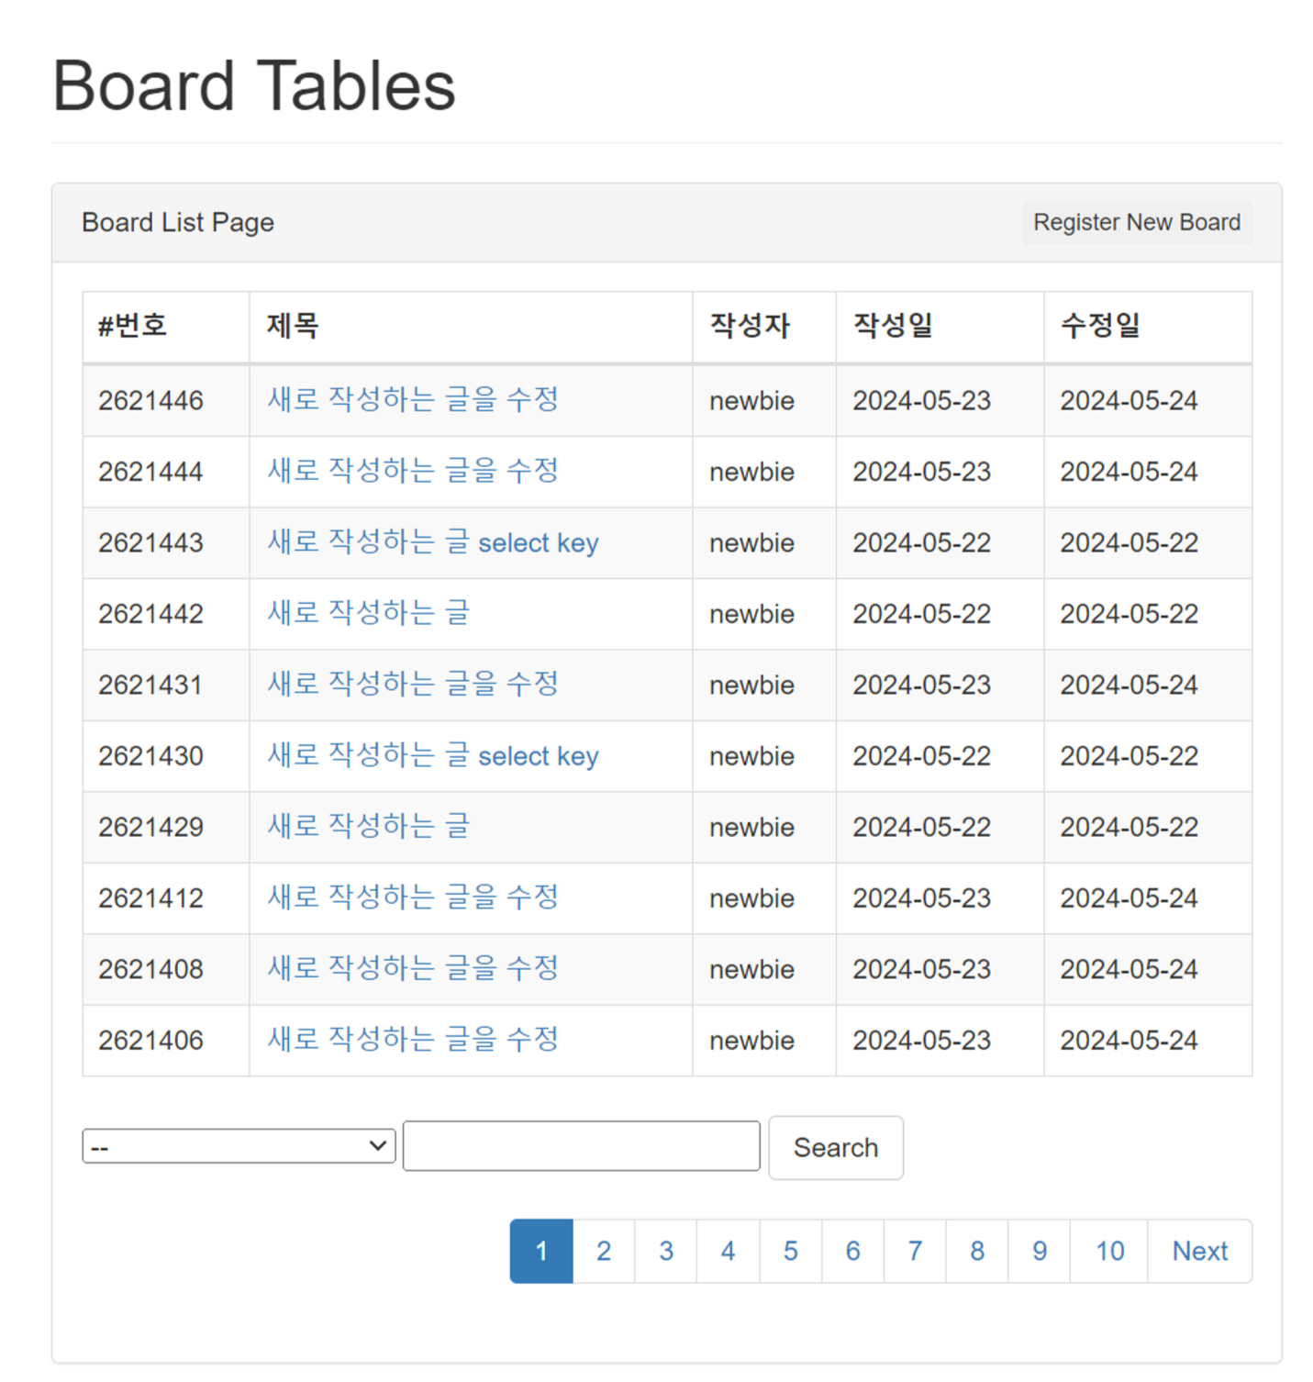
http://localhost/board/list?type=T&keyword=%EC%9E%91%EC%84%B1%ED%95%98%EB%8A%94&pageNum=1&amount=10

Slide 7
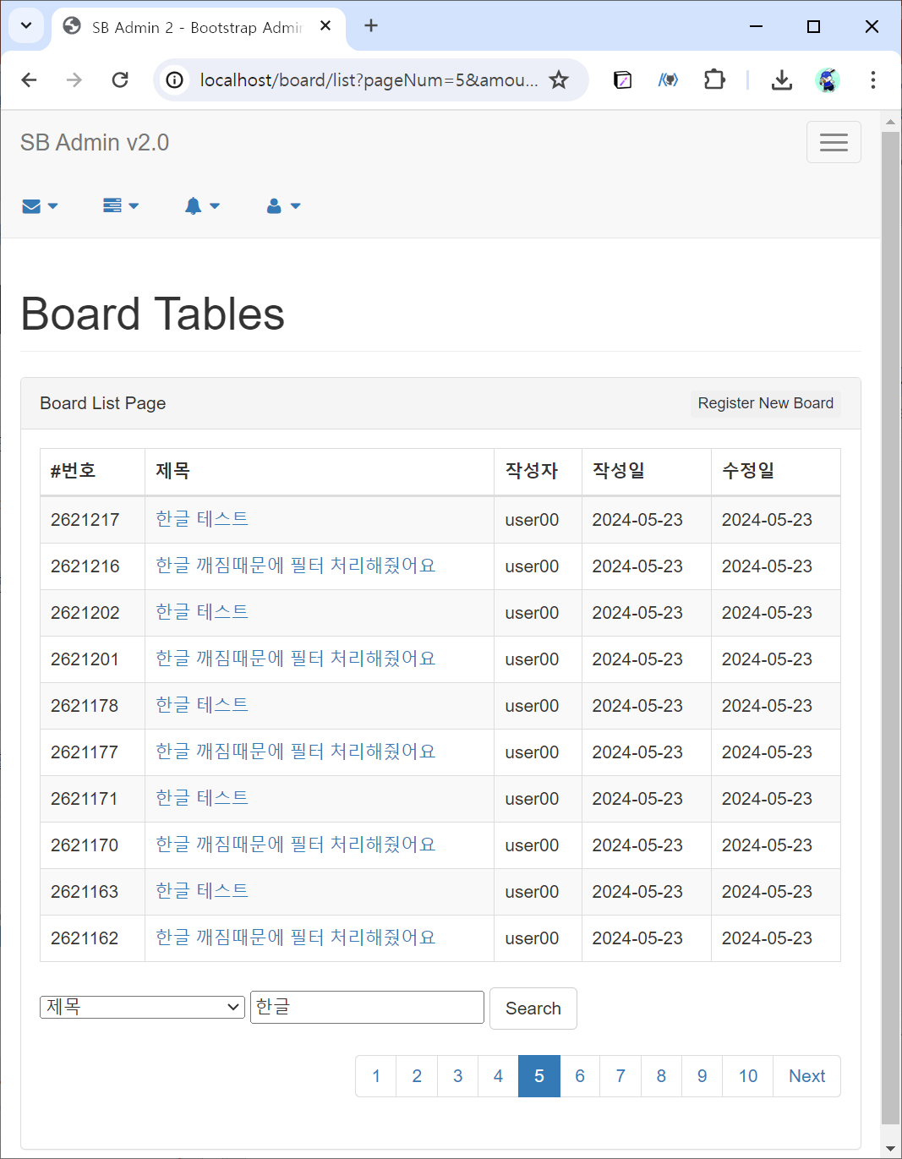
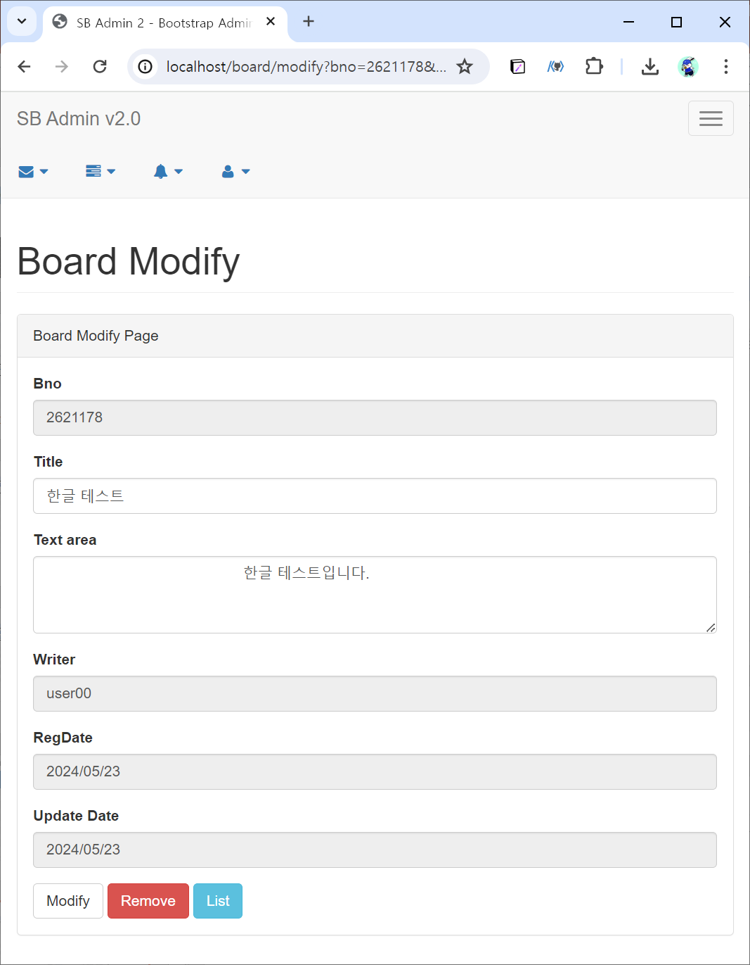
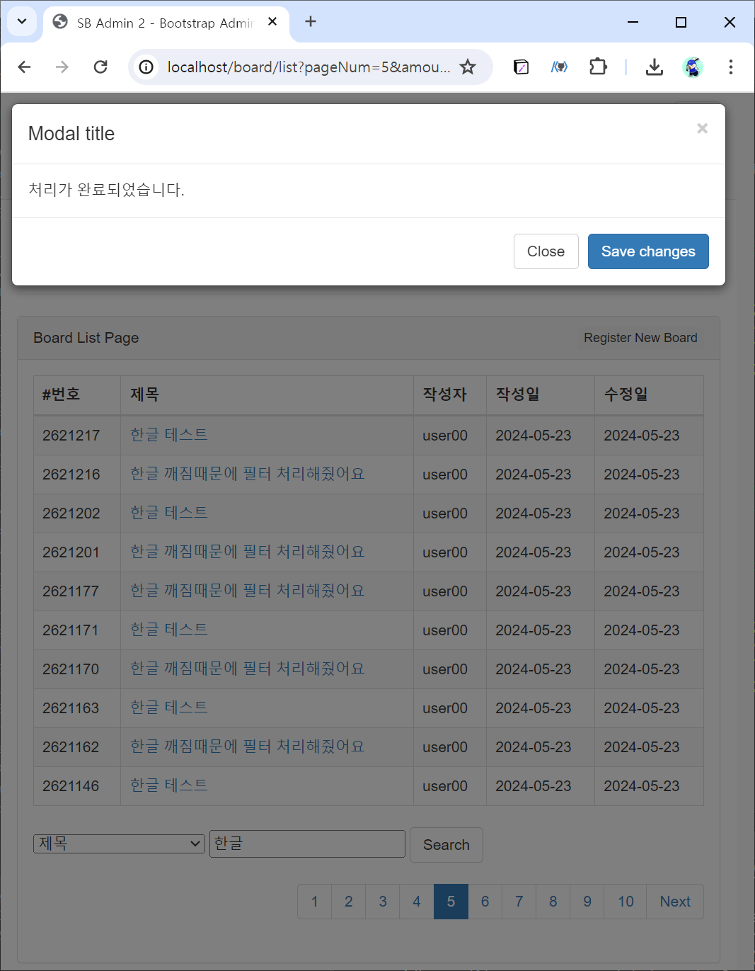
http://localhost/board/list?pageNum=5&amount=10&keyword=%ED%95%9C%EA%B8%80&type=T
http://localhost/board/modify?bno=2621178&pageNum=5&amount=10&keyword=%ED%95%9C%EA%B8%80&type=T
http://localhost/board/list?pageNum=5&amount=10&type=T&keyword=%ED%95%9C%EA%B8%80

Slide 8
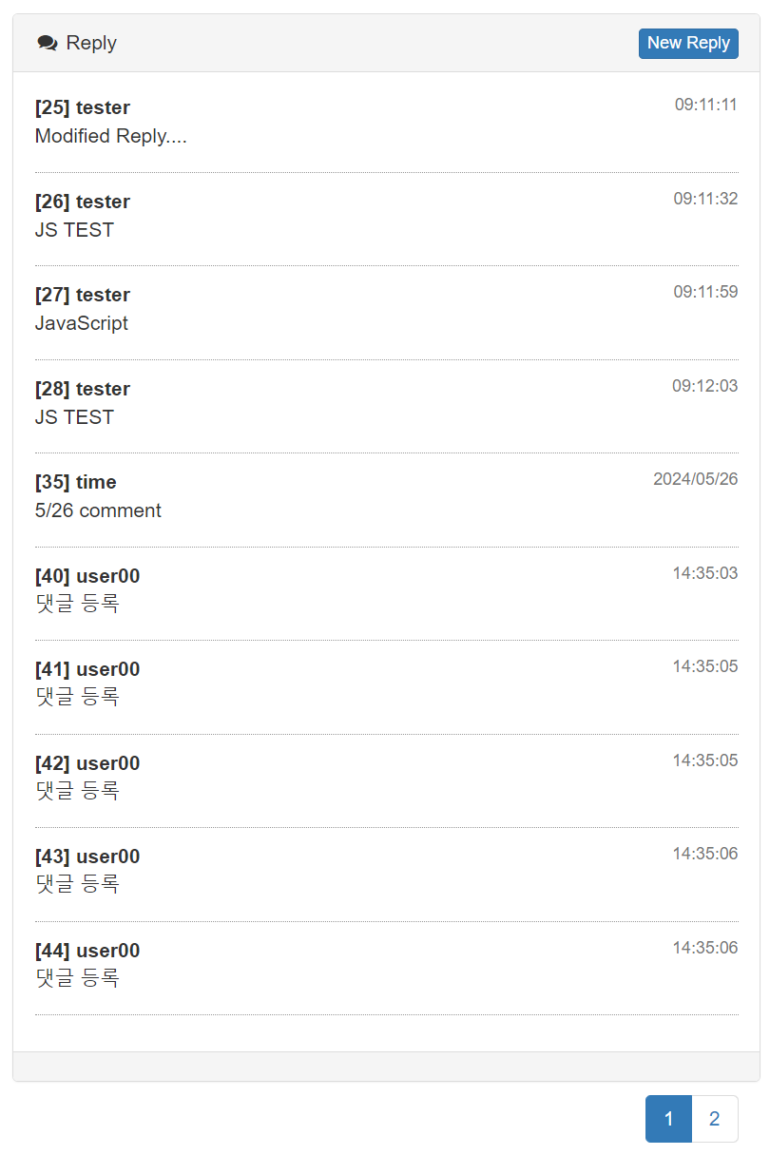
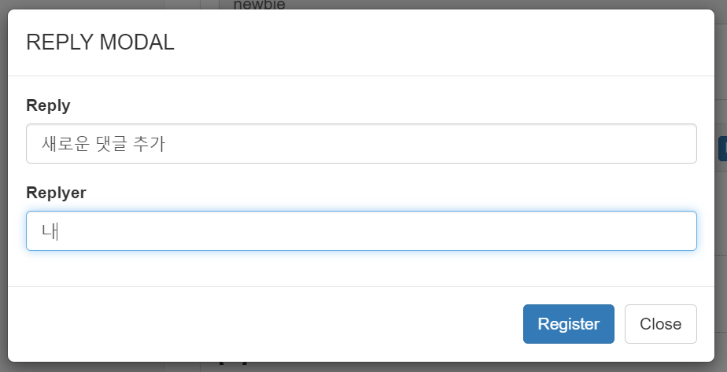
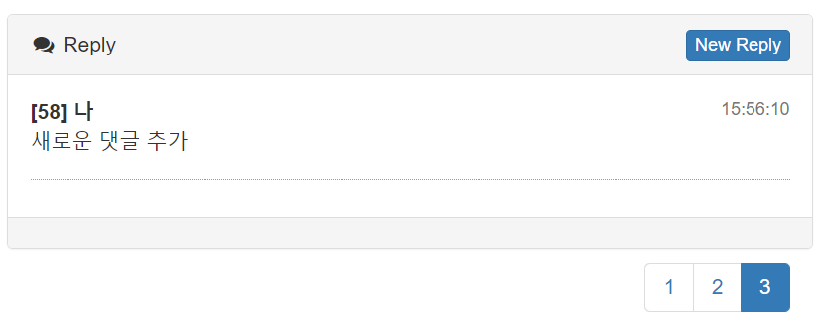

Slide 9
Aspect
Advice
Pointcut
Joinpoint
Joinpoint
Joinpoint

