Slide 1

Response Curves and Action Inertia in Utility-Based NPC Agents
Wenjie Jiang
Advisor: Navid Amini, PhD
October 2026

Slide 2

Deciding on Their Own
(Mark, 2009)

Slide 3
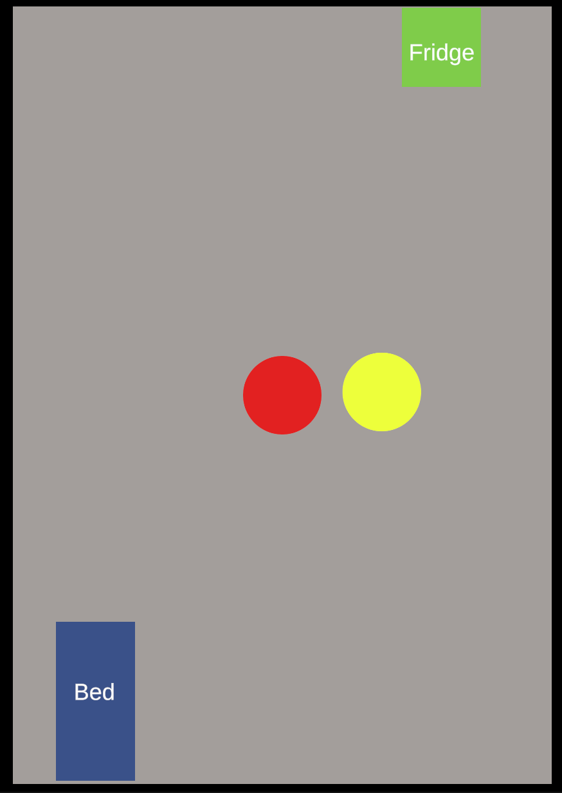
The Setup

Slide 4
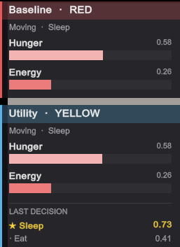
Two Agents

Slide 5
Response Curves
(Mark, 2009)

Slide 6
How Our Approach Addresses Limitations of Existing Models
Our approach aims to address this limitation by empirically isolating response curves and action inertia
Utility AI Foundations | Our Approach
Response curves: math mapping need to desire | Baseline vs. curves-only: measures the curve's contribution
Action inertia (decision momentum): commitment bonus on active action | Baseline vs. inertia-only: measures inertia's contribution
Established design tools; empirical isolation remains open | Full 4-condition ablation: quantifies each mechanism's effect on stability and adaptability
(Mark, 2009)

Slide 7
Potential Improvements over Current Techniques
We aim to move established utility AI from description to measurement
Mechanism contributions:
measure how curves and inertia each affect stability and adaptability
Interaction effects:
test whether curves and inertia compound, add, or interfere
Design guidance:
may suggest preliminary tuning cues for curves and inertia

Slide 8
Pilot Testing and Findings
The measurement pipeline is in use; these are the first pilot results
 | Baseline | Utility
Decisions | 46.0 | 45.5
Interruptions | 12.6 | 9.6
Interruption rate | 27% | 21%
8 repeats, 300 simulated seconds each
Two design flaws corrected:
misaligned intervention points
a shared action lock
First measured effect:
interruptions down 24%
direction held in all 8 repeats
Three limits remain:
curves and inertia varied together
no arbitration occurred
some interruptions were justified rather than harmful

Slide 9
A Tentative Timeline for Completion
Completed
Spring 2026
Foundation: simulation, swappable brains, both agents, live demo
Summer 2026
Measurement pipeline: decisions and configurations logged to CSV
Design corrections: intervention points calibrated, shared action lock removed
Pilot runs: first repeated measurements
Planned
Fall 2026
Stability metric: separate oscillation from justified switching
Adaptability scenario: resource removal
Seeded randomization: sample across starting conditions
Four-condition ablation: separate curve from inertia

Slide 10
References
Mark, D. (2009). Behavioral Mathematics for Game AI. Course Technology/Cengage.
Park, J. S., O'Brien, J. C., Cai, C. J., Morris, M. R., Liang, P., & Bernstein, M. S. (2023). Generative agents: Interactive simulacra of human behavior (arXiv:2304.03442). arXiv. https://arxiv.org/abs/2304.03442

